Slide 1
EDP AID-list handling on long power-save scenarios
Date: 2025-07-18
Authors:

Slide 2
Abstract
Proposed method to handle the smooth transition to active phase, for EDP stations without a valid AID list for the current epoch, without having to do a full new authentication and parameter negotiation process.
This submission proposes a resolution to CIDs 256 and 759.

Slide 3
Problem statement
BSS max idle period allows battery operated devices to avoid waking up often and send null frames, just to signal their continuous presence in the BSS.
The max idle time can reach more than 16 minutes (1000x1024 µSec).
With 802.11bi EDP, when setting a large Max Idle Timeout, the non-AP MLD may sleep beyond the AID Storage Size, resulting in a scenario where the STA wakes up with no usable AID.
An EDP non-AP MLD may also have no valid AIDs in case of late request or repeated failures of AID list assignment across epoch boundaries.

Slide 4
Proposed solution
Define a method to refresh the AID-list when the EDP non-AP MLD has no valid AID:
Allow a smooth transition to operational state without full auth/association
Mandate the AID-list refresh to be the only allowed action when no AIDs are available
Ensure the non-AP MLD has a complete configuration to forward data traffic

Slide 5
Refresh the expired AID list
Allowed methods for AID list refresh:
Via AID Assignment Response Action frame:
The EDP non-AP MLD sends an AID Assignment Response Action frame with Status Code set to NO_ASSIGNED_AID to request the AP to provide a new AID list assignment (as per 24/1714r6)
The EDP AP MLD provides the non-AP MLD with a list using the AID Assignment frame
The non-AP MLD acknowledges the AID list
In case of errors (e.g., AID list not stored or partially stored) the non-AP MLD sends an AID Assignment Response, with Status Code set as per 9.4.1.9
Alternatively, a re-association can be performed, receiving the new AID-list (as described in 25/302r1)

Slide 6
Refresh the expired AID list (cont.)
When the non-AP MLD has no usable AID, it shall request a new AID list as the first action:
If the non-AP MLD doesn’t complete AID list refreshed first, the AP MLD shall disassociate the non-AP MLD, with Status Code NO_ASSIGNED_AID
In case of non-AP MLD waking up from long sleep, AID list request doesn’t take the client out of sleep mode:
Full traffic forwarding (including buffered traffic) resumes once the newly assigned AID list is acknowledged by the non-AP MLD
This flow ensures that the non-AP MLD has full EDP parameters before it can forward data traffic

Slide 7
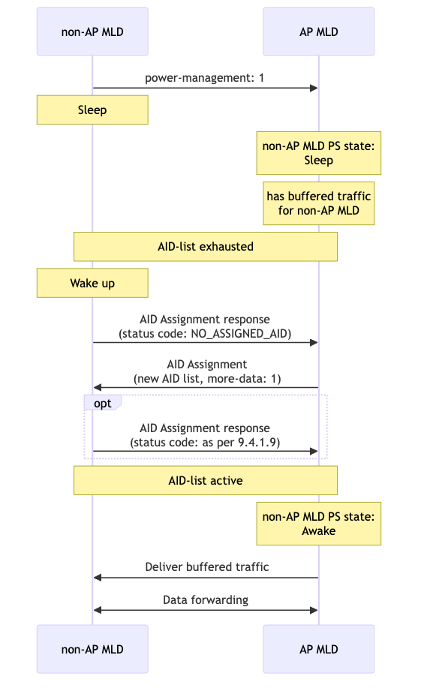
Power-save scenario
Buffered traffic during sleep, advertised on (D)TIM only while the non-AP MLD has a valid AID list
Considerations on wake-up:
Signaling wake-up with PS-Poll requires an AID
Waking-up with (QoS-Null-)Data as trigger frame may require an AID depending on the PHY mode
Using an Action Frame as the first operation is not currently defined in the specs as a wake-up trigger
Use the Action Frame to restore full parameters before the non-AP MLD is considered awake

Slide 8
Flow: Long sleep
Expired list,
No AID!
Get new AID-List upon wake
E1
E2
E3
E4
E5
E6
E7
E8
AP
STA
Assoc
AID: 1
AID-List:
[2, 3, 4, 5]
Active
AID: 2
Sleep
AID: 3
Sleep
AID: 4
Sleep
AID: 5
Sleep
AID
Assignment
AID-List: [21,22,23,24]
Active
AID: 22
New traffic AID: 21

Slide 9
Conclusions
A method is required to handle the AIDs for sleeping EDP non-AP MLDs
Proposal to:
Define the procedure to trigger the AID refresh upon wake-up or when entering an epoch without a valid AID list
Ensure that the non-AP MLD has full EDP parameters before data traffic forwarding is allowed

Slide 10
Straw poll #1
Do you support a mechanism for the EDP non-AP MLD without valid AIDs to request an AID-List refresh as the first action, via the AID Assignment Response Action frame?
Yes
No
Abstain

Slide 11
Straw poll #2
Do you support enforcing a full configuration requirement before the EDP non-AP MLD can be considered awake after a sleep period and forward traffic?
Yes
No
Abstain

Slide 12
References
IEEE 802.11-24/1714r5 Proposed spec text for AID anonymization
IEEE 802.11-24/1105r1 AID anonymization

