Slide 1
Fairness Problem in PEDCA
Date: 2025-09-12
Authors:

Slide 2
Background
In TGbn, there were discussions for priority enhanced distributed channel access (P-EDCA).
11bn D1.0 defines P-EDCA operation.
  A time synchronization mismatch problem related to PEDCA has not been discussed in the current draft.
This submission discusses the following:
  The time synchronization mismatch problem related to PEDCA in detail.
  The handling methods to address the time synchronization mismatch problem.

Slide 3
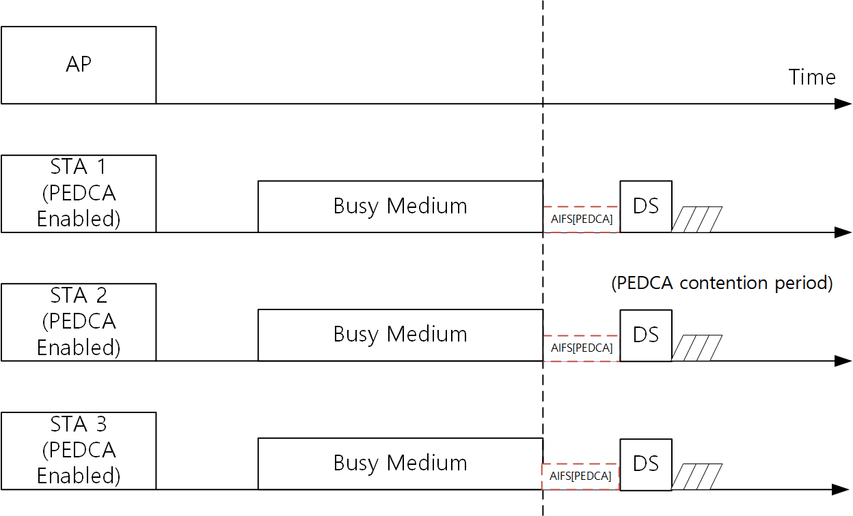
Recap: Ideal PEDCA operation
DS-CTS frames can be transmitted simultaneously from multiple STAs when after the medium is idle for DSAIFSN slot boundary.
After the DS-CTS frames are transmitted, PEDCA contention can be performed by the multiple STAs
  When PEDCA contention is successfully performed, a low latency frame can be transmitted.

Slide 4
End time mismatch problem: Between NAV and frame exchange sequence
In an ideal case, a NAV end time and a real frame exchange sequence end time are same.
However, the mismatch between the NAV end time and the real frame exchange sequence end time may occur.
In this case, unfairness may occur in P-EDCA operation due to the mismatch between the NAV end time and the real frame exchange sequence end time.

Slide 5
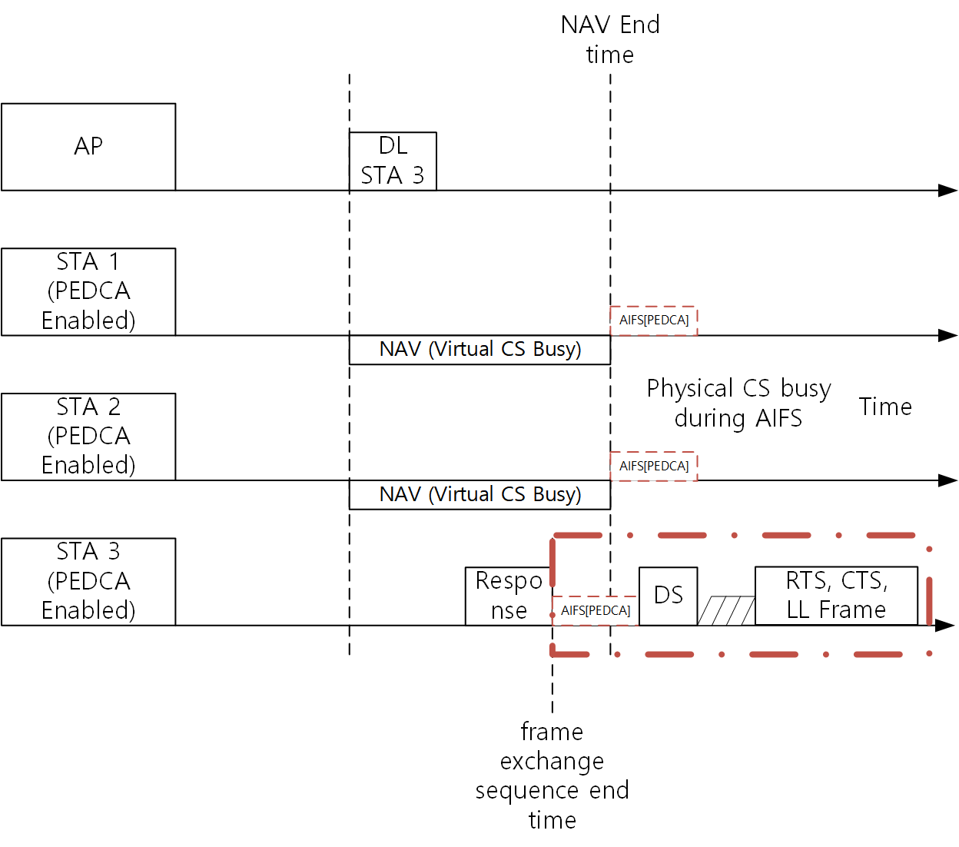
End time mismatch problem (Cont’d)
TXOP responder does not set NAV
  STA 3: TXOP responder
If STA 3 detects medium as idle during DSAIFS slot boundary, it will transmit DS-CTS while another STAs are detecting medium as busy because of their NAV.
  STA 3 is a first STA which transmits DS-CTS, and it can start low latency frame exchange while another STAs cannot transmit the DS-CTS.
  For a fair operation, all STAs with low latency traffic should start the DS-CTS transmission at the same time.
TXOP responder

Slide 6
End time mismatch problem (Cont’d)
Specific STA can be prioritized due to the NAV and frame exchange end time mismatch.
  In this case, another STAs which need to transmit low latency traffic cannot contend for the medium using P-EDCA.
  This causes unfairness in P-EDCA operation.

Slide 7
Possible approach for the mismatch problem
To synchronize DS-CTS transmission in the NAV and frame exchange end time mismatch case, a similar mechanism to UL MU CS mechanism can be utilized.
If STAs ignore intra-BSS NAV in determining whether to transmit DS-CTS, the STAs can transmit DS-CTS at the same time for intra-BSS NAV mismatch case.
IEEE 802.11-2024:
26.5.2.5 UL MU CS mechanism
A non-AP STA does not consider the intra-BSS NAV in determining whether to respond to a Trigger frame sent by the AP with which the non-AP STA is associated.

Slide 8
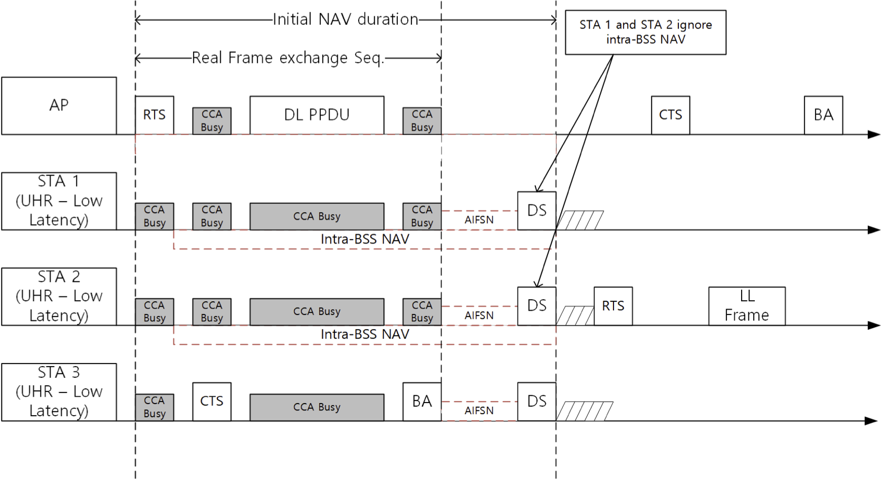
Possible approach for the mismatch problem (Cont’d)
TXOP responder

Slide 9
Conclusion
This submission proposed the NAV and frame exchange sequence end time mismatch problem in P-EDCA
  If the end time mismatch occurs, specific STA can perform P-EDCA contention while another STAs cannot.
  The unfairness will occur in P-EDCA
This submission proposed the possible approach for the mismatch problem
  STAs using P-EDCA can ignore its intra-BSS NAV
  Even if the intra-BSS NAV and frame exchange end time mismatch occurred, DS-CTS can be transmitted from multiple STAs at the same time with the approach.
    P-EDCA contention can be performed in the multiple STAs without unfairness.

Slide 10
Straw Poll #1
Do you agree that TGbn SFD shall define DS-CTS synchronization for P-EDCA fairness, as follows?:
3.13 Enhanced EDCA
11bn shall consider DS-CTS transmission synchronization between multiple STAs for fairness.
Y / N / A

