Slide 1
Enhanced Light Communication: Scope and Features
Date: 2025-01-13
Authors:

Slide 2
Abstract
This contribution presents the scope and main features introduced by the proposed Enhanced Light Communications (ELC) project to amend the IEEE 802.11 MAC and PHY.

Slide 3
Outlook
Introduction
ELC scope
  proposed set of features
Summary

Slide 4
Introduction
802.11bb [1]
  defined initial version of Light Communication (LC) based on 802.11
  original vision was enterprise/home market, i.e., low cost and high volume
  spec focus was put on minimum-viable product by reusing existing 802.11n/ac/ax chipsets
  11bb is already used for military and security markets [2]
  i.e., high cost and small volume markets
ELC
  aims to widen the currently limited market opportunities for LC
  evolve LC to become useful for industry/medical and enterprise/home markets, finally
  new use cases need adaptated use of 802.11 protocols to support new features
  high reliability, long range/low-power, high capacity

Slide 5
Current ELC Scope [3]
5.2.b. Scope of the project:
This amendment provides enhanced light communications (ELC) for Wireless LAN operation. The amendment introduces a new ELC PHY through the modification of existing IEEE 802.11 sub-7.25 GHz PHYs. These modifications are limited to specifying:
1) Operations in new optical bands in the range of 400 nm to 600 nm and 1200 nm to 1600 nm
2) New channelization
3) The use of wavelength division multiplexing (WDM)
4) Simpler integration of the IEEE 802.11 baseband with optical frontends
5) PHY support for existing ranging techniques
6) Methods to reduce the peak-to-average-power ratio
This amendment modifies the IEEE 802.11 MAC to support the ELC PHY and multi-link operation.
This amendment provides for compatibility with legacy IEEE 802.11 devices operating in the identified optical bands.

Slide 6

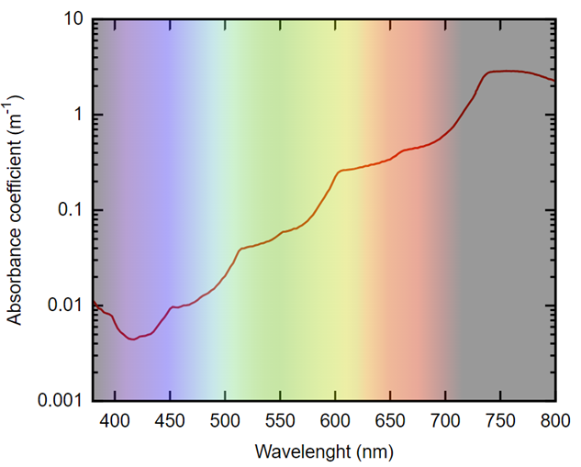
Operation in new optical bands [4]
Visible green and blue light has the lowest absorption in the water medium.
ELC will add 400 nm to 600 nm band from several to hundreds of meters for underwater links.

Slide 7
Operation in new optical bands (2)
LC IF over fiber allows narrow tracked-directed beams.
802.11 is helpful to lower cost.
ELC will add 1200nm to 1600nm band for extra capacity.

Slide 8
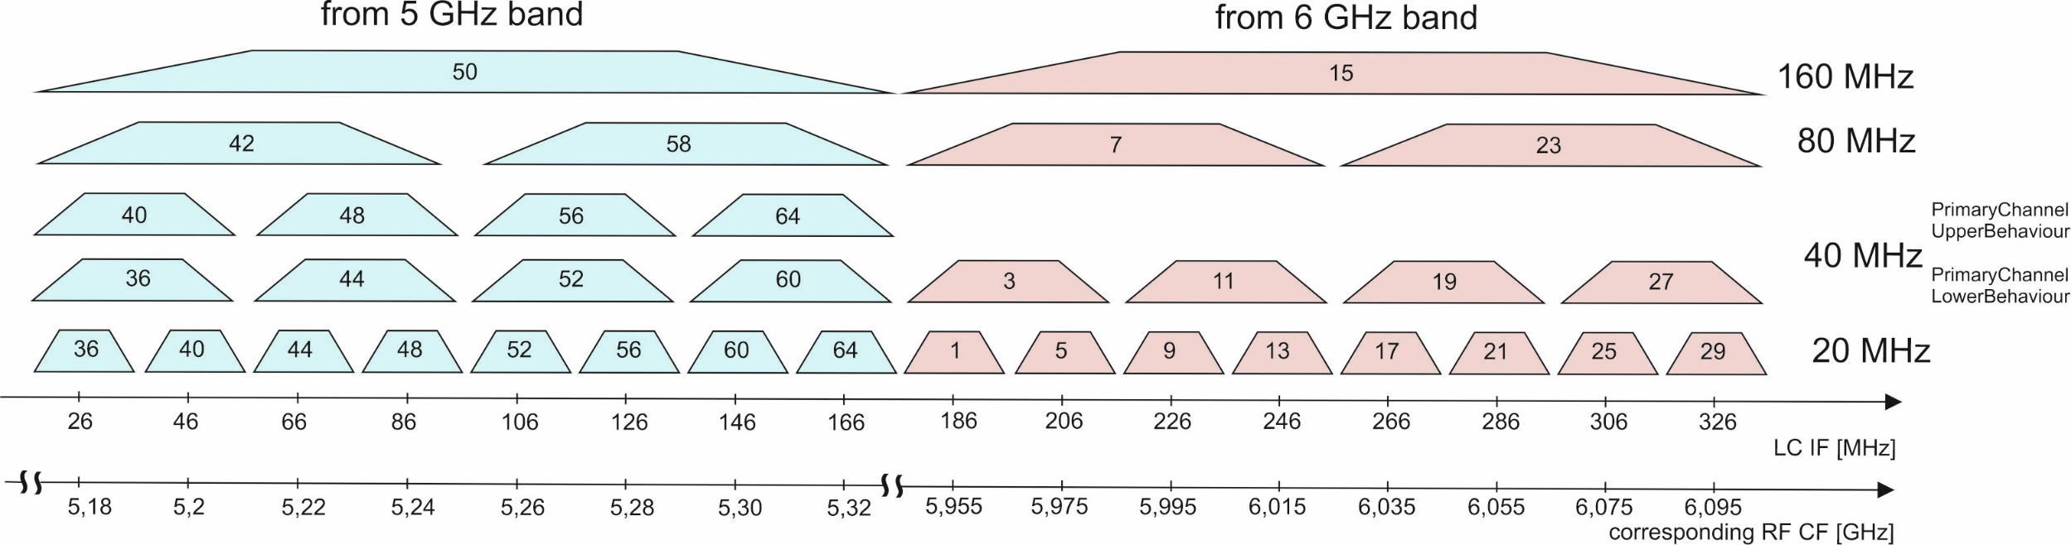
Existing channelization [1]
11bb channelization does block up/down conversion from 5 and 6 GHz bands
11bb fits to LEDs

Slide 9
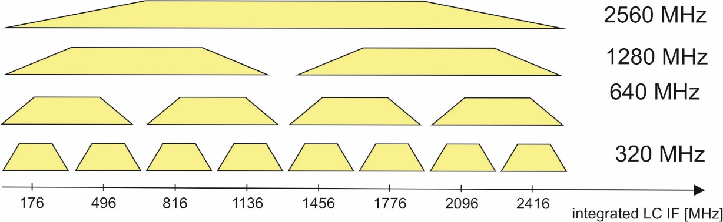
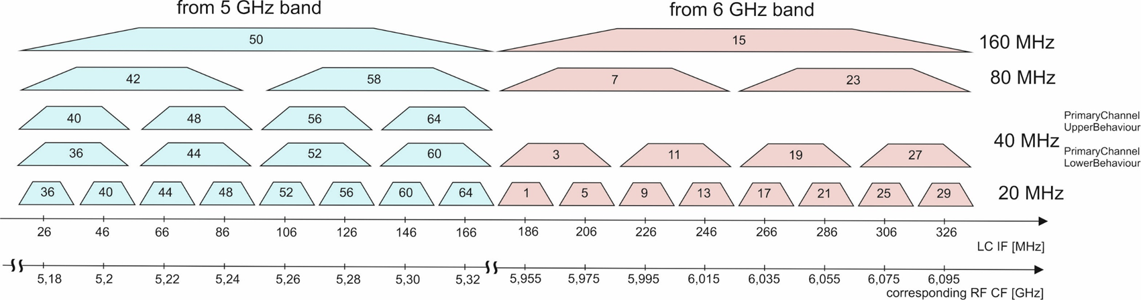
Potential new channelization [5] (2)
11bb channelization does block up/down conversion from 5 and 6 GHz bands
11bb fits to LEDs, ELC considers also lasers which offer GHz bandwidth
ELC will provide new channels for 320 (potentially 640) MHz using 802.11bn.
entire BW covered by 11bb

Slide 10
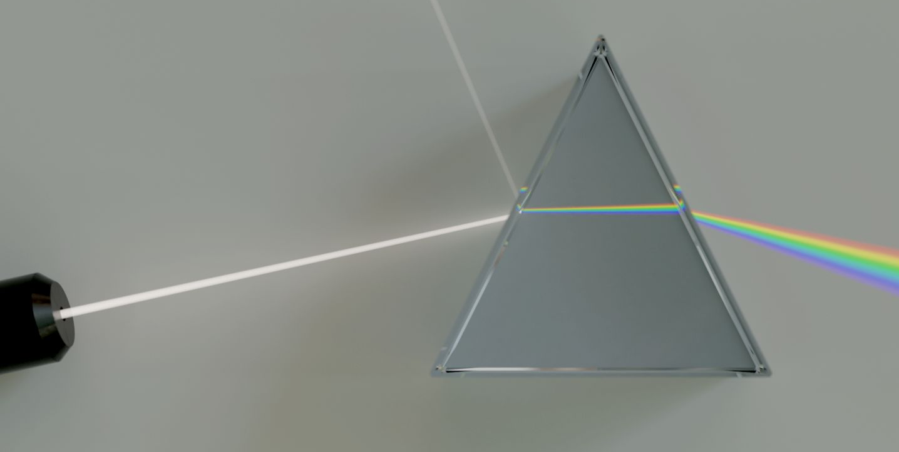
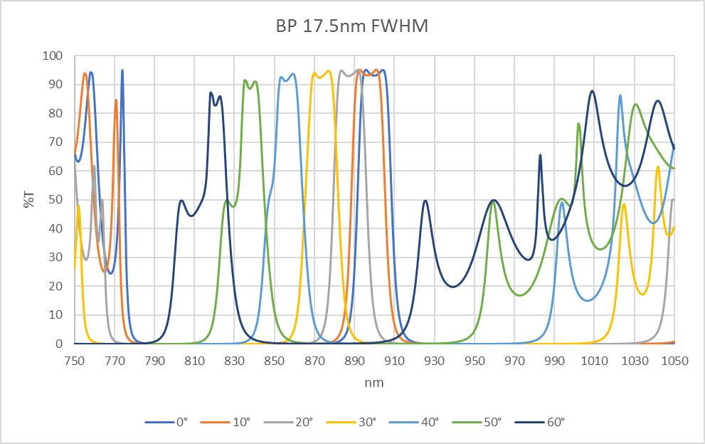
Wavelength-division multiplexing (WDM) [6]
WDM uses different colors of the light for different data streams.
11bb defines WDM for two bands: 800 nm to 900 nm and 900 nm to 1000 nm.
ELC will extend WDM to handle more bands and define how to use them.

Slide 11
Integration of 802.11 baseband with optical frontends [7]
11bb defines two options: direct conversion and up-/down conversion
ELC will identify potentially more practical interfaces (low cost, low energy).
p_control
DAC(I)
ELC optical frontend
PHY TX DSP
VGA
DAC(Q)
f_control
0°
-90°
Synthe-
sizer
ref. clock
Digital
IQ
Analog
IQ
Analog
IF/RF

Slide 12

PHY support for existing ranging techniques [8]
Positioning is essential for industrial use case: Automated Guided Vehicles

Slide 13
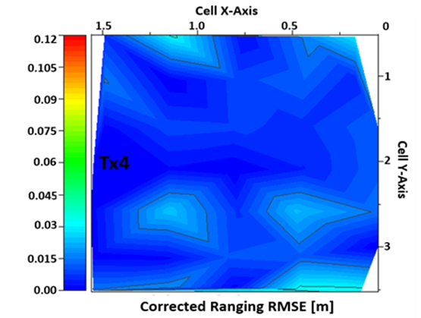
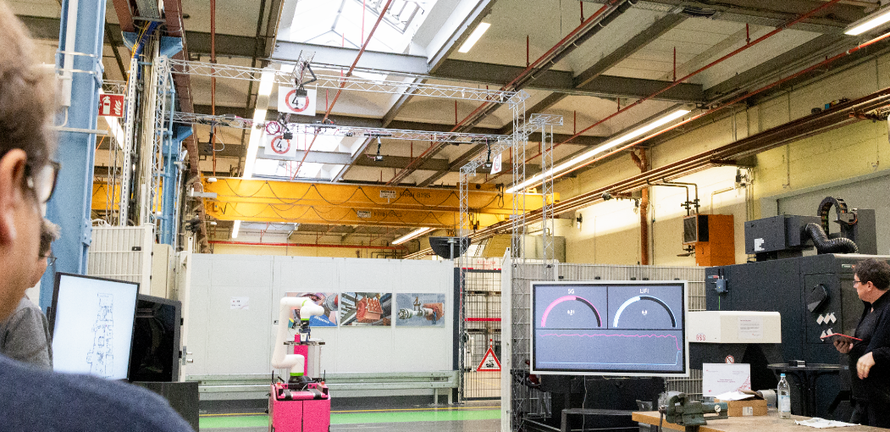
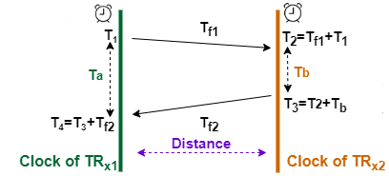
PHY support for existing ranging techniques [8] (2)
Positioning is essential for industrial use case: Automated Guided Vehicles
Light travels via LOS, is well suited for precise positioning: 3 cm in 3D shown.
Implementation could reuse Fine Time Measurements (FTM in 11az, 11bk).
ELC will enable FTMs using light and adapt existing algorithms.

Slide 14
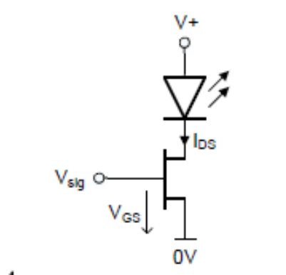
Methods to reduce PAPR [9]
11bb defines reuse of OFDM waveforms from existing 802.11 chipsets.
This lowers energy efficiency in optical frontends and achieveable link distance.
ELC may define minor changes in 802.11 OFDM PHYs to enable OOK/FDE.
OOK/FDE only
OFDM only

Slide 15
Methods to reduce PAPR [9]
11bb defines reuse of OFDM waveforms from existing 802.11 chipsets.
This lowers energy efficiency in optical frontends and achieveable link distance.
ELC may define minor changes in 802.11 OFDM PHYs to enable:
  On-Off-Keying (OOK) with Frequency-Domain Equalization (FDE, see example below)
  Space Shift Keying
OOK/FDE only
OFDM only

Slide 16
MAC Support for ELC in Multilink Operation [10, 11]
11be defines Multilink Operation for 2.4, 5 and 6 GHz. 11bq adds mm-wave .
ELC will add support for optical bands in MLO.
Enhanced Multilink Operation
Multilink Operation
Enhanced Multilink Operation
Sub7GHz
BB
Sub7GHz
BB
Sub7GHz BB
Sub7GHz
BB
Sub7GHz
BB
Sub7GHz
BB
Sub7GHz
BB
Sub7GHz
BB
Sub7GHz
BB
Sub7GHz
BB
Sub7GHz
BB
Sub7GHz
BB
2.4 GHz front-end
2.4 GHz front-end
2.4 GHz front-end
5 GHz
front-end
5 GHz
front-end
mm-wave front-end
5 GHz
front-end
6 GHz
front-end
mm-wave front-end
LC
front-end
6 GHz front-end
6 GHz front-end

Slide 17
Conclusions
ELC Study Group agreed on the PAR and CSD of a potential new project [3].
Now it seeks feedback from, and approval by, the 802.11 Working Group.

Slide 18
References
[1] IEEE Std 802.11bb, available: https://ieeexplore.ieee.org/document/10315104
[2] https://intelligentwaves.com/2025/01/03/intelligent-waves-iw-and-signify-form-joint-venture-to-advance-lifi-and-optical-wireless-technology-for-the-u-s-department-of-defense/
[3] Draft PAR 11-24/1599r5 and Draft CSD 11-24/1600r2 developed by ELC SG
[4] ELC Underwater Use Case: 11-24/1628r0
[5] Channelization to include optical bands: 11-24/0062r0
[6] March 2024 LC proposal: 11-24/0571r0
[7] Unified IF interface for mm- and light-wave: 11-24/0406r1
[8] ELC support for Positioning 11-24/1956r0
[9] Low-Power Enhanced-Range PHY Mode for ELC 11-24/1926r1
[10] Extend IMMW scope to include optical bands 11-23/2016r1
[11] Thoughts on IMMW extensions to optical bands 11-23/0081r1

