Slide 1
UHR Operating Mode Notification
Date: 2025-05-27
Authors:

Slide 2
Introduction
UHR is adding multiple link-specific features/operating modes (OM):
  Dynamic Power Save (DPS)
  Non-primary Channel Access (NPCA)
  Dynamic Unavailability operation (DUO)
  Limited operation mode (LOM)
  Dynamic subchannel operation (DSO)
  Dynamic Bandwidth Expansion (DBE)
For these features/OMs signaling is needed for a STA to be able to enable/disable the feature and support updates to operating parameters (if applicable)

Slide 3
Solution Considerations
For link specific operating modes in UHR (e.g. DPS, NCPA, DUO, DSO, DBE), following functionality is desired:
  A STA should be able to signal OM enable/disable or OM parameters updates from any link (cross-link OM updates) – not require STA to switch to another link for OM changes of that link
  A STA should be able to change OM/parameters for a feature for multiple links in the same frame – to avoid the overhead of multiple OM notification frames
  A STA should be able to update OM/parameters for multiple features (if needed) in the same frame – to avoid the overhead of sending separate OM notification frames for each OM
  Examples:
    1) a STA signaling enabling of DPS mode (+DPS parameters) for 6 GHz link from a 5 GHz link
    2) a STA enabling NPCA mode on both 5 and 6 GHz links in the same OM notification frame
    3) a STA updating operating parameters for DPS and NPCA in the same OM notification frame

Slide 4
Collab Consensus on Enable/Disable of OMs
11bn Collab reached following consensus:
  Do you agree to define a generic mechanism for notifying operating mode changes (configured as request/response), initiated by the non-AP STA, for DUO, DPS, DSO, NPCA, LLI, P-EDCA, LOM to enable/disable different UHR features on non-AP STA side?
    Details for request/response are TBD
    The request shall be a Link Reconfiguration Request frame
    The response shall be a Link Reconfiguration Notify frame

Slide 5
Common framework for UHR Operating Mode updates
To meet the requirements on slide 3, we should define a common UHR OM updates framework that can be used across multiple OMs to enable/disable OMs or update OM parameters for one or more links
Per Collab consensus on slide 4, a non-AP STA would use a UHR Link Reconfiguration Request frame to enable/disable OMs or update OM parameters
AP would respond with a UHR Link Reconfiguration Notify frame in response
The UHR Link Reconfiguration Request frame would include OM related information for enable/disable of OMs or updates to OM parameters (as applicable)
Two possible options can be considered to provide UHR OM updates in the Link Reconfig Request frame:
  Option 1: define a new UHR Operating Mode Update ML element to carry UHR OM updates
  Option 2: enhance Reconfiguration ML element to carry UHR OM updates

Slide 6
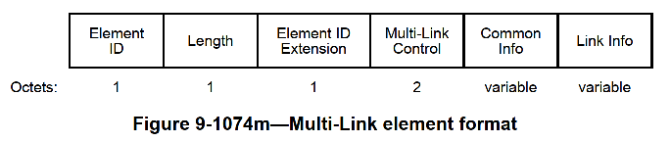
Option 1: New ML element for UHR OM Updates (1)
Define a new UHR Operating Mode Update ML element
  Define a new ML element ‘Type’ (e.g. use value 5) for this new ML element
  Contains one or more Per-STA Profiles subelement, each subelement includes enable/disable or parameters updates (if any) for one or more OMs for a specific Link ID
  Multiple Per-STA Profile subelements are included if a non-AP STA needs to update OMs for multiple links
  New ML element follows similar format as other existing ML elements, for consistency across different ML element formats, unifies processing logic both on STA and AP side

Slide 7
Option 1: New ML element for UHR OM Updates (2)
One possible formal for UHR Operating Mode Update ML element shown below:
  Common Info field only need to include ‘MLD MAC Address’
  STA Control includes Link ID + UHR Control that indicates enable/disable for OMs for that link. STA Info includes OM parameters based on presence indication – this aligns with how Basic/Reconfig ML elements are defined
  STA Profile field is not needed

Slide 8
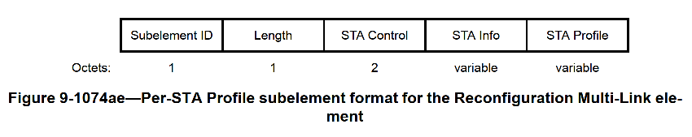
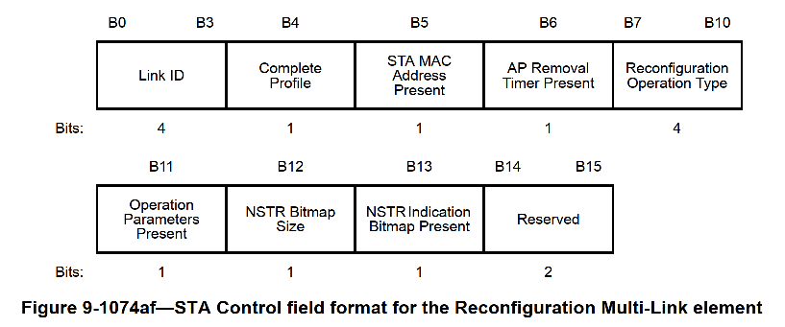
Option 2: Enhance Reconfig ML element for UHR OM Updates (1)
One reason for reusing Link Reconfig Request/Notify frame is to be able to use 11be ML reconfiguration framework, which is defined using the Reconfiguration ML element.
So, one natural approach could be to enhance Reconfiguration ML element to provide UHR OM updates
  Add a new Reconfiguration Operation Type indicating ‘UHR Operating mode updates’ (e.g. value 5)
  For this new type value, the STA Info field would include UHR Operating Modes & parameters

Slide 9
Option 2: Enhance Reconfig ML element for UHR OM Updates (2)
One possible formal for enhancement to Reconfiguration ML element is shown below:
  STA Info field in the Per-STA Profile includes a new ‘Operating Mode and Parameters’ field providing information for UHR OMs enable/disable and parameters
  UHR Control (1 or 2 octets) bitmap indicates enable/disable for UHR OMs
  This format is consistent with including parameters in the STA Info for other parameter updates defined in 11be

Slide 10
UHR Link Reconfig Request (Option1 vs Option 2)
Option 1: UHR Link Reconfiguration Request frame
Option 2: UHR Link Reconfiguration Request frame
Order | Meaning
1 | Category
2 | Protected UHR Action
3 | Dialog Token
4 | Type
5 | Reconfiguration Multi-Link element (optional)
6 | OCI element
7 | UHR Operating Mode Update ML element
Order | Meaning
1 | Category
2 | Protected UHR Action
3 | Dialog Token
4 | Type
5 | Reconfiguration Multi-Link element (with extension)
6 | OCI element
Type field in the UHR Link Reconfig Request can be set to:
  OM updates
  Add link with OM updates (to support OM updates for added link)
Option 1 is cleaner - provides more flexibility for signaling parameters for OM updates and add link/roaming prep independently
  Reconfig ML element is not included when only OM updates is done

Slide 11
MLD Level Parameters Updates
In 11be, no mechanism is defined for a STA to update its MLD level capabilities/parameters, except for EML(SR/MR) parameters.
  (Expended) MLD Capabilities And Operations parameters can not be updated except when adding links
A STA may want to update its MLD level parameters even w/o add link (similar to link level OM parameters updates). Hence, would be desired to define a mechanism for this.
In either Option 1 or Option 2, the ML element used for UHR OM updates can also be used to update the MLD level capabilities/operation parameters (if needed)
  Support updates to (Extended) MLD Capabilities And Operations, EML Capabilities, plus any new MLD level parameters for UHR
  Common Info field would include updated MLD level capabilities/parameters. For Reconfiguration ML element, these MLD level parameters are already included in Common Info.
A STA can send a UHR Link Reconfiguration Request frame to update:
  A) Only MLD level capabilities/parameters (no Per-STA Profile subelement included); or
  B) Update both MLD level capabilities/parameters and link level OM updates (includes MLD level updates in Common Info field and link level updates in Per-STA Profile subelements); or
  C) Update only link level OMs (no MLD level parameters in Common Info)

Slide 12
Summary
UHR is defining multiple link specific features/OMs (e.g. DPS, NPCA, DUO, DSO, DBE)
It is desired to define a common operating mode updates framework that can be used across multiple OMs to enable/disable OMs or update OM parameters for one or more links of non-AP STAs
We propose two options to provide UHR OM updates in UHR Link Reconfiguration Request:
  Option 1: define a new UHR Operating Mode Update ML element to carry UHR OM updates
  Option 2: enhance Reconfiguration ML element to carry UHR OM updates
  We define possible formats for ML element for UHR OM updates these options
Option 1 is cleaner - provides more flexibility for signaling parameters for OM updates and add link/roaming prep independently in UHR Link Reconfig Request
We also propose that the common UHR OM updates mechanism can enable updating MLD level capabilities/parameters for the non-AP MLD as well
  Support updates for (Extended) MLD Capabilities And Operations & EML Capabilities, plus any new MLD level parameters in UHR
A non-AP STA cap update only link level OMs, only MLD level parameters or both.

Slide 13
SP1 (Option 1)
Do you support to define a new Multi-Link element (e.g. a UHR Operating Mode Update ML element) to carry UHR OM updates in the UHR Link Reconfiguration Request frame?
  Define a new ML element ‘Type’ (e.g. value 5) for this new ML element
  STA Control field in the Per-STA Profile subelement includes Link ID and a UHR Control that indicates enable/disable for UHR OMs for that link
  STA Info field in the Per-STA Profile subelement includes operating mode parameters based on presence indication for OM parameters

Slide 14
SP2
Do you support to define a mechanism to update MLD level capabilities and parameters for a non-AP MLD?
The mechanism enables updates for (Extended) MLD Capabilities And Operations, EML Capabilities, plus any new MLD level parameters defined in UHR
The mechanism is based on the common UHR operating mode updates framework

