Slide 1
Discussion on PE Requirement for UEQM
Date: 2025-01-10
Authors:
Name | Affiliations | Address | Phone | email
Mengshi Hu | Huawei |  |  | humengshi@huawei.com
Ross Jian Yu
Ming Gan

Slide 2
Background
UEQM (Unequal Modulation) is a promising feature enabling different modulation orders in the resource allocated to a user. The spatial domain UEQM has been adopted in UHR.
  Define unequal modulation over different spatial streams (Motion 23)
  Previously in the EHT standard, the PE requirement of an EHT MU PPDU is related to the capability “nominal packet padding value”. This value could be determined by two methods and both of them are affected by the used constellation order.
  The reason is that a higher constellation order corresponds to a higher complexity.
  NOTE: Only the equal modulation (EQM) is supported in EHT.
  In this contribution, the selection of nominal packet padding values is further discussed in the case of UEQM in UHR.

Slide 3
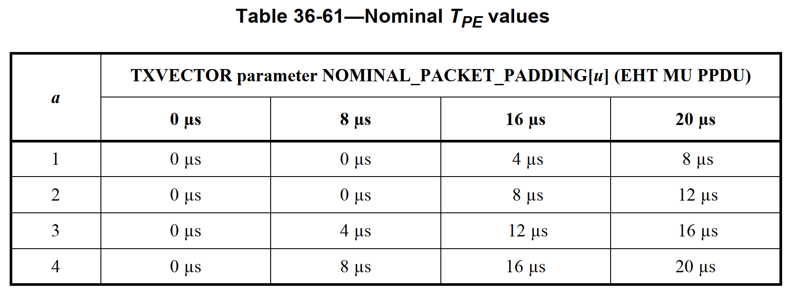
Nominal Packet Padding value
  In the EHT standard, the PE requirement (Nominal T_{PE} values) of an EHT MU PPDU is related to the capability “nominal packet padding value”, which is shown in the following table.
  The nominal packet padding value along with pre-FEC padding factor (a) determines the Nominal T_{PE} values for PE field.
  The duration of the PE field, T_{PE}, may take values of 0, 4, 8, 12, 16 or 20 µs, and should be equal to the Nominal T_{PE} to minimize the PE overhead.
Pre-FEC Padding Factor
Nominal Packet Padding value

Slide 4
Two Method to Get the Value
In the EHT standard, two methods are supported to get the nominal packet padding values:
  Method 1: Use the Common Nominal Packet Padding subfield (Static)
  Method 2: Use the PPE Thresholds field (Dynamic).
Table: Two Methods for Nominal Packet Padding Values
Condition | Corresponding Methods
If the PPE Thresholds Present subfield is set to 0 | Method 1
If the PPE Thresholds Present subfield is set to 1 | Method 2

Slide 5
Method 1: Common Nominal Packet Padding
In the EHT standard, Method 1 can be regarded as a static option, where the following four types indicated by the Common Nominal Packet Padding subfield (2 bits) are supported:
  In UHR, since the UEQM is newly supported, how to determine the nominal packet padding value in the case of UEQM should be clarified. We propose to have the following simplified rule:
  The PE requirements of an UEQM with a highest constellation order x is equal to the PE requirements of an equal modulation with a constellation order x.
Subfield Value | Nominal Packet Padding Values
00 | 0 µs for all constellations, and RU or MRU allocations the STA supports.
01 | 8 µs for all constellations, and RU or MRU allocations the STA supports.
10 | 16 µs for all constellations, and RU or MRU allocations the STA supports.
11 | 16 µs for all modes with constellation ≤ 1024 and RU or MRU ≤ 2×996; 20 µs for all other modes the STA supports.

Slide 6
Modified Method 1 in UHR
According to the previous slides, the modified Method 1 in UHR could be:
Subfield Value | Nominal Packet Padding Values
00 | 0 µs for all constellations, and RU or MRU allocations the STA supports.
01 | 8 µs for all constellations, and RU or MRU allocations the STA supports.
10 | 16 µs for all constellations, and RU or MRU allocations the STA supports.
11 | 16 µs for all modes with the highest constellation ≤ 1024 and RU or MRU ≤ 2×996; 20 µs for all other modes the STA supports.
  NOTE: The highest constellation indicates the constellation in EQM, and indicates the highest constellation in UEQM.

Slide 7
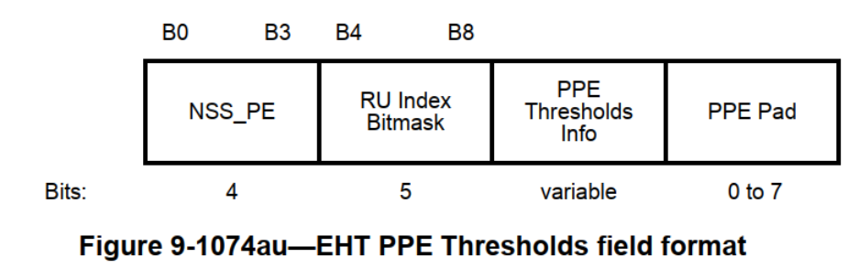
Method 2: PPE Thresholds field
Besides the static indication (Method 1), EHT also defines a dynamic indication (Method 2).
  To be brief, this contribution will not show the details of Method 2. The only thing needed to be mentioned is that in Method 2, the nominal packet padding value is known based on the configuration tuple {RU or MRU size, constellation, Number of spatial streams}.
  To simplify the signaling, the same rule could be used for Method 2:
  The PE requirements of an UEQM with a highest constellation order x is equal to the PE requirements of an equal modulation with a constellation order x.
  NOTE: Nothing else will be changed!

Slide 8
Summary
For UEQM, to simplify the signaling of the Nominal Packet Padding value, a quite simple way is to assume that:
  The PE requirements of an UEQM with a highest constellation order x is equal to the PE requirements of a EQM with a constellation order x.
  The above assumption could be used for both methods and there is almost no change.

Slide 9
References
[1] 11-24-0171-21-00bn-tgbn-motions-list-part-1
[2] 11-20-1847-00-00bn-eht-ppe-thresholds-field

Slide 10
SP 1
Do you agree that in the UHR MU PPDU in 11bn, the PE requirements of UEQM with the constellation order x of the first spatial stream is equal to the PE requirements of EQM with the constellation order x?
  Y
  N
  A

