Slide 1
Some details on Polling phase in Co-TDMA
Date: 2025-06-07
Authors:
Name | Affiliation | Address | Phone | Email
Geonhwan Kim | LG Electronics | 19, Yangjae-daero 11gil, Seocho-gu, Seoul 137-130, Korea |  | geonhwan.kim@lge.com
Insun Jang |  |  |  | insun.jang@lge.com
Jinsoo Choi |  |  |  | js.choi@lge.com
Sunhee Baek |  |  |  | sunhee.baek@lge.com
Yelin Yoon |  |  |  | yl.yoon@lge.com
Dongju Cha |  |  |  | dongju.cha@lge.com
Hongwon Lee |  |  |  | hongwon.lee@lge.com
Jinsoo Choi |  |  |  | js.choi@lge.com
Hangyu Cho |  |  |  | hg.cho@lge.com
Sanggook Kim |  | 10225 Willow Creek Rd, San Diego, CA, USA |  | sanggook.kim@lge.com

Slide 2
Introduction
Based on the recent 11bn Draft 0.2, the expected Co-TDMA procedure between the 3 APs is as follows [1]:
There are three main phases in Co-TDMA.
Polling [2, 3]
TXOP allocation [4]
TXOP return [5, 6]
It is time to discuss in more detail each of the steps proposed for further progress of Co-TDMA.

Slide 3
Recap: ICF/ICR in Co-TDMA
The May F2F meeting determined how to include Co-TDMA information in ICF/ICR [7].
Co-TDMA TB ICF delivers a Feedback User Info field (2008) with the Feedback Type field set to 3.
Co-TDMA NTB ICF includes a Feedback Type and Feedback Info in User Info field (AP ID).
Contents in ICF: Primary AC and TXOP Return Solicited
The ICR sent from the polled AP contains Co-TDMA information by setting the AID11 field to a value other than 2045, the Ack Type field to 0, the TID field to 13, and the Feedback Type field to Co-TDMA (set to 3).
Contents in ICR: TXOP Sharing Solicited
Additional information that may be useful for Co-TDMA can be included in the ICF/ICR.

Slide 4
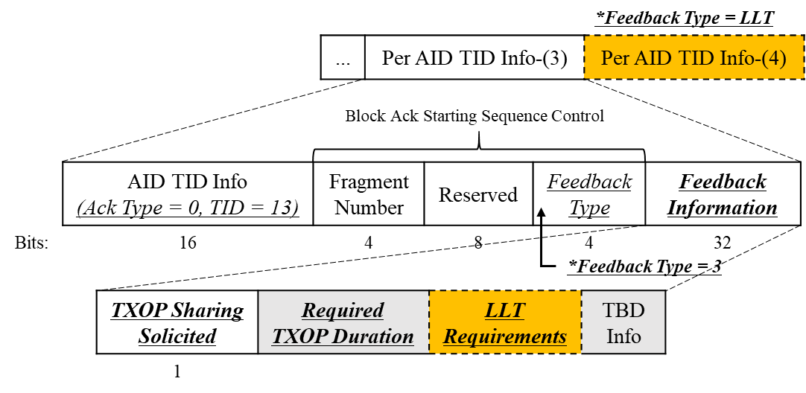
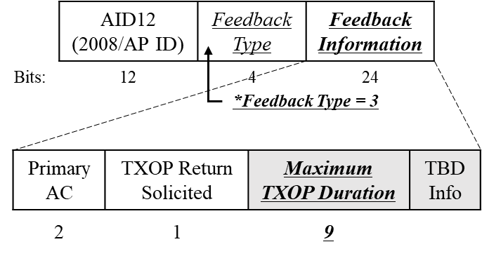
Additional Info within Co-TDMA ICF/ICR
The Feedback Information field in the ICF can contain a Maximum TXOP Duration.
Maximum TXOP Duration: The expected allocatable TXOP duration.
The expected allocatable TXOP duration helps polled APs request the TXOP duration they need via ICR.
The Feedback Information field in the ICR can include Required TXOP Duration and LLT Requirements.
Required TXOP Duration: The explicit duration of TXOP required.
This duration shall be shorter than the Maximum TXOP Duration provided by the Co-TDMA sharing AP.
LLT Requirements: Final sharing timing (or time limits) required for LLT transmission.
It may be replaced with an additional Per AID TID Info field with Feedback Type field set to 1 (LLT).

Slide 5
Failure handling in the Polling phase
Co-TDMA sharing AP transmits TB (or) NTB ICF at the beginning of the TXOP.
The Duration field is set to the time required to transmit the solicited response from the polled AP(s) plus one SIFS.
Since ICF is the first frame transmitted without any protection after obtaining TXOP, a situation may occur where the polled AP(s) cannot respond due to the NAV of the third-party STA (hidden from the sharing AP).
Therefore, the polling phase of Co-TDMA requires appropriate handling of transmission failure.
If the transmission of all MPDUs in the initial PPDU of a TXOP fails and the PPDU contains an MPDU that solicits TB PPDU, the backoff procedure shall be invoked (10.23.2.2 EDCA backoff procedure).
Failure of ICF/ICR exchange results in loss of transmission opportunity of the Co-TDMA sharing AP and waste of medium.
PIFS recovery may be performed to ensure TXOP and to exchange ICF/ICR successfully.
If an Co-TDMA sharing AP transmits an ICF in an initial PPDU of a TXOP and the ICF transmission fails, then the AP might perform a PIFS recovery or invoke the backoff procedure.
Additionally, Co-TDMA sharing AP may choose one of the following:
Retransmit ICF
Transmit another frame (for In-BSS frame exchange)

Slide 6
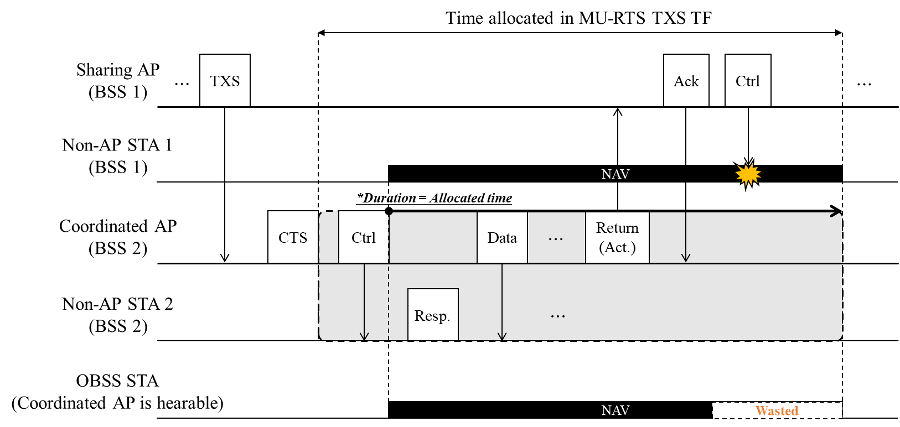
NAV Issues (1/2)
When TXOP is returned, NAV issues may occur for third-party STAs and STAs associated with the Co-TDMA sharing AP.

Slide 7
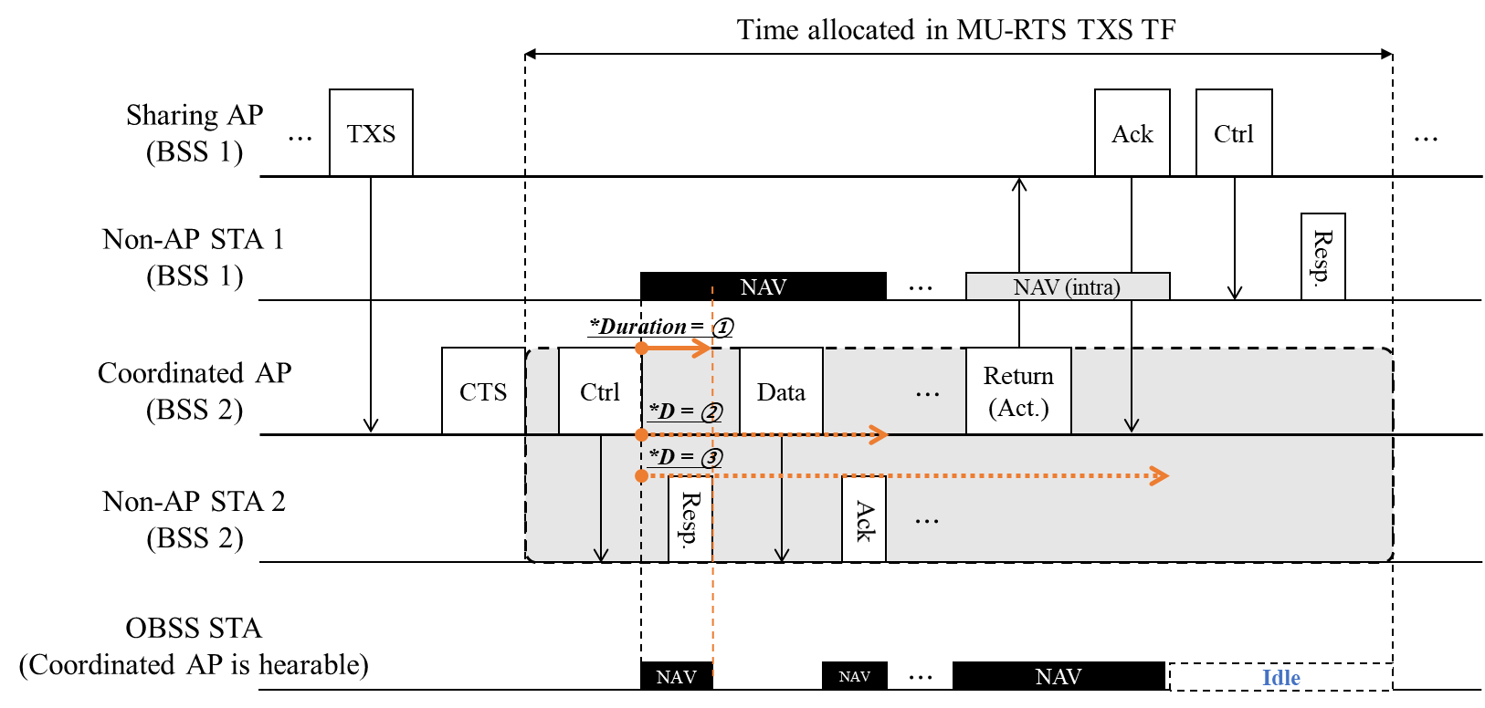
NAV Issues (2/2)
To avoid NAV issues, the Duration field of frames transmitted by the Co-TDMA coordinated AP during the allocated time can be set to 0 (i.e., example ① in figure below).
Alternatively, the Co-TDMA coordinated AP can set the Duration field of its frame(s) to a value for a single protection setting (e.g., ②) or the value until Ack is received for the TXOP return frame (e.g., ③).

Slide 8
Summary
In this contribution, we discussed additional information for Co-TDMA ICF/ICR as follows:
Maximum TXOP Duration in ICF
Required TXOP Duration and LLT Requirements in ICR
Since ICF is the first frame transmitted after obtaining TXOP, proper handling of transmission failures seems required.
Finally, we propose a rule for setting the Duration field during the allocated time to avoid NAV issues due to TXOP returns.

Slide 9
References
[1] Draft P802.11bn_D0.2
[2] 24/1016, “C-TDMA Follow-up: Additional Details on Framing Sequence”
[3] 24/1912, “Coordinated TDMA Procedure”
[4] 24/1250, “Discussion on TXOP Allocation in C-TDMA”
[5] 24/0411, “TXOP Return in C-TDMA”
[6] 24/1017, “Mechanism for TXOP Return in C-TDMA”
[7] 25/0755r11, “PDT-MAC-Co-TDMA-CR-CC50-Part-2”

Slide 10
Straw Poll 1
Do you agree to add the following text to the TGbn SFD?
The Feedback Information field with the Feedback Type set to 3 (i.e., Co-TDMA) shall include the following:
Maximum TXOP Duration: Indicates the expected TXOP duration that a Co-TDMA sharing AP can allocate.

Slide 11
Straw Poll 2
Do you agree to add the following text to the TGbn SFD?
The Feedback Information field of the Feedback Per AID TID Info field with AID11 field set to a value other than 2045, the Ack Type field set to 0, the TID field set to 13, and the Feedback Type field set to 3 of the Multi-STA Block Ack shall include the following:
Required TXOP Duration: Indicates the explicit TXOP duration required by the polled AP.

