Slide 1
Bandwidth configuration for Co-TDMA
Date: 2025-06-07
Authors:
Name | Affiliation | Address | Phone | Email
Geonhwan Kim | LG Electronics | 19, Yangjae-daero 11gil, Seocho-gu, Seoul 137-130, Korea |  | geonhwan.kim@lge.com
Insun Jang |  |  |  | insun.jang@lge.com
Jinsoo Choi |  |  |  | js.choi@lge.com
Sunhee Baek |  |  |  | sunhee.baek@lge.com
Yelin Yoon |  |  |  | yl.yoon@lge.com
Dongju Cha |  |  |  | dongju.cha@lge.com
Hongwon Lee |  |  |  | hongwon.lee@lge.com
Jinsoo Choi |  |  |  | js.choi@lge.com
Hangyu Cho |  |  |  | hg.cho@lge.com
Sanggook Kim |  | 10225 Willow Creek Rd, San Diego, CA, USA |  | sanggook.kim@lge.com

Slide 2
Primary channel in MAPC
Basically, AP may set a larger BSS operating channel width to achieve a higher throughput [1] and AP may select a primary channel (PCH) of the new BSS that is identical to the PCH of any one of the existing BSSs [2].
At the March F2F meeting, the following motion was passed [3]:
  M#363: The Co-TDMA sharing AP and the Co-TDMA coordinated AP shall have the same primary 20 MHz channel.
If the PCH is different, the interpretation of the RU Allocation field of the MU-RTS TXS TF transmitted to allocate a time may not match, causing the CTS transmission to fail.
As a next step of M#363 that sets the same PCH, this contribution introduces the bandwidth setting of each AP in Co-TDMA.
  Method for improving Co-TDMA efficiency
  How to set the bandwidth of Co-TDMA sharing AP after TXOP return

Slide 3
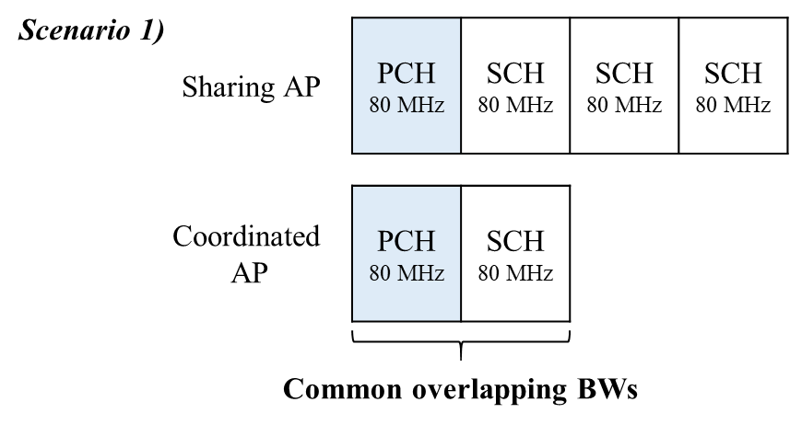
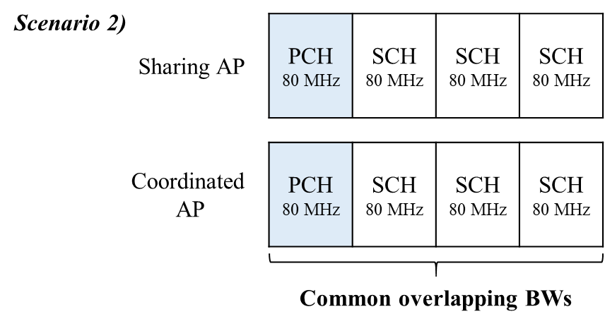
CTS frame transmission in Co-TDMA
According to baseline [4, 5], the CTS frame is to be sent on the P20, P40, P80, P160, P320 indicated in the RU Allocation field of the MU-RTS TXS TF addressed to the Co-TDMA coordinated AP.
  To support a larger bandwidth as possible for the Co-TDMA coordinated AP, the Co-TDMA sharing AP can set the value of the RU Allocation field to the maximum available bandwidth among the common overlapping bandwidths.
    e.g., in Scenario 1), a sharing AP can set the RU Allocation field to 160 MHz, and in Scenario 2), it can set it to 320 MHz.
However, if the coordinated AP detects that the 20 MHz channels containing the allocated RUs (i.e., indicated in the RU Allocation) are not all idle, then the coordinated AP shall not transmit a solicited PPDU [6]*.
  Especially, in a Co-TDMA environment, there may be situations where some of the indicated subchannels are occupied by OBSS STAs (e.g., hidden from the sharing AP), making it impossible for the coordinated AP to respond with a CTS frame.
*Draft P802.11REVme_D7.0, 26.5.2.5 UL MU CS mechanism, pp. 4102

Slide 4
Bandwidth signaling TA (1/2)
To allow the Co-TDMA coordinated AP to send a CTS frame with a channel width less than the channel width indicated in the RU Allocation field, the MU-RTS TF and CTS frame may have a bandwidth signaling TA.
Basically, AP transmits the MU-RTS TF to request simultaneous CTS frame from one or more STAs.
  On the other hand, to simplify the protocol, Co-TDMA sharing AP solicits CTS frame from only one coordinated AP.
  If MU-RTS TF is transmitted to only one coordinated AP in Co-TDMA, it can have a bandwidth signaling TA.
Then, both TXVECTOR parameters CH_BANDWIDTH_IN_NON_HT and DYN_BANDWIDTH_IN_NON_HT can be present in a PPDU containing a MU-RTS TXS TF.
When the MU-RTS TF that has the DYN_BANDWIDTH_IN_NON_HT equal to dynamic, the Co-TDMA coordinated AP can set CTS frame’s CH_BANDWIDTH to less than or equal to the channel width indicated in the RU Allocation field.

Slide 5
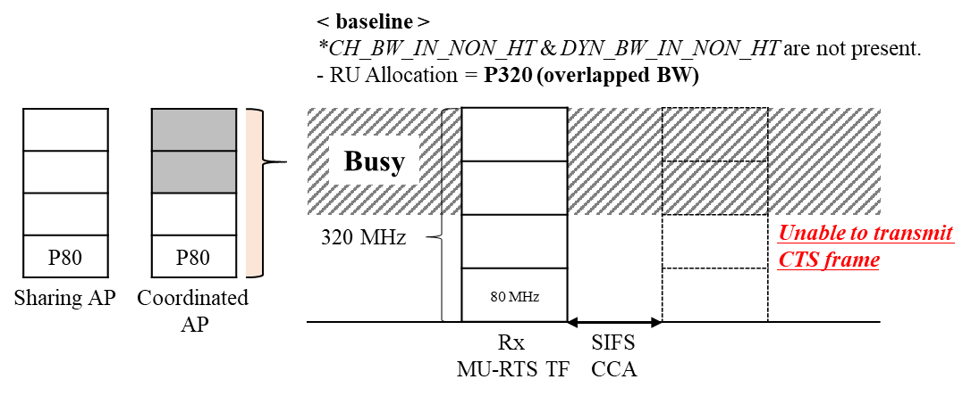
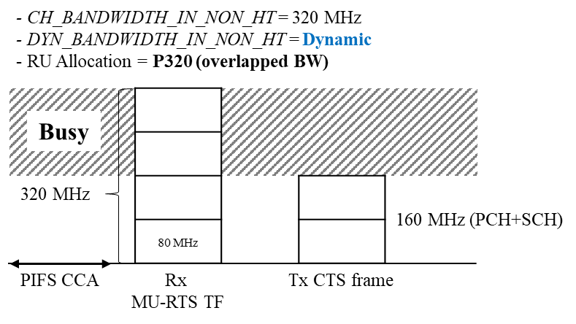
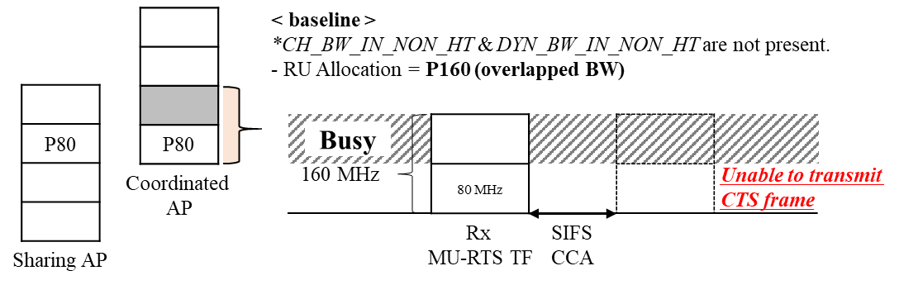
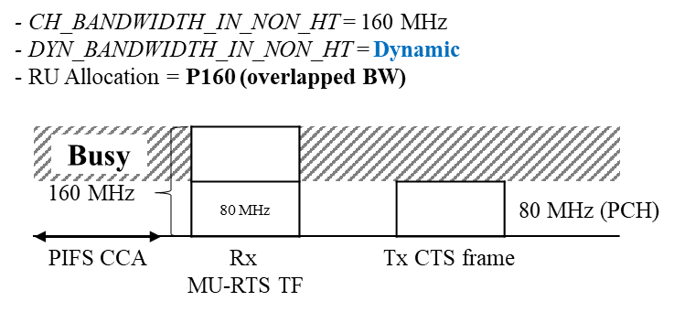
Bandwidth signaling TA (2/2)
Example of bandwidth configuration using bandwidth signaling TA

Slide 6
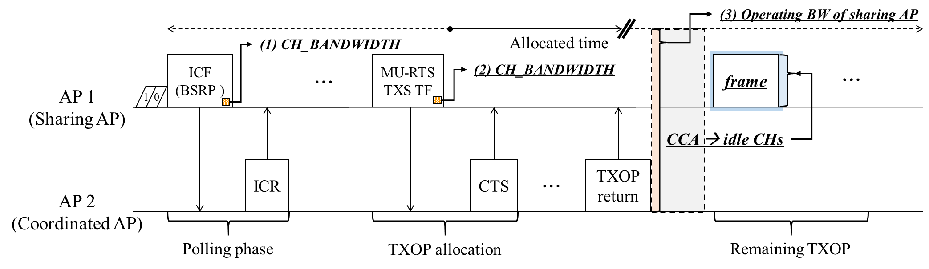
Bandwidth after TXOP return
As shown in the slide 5, when performing TXS, the PPDU bandwidth of the coordinated AP may be smaller.
  There is no guarantee that the entire BW of the Co-TDMA sharing AP will remain available after the allocated time.
  The available bandwidth of the Co-TDMA sharing AP must be determined after the TXOP is returned.
Performs CCA based on CH_BANDWIDTH of one of the frames before allocating time;
  The frame may be ICF (BSRP TF) or MU-RTS TXS TF.
    If AP performs CCA based on CH_BW of ICF, there is a chance to get larger BW, but it may harm nearby OBSS STAs (which obtained TXOP during the time allocated to coordinated AP).
We propose that after TXOP return, sharing AP shall perform CCA based on CH_BW of MU-RTS TXS TF.

Slide 7
Conclusion
In this contribution, we propose bandwidth configurations for Co-TDMA as follows:
An Co-TDMA sharing AP shall set the value of the RU Allocation field to the maximum available bandwidth among the common overlapping bandwidths.
An MU-RTS Trigger frame and CTS frame can have bandwidth signaling TA in Co-TDMA.
An Co-TDMA sharing AP shall perform CCA based on CH_BW of MU-RTS TXS TF.

Slide 8
References
[1] 24/1075, “MAP coordination follow up”
[2] Draft P802.11REVme_D7.0, pp. 2923
[3] 25/0014r2, “TGbn Motions List – Part 2”
[4] Draft P802.11REVme_D7.0, pp. 4062
[5] Draft P802.11be_D7.0, pp. 180
[6] Draft P802.11REVme_D7.0, 26.5.2.5 UL MU CS mechanism, pp. 4102

Slide 9
Straw Poll 1
Do you agree to add the following text to the TGbn SFD?
  An Co-TDMA sharing AP shall set the RU Allocation field value of the MU-RTS TXS Trigger frame to the maximum available bandwidth among the common overlapping bandwidths.
    Maximum available bandwidth includes the primary channel and some of nonpunctured nonprimary 20 MHz subchannels that has been used by the Co-TDMA sharing AP.

Slide 10
Straw Poll 2
Do you agree to add the following text to the TGbn SFD?
  An Co-TDMA coordinated AP shall set CH_BANDWIDTH_IN_NON_HT of CTS frame to be less than or equal to CH_BANDWIDTH_IN_NON_HT of MU-RTS Trigger frame.

Slide 11
Straw Poll 3
Do you agree to add the following text to the TGbn SFD?
  An Co-TDMA sharing AP shall not transmit PPDUs occupying subchannels that are not used when sending the MU-RTS TXS Trigger frame to allocate time to the preceding Co-TDMA coordinated AP during the remaining TXOP duration (or) after reclaiming a TXOP.

Slide 12
Appendix: CTS frame sent in response to an RTS frame
An EHT STA that is addressed by an RTS frame that has the DYN_BANDWIDTH_IN_NOT_HT equal to Static behaves as follows:
  If the NAV indicates idle and CCA has been idle for all nonpunctured nonprimary 20 MHz subchannels in the channel width indicated by the RTS frame’s CH_BANDWIDTH_IN_NON_HT for a PIFS prior to the start of the RTS frame, then the STA shall respond with a CTS frame after a SIFS. The CTS frame’s CH_BANDWIDTH shall be set to the same value as the RTS frame’s CH_BANDWIDTH_IN_NON_HT.
An EHT STA that is addressed by an RTS frame that has the DYN_BANDWIDTH_IN_NOT_HT equal to Dynamic behaves:
  If the NAV indicates idle, then the STA shall respond with a CTS frame after a SIFS. The CTS frame’s CH_BANDWIDTH shall be set to any channel width for which CCA on all nonpunctured nonprimary 20 MHz subchannels has been idle for a PIFS prior to the start of the RTS frame and that is less than or equal to the channel width indicated in the RTS frame’s CH_BANDWIDTH_IN_NON_HT.
Reference: 11be/D7.0; 10.3.2.9 CTS and DMG CTS procedure

