Slide 1
Some Open Issues on DRU
Date: 2025-01-xx
Authors:
Name | Affiliations | Address | Phone | email
Lin Yang | Qualcomm
Qifan Chen
Bin Tian
Youhan Kim

Slide 2
Outline
Discussion on 20MHz+20MHz+40MHz DRU mode
Application of Global CSD for dRU
Impact of 20MHz TX LO leakage to DRU performance when DRU spreading over 20MHz in wider BW OFDMA

Slide 3
Regarding 20MHz+20MHz+40MHz DRU mode
In the passed motion, 20+20+40 in non-punctured 80 is only supported in 80MHz PPDU, but not in each 80MHz subblocks in wider BW PPDU
  In a non-punctured 80 MHz PPDU, the following distribution bandwidthDBW modes are allowed for DRU
    80 MHz
    20 MHz + 20 MHz + 40 MHz (or 40 MHz + 20 MHz + 20 MHz)
Considering 20+20+40 DRU mode was introduced to support 20MHz operating STA in wide BW UL OFDMA using dRU, propose to support this mode also in PPDU with BW>80MHz but only in the primary 80MHz subblock in which 20MHz device normally operates

Slide 4
SP 1
Do you agree to include the following into the 11bn SFD?
For 160 MHz and 320 MHz PPDUs, in only the non-punctured primary 80 MHz subblock, the following distribution bandwidth mode is allowed for DRU
  20 MHz + 20 MHz + 40 MHz (or 40 MHz + 20 MHz + 20 MHz)

Slide 5
Application of Global CSD for dRU
Global CSD is introduced to 11bn [24/0209r7] to solve the unintentional BF issue in STF transmission for dRU
  Multiple dRUs over same DBW transmitting the same STF signal may cause unintentional beamforming w/o global CSD
UHR-LTF sequence and populated tones for each DRU in same DBW are different based on the specific per DRU’s tone mapping. So UHR-LTF transmission for DRU may not have unintentional BF issue
So for DRU transmission we propose to apply global CSD to UHR-STF only, and UHR-LTF and data still apply local per stream CSD, just like RRU

Slide 6
SP 2
Do you agree to include the following into the 11bn SFD?
  For distributed transmission, apply global CSD to UHR-STF only, and UHR-LTF and data still apply local per stream CSD, just like RRU

Slide 7
  Impact of 20MHz TX LO leakage to DRU performance when DRU spreading over 20MHz in wider BW OFDMA
This following slides show performance impact of 20MHz Tx LO leakage to 20MHz DRU in wider BW PPDU, and propose possible solution and change to 11bn spec

Slide 8
Ref: DRU transmission for distribution BW < PPDU BW
When DRU over 20/40/80MHz participate in 80/160/320MHz transmission, the adopted DRU tone plan accommodates shifting DRU over 20/40/80MHz into wide BW OFDMA tone plan as an RU
  DRU over 20MHz → RRU242 in 80/160/320MHz
  DRU over 40MHz → RRU484 in 80/160/320MHz
  DRU over 80MHz → RRU996 in 80/160/320MHz
The DRUs on frequency sublocks of wide bandwidth PPDU are defined as DRUs on 20MHz, 40MHz and 80MHz PPDU with the following constant shifts
Frequency Subblock Size | BW80 | BW160 | BW320
20MHz | [-380,-133,132,379] | [-892,-645,-380,-133,132,379,644,891] | [ -1916, -1669, -1404, -1157, -892, -645, -380, -133, 132, 379, 644, 891, 1156, 1403, 1668, 1915]
40MHz | [-256, 256] | [-768,-256,256,768] | [-1792,-1280,-768,-256,256,768,1280,1792]
80MHz | NA | [-512,512] | [-1536,-512,512,1536]

Slide 9
Impact of 20MHz TX LO leakage to 20MHz DRU in Wide BW
In HE/EHT, RRU242 is not allowed for 20MHz operation devices in wide BW OFDMA, because TX LO leakage will be self jamming its own data tones
TX LO leakage issue is even more severe in DRU cases
  Unlike in RRU cases, the Tx LO leakage impact is not just limited to center RRU26 and RRU242. Multiple DRUs would be affected
  E.g., in the 1st 20MHz within 80MHz, DC tones are around tone index of -384
    Every DRU106 over 20MHz has two tones next to sub20 DC (next slide)
    Two DRU52s out of four over 20MHz, each has one tones next to sub20 DC (next slide)
    Three DRU26s out of nine over 20MHz, each has one tones next to or exactly at sub20 DC
      dRU26_5 has a tone at -384 after shifting by -380
Data and pilot subcarrier indices for Distributed Tone RUs (DRUs) in a 20 MHz UHR PPDU
DRU type | DRU index and subcarrier range
26-tone DRU i=1:9 | DRU1 [-120:9:-12, 6:9:114] | DRU2 [-116:9:-8, 10:9:118] | DRU3 [-118:9:-10, 8:9:116] | DRU4 [-114:9:-6, 12:9:120] | DRU5 [-112:9:-4, 5:9:113]
 | DRU6 [-119:9:-11, 7:9:115] | DRU7 [-115:9:-7, 11:9:119] | DRU8 [-117:9:-9, 9:9:117] | DRU9 [-113:9:-5, 4:9:112]
52-tone DRU i=1:4 | DRU1 26-tone [DRU1, DRU2] |  | DRU2 26-tone [DRU3, DRU4]
 | DRU3 26-tone [DRU6, DRU7] |  | DRU4 26-tone [DRU8, DRU9]
106-tone DRU i=1:2 | DRU1 26-tone [DRU1~4], [-3, 3] |  | DRU2 26-tone [DRU6~9], [-2, 2]

Slide 10
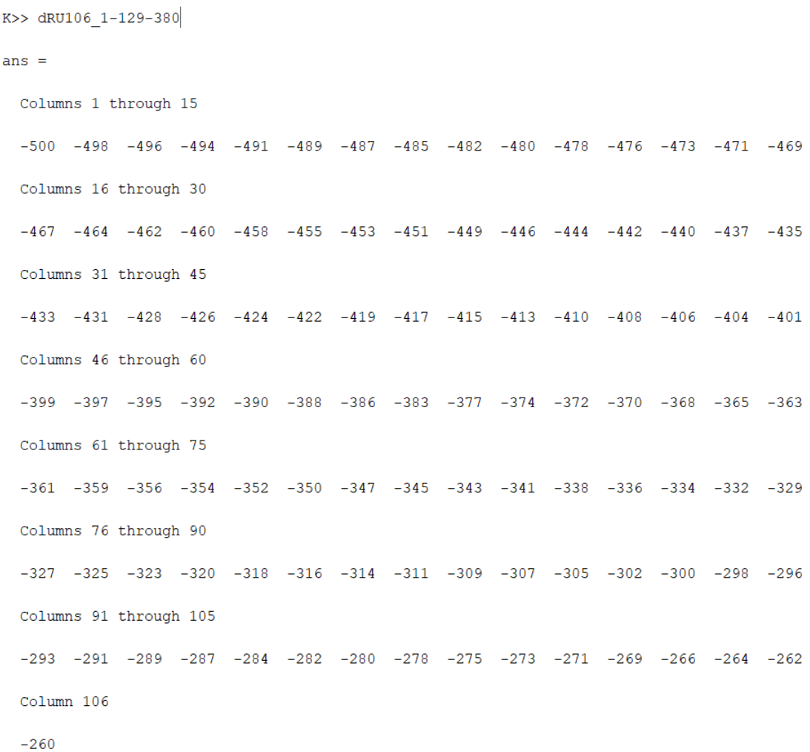
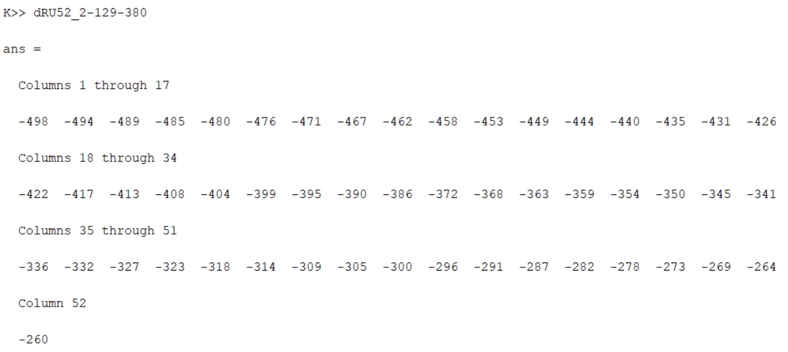
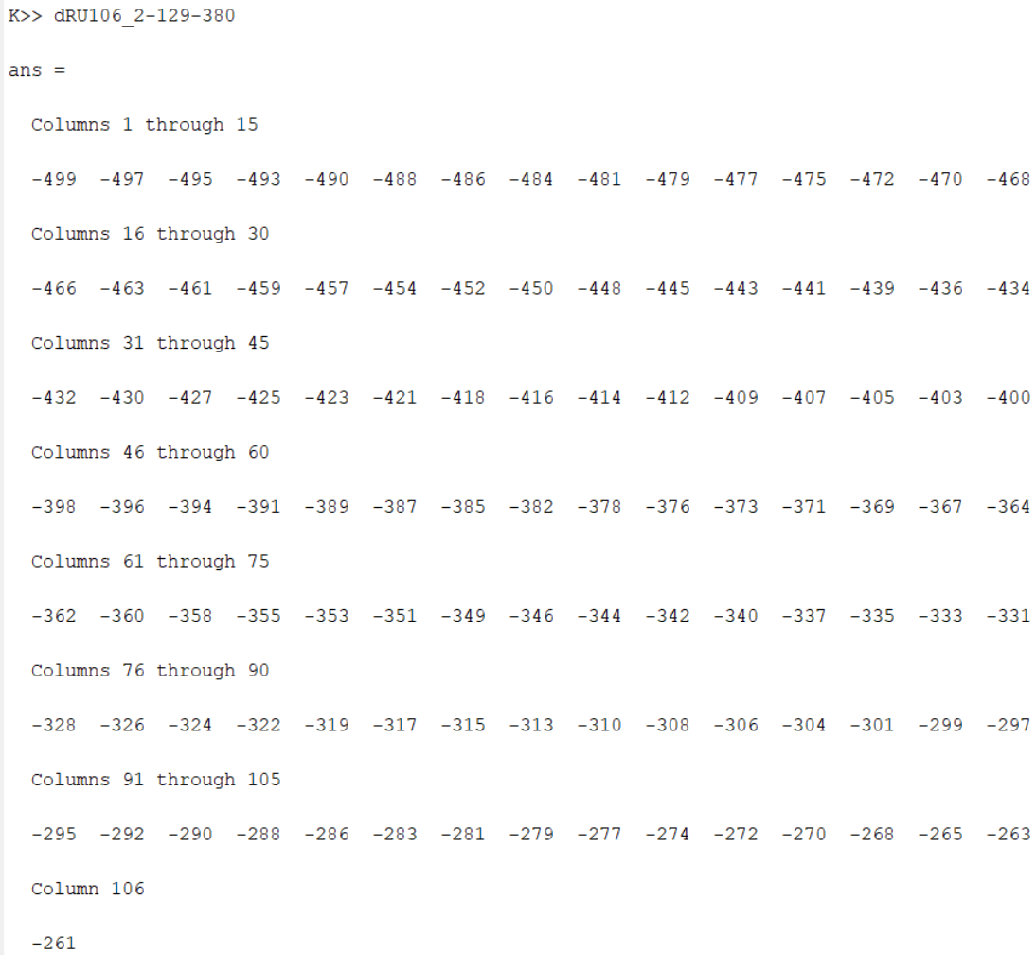
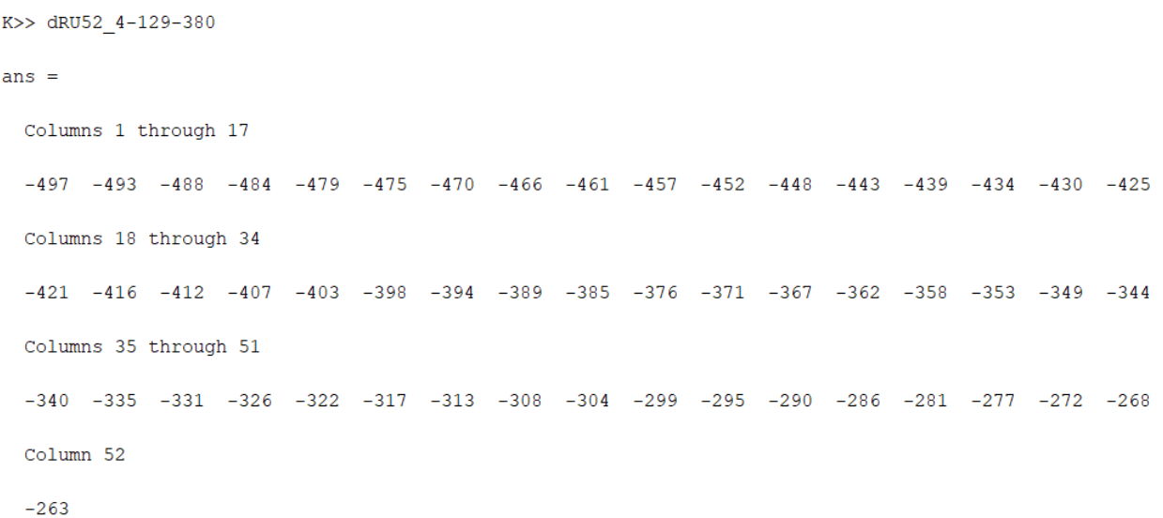
Example Tone Plan of 20MHz dRU in 80MHz OFDMA
Ex of dRU106 in 1st 20M
Ex of dRU52 in 1st 20M

Slide 11
Simulation Results of LO Leakage Impact
Simulation Assumption
  MCS0, 9, 1x1 (1T1R)
  PPDU BW=80MHz, dRU distribution BW=20MHz
  DRU26_5, DRU106_2 on the left most 20MHz
  Carrier leakage strength
    -32dBc (IEEE spec requirement)
    -20dBc: when P_chain=0dBm, max(-20, P_chain-32) dBm = -20dBm
  Carrier leakage location @ -384 or -384.5
  Performance loss: With LO leakage vs. Without LO leakage
Observation
  For both DRU26 and DRU106, MCS 9 suffers significant loss for both AWGN and DNLOS, especially when -20dBc carrier leakage is present
    It may suffer more by multiple-DC in OFDMA, due to small tone spacing
  Similar loss also seen when channel smoothing is off
Recommendation
  Add note to spec that be cautious of using high MCS when 20MHz operating STA with dRU in wide BW OFDMA
Leakage scenarios | Performance loss (in dB) @ 10% PER from LO leakage 1T1R, dRU over 20MHz in 80MHz, with smoothing on
 | dRU26 |  |  |  | dRU106
 | AWGN |  | DNLOS |  | AWGN |  | DNLOS
 | MCS0 | MCS9 | MCS0 | MCS9 | MCS0 | MCS9 | MCS0 | MCS9
-32 dBc @-384 | 0 | 2.4 | 0 | >10% floor | 0 | 0.1 | 0 | 0
-32 dBc @-384.5 | 0 | 0.8 | 0 | 1.9 | 0 | 0.4 | 0 | 1.6
-20 dBc @-384 | 0.1 | >10% floor | 0.1 | >10% floor | 0 | 0.1 | 0 | 0.1
-20 dBc @-384.5 | 0.1 | >10% floor | 0.1 | >10% floor | 0 | >10% floor | 0.1 | >10% floor

Slide 12
Summary
When a 20 MHz operating STA participates in wide BW UL OFDMA using DRU, some DRUs in that 20MHz DBW may be impacted by the DC leakage from the 20MHz operating device such that performance of high MCS may be significantly degraded

Slide 13
SP 3
Do you agree to include the following into the 11bn SFD?
Add the following note to spec that
  When a 20 MHz operating STA participates in an 80 MHz <or wider> UHR TB PPDU using 20 MHz distribution bandwidth, the TX LO leakage of the STA might interfere with some of the data subcarriers within the 20 MHz distribution bandwidth such that for some DRUs in that 20MHz DBW performance of high MCS may be significantly degraded.

Slide 14
Appendix

Slide 15
Related Motions
In a non-punctured 80 MHz PPDU, the following distribution bandwidthDBW modes are allowed for DRU
  80 MHz
  20 MHz + 20 MHz + 40 MHz (or 40 MHz + 20 MHz + 20 MHz)
[Motion #20, [1] and [36]]
DRU distribution bandwidthDBW of 60 MHz is defined in an 80 MHz frequency subblock (with the highest 20 MHz subchannel unallocated) in a UHR TB PPDU
No allocation is made in the highest 20 MHz subchannel
[Motion #64, [1] and [166]]
For 80 MHz PPDU where one of the 20 MHz channels is punctured, the following distribution bandwidthDBW mode is allowed for DRU
  20 MHz + 40 MHz (or 40 MHz + 20 MHz) mode
[Motion #87, [1] and [173]]
For 160 MHz and 320 MHz PPDUs, in an 80 MHz frequency subblock where one of the 20 MHz channels is punctured, the following distribution bandwidth mode is allowed for DRU
  20 MHz + 40 MHz (or 40 MHz + 20 MHz) mode
[Motion #88, [1] and [173]]
For 160 MHz and 320 MHz PPDUs, in an 80 MHz frequency subblock where one of the 40 MHz channels is punctured (i.e., either 1100 or 0011 case), the following distribution bandwidthDBW mode is allowed for DRU
  40 MHz mode
[Motion #89, [1] and [173]]
For a 40 MHz PPDU, the following distribution bandwidthDBW mode is allowed for DRU
  Only 40 MHz mode
[Motion #90, [1] and [173]]

Slide 16
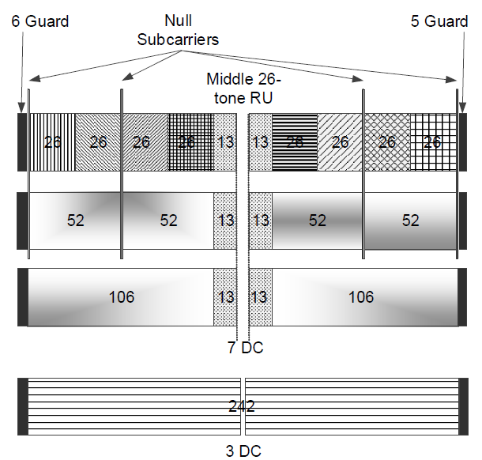
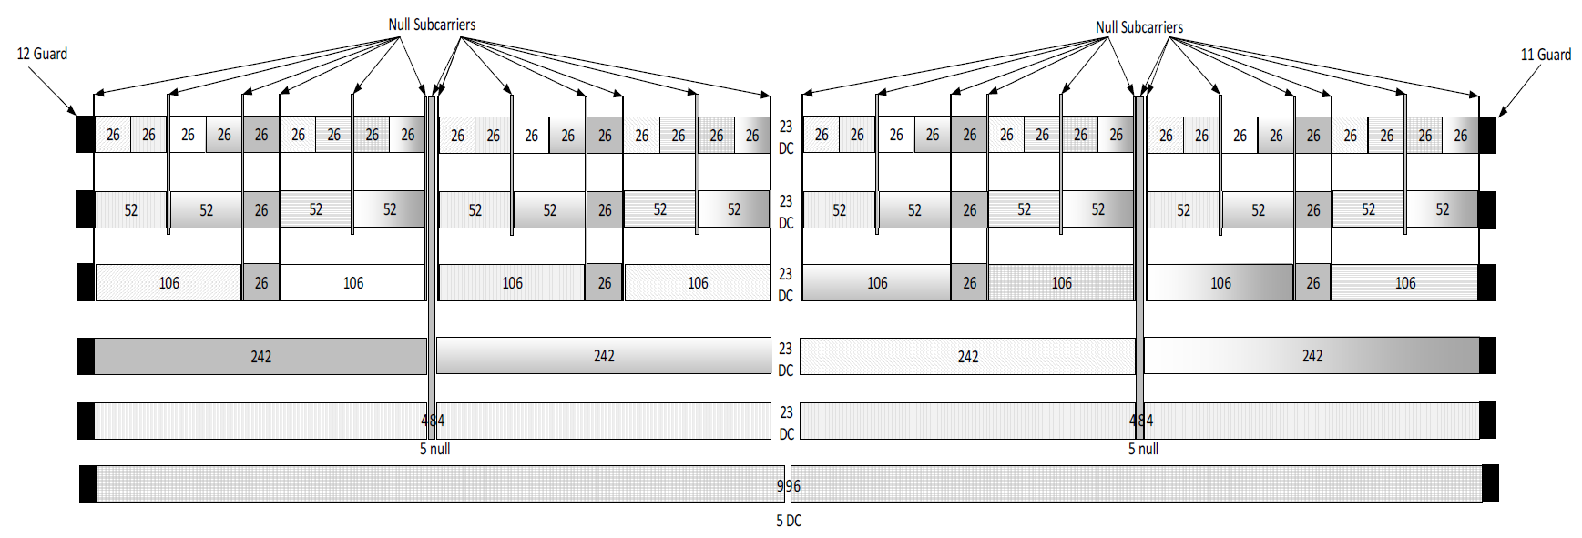
Ref: DRU Distribution Range on 20MHz
RRUs Span over 245 tones in range of [-122:-3,3:122] on BW20
DRU within 242-tone region for each 20MHz subblock on BW80/160/320
This allows DRU distribution on 20MHz subblock for puncture mode or 20MHz only operating devices
-120
120
DRUs Span over 241 tones in range of [-120:-2,2:120]
all DRUs keep >= 3 DC tones
Slide 16

Slide 17
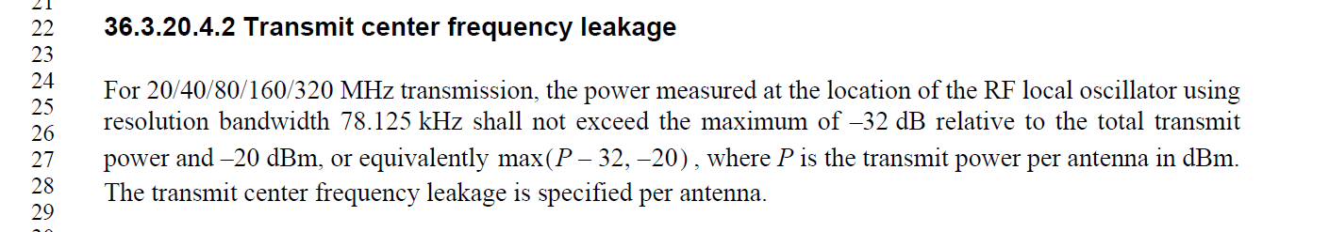
Simulation Setup
Assumptions:
MCS0, 9, 1T1R
BSS BW80, NBW DRU BW20
NBW DRU26, DRU106 on the left most 20MHz
W/o carrier leakage, -32dBc carrier leakage
Carrier leakage strength: -32, -20dBc (IEEE spec)
Carrier leakage location
  DRU106_2
    Data tone index … -387 -385 -382 -378 -376 …
    Carrier leakage appear @ -384 or -384.5
  DRU26_5
    Data tone index … -402 -393 -384 -375 -366 …
    Carrier leakage appear @ -384 or -384.5

