Slide 1
High-Priority EDCA Management
Date: 2025-07-03
Authors:
Name | Affiliations | Address | Phone | Email
Mikhail Liubogoshchev | Nokia |  |  | Mikhail.Liubogoshchev@nokia.com
Davis Robertson
Behnam Dezfouli
Kerstin Johnsson
Okan Mutgan
Prabodh Varshney
Klaus Doppler
Behnam Dezfouli
Mika Kasslin
Mika Kasslin
Eda Genc
Juhyung Lee
Juhyung Lee
Salvatore Talarico
Mario Costa
Enrico Rantala

Slide 2
DS-CTS Duration value

Slide 3
RTS/CTS behavior per 802.11revME [1]
Excerpt from Section 10.3.2.9: A STA that receives an RTS frame addressed to it considers the NAV in determining whether to respond with CTS
If the NAV indicates idle, the STA shall respond with a CTS frame after a SIFS.
Otherwise, the STA shall not respond with a CTS frame.
Excerpts from Section 10.23.2.4: If a [non-VHT non-HE STA, VHT STA (11ax), or HE STA] receives an RTS frame [whose TA] matches the saved TXOP holder address, then the STA shall send the CTS frame after a SIFS, without regard for, and without resetting, its NAV.
When a STA receives a frame addressed to it that requires an immediate response, except for RTS and Trigger frames, it shall transmit the response independent of its NAV.

Slide 4
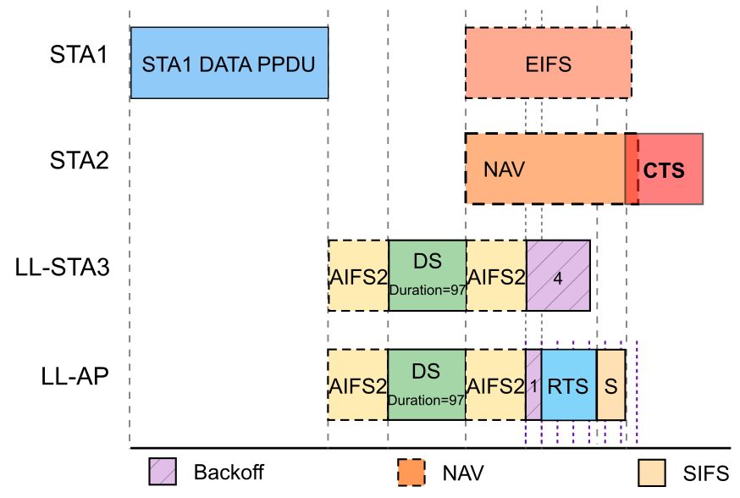
Does NAV from DS-CTS Allow Responding to the RTS?
STA3 and AP send DS-CTS frames simultaneously
STA2 decodes on of DS-CTSs
STA2 sets its NAV and identifies an RA from the DS-CTS as TXOP owner
AP wins P-EDCA contention and transmits an RTS frame to STA2
Since STA2 recognizes an RA from the DS-CTS as TXOP owner, it shall not to respond to AP’s RTS.
An LL-STA will not be able to establish a TXOP if it (1) sends an RTS to an STA that did not decode the LL-STA’s DS-CTS, and (2) the DS-related NAV has not expired when it is time to transmit the CTS.

Slide 5
Solution from the 802.11bn D0.3
Current draft suggests:
“The (#339)DS-CTS frame shall be transmitted in a non-HT PPDU or non-HT PPDU duplicate format, using 6 Mb/s data rate, and SCRAMBLER_INITIAL_VALUE is fixed. The RA field shall be set to the unicast MAC address with OUI 00:0F:AC and the remaining bits set by <ANA>, and the Duration field shall be set to the value of the P-EDCA contention duration in Table 37-1.”
A pre-defined common format of a DS-CTS enables UHR STAs to distinguish it from a legacy CTS => STAs can be explicitly allowed to respond to an RTS after a DS-CTS.
Disadvantages of this solution
Changes EDCA state-machine: 11bn STAs must distinguish between CTS and DS-CTS frames and, during DS-CTS NAV, alter NAV behavior (STA can respond to any frame regardless of the TXOP owner)
Legacy STAs can only respond to RTSs with TA equal to the RA of the DS-CTS.

Slide 6
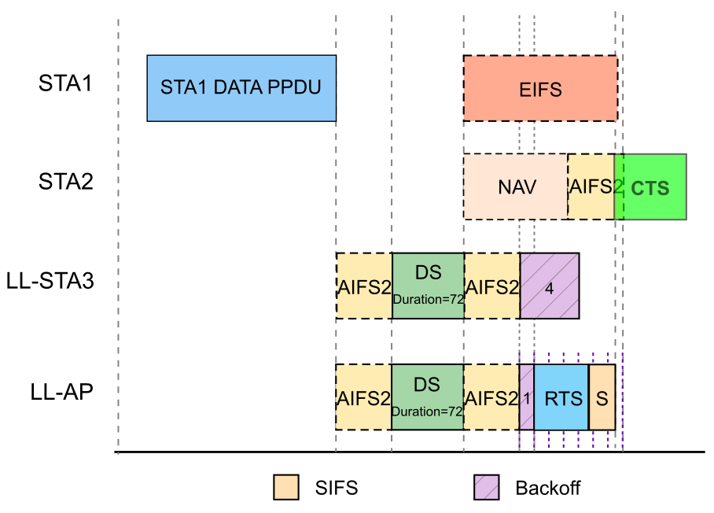
Suggested Solution
Modify the Duration field value for the NAV to end before the CTS has to be sent.
Constraints to the NAV value selection:
NAV shall expire before the earliest CTS is to be sent:
$$Duration<D_{cts} = AIFS\left[P−EDCA\right]+minRTS+SIFS$$
2. Non-P-EDCA STAs should not resume backoff before the P-EDCA contention ends:
$Duration+AIFS[VO] > AIFS[P−EDCA]+CWmax[P−EDCA]$*aSlotTime =>
$$Duration≥D_{protection}= \left(AIFSN\left[P−EDCA\right]+CWmax\left[P−EDCA\right]−AIFSN\left[VO\right]+1\right)∗aSlotTime$$
Note 1. AIFS[VO] term considers that non-P-EDCA STAs resume contention an AIFS after NAV ends: “EDCAF operations shall be performed at slot boundaries <…>: e) Following AIFSN[AC] × aSlotTime + aSIFSTime – aRxTxTurnaroundTime of idle medium after the last indicated busy medium as indicated by the CS mechanism that is not covered by condition a) to condition d)”
Note 2. +1*aSlotTime is the part of the equation to take the $\text{aRxTxTurnaroundTime}$ of any STA into account

Slide 7
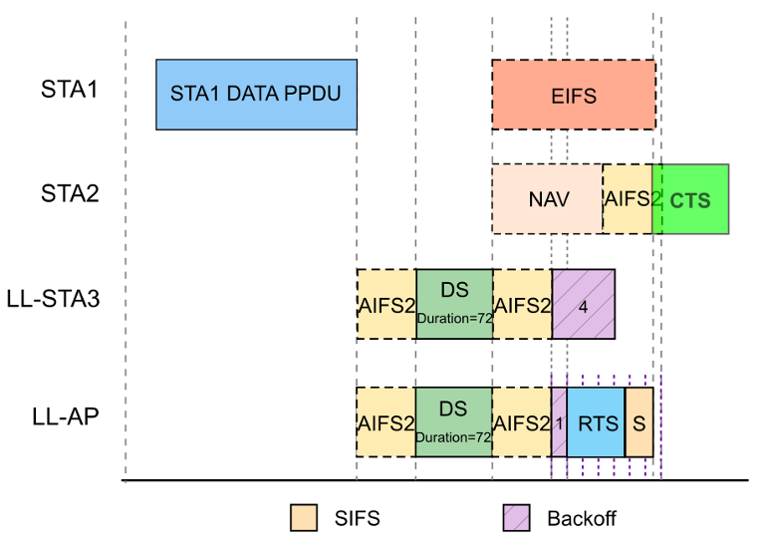
Selecting Duration Value
$D_{cts}$ and $D_{protection}$ depend on EDCA and P-EDCA parameters
If $D_{cts}>D_{protection}$, any $D_{cts}>Duration>D_{protection}$ suffices
If $D_{cts}<D_{protection}$, optimal $Duration=D_{cts}$. This protects some P-EDCA slots and allows STAs to respond to an RTS.
What are the realistic $D_{cts}$ and $D_{protection}$?
RTS@6,12,24Mb/s = 52,36,28us
Default AIFSN[P-EDCA]=2
Default CWmax[P-EDCA]=7
Default AIFSN[VO] = 2
Default: $D_{cts}= AIFS\left[P−EDCA\right]+minRTS+SIFS=78us$
Default: $D_{protection}= \left(AIFSN\left[P−EDCA\right]+CWmax\left[P−EDCA\right]−AIFSN\left[VO\right]+1\right)∗aSlotTime=72us$
Default: $Duration = D_{protection}$=72us
Generic: $Duration = min⁡(D_{protection}, D_{cts})$

Slide 8
Summary
Problem:
During P-EDCA, if an LL-STA transmits an RTS to a STA that decoded a DS-CTS from another LL-STA, the STA will not respond with a CTS unless the NAV has expired
Solutions:
Treat DS-CTS and legacy CTS differently and allow STAs to respond to any frame received during DS-CTS NAV, which involves change in NAV state machine and risks channel blocking
Change DS-CTS Duration logic to ensure that NAV expires before any CTS is to be sent.

Slide 9
Failing a p-edca contention

Slide 10
Problem Statement
Current PDT:
A P-EDCA STA that participated in a P-EDCA contention but did not initiate a TXOP (see 10.23.2.4) during the P-EDCA contention or that initiated a TXOP but did not receive the CTS frame in response to the RTS frame used to initiate the TXOP may start another P-EDCA contention by sending the DS-CTS frame at DSAIFSN[AC_VO] slot boundary if the STA’s CS mechanism (see 10.2.3.1 (CS mechanism)) determines that the medium is idle, for up to dot11PEDCAConsecutiveAttempt.
How shall the STA act if it decides not to start another P-EDCA contention?

Slide 11
STA failing a P-EDCA contention and not sending a DS
May the STA resume the unfinished backoff?
QSRC[VO] remains positive
=> CWmax[VO] = CW[P-EDCA]
=> the only change would be the backoff counter reset, which would increase the tail delay for LL traffic.
May the STA select new backoff without resetting the EDCA parameters for EDCAF[VO]?
Default EDCA/P-EDCA parameter can be uses interchangeably
Benefits of both:
Keep the P-EDCA implementation simple and reset EDCAF under any of the following conditions:
When the STA sends the first DS-CTS frame
When PSRC[AC_VO] reaches dot11PEDCARetryThreshold
When QSRC[AC_VO] is set to 0
Give the AP power to prioritize P-EDCA eligible STAs without the P-EDCA contention overheads
E.g., via a P-EDCA parameter set: AIFSN=2, CW=1

Slide 12
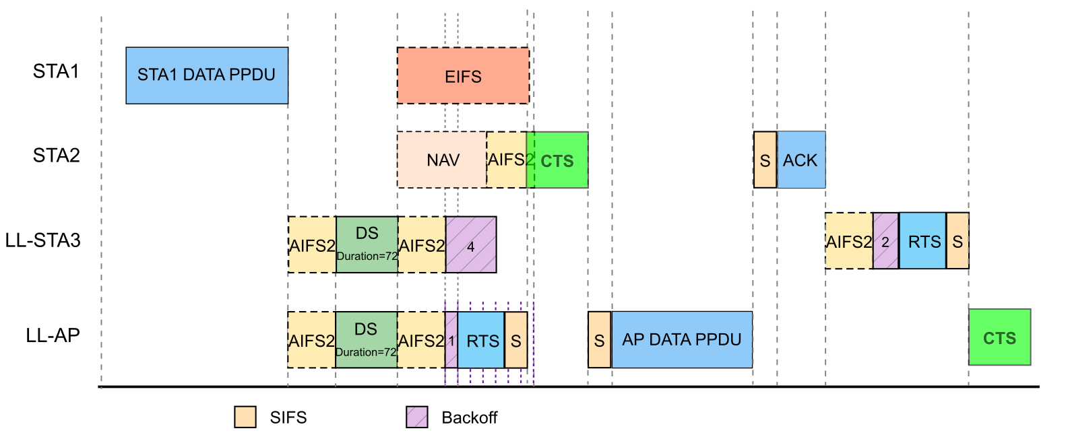
Example of an LL STA keeping the backoff counter from the P-EDCA contention

Slide 13
Straw Polls (DS-CTS Duration)
SP1. Do you agree that the issue of an STA being unable to respond to an RTS sent by an LL STA during P-EDCA contention needs to be addressed?
SP2. Which option do you prefer?
Option 1. Allow UHR STAs to ignore NAV set by DS-CTS when responding to the following RTS?
Option 2. Adjust the DS-CTS Duration to ensure that NAV expires before a CTS needs to be transmitted in response to any RTS (i.e., regardless of P-EDCA backoff and MCS selected for RTS transmission).
SP3. Which DS-CTS Duration option do you prefer?
Option 1. Fixed to 72us to make sure that the contention is protected for the default P-EDCA parameters
Option 2. $Duration = min⁡(D_{protection}, D_{cts})$ to adapt to the EDCA and P-EDCA parameters depending on the BSS configuration.

Slide 14
Straw Polls (STA failing a P-EDCA contention)
SP4. Do you agree that a P-EDCA STA that loses a P-EDCA contention but has PSRC[AC_VO] < dot11PEDCAConsecutiveAttempt maintains the backoff counter and keeps EDCAF[VO] parameters according to the P-EDCA Parameter Set?

Slide 15
References
[1] IEEE 802.11 Working Group, Draft Standard for Information Technology—Telecommunications and Information Exchange Between Systems—Local and Metropolitan Area Networks—Specific Requirements—Part 11: Wireless LAN Medium Access Control (MAC) and Physical Layer (PHY) Specifications, IEEE P802.11-REVme/D7.0, August 2024.
[2] CC50 CR Prioritized EDCAs https://mentor.ieee.org/802.11/dcn/25/11-25-0627-14-00bn-cc50-cr-for-p-edca.docx

Slide 16
Backup

Slide 17
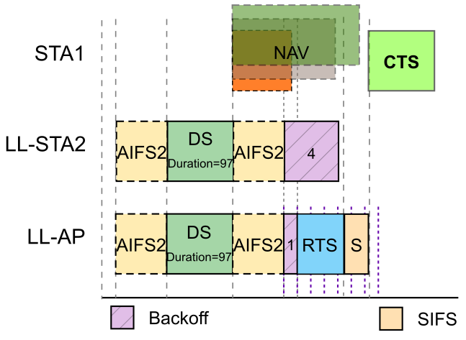
When does the STA evaluate the NAV?
What is the latest time the NAV shall expire for the STA to respond to an RTS?
At the beginning of an RTS
At the end of an RTS
At the end of a SIFS after an RTS
The standard isn’t very precise: Section 10.3.2.9: A STA that receives an RTS frame addressed to it considers the NAV in determining whether to respond with CTS, unless the NAV was set by a frame originating from the STA sending the RTS frame <…>
If the NAV indicates idle, the STA shall respond with a CTS frame after a SIFS.
Otherwise, the STA shall not respond with a CTS frame.
We assume that both options 2 and 3 are possible

