Slide 1
Wireless Broadband Alliance (WBA) Liaison Report – January 2025
Date: 2025-01-15
Authors:
Name | Company | Address | Phone | Email
Necati Canpolat | Intel |  |  | necati.canpolat@intel.com

Slide 2
Wireless Broadband Alliance (WBA)
January 2025
Drives enabling seamless & interoperable Wi-Fi services
Addresses business and technical issues, as well as opportunities in the industry
IEEE 802.11 (std dev) WFA (cert) WBA (enablement)

Slide 3
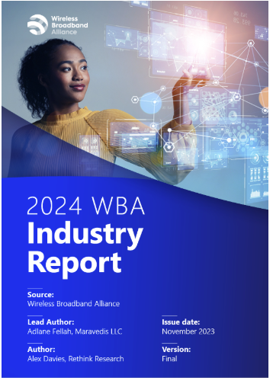
WBA Annual Industry Report 2024
Highlights significant trends and developments in the Wi-Fi and connectivity sector
Based on insights from 200 global industry executives
It is publicly available at: https://wballiance.com/resource/annual-industry-report-2024/

Slide 4
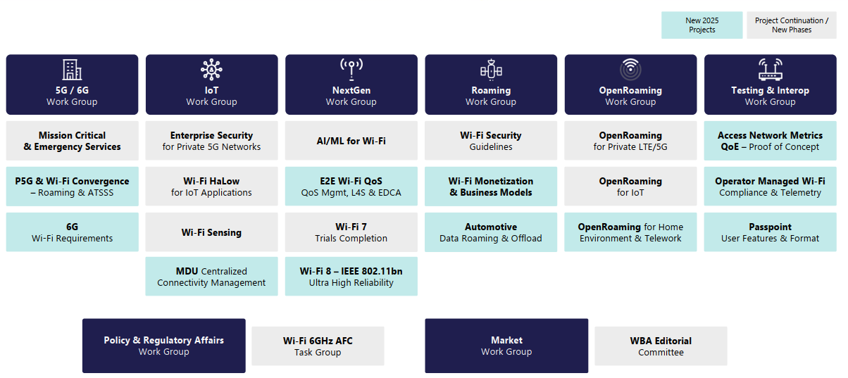
WBA Technical Activities & Roadmap for 2025
https://wballiance.com/wba-program-overview-2025/
https://wballiancec.com/proejcts-details

Slide 5

Wireless Global Congress & Members Meeting
https://www.wirelessglobalcongress.com/apac2025/

Slide 6
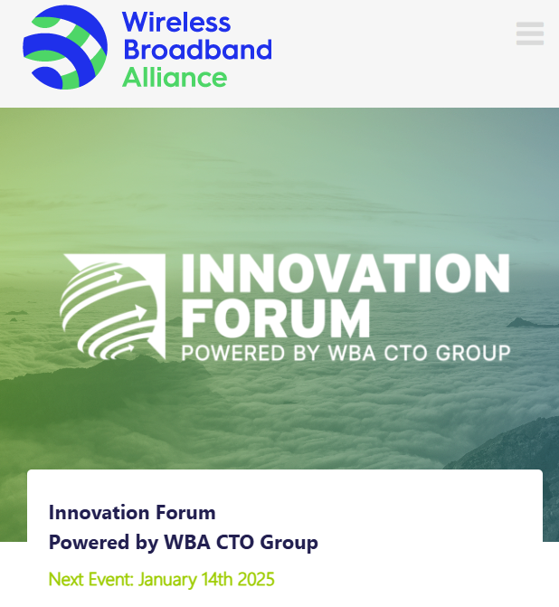
WBA Innovation Forum
https://wballiance.com/innovation-forum/
Focus on key themes sharing perspectives that will shape the future of connectivity for the next decade and beyond

Slide 7
WBA 6G/Wi-Fi Vision Statement
Launched WBA 6G/Wi-Fi Vision Statement on Jan’14
Calls for greater collaboration and among standard bodies all stakeholders for 6G to deliver on its promise
Details five key vision points for 6G, to achieve ubiquitous connectivity that comprises Wi-Fi and cellular

Slide 8
Further information
WBA information at https://wballiance.com/
Current work areas https://wballiance.com/wba-program-overview-2025/
WBA resource center https://wballiance.com/resource/
WBA events https://wballiance.com/events-awards/
WBA memberships: https://wballiance.com/membership/

Slide 9
Backup

Slide 10






WBA ORGANIZATION
WBA IS A NONPROFIT ASSOCIATION WITH THE VISION TO ACCELERATE THE DEVELOPMENT OF
“SEAMLESS AND INTEROPERABLE WI-FI SERVICES”
Seamless, Secure and Interoperable Wi-Fi
Convergence and Coexistence of Wireless Technologies
Accelerate Next Generation Wi-Fi Networks
Established
in 2003
+200 MEMBERSHIP
COMMUNITY
PROJECTS &
PROGRAMS
3 ANNUAL
EVENTS
PROMOTION AND
GO-TO-MARKET
THOUGHT LEADERSHIP &
MARKET RESEARCH

Slide 11


WBA Focus Areas
WBA MEMBERS SOLVE
REAL BUSINESS ISSUES
Fosters success for its members
WBA’s mission is to enable collaboration between service providers, technology companies and organizations to drive positive change and enable opportunities for growth.
Standards & Specifications - Setting the scene, requirements and creating specifications
Testing & Interoperability - Creating test plans to showcase the technology capabilities
End-to-End Trials - Running field trials/ proof of concept on real-world environment
Guidelines & Best Practices – Accelerate deployments of services and technologies
Certification & Plug Fests - Addressing gaps and helping the industry to maximizing biz opportunities
Think Thank & Advocacy – Industry leaders roundtables and targeted verticals analysis

