Slide 1
Field Considerations on WiFi for Vehicles
Authors:

Slide 2
Abstract
Summary of collection of problems observed in the field, that should be tracked for consideration on Auto TIG
No solutions discussed, just overview for awareness
Part of scope definition

Slide 3
Quick Intro
Diverse 802.11 based vehicle deployment scenarios in the field
  Emergency Response Teams
  In-Vehicle mass bus public transport (Info, ticketing)
  In-Vehicle mass train public transport (telemetry, positioning, video)
  Telemetry, data on opportunistic connections (Charge station, home, etc)
  Application specific: Roller coasters, Mine Systems etc
Common Problems
  Roaming
  Authentication
  Session Key “Survival”
  IP traffic across ESS
  RF Interference (other systems, RF design)
  AP placement
New problems
  Car tracking/privacy

Slide 4

Roaming
Roaming defined as:
  Scan time: find suitable BSSID
  Session establishment (FT, Association, with full 802.1x, PSK/SAE)
  Traffic Forwarding (Initial DHCP/ARP, DNS, etc)
Scan time is expensive:
  Let’s ignore 2.4GHz
  6GHz has complexities on outdoor deployments, plus it is severely restricted to few countries (US, Canada, etc)
  ETSI: 10 to 12 5GHz channels outdoors with similar EIRP, all with DFS requirements
  FCC: adds additional 5 non-DFS outdoor channels
  No active probing for DFS enabled channel (most devices)
  12 Channels at 100ms listen time + unknown channel change time: 1.2 seconds best case, around 13 meters for 40KM/H
  Channel change time varies per implementation, from 30ms to seconds
  Some deployments restrict to single channel, at the price of throughput
  Channel scan “spread” does not work for moving devices

Slide 5
Scan Issues
13 mts later
Scanned RF view can be misleading
10 seconds later
Scanned RF view expires quickly
Slide 5

Slide 6
Authentication
Identities
  OpenRoaming
  Proprietary
  How to provision
  Per device
Some EAP types are very expensive + 802.11 + EAPoL (4)
  PEAP @ 22 frames
  EAP-TLS @ 26 or more
  PSK/SAE @ 4
  Common used EAP types maybe to slow

Slide 7
Session Preservation
Initial session creation is expensive
Roaming as fast as possible
FT needs 4 Frames
  Over Air needs channel change
No matter what, things will go wrong
  Fallback from FT into 802.1x will be impacting
  Full slow roam while moving may not be successful
  New mechanisms for FT to "recover" may be needed

Slide 8
IP Session
Inter ESS roaming may need new IP level negotiation
  Assuming authentication federation (OpenRoaming or similar)
IP negotiation is very expensive
  2 to 8 seconds are common on first association
Opportunistic services may not span multiple providers easily

Slide 9
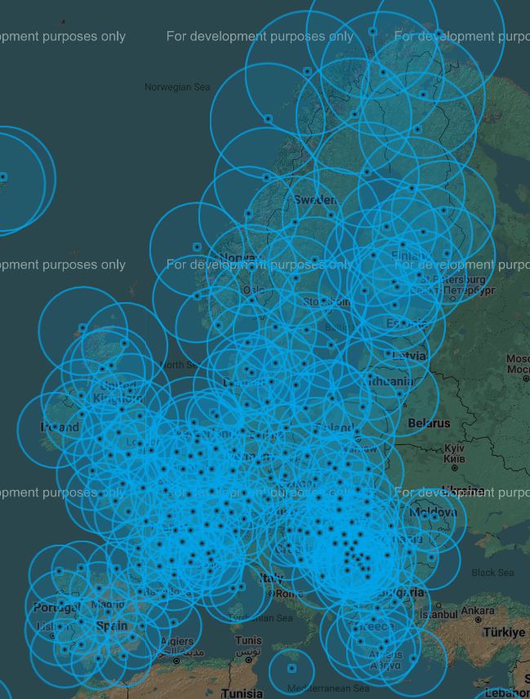
RF Interference
City deployments will have large Interference
  Even with road focused antennas, environment will play a role
  Not possible to control
  Limited options
DFS will be present
  Impact has a lot of variables
  Weather Radar:
    May reduce available channels
    May render outdoor not usable at short distance
  Special Case: Military Radar
Source: Opera Database

Slide 10
AP Placement
Cost of installing AP outdoors: 20 x Cost of the AP
Most installations today are focused on sidewalks coverage
Cities tend to do “max coverage” (less Aps), and ignore throughput
AP placement is difficult and tend to be suboptimal
Architectural restrictions on historical areas

Slide 11
Car Privacy
Car as device has physical security implications
Tracking is possible by service provider
Privacy aspects if car can be identified

Slide 12
Strawpoll
Do you agree on including infrastructure assisted client side roaming as use case study as part of this group?
(GEO help, large scale, beyond 11k/v)
Y:
N:
Abs:
No answer:

Slide 13
Strawpoll
Do you agree on discussing inter-ESS IP handling as part of this group?
Y:
N:
Abs:
No answer:

Slide 14
Strawpoll
Do you agree on discussing AP placement/RF solutions as part of this group?
Y:
N:
Abs:
No answer:

