Slide 1
60 MHz DRU Tone Plan
Date: 2025-01-12
Authors:
Name | Affiliation | Address | Phone | Email
Eunsung Park | LG Electronics | 19, Yangjae-daero 11gil, Seocho-gu, Seoul 137-130, Korea |  | esung.park@lge.com
Dongguk Lim |  |  |  | dongguk.lim@lge.com
Jinyoung Chun |  |  |  | jiny.chun@lge.com
Insik Jung |  |  |  | insik0618.jung@lge.com
Jinsoo Choi |  |  |  | js.choi@lge.com
HanGyu Cho |  |  |  | hg.cho@lge.com

Slide 2
Introduction
TGbn approved 60 MHz DBW in an 80 MHz frequency subblock where the highest 20 MHz subchannel is punctured
In this contribution, we propose a 60 MHz DRU tone plan
In order to show the benefit of our proposal, we analyze it taking account of various factors such as power boost gain, tone range, PAPR and channel smoothing complexity
  We compare our proposal with the tone plan proposed in [1]

Slide 3
Proposed 60 MHz DRU Tone Plan
Data and pilot subcarrier indices for Distributed Tone RUs (DRUs) in a 60 MHz UHR TB PPDU
DRU type | DRU index and subcarrier range
26-tone DRU i=1:28 | DRU1 [-499:27:-40, 14:27:203] | DRU2 [-487:27:-28, 26:27:215] | DRU3 [-493:27:-34, 20:27:209] | DRU4 [-481:27:-22, 32:27:221] | DRU5 [-475:27:-16, 38:27:227]
 | DRU6 [-496:27:-37, 17:27:206] | DRU7 [-484:27:-25, 29:27:218] | DRU8 [-490:27:-31, 23:27:212] | DRU9 [-478:27:-19, 35:27:224]
 | DRU10 [-497:27:-38, 16:27:205] | DRU11 [-485:27:-26, 28:27:217] | DRU12 [-491:27:-32, 22:27:211] | DRU13 [-479:27:-20, 34:27:223] | DRU14 [-473:27:-14, 40:27:229]
 | DRU15 [-494:27:-35, 19:27:208] | DRU16 [-482:27:-23, 31:27:220] | DRU17 [-488:27:-29, 25:27:214] | DRU18 [-476:27:-17, 37:27:226] | DRU19 [not defined]
 | DRU20 [-498:27:-39, 15:27:204] | DRU21 [-486:27:-27, 27:27:216] | DRU22 [-492:27:-33, 21:27:210] | DRU23 [-480:27:-21, 33:27:222] | DRU24 [-474:27:-15, 39:27:228]
 | DRU25 [-495:27:-36, 18:27:207] | DRU26 [-483:27:-24, 30:27:219] | DRU27 [-489:27:-30, 24:27:213] | DRU28 [-477:27:-18, 36:27:225]
52-tone DRU i=1:12 | DRU1 26-tone [DRU1, DRU2] | DRU2 26-tone [DRU3, DRU4] | DRU3 26-tone [DRU6, DRU7] | DRU4 26-tone [DRU8, DRU9]
 | DRU5 26-tone [DRU10, DRU11] | DRU6 26-tone [DRU12, DRU13] | DRU7 26-tone [DRU15, DRU16] | DRU8 26-tone [DRU17, DRU18]
 | DRU9 26-tone [DRU20, DRU21] | DRU10 26-tone [DRU22, DRU23] | DRU11 26-tone [DRU25, DRU26] | DRU12 26-tone [DRU27, DRU28]
106-tone DRU i=1:6 | DRU1 52-tone [DRU1, DRU2], [230 236] | DRU2 52-tone [DRU3, DRU4], [233, 239] | DRU3 52-tone [DRU5, DRU6], [232, 238] | DRU4 52-tone [DRU7, DRU8], [235, 241]
 | DRU5 52-tone [DRU9, DRU10], [231, 237] | DRU6 52-tone [DRU11, DRU12], [234, 240]
242-tone DRU i=1:3 | DRU1 [-499:3:-16, 14:3:251] | DRU2 [-497:3:-14, 16:3:253] | DRU3 [-498:3:-15, 15:3:252]

Slide 4
Power Boost Gain
The proposed DRUs have the following power boost gains
  Each gain is the maximum each DRU can obtain
The tone plan in [1] also achieves the same power boost gain
DRU Size | Max. # of tones per 1 MHz | Power Boost Gain (dB)
26 | 1 | 11.14
52 | 2 | 8.12
106 | 3 | 6.37
242 | 5 | 4.15

Slide 5
Tone Range (1/2)
The conventional 80 MHz RRU tone plan has the following tone range
  Left guard: [-512 ~ -501]
  DC: [-11 ~ 11]
  Third 242 RRU: [12 ~ 253]
The proposed tone plan which tone range is [-499 ~ -14, 14 ~ 253] has no tones overlapped with DC / guard tones or beyond the third 242 RRU
  Thus, there is no additional issue related to interference, mask requirement, signal loss, etc.
  The tone plan proposed in [1] also has no additional issue
    Tone range: [-495 ~ -12, 12 ~ 253]

Slide 6
Tone Range (2/2)
Furthermore, the proposed 26 / 52 / 106 DRUs have a smaller number of tones adjacent to the highest 20 MHz channel
  Interference effect, signal loss and mask requirement may be less serious for small DRUs compared to those in [1]
  Note that the tone range of small DRUs are as follows
    Proposed 26/52 DRUs: [-499 ~ -14, 14 ~ 229]
    Proposed 106 DRUs: [-499 ~ -17, 14 ~ 241]
    26/52 DRUs in [1]: [-489 ~ -139, -126 ~ -12, 12 ~ 247]
    106 DRUs in [1]: [-495 ~ -139, -126 ~ -12, 12 ~ 253]
3rd 20 MHz
4th 20 MHz
3rd 242 RRU
106 DRUs in [1]
26/52 DRUs in [1]
...
...
Proposed 106 DRUs
228 229 230 … 240 241 242 243 244 245 246 247 248 249 250 251 252 253 254 255 256 257 258 259 …
Proposed 26/52 DRUs

Slide 7
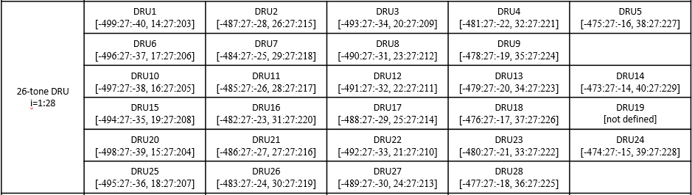
PAPR (1/3)
Proposed 26 DRUs and 242 DRUs achieve almost the same PAPR as 26 RRUs and 242 RRUs, respectively
  GCD (greatest common divisor) of tone gaps for all 26 DRUs is 27
    Tone gap around DC is 54
  GCD of tone gaps for all 242 DRUs is 3
    Tone gap around DC is 30

Slide 8
PAPR (2/3)
PAPR results for 26 RUs and 242 RUs
  We can confirm that the proposed DRUs have almost same PAPR as RRUs and better PAPR than DRUs in [1]
26 RUs
242 RUs
26 RUs
242 RUs
BPSK
QAM

Slide 9
PAPR (3/3)
PAPR results for 52 RUs and 106 RUs w/ QAM
  We can confirm that the proposed DRUs have slightly worse PAPR than RRUs and better PAPR than DRUs in [1]
  PAPR results for 52 RUs and 106 RUs w/ BPSK are shown in Appendix
52 DRUs
106 DRUs

Slide 10
Channel Smoothing Complexity
The proposed DRUs with the same size have a same pattern and there is no irregular pattern except for tones around DC
  We can confirm that our proposed tone plan has no significant issue in terms of channel smoothing
    We think that channel smoothing can be easily achieved
  The pattern of the gap between adjacent tones for all DRUs is shown in Appendix
Whereas, for the tone plan in [1], DRUs with the same size don’t have a consistent pattern and there even exist several irregular patterns
  Channel smoothing may be complicated compared to our proposal
  The pattern of the gap between adjacent tones for all DRUs are shown in Appendix

Slide 11
Summary
Comparison
 | Power Boost Gain | Tone range | PAPR | Channel smoothing
Proposal | Max. gain | No additional issue Better in terms of interference, signal loss, etc. for small DRUs | Lower Almost the same as RRUs for 26 / 242 DRUs | Easy to achieve
Tone plan [1] | Max. gain | No additional issue | Higher | Complex

Slide 12
Conclusion
We have proposed the 60 MHz DRU tone plan and confirmed that it has lots of benefits in terms of power boost gain, tone range, PAPR and channel smoothing complexity

Slide 13
Straw Poll #1
Do you agree to add the following text to the 11bn SFD?
  Data and pilot subcarrier indices for DRUs in a 60 MHz UHR PPDU are defined in following table:
Data and pilot subcarrier indices for Distributed Tone RUs (DRUs) in a 60 MHz UHR TB PPDU
DRU type | DRU index and subcarrier range
26-tone DRU i=1:28 | DRU1 [-499:27:-40, 14:27:203] | DRU2 [-487:27:-28, 26:27:215] | DRU3 [-493:27:-34, 20:27:209] | DRU4 [-481:27:-22, 32:27:221] | DRU5 [-475:27:-16, 38:27:227]
 | DRU6 [-496:27:-37, 17:27:206] | DRU7 [-484:27:-25, 29:27:218] | DRU8 [-490:27:-31, 23:27:212] | DRU9 [-478:27:-19, 35:27:224]
 | DRU10 [-497:27:-38, 16:27:205] | DRU11 [-485:27:-26, 28:27:217] | DRU12 [-491:27:-32, 22:27:211] | DRU13 [-479:27:-20, 34:27:223] | DRU14 [-473:27:-14, 40:27:229]
 | DRU15 [-494:27:-35, 19:27:208] | DRU16 [-482:27:-23, 31:27:220] | DRU17 [-488:27:-29, 25:27:214] | DRU18 [-476:27:-17, 37:27:226] | DRU19 [not defined]
 | DRU20 [-498:27:-39, 15:27:204] | DRU21 [-486:27:-27, 27:27:216] | DRU22 [-492:27:-33, 21:27:210] | DRU23 [-480:27:-21, 33:27:222] | DRU24 [-474:27:-15, 39:27:228]
 | DRU25 [-495:27:-36, 18:27:207] | DRU26 [-483:27:-24, 30:27:219] | DRU27 [-489:27:-30, 24:27:213] | DRU28 [-477:27:-18, 36:27:225]

Slide 14
Straw Poll #1 (contd.)
Data and pilot subcarrier indices for Distributed Tone RUs (DRUs) in a 60 MHz UHR TB PPDU
DRU type | DRU index and subcarrier range
52-tone DRU i=1:12 | DRU1 26-tone [DRU1, DRU2] | DRU2 26-tone [DRU3, DRU4] | DRU3 26-tone [DRU6, DRU7] | DRU4 26-tone [DRU8, DRU9]
 | DRU5 26-tone [DRU10, DRU11] | DRU6 26-tone [DRU12, DRU13] | DRU7 26-tone [DRU15, DRU16] | DRU8 26-tone [DRU17, DRU18]
 | DRU9 26-tone [DRU20, DRU21] | DRU10 26-tone [DRU22, DRU23] | DRU11 26-tone [DRU25, DRU26] | DRU12 26-tone [DRU27, DRU28]
106-tone DRU i=1:6 | DRU1 52-tone [DRU1, DRU2], [230 236] | DRU2 52-tone [DRU3, DRU4], [233, 239] | DRU3 52-tone [DRU5, DRU6], [232, 238] | DRU4 52-tone [DRU7, DRU8], [235, 241]
 | DRU5 52-tone [DRU9, DRU10], [231, 237] | DRU6 52-tone [DRU11, DRU12], [234, 240]
242-tone DRU i=1:3 | DRU1 [-499:3:-16, 14:3:251] | DRU2 [-497:3:-14, 16:3:253] | DRU3 [-498:3:-15, 15:3:252]

Slide 15
References
[1] 11-24-1856-01-00bn-tone-distribution-in-dru-with-puncturing-follow-up

Slide 16
Appendix
PAPR results for 52 RUs and 106 RUs w/ BPSK
  We can confirm that the proposed DRUs have slightly worse PAPR than RRUs and better PAPR than DRUs in [1]
52 DRUs
106 DRUs

Slide 17
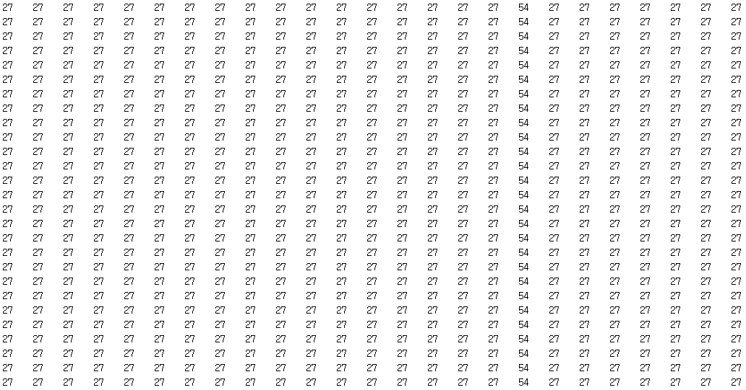
Appendix
The pattern of the gap between adjacent tones for the proposed 26 DRUs
Gap between j-th tone and j+1-th tone, j=1~25
Repetition of 27 except for 54 around DC
26 DRU_i
i=1~18, 20~28

Slide 18
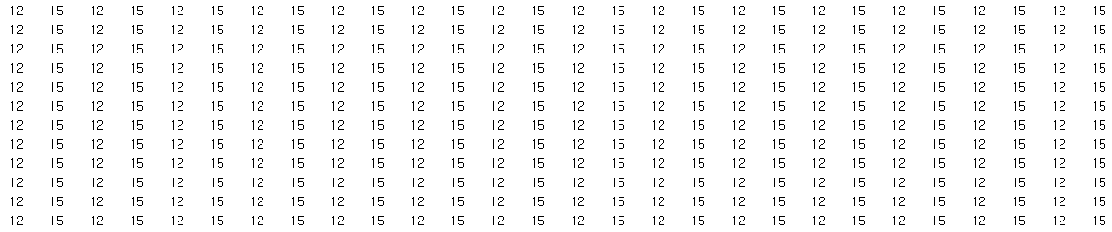
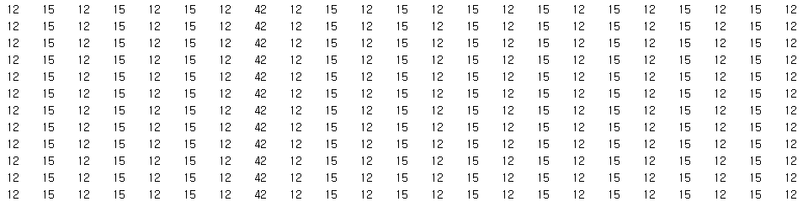
Appendix
The pattern of the gap between adjacent tones for the proposed 52 DRUs
Gap between j-th tone and j+1-th tone, j=1~51
Repetition of 12, 15 except for 42 around DC
52 DRU_i
i=1~12
52 DRU_i
i=1~12

Slide 19
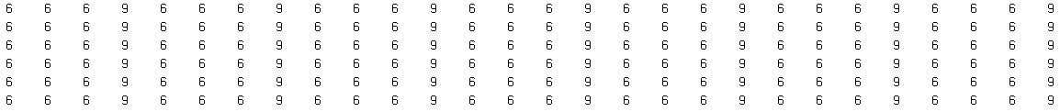
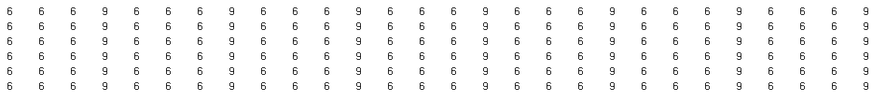
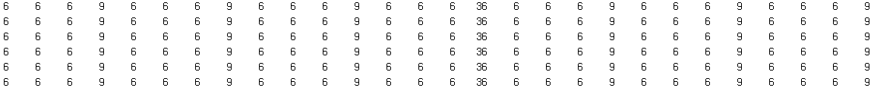
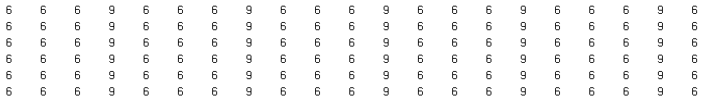
Appendix
The pattern of the gap between adjacent tones for the proposed 106 DRUs
Gap between j-th tone and j+1-th tone, j=1~105
Repetition of 6, 6, 6, 9 except for 36 around DC
106 DRU_i
i=1~6
106 DRU_i
i=1~6
106 DRU_i
i=1~6
106 DRU_i
i=1~6

Slide 20
Appendix
The pattern of the gap between adjacent tones for our proposed 242 DRUs
Repetition of 3 except for 30 around DC
Gap between j-th tone and j+1-th tone, j=1~241
242 DRU_i
i=1~3
…
242 DRU_i
i=1~3
…
242 DRU_i
i=1~3

Slide 21
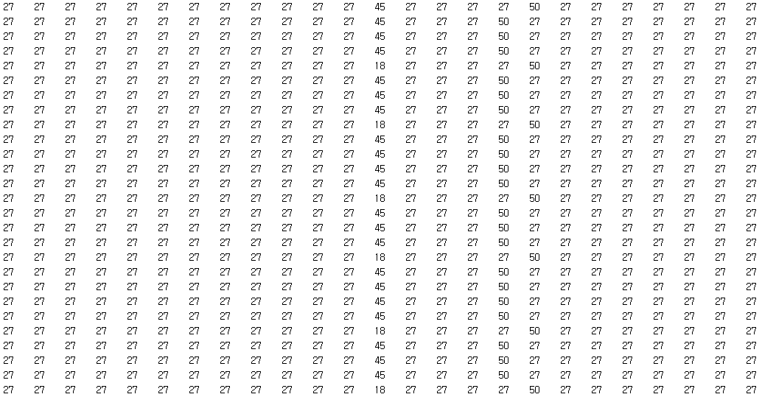
Appendix
The pattern of the gap between adjacent tones for 26 DRUs in [1]
Gap between j-th tone and j+1-th tone, j=1~25
There are irregular patterns besides the gap around DC
26 DRU_i
i=1~18, 20~28

Slide 22
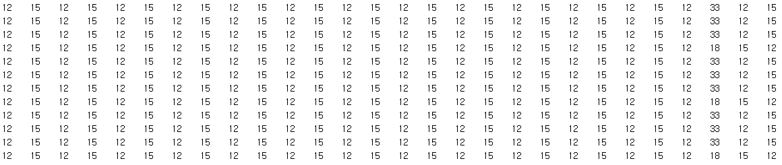
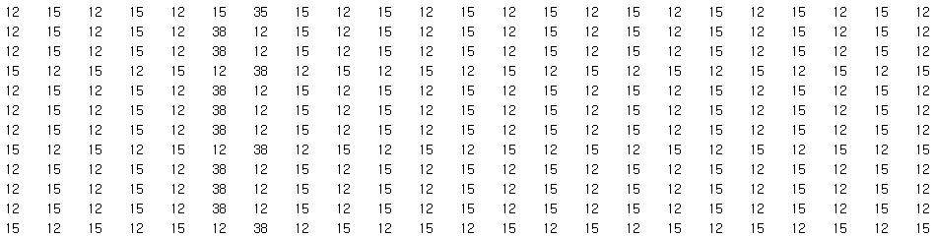
Appendix
The pattern of the gap between adjacent tones for 52 DRUs in [1]
Gap between j-th tone and j+1-th tone, j=1~51
There are irregular patterns besides the gap around DC
Pattern is reversed in some DRUs from a specific tone
52 DRU_i
i=1~12
52 DRU_i
i=1~12

Slide 23
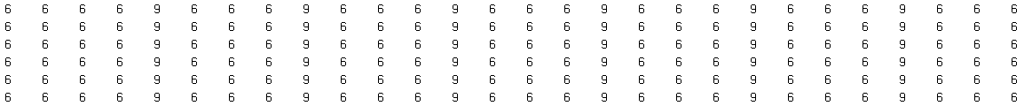
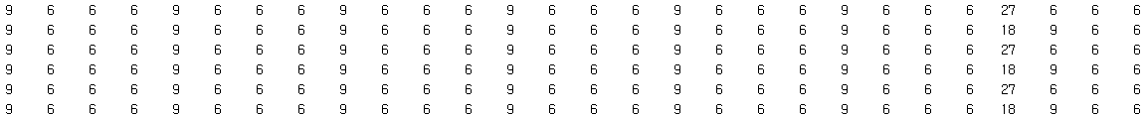
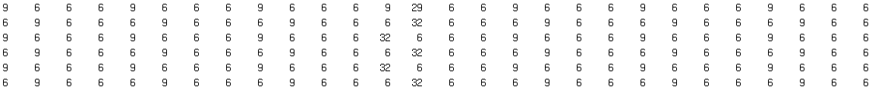
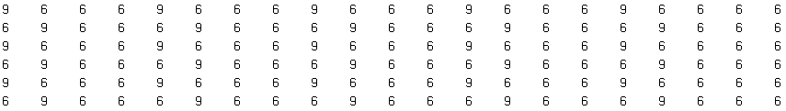
Appendix
The pattern of the gap between adjacent tones for 106 DRUs in [1]
There are irregular patterns besides the gap around DC
Pattern is shifted in some DRUs from a specific tone
Gap between j-th tone and j+1-th tone, j=1~105
106 DRU_i
i=1~6
106 DRU_i
i=1~6
106 DRU_i
i=1~6
106 DRU_i
i=1~6

Slide 24
Appendix
The pattern of the gap between adjacent tones for 242 DRUs in [1]
Gap between j-th tone and j+1-th tone, j=1~241
Repetition of 3 except for 26 around DC
242 DRU_i
i=1~3
…
242 DRU_i
i=1~3
…
242 DRU_i
i=1~3

