Slide 1
Discussion on Uplink Transmissions for Backscatter STAs
Jan. 2025
Date: 2025-01-13
Authors:
Name | Affiliations | Address | Phone | Email
Bin Qian | Huawei | Shenzhen, China |  | qianbin14@huawei.com
Lei Huang |  | Singapore
Panpan Li |  | Singapore
Notes:
September 2012

Slide 2
Introduction
Jan. 2025
Both mono-static and bi-static backscatter use cases have been previously discussed in [1-4]
  [1-2] analyzed the feasibility of backscatter use cases
  [3] proposed that the mono-static backscatter tag should share common or similar RF/hardware requirements as UHF RFID tags
  [4] proposed that the bi-static and mono-static backscatter tags could share similar basic requirements, with optional enhanced features (e.g., mixer, amplifier and larger energy storage)
This contribution discusses the uplink transmissions for backscatter STAs in both mono-static and bi-static deployments

Slide 3

Recap: Mono-static Backscatter Use Case
Jan. 2025
The DL PPDU is transmitted by the AP, with the Excitation field used for charging and backscattering
Self-interference occurs due to the direct leakage of the DL PPDU into the receiver
Self-interference mitigation: The 802.11 preamble or initial part of the Excitation field can be treated as reference symbols to estimate Tx-Rx leakage channel, enabling the subtraction of the leakage signal from the received signal

Slide 4
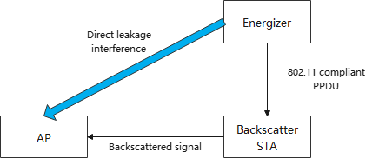
Recap: Bi-static Backscatter Use Case
Jan. 2025
The Energizer and AP are separated, resulting in half-duplex operation
The Energizer transmits an 802.11 compliant PPDU (e.g., 11b or 11n) to the backscatter STA
Bi-static backscatter is affected by direct leakage interference, where the direct signal can overpower the backscattered signal
The initial part of the 802.11 compliant PPDU could be treated as reference symbols, enabling the AP to estimate the leakage channel for interference compensation

Slide 5
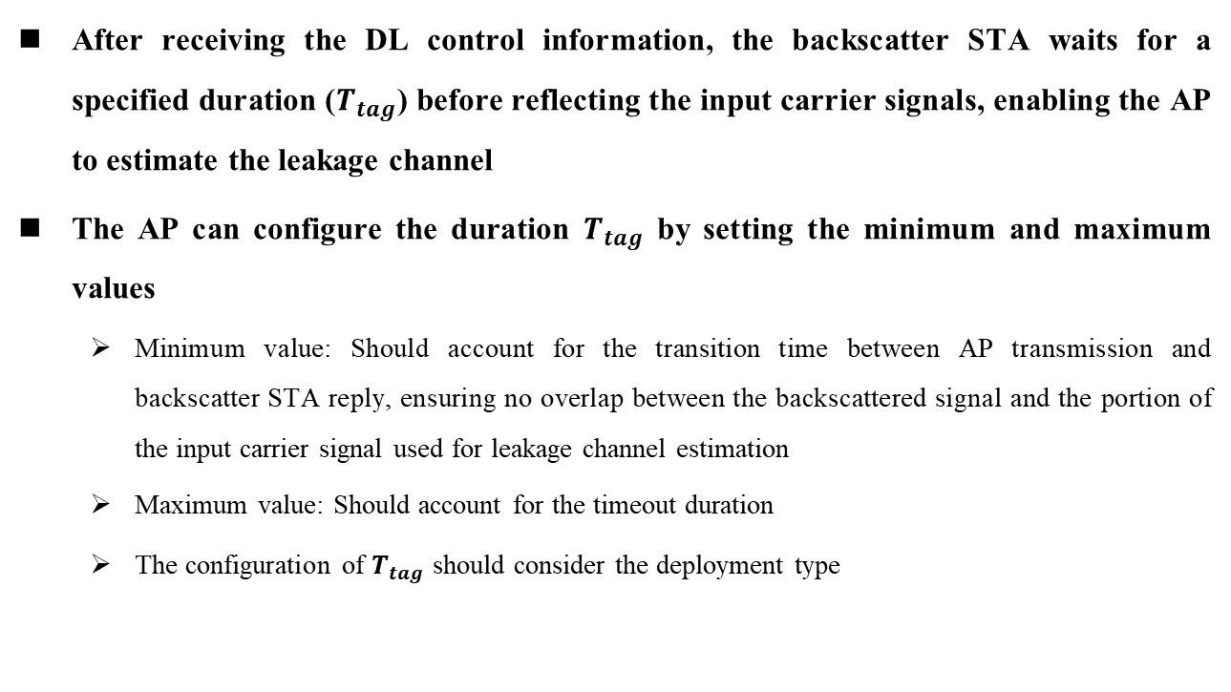
Link Timing
Jan. 2025
After receiving the DL control information, the backscatter STA waits for a specified duration ($T_{tag}$) before reflecting the input carrier signals, enabling the AP to estimate the leakage channel
The AP can configure the duration $T_{tag}$ by setting the minimum and maximum values
  Minimum value: Should account for the transition time between AP transmission and backscatter STA reply, ensuring no overlap between the backscattered signal and the portion of the input carrier signal used for leakage channel estimation
  Maximum value: Should account for the timeout duration
  The configuration of $T_{tag}$ should consider the deployment type

Slide 6
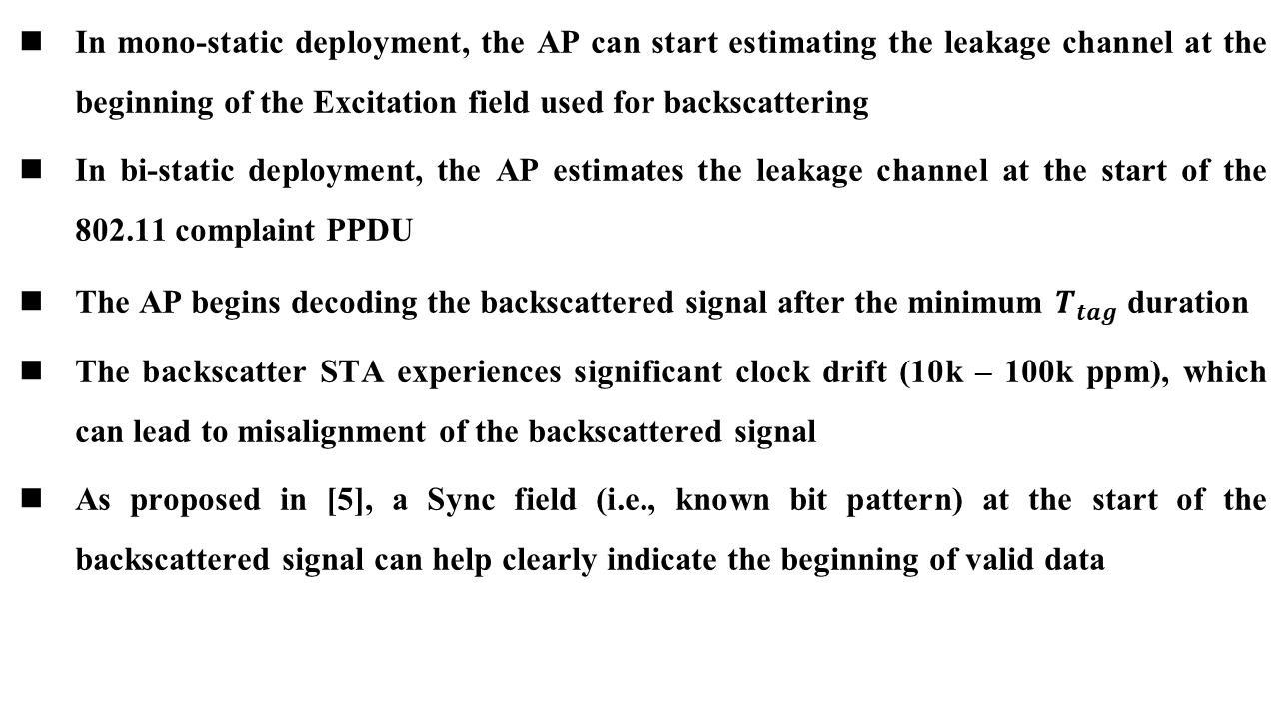
Start Time Synchronization for Backscatter Signals (1/3)
Jan. 2025
In mono-static deployment, the AP can start estimating the leakage channel at the beginning of the Excitation field used for backscattering
In bi-static deployment, the AP estimates the leakage channel at the start of the 802.11 complaint PPDU
The AP begins decoding the backscattered signal after the minimum $T_{tag}$ duration
The backscatter STA experiences significant clock drift (10k – 100k ppm), which can lead to misalignment of the backscattered signal
As proposed in [5], a Sync field (i.e., known bit pattern) at the start of the backscattered signal can help clearly indicate the beginning of valid data

Slide 7
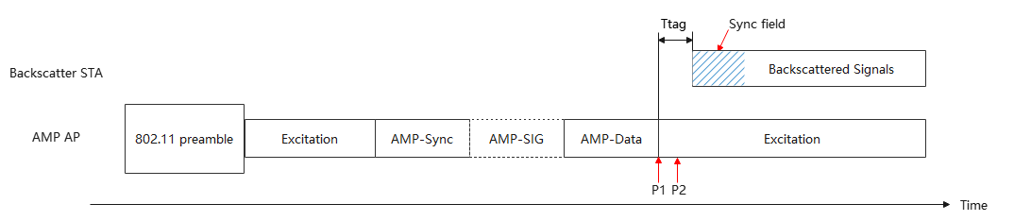

Start Time Synchronization for Backscatter Signals (2/3)
Jan. 2025
Mono-static
  P1: AP starts to estimate the leakage channel
  P2: AP starts to decode the backscattered signal
  The minimum value of $T_{tag}$ should be no less than the time interval between P1 and P2

Slide 8
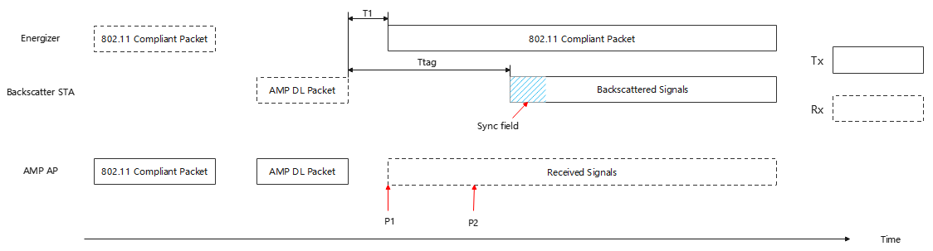

Start Time Synchronization for Backscatter Signals (3/3)
Jan. 2025
Bi-static
  P1: AP starts to estimate the leakage channel
  P2: AP starts to decode the backscattered signal
  The minimum value of $T_{tag}$ should be no less than the time interval between P1 and P2 plus T1, which is the interval between AMP DL packet transmitted by AMP AP and the 802.11 compliant packet transmitted by Energizer

Slide 9
UL Sync Field
Jan. 2025
Criteria for UL Sync field
  Includes invalid Manchester pattern (e.g., 3 continuous 1s or 0s) to signal the start of synchronization
  Ends with a valid Manchester pattern, marking the beginning of valid data
Example of the UL Sync field: 1 1 1 0 1 0
A pre-defined pilot tone could be added to the UL Sync field to assist the AP in phase synchronization and enhance signal detection, especially in bi-static deployment
[6] proposed two uplink data rates with Manchester encoding for backscatter uplink data transmission
  250 kbps: Chip duration = 2 us
  1 Mbps: Chip duration = 0.5 us
It is suggested that the chip duration of the UL Sync field aligns with the backscatter uplink data transmission to reduce STA complexity

Slide 10
Summary
Jan. 2025
A specific duration could be configured to allow the AP to estimate the leakage channel
The UL Sync field for backscatter STAs in both mono-static and bi-static deployment has been discussed
  The UL Sync field is used to mitigate clock drift and indicate the start of valid data
  The chip duration of the UL Sync field aligns with the backscatter UL data transmission

Slide 11
References
Jan. 2025
[1] 11-24-0798-01-00bp-close-range-amp-wifi-reader-feasibility-study-followup
[2] 11-24-1215-00-00bp-feasibility-study-on-long-range-backscatter-operation
[3] 11-24-1237-00-00bp-amp-tag-sta-requirements-for-close-range-backscattering
[4] 11-24-1731-01-00bp-downlink-data-rates-for-bi-static-backscatter
[5] 11-24-1214-02-00bp-carrier-ppdu-discussion-for-long-range-backscatter-operation
[6] 11-24-1798-00-00bp-backscattering-ul-data-rate-and-modulation

Slide 12
Straw Poll #1
Jan. 2025
Do you agree to add following content to TGbp SFD:
  IEEE 802.11bp specifies that the initial portion of the packet transmitted by the Energizer be used by the AP to estimate the leakage channel from the Energizer to the AP for bi-static backscatter in 2.4 GHz
    The duration of this initial portion is TBD

Slide 13
Straw Poll #2
Jan. 2025
Do you agree to add following content to TGbp SFD:
  IEEE 802.11bp defines a unified UL Sync field at the beginning of the backscattered signal for both mono-static and bi-static backscatter transmissions in 2.4 GHz
    The format of the UL Sync field is TBD

