Slide 1
Channel access for Active Tx non-AP AMP STAs
Date: 10 January 2025
Name | Affiliation | Address | Phone | Email
Rojan Chitrakar | Huawei | Singapore |  | rojan.chitrakar@huawei.com
Lei Huang
Ian Bajaj
Notes:
Jul 12, 2010
Page 1

Slide 2
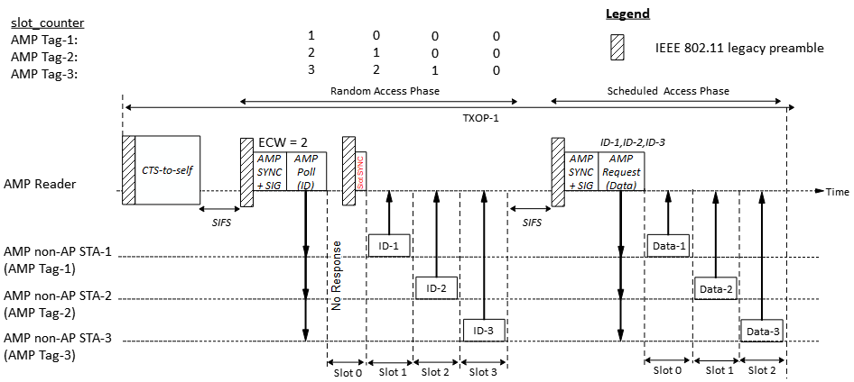
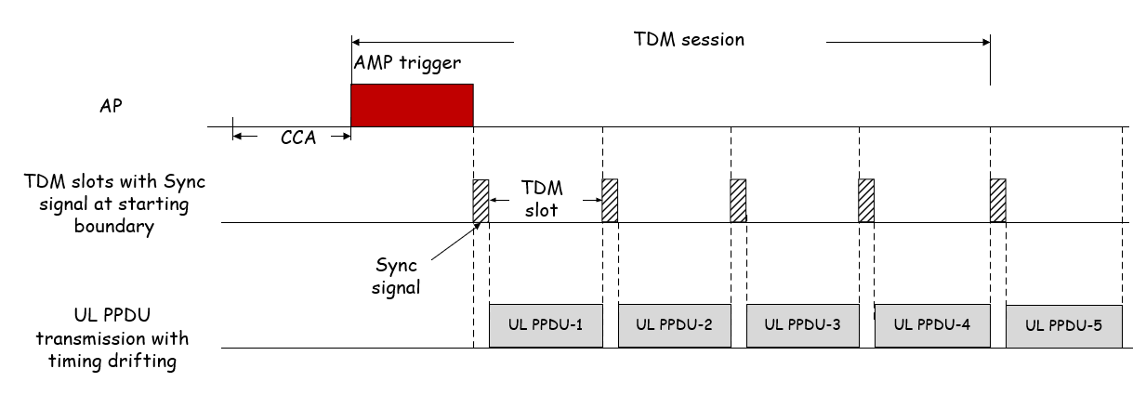
Recap: Time-slot based random access
Time-slot based channel access schemes for active Tx non-AP AMP STAs are discussed in [1], [2].
[1]
[2]
Slots Sync may be transmitted at slot boundaries to help the non-AP AMP STAs to align with the slots.
In this contribution we clarify the basic details of time-slot based channel access.

Slide 3
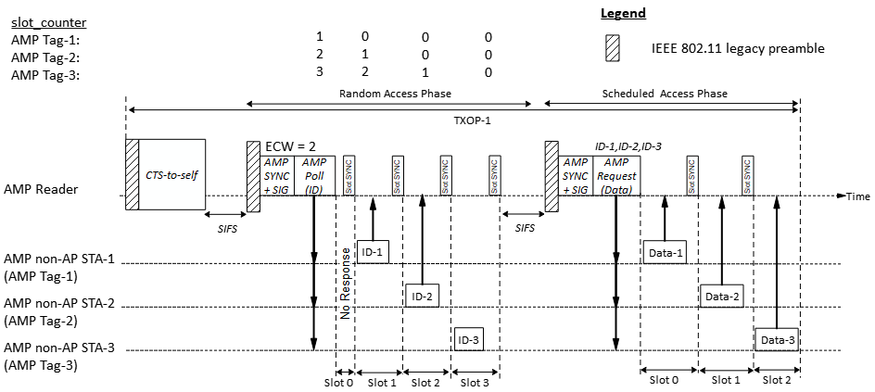
Time-slot based channel access
A time-slot based channel access may be based on random access or scheduled access. An AMP Reader initiates a random access when it is not aware of the identities of the non-AP AMP STAs in its coverage, while it uses the scheduled access to communicate with AMP STAs that are known to it. The random access phase can be omitted if the AMP Reader is already aware of the AMP tag’s IDs.

Slide 4
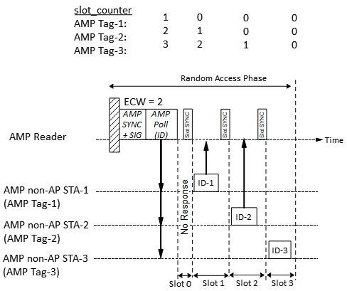
Time-slot based random access
Random access procedure:
1. The AMP Reader gains access to wireless medium and transmits a control frame (e.g., an AMP Poll frame) to start a random access session. The frame indicates:
Session ID: Identifies the random access session
The total number of random access slots = 2^{ECW}
Response Type (e.g., ID, Energy level, small data etc.)
2. Upon receiving an AMP Poll frame, a non-AP AMP STA randomly choose a slot_counter in the range [0, 2^{ECW} - 1]. If slot_counter is 0, the AMP STA transmits the requested response (e.g., ID).
3. The AMP Reader transmits a Slot Sync to indicate start of the next time-slot.
4. Upon receiving the Slot Sync, a non-AP AMP STA decrements its slot_counter (if larger than 0). If slot_counter is 0, the AMP STA transmits the request response (e.g., ID).

Slide 5
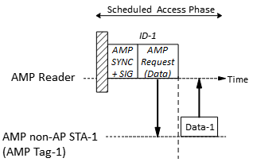
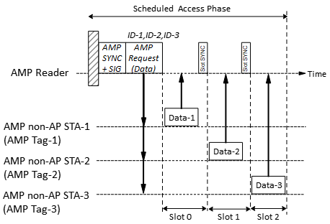
Time-slot based scheduled access
Scheduled access procedure:
1. The AMP Reader transmits a control frame (e.g., an AMP Request frame) assigning transmission time-slots to one or more non-AP AMP STAs. If two or more AMP STAs are scheduled, the first slot (slot 0) starts at the end of the AMP Request frame.
2. If an AMP STA receives an AMP Request frame addressed to itself or finds itself assigned a time-slot AMP Request frame, it transmits its response in the assigned time-slot.
3. The AMP Reader transmits a Slot Sync to indicate start of the next time-slot.

Slide 6

Slot Sync
An AMP Reader transmits a Slot Sync to indicate the start of the a time-slot. If there is no response in a time-slot within a pre-defined value, the AMP Reader may transmit the Slot Sync earlier to indicate an early start of the next time-slot.
To save air-time overhead, the Slot Sync should be as compact as possible. A unique AMP-SYNC sequence could be designed to be used as the Slot Sync.

Slide 7
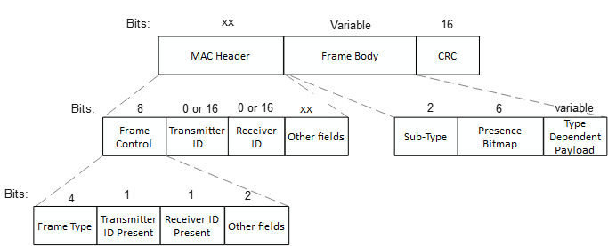
AMP frame
Similar to the views expressed in [3], [4], we propose that AMP frame be designed similar to WUR frames, only carrying the absolutely essential fields.
One AMP Frame Type (AMP Trigger) is used to initiate time-slot based channel access
Frame Type | Name | Description
0 | AMP Trigger | AMP frame to solicit a response from non-AP AMP STAs either during random access or scheduled access.
1 | AMP RFID | AMP frames used to encapsulate AMP RFID commands
2 – 15 | - | Reserved

Slide 8
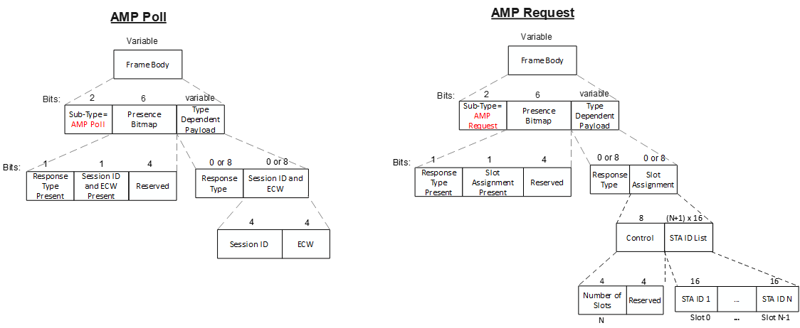
AMP Trigger frame
The parameters to be carried in the AMP Trigger frame will be different for random access and scheduled access. In order to keep the frames compact, we propose to define different sub-types of the AMP Trigger frame, e.g., AMP Poll for random access and AMP Request for scheduled access.

Slide 9
Summary
We discussed the details of the time-slot based channel access for active TX AMP STAs and propose:
  The time-slot based channel access may be based on random access or scheduled access.
  We propose to use an AMP DL PPDU without an AMP-Data field as the Slot Sync to indicate the start of the a time-slot.
  We propose to define different sub-types of the AMP Trigger frame, e.g., AMP Poll for random access and AMP Request for scheduled access.

Slide 10
SP 1
Do you agree to add to 11bp SFD:
802.11bp shall support a time-slot based channel access mechanism for Active Tx non-AP AMP STA?

Slide 11
SP 2
Do you agree that:
The time-slot based channel access mechanism for Active Tx non-AP AMP STA may be based on random access or may also be scheduled access?

Slide 12
References
[1] 24/1806r0, AMP time-based channel access for active tags (Rojan Chitrakar et. al.)
[2] 24/1776r1, Multiple access mechanisms for AMP (Chuanfeng He et. al.)
[3] 24/1811r0, Frame format discussion (Liwen Chu et. al.)
[4] 11-24/1537r2, Wireless connectivity challenges for AMP only IoT devices under 802.11 specification (Solomon Trainin)

