Slide 1
Channel access for Backscatter non-AP AMP STAs
Date: 10 January 2025
Name | Affiliation | Address | Phone | Email
Rojan Chitrakar | Huawei | Singapore |  | rojan.chitrakar@huawei.com
Lei Huang
Ian Bajaj
Notes:
Jul 12, 2010
Page 1

Slide 2
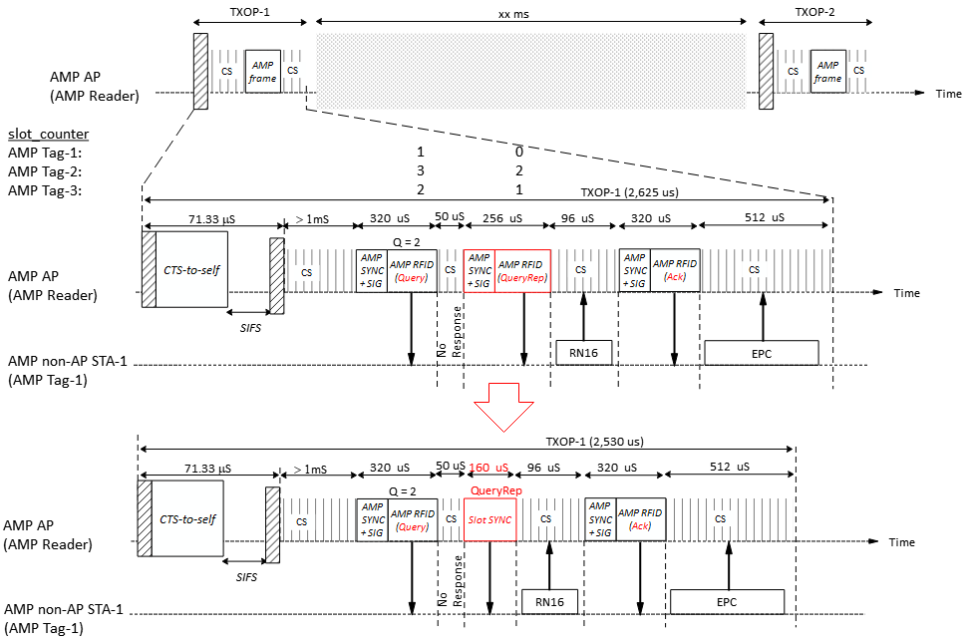
Recap: Channel Access for Backscatter AMP tags
[4] Provides a very good summary of the UHF RFID protocol.
In [1], [2] we shared that for backscatter AMP tags, the channel access protocol can be much simplified by reusing the logical interface of the UHF RFID Standard [3]:
AMP frames from the AMP Reader encapsulates UHF commands.
AMP tags process the UHF commands and respond as per logical interface specified by the UHF RFID standard [3].
Some optimization may be made to improve the air-time efficiency: e.g., the QueryRep UHF command may be replaced by a shorter transmission (Slot SYNC) instead of being encapsulated within a AMP frame.
In this contribution, we will discuss some relevant details of the UHF RFID standard.

Slide 3
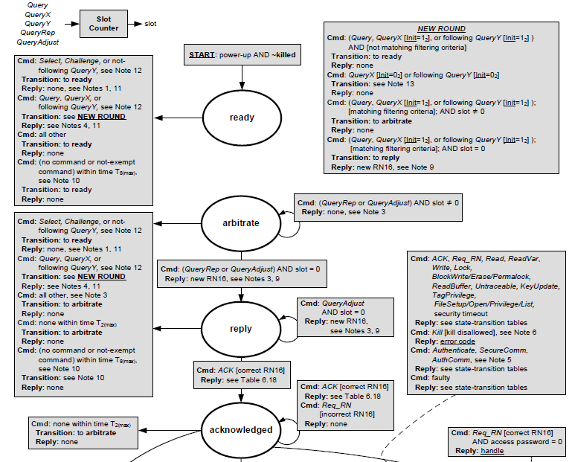
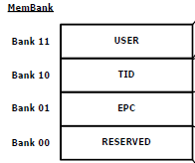
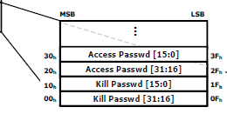
Logical Interface of the UHF RFID Standard [3], [4] - 1
The logical interface between an Interrogator and a Tag may be viewed as the lowest level in the data link layer of a layered network communication system. The logical interface defines Tag memory, flags, states, selection, inventory, and access. [3]
Sessions and flags: 1) Inventoried flags for S0, S1, S2, S3 sessions; 2) Selected flag (SL)
Tag States:
Memory Bank

Slide 4
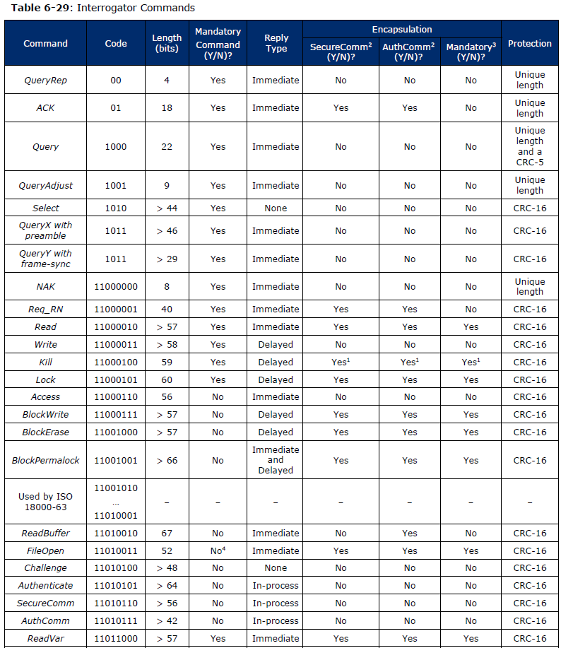


Logical Interface of the UHF RFID Standard [3], [4] - 2
3 sets of Interrogator Commands are defined:
  Select commands: the select command set comprises Select and Challenge.
  Inventory commands: The inventory command set comprises Query, QueryX, QueryY, QueryAdjust, QueryRep, ACK, and NAK.
  Access commands: The access command set comprises Req_RN, Read, ReadVar, Write, Lock, Kill, Access, BlockWrite, BlockErase, BlockPermalock, Authenticate, ReadBuffer, SecureComm, AuthComm, KeyUpdate, Untraceable, FileOpen, FileList, FilePrivilege, FileSetup, and TagPrivilege.
Tag replies are defined for some commands. E.g.,:
  Tag reply to a Query command:
  Tag reply to a Req_RN command:

Slide 5
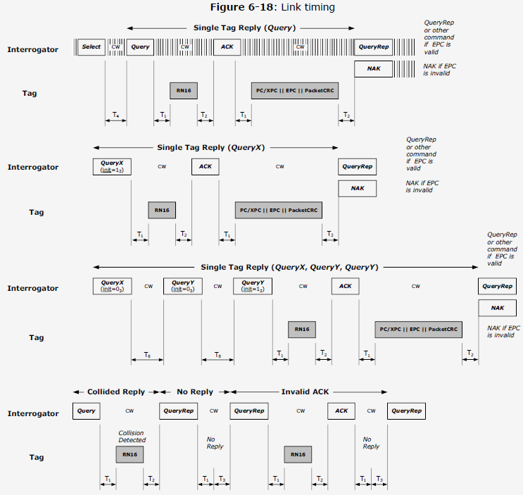
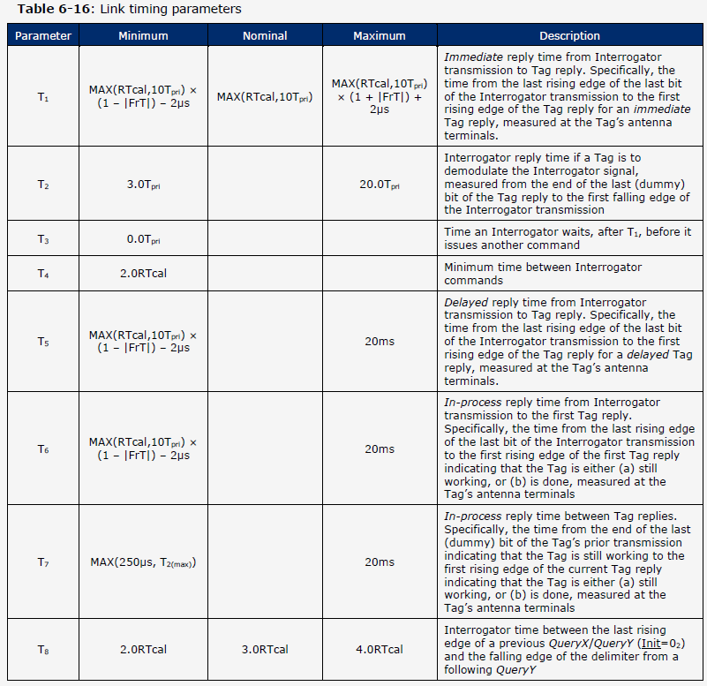
Link Timings in UHF RFID Standard [3] - 1
The Physical interface of the UHF RFID standard defines timing requirements (Table 6-16) that tags and interrogators need to meet.

Slide 6
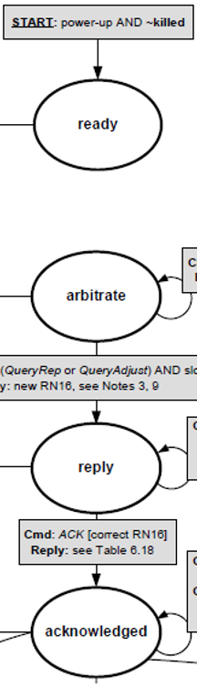
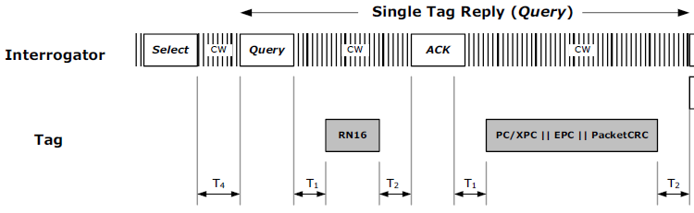
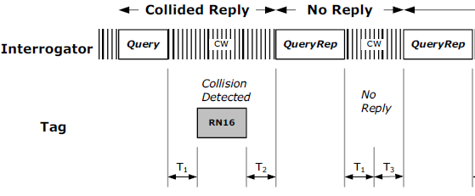
Link Timings in UHF RFID Standard [3] - 2
Some of the link timing requirements are tied to the tag’s state transitions. E.g.,
T₁ timings:
If the reader doesn’t get an response within T₁, the reader assumes that there is no reply and may transmit another command (e.g., QueryRep).
T2 timings:
For a tag in the reply or acknowledged states, if T₂ expires without the Tag receiving a valid command, the tag shall transition to the arbitrate state.
This implies that the backscatter non-AP AMP STAs need to be aware of the various link timings.

Slide 7
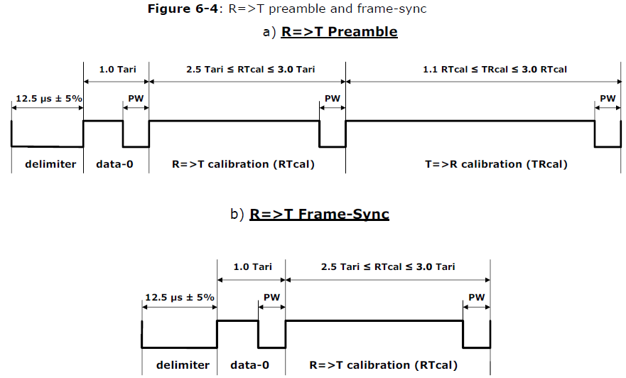
Link Timings in UHF RFID Standard [3] - 3
The UHF link timings are expressed in terms of RTcal and T_{pri}. T_{pri} is the T=>R link period (Tpri = 1 / BLF = TRcal/DR).
For UHF tags, RTcal and TRcal are signaled by the Reader either in the R=>T Preamble or the R=>T Frame-Sync, while DR (Divide Ratio) is signaled in the Query or QueryX UHF command.
However, preamble of the downlink control signal for backscatter non-AP AMP STAs are not expected to signal RTcal and TRcal.
=> Link timing information (e.g., RTcal and TRcal) may need to be carried in the DL control frame for backscatter non-AP AMP STAs.
Alternatively, the link timing parameters may be tied to related AMP PHY parameters (e.g., UL data rate, DL data rate etc.) or fixed by the AMP standard.

Slide 8
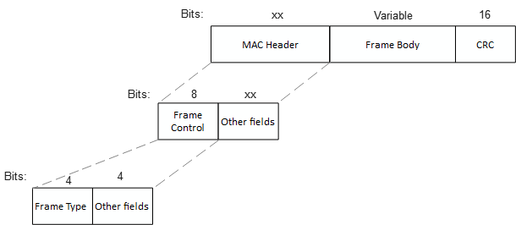
AMP frame
Similar to the views expressed in [5], [6], we propose that AMP frame be designed similar to WUR frames, but only carrying the absolutely essential fields.
One AMP Frame Type (AMP RFID) is used to encapsulate the UHF Commands.
Frame Type | Name | Description
0 | AMP Trigger | AMP frame to solicit a response from non-AP AMP STAs either during random access or scheduled access.
1 | AMP RFID | AMP frames used to encapsulate AMP RFID commands
2 – 15 | - | Reserved

Slide 9
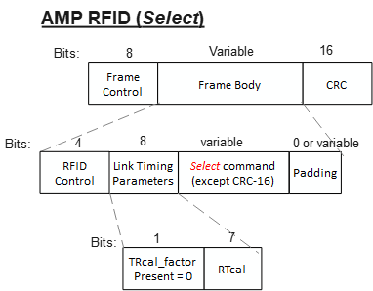
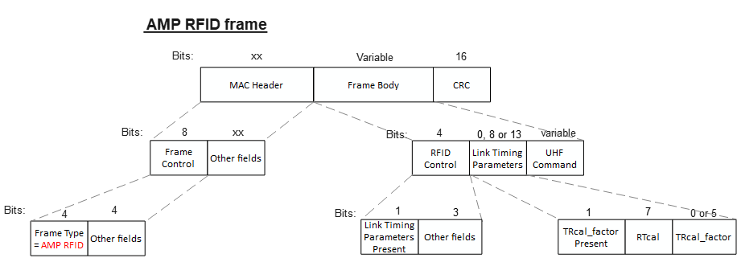
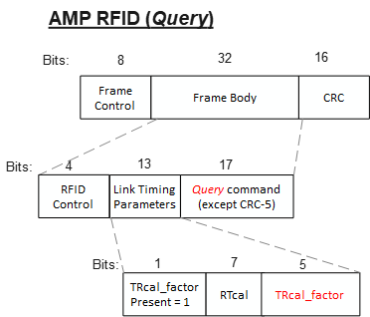
AMP RFID frame - 1
Example frames:
AMP RFID frame carries the UHF command in the Frame Body field and optionally includes the Link Timing Parameters field to signal RTcal and if applicable, the TRcal. TRcal can be expressed in terms of RTcal to save bits. TRcal = RTcal * TRcal_factor.
The link timing parameters can be omitted if they are tied to related AMP PHY parameters.

Slide 10
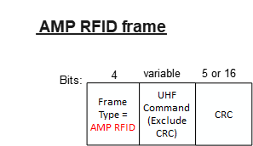
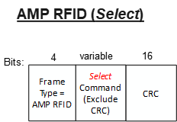
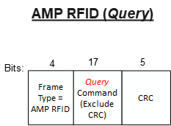
AMP RFID frame - 2
The link timing parameters can be omitted if they are tied to related AMP PHY parameters and the frame can be made very compact (for example with just a Frame Type field to differentiate from other AMP frames => AMP RFID frames are only 4 bits larger than the encapsulated UHF commands).
Example frames:

Slide 11
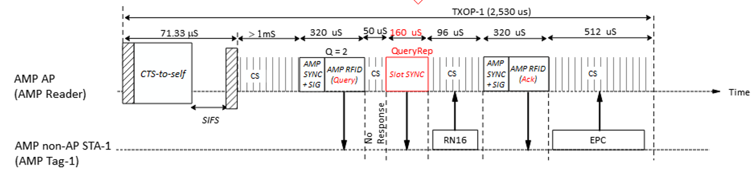
Slot Sync
Instead of the QueryRep UHF command, an AMP Reader transmits a Slot Sync (to get the non-AP AMP STAs to decrement the slot counter). If there is no response in a time-slot, the AMP Reader may transmit the Slot Sync earlier to indicate an early start of the next time-slot.
To save air-time overhead, the Slot Sync should be as compact as possible. A unique AMP-SYNC sequence could be designed to be used as the Slot Sync.

Slide 12
Summary
We proposed that the logical interface of the UHF protocol is reused for backscatter non-AP AMP STAs (using 802.11 frames that encapsulates UHF commands).
  Some optimization may be made to improve the air-time efficiency.
We also discuss some relevant details of the UHF RFID standard, specifically the link timing related aspects.
We also discussed a potential format for AMP frames and proposed that one AMP Frame Type (AMP RFID) is used to encapsulate the UHF Commands.
An AMP RFID frame carries the UHF command in the Frame Body field and may also include parameters required to compute the link timing requirements.

Slide 13
SP 1
Do you agree to add to the 11bp SFD:
11bp shall reuse a sub-set of the logical interface of the UHF RFID Standard for backscattering communication.
Applicable UHF commands are encapsulated in 802.11 frames.
Applicable to both mono-static & bi-static backscattering.
The sub-set of the logical interface to be reused is TBD.
NOTE – The logical interface of the UHF RFID Standard is defined by the EPC® Radio-Frequency Identity Generation-2 UHF RFID Standard.

Slide 14
References
[1] 24/0836r0, Thoughts on AMP RFID tags (Rojan Chitrakar et. al.)
[2] 24/1805r0, AMP time-based channel access discussion (Rojan Chitrakar et. al.)
[3] EPC® Radio-Frequency Identity Generation-2 UHF RFID Standard V3.0 (GS1)
[4] 24/722r0, Introduction to passive sub-1GHz RFID systems (Franz Amtmann)
[5] 24/1811r0, Frame format discussion (Liwen Chu et. al.)
[6] 11-24/1537r2, Wireless connectivity challenges for AMP only IoT devices under 802.11 specification (Solomon Trainin)

