Slide 1
Thoughts on Context Transfer in Seamless Roaming
Date: 2025-02-05
Authors:

Slide 2
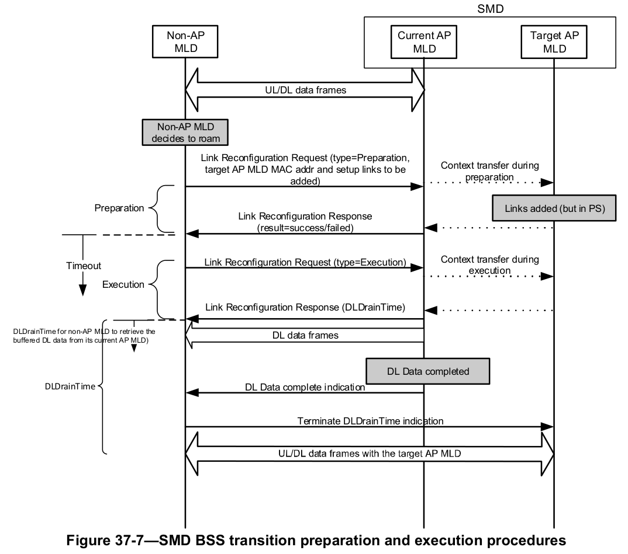
Introduction
In 11bn seamless roaming (ST), context can be transferred to target AP MLD to reduce overhead
Static context: BA parameters, SCS/MSCS, …
Dynamic context: SN, …
Context can also be renegotiated with target AP MLD
Context transfer/renegotiation can happen in different roaming phases
Static context can be transferred/renegotiated in both preparation phase and execution phase
Dynamic context can be transferred in execution phase
In this contribution, we discuss several aspects of context transfer and renegotiation

Slide 3
Ping-pong roaming problem
In some scenarios, non-AP MLD may roam between two AP MLDs back and forth
e.g., AP MLD’s signal fluctuates around roaming threshold
It is difficult to completely avoid ping-pong roaming from happening
Non-AP MLD may realize it only after roaming between two AP MLDs a few times
Context needs to be transferred or negotiated every time
Results in additional overhead
If ping-pong roaming happens, how to reduce this overhead?

Slide 4
Context preserve by current AP MLD
To minimize context to be transferred or renegotiated in ping-pong roaming scenario, we propose:
Current AP MLD preserves context of non-AP MLD within a timeout period after roaming is completed or retrieval of buffered DL data is finished
Including BA, SCS/MSCS, ...
Setup links between current AP MLD and non-AP MLD can also be preserved
Context preserve timeout can be the ST timeout
Overhead of preparation phase is reduced if non-AP MLD decides to roam back to current AP MLD within the timeout

Slide 5
Context transfer indication
By default, non-AP MLD may assume context transfer from current AP MLD to target AP MLD is successful
However, target AP MLD may reject some transferred context due to limited capability
Non-AP MLD can indicate whether/what context needs to be transferred
Context transfer result needs to be indicated to non-AP MLD in roaming response
In this way, non-AP MLD knows which context is maintained and which needs renegotiation
Target AP MLD can provide context suggestion for rejected context
e.g., SCS parameters recommended by target AP MLD
Non-AP MLD can use it for efficient renegotiation

Slide 6
Roaming timeout update
After roaming preparation is completed, non-AP MLD needs to initiate roaming execution within a timeout
the timeout is between roaming preparation response and execution request
to avoid target AP MLD reserving resources for non-AP MLD for a long time
However, non-AP MLD might not be able to initiate roaming within the timeout
e.g., due to DUO, OBSS interference, fluctuating signal strength, etc.
Non-AP MLD may want to extend the timeout, to avoid overhead of repeating roaming preparation
Or early terminate roaming, to release reserved resources at target AP MLD
A mechanism can be defined for non-AP MLD to request updating roaming timeout
Allows non-AP MLD to flexibly adjust roaming timeout based on its needs

Slide 7
Conclusion
In this contribution, we have discussed several aspects of context transfer and renegotiation in seamless roaming
To reduce overhead in some roaming scenarios, we propose
Current AP MLD preserves context about non-AP MLD within a timeout after roaming is completed or retrieval of buffered DL data is finished
Context transfer result is indicated to non-AP MLD, optionally with suggestions by target AP MLD
Non-AP MLD can request to update timeout for initiate roaming

Slide 8
References
11-24-0052-00-00bn-seamless-roaming-details
11-24-0349-03-00bn-enhanced-fast-bss-transition
11-24-0396-02-00bn-seamless-roaming-within-a-mobility-domain-follow-up
11-24-0480-00-00bn-details-on-context-transfer-and-data-forwarding-under-ft-protocol
11-24-0679-01-00bn-thoughts-on-functionality-and-security-architecture-for-uhr-seamless-roaming
11-24-0830-00-00bn-improve-roaming-between-mlds-follow-up
11-24-0881-00-00bn-improving-stability-during-roaming-process
11-24-1425-00-00bn-considerations-for-context-transfer-in-11bn
11-24-1746-01-00bn-comparision-between-enhanced-fast-bss-transition-and-smd
11-24-1824-00-00bn-discussion-on-context-transfer-in-seamless-roaming
11-24-1883-00-00bn-seamless-roaming

