Slide 1
Mobile Wi-Fi
Date: Jan 2025
Authors:
Name | Affiliation | Address | Phone | Email
Steve Arendt | CableLabs |  |  | s.arendt@cablelabs.com
Lili Hervieu |  |  |  | l.hervieu@cablelabs.com

Slide 2



Introduction
What is Mobile Wi-Fi? A way to do AP-AP roaming without breaking the current Wi-Fi session.
1.
2.
3.

Slide 3

Same AP-AP Roaming Can Work For Vehicles
1.
2.
3.

Slide 4
Don’t We Already Have AP-AP Roaming?
“Sticky Client”: Client stays associated to an AP even if better AP available
Other Roaming issues:
“Edge of Coverage”: Client stays connected to Wi-Fi even if signal strength is too low and there is a cellular network available
“Sub-Optimal Band”: Client stays on a particular band even when there is a more appropriate band available (e.g. 2.4 when should be on 5, or vice versa)

Slide 5
This Is Not A New Problem
Many attempts to improve roaming over 10+ years
  802.11r (2008) –Fast BSS Transition
    Shorten the time to re-authenticate when moving AP
  802.11k (2008) – Radio Resource Measurement
    “Assisted Roaming”
    Neighbor report to help choose next AP based on RSSI and load
  802.11v (2011) BSS Transition
    Unsolicited/Solicited roaming request
  802.11ai (2016)
    Fast Initial Link Setup
  802.11u (2011)
    Automatic discovery of networks (HotSpot 2.0/Vantage)
  Vantage/Agile Multiband
    802.11r/k/v/u
  Vantage/Optimized Connectivity
    802.11k/ai
  802.11 bn (coming)
None of these fix the underlying problem: The phone struggles to maintain optimal Wi-Fi connection, and functionality varies by phone.

Slide 6
What’s the Real Problem?
Clients are responsible for choosing when to go to another AP or band and often don’t do a good job of Wi-Fi roaming.
Clients often stick with what they know
  Connectivity is “good enough”, don’t risk switching (reassociation delay/failure = risk)
  Stay with what they know – don’t risk changing
  Clients may not have full visibility into network
  Phones often stick to using Wi-Fi over cellular, even when Wi-Fi is the worst choice (very low throughput)
Consumer has bad experience: unresponsive phone -> turn Wi-Fi off

Slide 7
Mobile Wi-Fi / vBSS Technology
Converts APs into a managed, virtualized Wi-Fi Radio Access Network (RAN)
  The client associates with its own virtualized BSS
  When a client moves, its virtualized BSS moves with it, no reassociation is needed
  No more need for client steering to try to force a client to roam
  Similar in spirit to cellular network
Does not require any changes to client devices: no apps, no connection manager modifications, no VPNs

Slide 8
Controller
VBSS
(Assoc. Context)
AP1
AP2
Radio 1
Radio 2
Radio 1
Radio 2
Normal BSS
Normal BSS
Normal BSS
Normal BSS
VBSS
(Assoc. Context)
Normal BSS
Normal BSS
Normal BSS
VBSS
(Assoc. Context)
Normal BSS
Normal BSS
VBSS
(Assoc. Context)
Normal BSS
Normal BSS
Normal BSS
Mobile Client
8

Slide 9

Example Throughput
AP1
AP2
Throughput Mobile Wi-Fi
Throughput Traditional
“Bad Wi-Fi”
Position

Slide 10
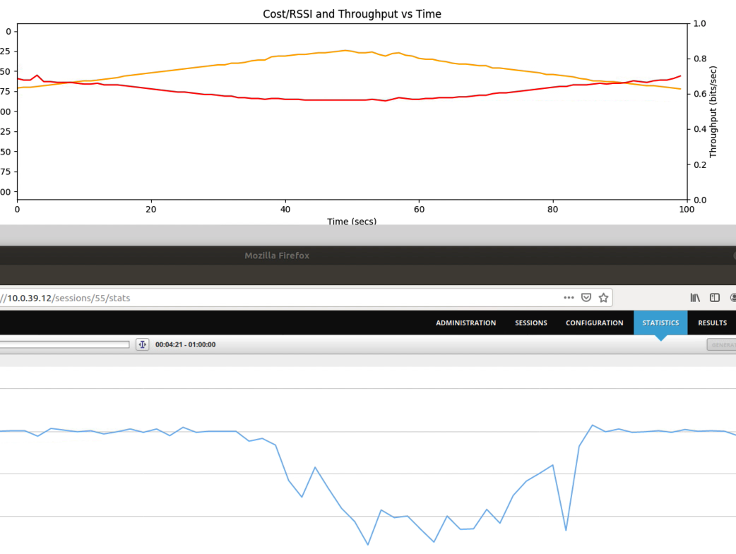
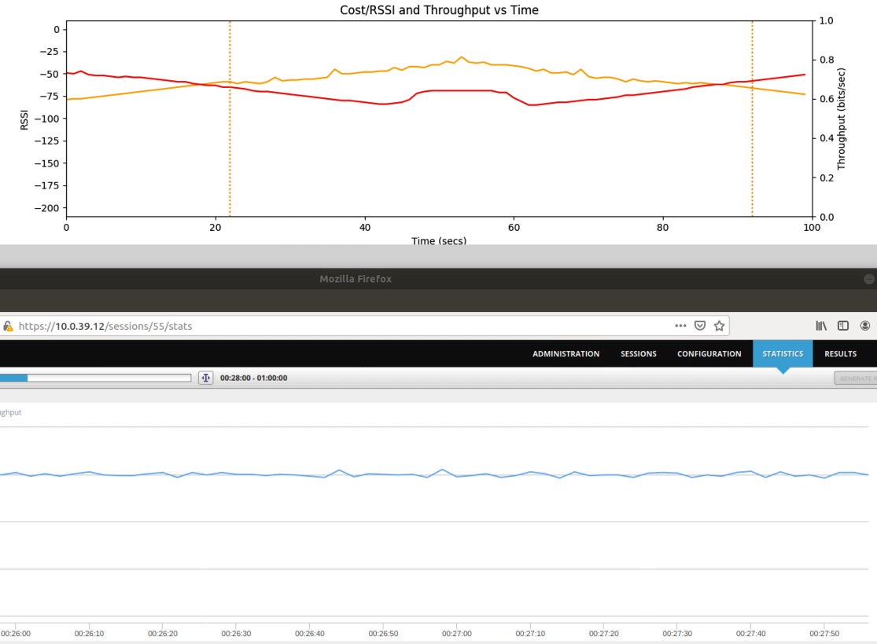

How Well Does It Work?
Actual High-End Phone without Mobile Wi-Fi
Actual High-End Phone with Mobile Wi-Fi
RSSI to Red and
YellowAPs
NO Drop in throughput
Drop in throughput

Slide 11
Current State of Project
Concept developed and prototyped at CableLabs -- 2018
WFA EasyMesh R5 spec contribution for Mobile Wi-Fi submitted, approved, and released (2021 - 2022).
Mobile Wi-Fi implemented in prplMesh open-source EasyMesh codebase (2022-2023).
Currently working on RDK-B implementation (2024) – RDK-B is an open-source software platform that standardizes core functions used in broadband home network devices.

Slide 12
Automotive Possibilities
Seamless Wi-Fi connectivity for vehicles via
  Community-wide Wi-Fi networks
  Municipal Wi-Fi networks
  Automotive-specific Wi-Fi networks
  Campus Wi-Fi networks
Automotive users:
  Service vehicle fleets
  Delivery vans
  Public transit

