Slide 1
Discussion on Transmission of PE in ELR PPDU
Date: 2025-01-12
Authors:
Name | Affiliation | Address | Phone | email
Ke Zhong | Ruijie Networks Co., Ltd. |  |  | zhongke@ruijie.com.cn
Fachang Guo

Slide 2
Abstract
Introduction
Recap
Discussion on transmission of PE in ELR PPDU
Conclusion

Slide 3
Introduction
In PAR of P802.11bn, the Ultra High Reliability (UHR) capability has been defined to improve Rate-vs-Range enhancement, reduce latency, and reduce power consumption for AP, compared to Extremely High Throughput (EHT) MAC/PHY operation [1].
To address the Tx power imbalance issue between downlink and uplink (about 10dB or so), Enhanced Long Range (ELR) has been investigated in UHR study group since the beginning of 802.11bn. The motion for PPDU frame format for ELR was passed in the November 2024 Plenary meeting. The detail of the motion is as follows [2]:
  Move to add to the TGbn SFD the following:
  11bn defines the following PPDU frame format for ELR
    PE TBD
As we can see from the above passed motion that packet extension (PE) in ELR PPDU is still TBD. In this contribution, the transmission of PE in ELR PPDU is discussed.

Slide 4
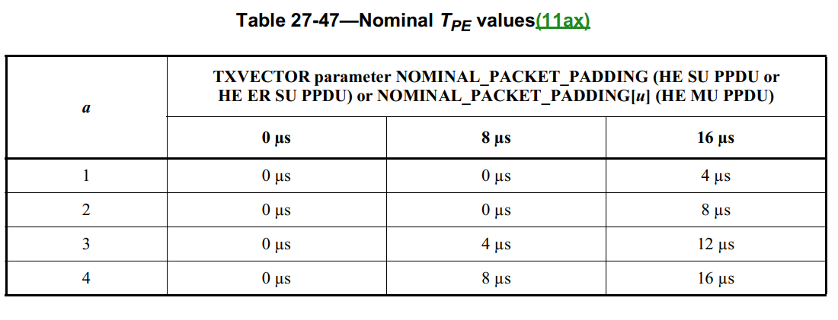
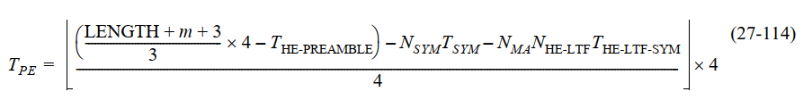
Recap: PE in an HE PPDU
A PE field of duration 0 µs, 4 µs, 8 µs, 12 µs, or 16 µs is present in an HE PPDU.
The PE field provides additional receive processing time at the end of the HE PPDU.
The PE field, if present, shall be transmitted with the same average power as the Data field and shall not cause significant power leakage outside of the spectrum used by the Data field. Other than that, its content is arbitrary.
In an OFDMA HE PPDU, the spectrum used by the Data field for the purpose of packet extension is commensurate with the locations and sizes of the occupied RUs, not the PPDU bandwidth.
The duration of the PE field for an HE SU PPDU, HE ER SU PPDU, or HE MU PPDU is determined by both the pre-FEC padding factor value in the last OFDM symbol(s) of the Data field and the TXVECTOR parameter NOMINAL_PACKET_PADDING.
If transmitting an HE TB PPDU for which the TXVECTOR parameter TRIGGER_METHOD is TRIGGER_FRAME, each transmitter of an HE TB PPDU shall append a PE field with a duration TPE calculated using Equation (27-114)

Slide 5
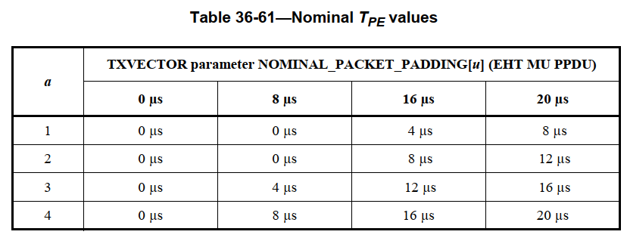
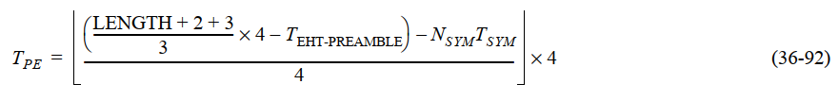
Recap: PE in an EHT PPDU
A PE field of duration 0 µs, 4 µs, 8 µs, 12 µs, 16 µs, or 20 µs is present in an EHT PPDU. A PE field of duration 20 µs is only allowed in the following cases:
  — an EHT MU PPDU with at least one participating STA being modulated with 4096-QAM,
  — a 320 MHz EHT MU PPDU if the size of one of the allocated RU or MRU is greater than 2×996,
  — an EHT TB PPDU
A non-AP EHT STA shall support transmission of an EHT TB PPDU with a PE field of duration up to 20 µs, and reception of an EHT MU PPDU with a PE field of duration up to 20 µs.
The PE field, if present, shall be transmitted with the same average power as the Data field. Other than that, its content is arbitrary.
The spectrum used by the PE field shall be commensurate with the locations and sizes of the occupied RU(s) or MRU(s) in the Data field to minimize power leakage outside of the spectrum used by the Data field.
The duration of the PE field for an EHT MU PPDU is determined by both the pre-FEC padding factor value in the last OFDM symbol of the Data field, and the TXVECTOR parameter NOMINAL_PACKET_PADDING as described in 35.13 (Nominal packet padding values selection rules).
If transmitting an EHT TB PPDU for which the TXVECTOR parameter TRIGGER_METHOD is TRIGGER_FRAME, each transmitter of an EHT TB PPDU shall append a PE field with a duration calculated using Equation (36-92).

Slide 6
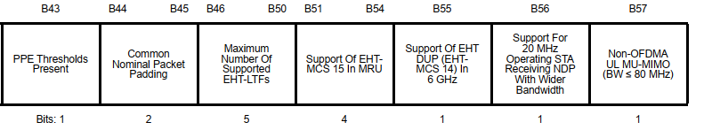
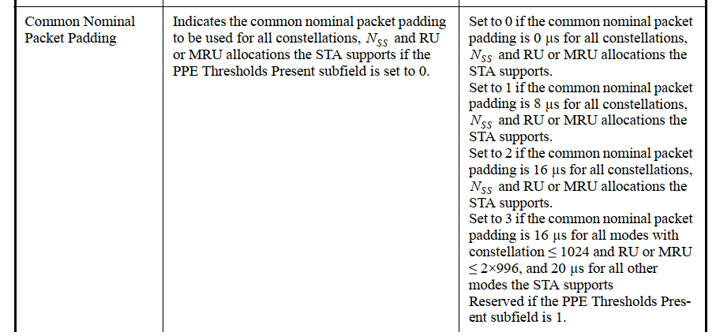
Recap: Current PE considerations in ELR PPDU [3],[4]
In [3], the pre-FEC padding factor value in the last OFDM symbol of the ELR-Data field, is proposed to be fixed (e.g., a_factor = 4 in Table 27-47 in HE and Table 36-61 in EHT) to reduce signalling overhead.
In [4], for ELR PPDU it further suggests to define T_PE = 8µs to accommodate more Rx support (i.e., for all constellations, NSS and RU allocations in ELR) considering that a_factor = 4. This T_PE = 8µs is claimed to be enough for the maximum 3.33Mb/s target data rate for ELR PPDU.
EHT PHY Capabilities Information field format
Subfield of the EHT PHY Capabilities Information field

Slide 7
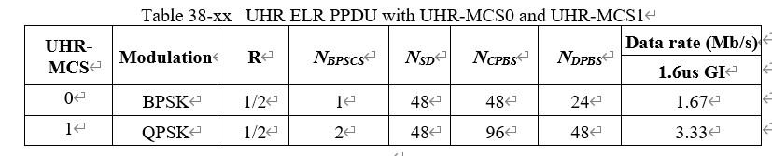
Discussion on transmission of PE in ELR PPDU
Based on PE in HE and EHT as well as current PE considerations in ELR PPDU ([3] and [4]), the following PE parameters are suggested for PE transmission in ELR PPDU:
 | Suggested PE parameters in ELR PPDU
Transmission power | The PE field in ELR PPDU shall be transmitted with the same average power as the ELR-Data field
Duration of the PE field | Follow [3] and [4] for both uplink and downlink, i.e., T_PE = 8µs (Common Nominal Packet Padding is fixed to 1) Note: A UHR ELR PPDU is applicable for 2.4 GHz, 5 GHz, and 6 GHz bands in uplink, and only for 2.4 GHz in downlink. A UHR ELR PPDU is defined only for 20 MHz PPDU bandwidth, a single spatial stream and UHR-MCSs 0 and 1 with four times frequency domain duplication over 52-tone regular RUs (RRU52s or 52-tone RRUs) in primary 20 MHz channel [5].

Slide 8
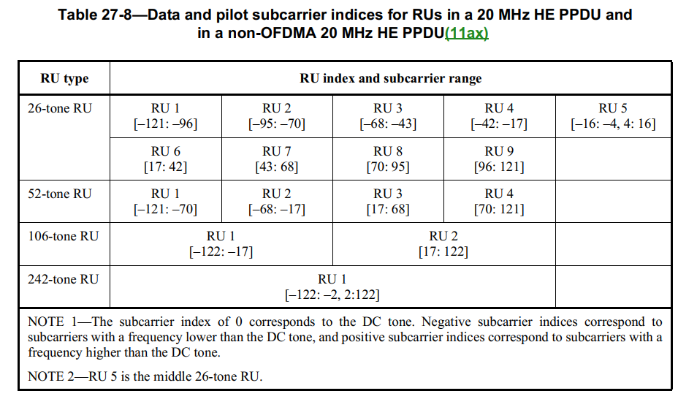
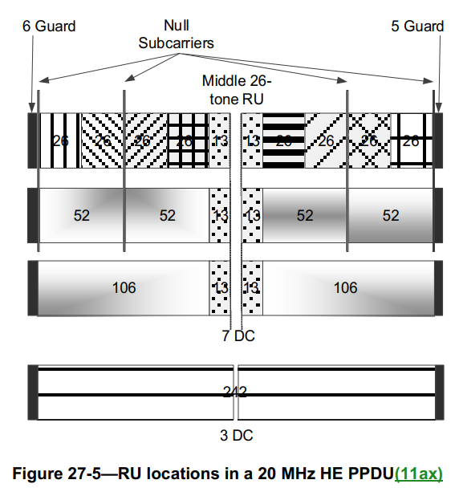
Discussion on transmission of PE in ELR PPDU - continued
Based on PE in HE and EHT as well as current PE considerations in ELR PPDU ([3] and [4]), the following PE parameters are suggested for PE transmission in ELR PPDU:
 | Suggested PE parameters in ELR PPDU
The spectrum used by the PE field | 20MHz or approximately 20MHz wide Note: A UHR ELR PPDU is defined only for 20 MHz PPDU bandwidth, with four times frequency domain duplication over 52-tone regular RUs (RRU52s or 52-tone RRUs) in primary 20 MHz channel [5]. The example in EHT spec: for a 20 MHz OFDMA EHT PPDU, if the occupied RU in the Data field is a 106-tone RU, the PE would have a spectrum that is approximately 10 MHz wide.

Slide 9
Conclusion
Transmission of PE in ELR PPDU is discussed in this presentation.
For PE in ELR PPDU the following transmission parameters are suggested:
 | Suggested PE parameters in ELR PPDU
Transmission power | The PE field in ELR PPDU shall be transmitted with the same average power as the ELR-Data field
Duration of the PE field | Follow [3] and [4] for both uplink and downlink, i.e., T_PE = 8µs (Common Nominal Packet Padding is fixed to 1)
The spectrum used by the PE field | 20MHz or approximately 20MHz wide

Slide 10
Straw Poll
January 2025
Do you agree that TGbn will adopt the following parameters/description for PE transmission in ELR PPDU?
 | Suggested PE parameters in ELR PPDU
Transmission power | The PE field in ELR PPDU shall be transmitted with the same average power as the ELR-Data field
Duration of the PE field | T_PE = 8µs for both uplink and downlink
The spectrum used by the PE field | 20MHz or approximately 20MHz wide
  Yes:
  No:
  Abstain:
Ke Zhong, Ruijie Networks Co., Ltd

Slide 11
References
[1] IEEE 802.11-23/0480r3, UHR proposed PAR, Laurent Cariou (Intel)
[2] IEEE 802.11-24/0209r7, Specification framework for TGBn, Ross Jian Yu (Huawei)
[3] IEEE 802.11-24/1590r1, Signal field and LDPC rate matching for Enhanced Long-Range, Juan Fang (Intel)
[4] IEEE 802.11-24/1841r0, UHR ELR Design Open Topics, Rui Cao (NXP)
[5] IEEE 802.11-24/1981r3, PDT PHY Enhanced Long Range (ELR), Lin Yang (Qualcomm)

