Slide 1
Sounding procedure following up

Slide 2
Introduction
In Co-BF,11bn agreed on two new sounding sequences: Joint sounding and sequential sounding.
    In Joint sounding procedure, the NDPA solicits the NDP from both initiating AP and responding AP , and solicits the associated STA to receive the NDP.
    In Cross-BSS Sequential sounding, the NDPA solicits the NDP from responding AP , and solicits the associated to STA receive the NDP.
The problem is: the responding AP may not send the NDP due to some reasons, which causes the sounding procedure failure.
In this contribution, we would like to discuss the sounding protection and fast recovery approach

Slide 3
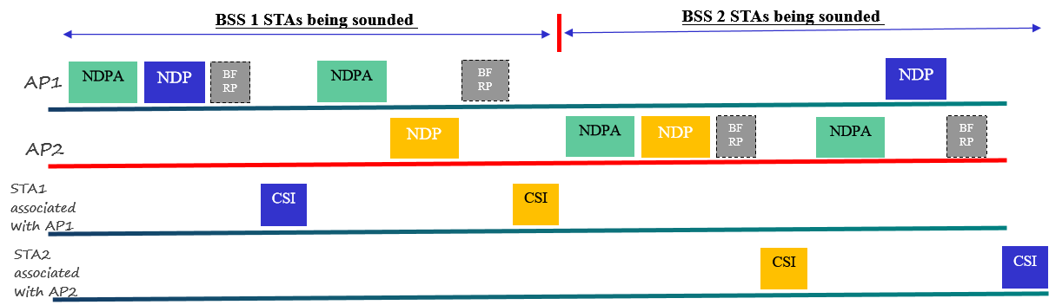
Recap: Sequential sounding in motion[#100]

Slide 4
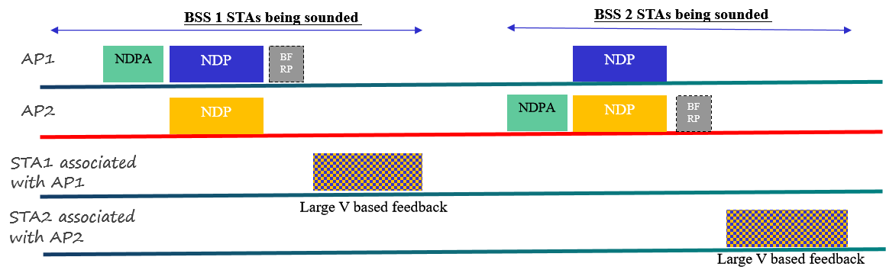
Recap: Joint sounding sequence in motion[#101]

Slide 5
Problem : NDP from responding AP missing issue
responding AP may not send NDP after NDPA+SIFS
  The CCA indicates medium busy due to the interference from some hidden nodes.
  The responding AP may not receive the NDPA or error parse the received NDPA
The initiating AP may detect the NDP missing issue from responding AP in sequential sounding procedure.
  After SIFS, if the initiating AP doesn’t detect the NDP frame, the initiating AP will determine the NDP is missing from the responding AP.
  The initiating AP may retransmit the NDPA frame to fast recovery the sounding procedure.
The initiating AP can’t detect the NDP missing issue from responding AP in Joint sounding procedure.
  The initiating AP will stay in TX state(to transmit NDP in parallel)

Slide 6
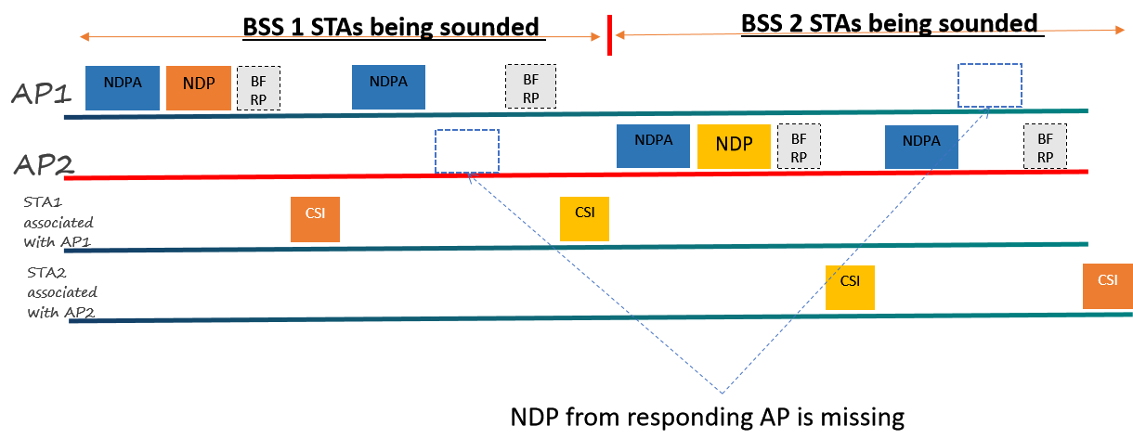
The following figure depicts the NDP from responding AP missing issue in sequence sounding procedure

Slide 7
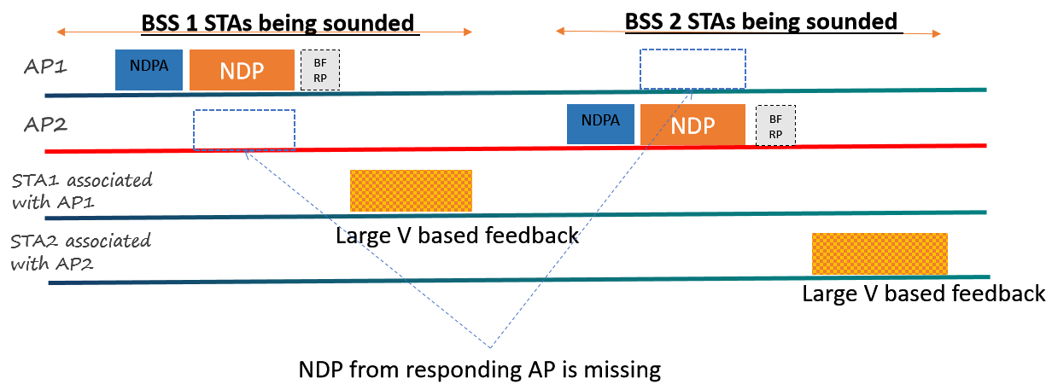
The following figure depicts the NDP from responding AP missing issue in Joint sounding procedure

Slide 8
Proposal: Add ICF/ICR to address the hidden node issue
ICF/ICR exchange in cross-BSS sequential sounding and Joint sounding
  BSRP/M-BA(multi-STA BA) already used in other features, we propose to reused BSRP/M-BA as ICF/ICR
  The Duration of ICF/ICR should cover the whole sounding procedure, or at least cover the NDP transmission time from responding AP(long protection).
It’s still not efficient if the responding AP doesn’t make the response when ICF solicits single responding AP. One approach is to add double ICF/ICR exchanges
  The first ICF/ICR（polling phase）: solicit multiple responding APs and associated STAs with short protection.
  The second ICF/ICR(responding AP’s TXOP protection): solicit single responding AP with long protection.

Slide 9
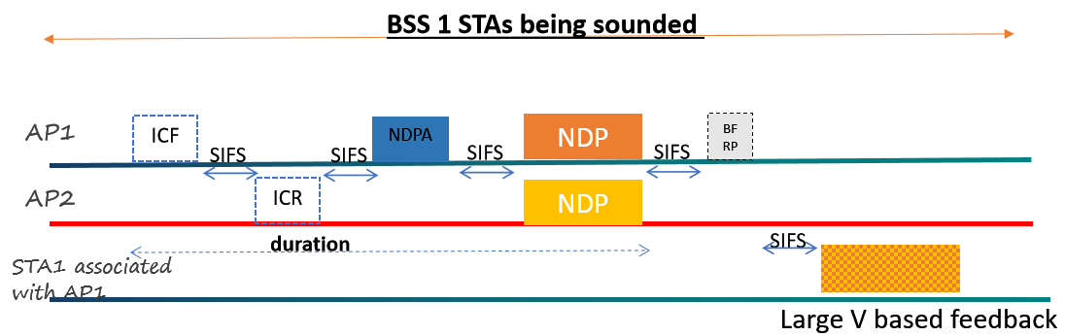
The following figure depicts the single ICF/ICR exchange to protect the TXOP in Joint sounding procedure

Slide 10
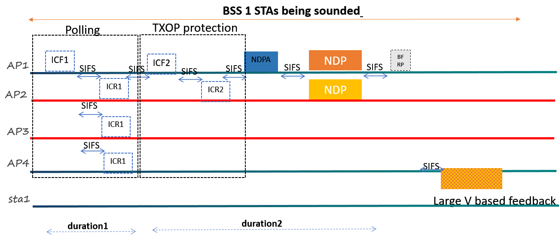
The following figure depicts the double ICF/ICR exchange in Joint sounding procedure

Slide 11
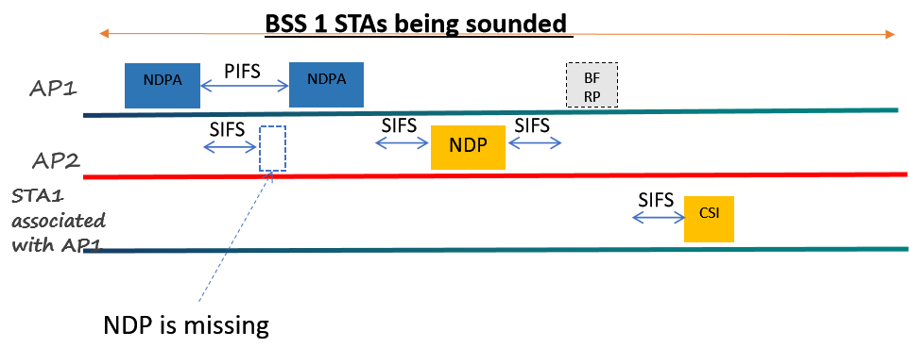
Proposal2:NDPA retransmission in sequential sounding procedure
The initiating AP retransmit NDPA if NDP from responding AP is not detected
  The initiating AP may retransmit NDPA after PIFS (as shown in the Figure)
  The initiating AP may terminate the cross-BSS sounding procedure after retry several times.

Slide 12
Summary
Analyze the NDP from responding AP missing issue
Propose to use ICF/ICR for sounding procedure protection
  Single ICF/ICR approach
  Double ICF/ICR approach
Propose to retransmit NDPA if the solicited NDP from responding AP is missing in sequential sounding procedure

Slide 13
THANK YOU ☺

Slide 14
Reference
24/209r6 TGbn Specification Framework for TGbn

Slide 15
SP1
Do you agree to add the ICF/ICR frame exchange to protect the TXOP of the responding AP in the Co-BF sounding procedure?
  The duration in ICF/ICR should at least cover the transmission time of NDP

Slide 16
SP2
Do you agree to add the double ICF/ICR frame exchange to protect the sounding procedure?
  The duration in the first ICF/ICR only cover the transmission of ICR1
    ICF1 may solicit multiple APs to make the response.
  The duration in the second ICF/ICR should at least cover the transmission time of NDP
    ICF2 at most solicit one of the APs that responded with ICR1 to ICF1 to make the response.

Slide 17
SP3
Do you agree the initiating AP may retransmit the NDPA frame after PIFS interval if the NDP from the responding AP is missing in sequential sounding procedure.

