Slide 1
MAPC discovery follow up

Slide 2
Introduction
11bn group agreed on the unified MAPC framework and the UHR AP is capable of transmitting a TB PPDU with the following motion:
  11bn defines a common framework of a MAPC for various coordination schemes[M#50].
    Note - Coordination schemes such as (but not limited to): Co-SR (TXOP-based with power control), Co-BF, Co-TDMA , C-RTWT, etc.
  11bn defines a common framework of a MAPC that can enable the following procedures[M#51]
    MAPC Discovery procedure
    MAPC agreement negotiation procedure
    Note: Details of the procedures and whether the above procedures are mandatory/optional - TBD
  A UHR AP shall indicate to another AP its capability to respond in a TB PPDU or not[M #120].
In this contribution, we propose to define a TB MAPC Discovery procedure

Slide 3
Recap: M-AP discovery procedure
The characteristic of MAPC discovery procedure
  The purpose of MAPC discovery is to find another AP in the same or the overlapping channel.
  The discovery request and response frame may be only exchanged on their operating channel.
  Possibly to allow the off-channel scan to support the use cases in some special scenario(one AP plans to switch to another channel, also, the off-channel scan operation may be requested by STA for P2P operation).
  In this contribution, we focus on the M-AP scan operation on the current operating channel.
In Mesh BSS network, one AP may discover another AP via the passive scan or active scan operation.
  passive scan for Beacon frame, and probe request/response frame exchange for active scan.
  In active scan, one AP may send broadcast probe request frame, and receives the probe response frame one by one in different TXOPs, in which a serious overhead issue may happen

Slide 4
The following figure depicts the overhead issue in actively scan procedure
TXOP1
TXOP2
TXOP3
TXOP4
TXOP5
probe request
probe response
probe response
probe response
probe response
AP1 AP2 AP3 AP4 AP5
T

Slide 5
Propose to define Trigger-based M-AP actively scan
Leverage the gain of RA-RU, the initiating AP may transmit a TB frame including multiple RA-RU for the responding AP without AP ID.
  The responding APs that don’t support transmitting TB PPDU won’t make the response.
  Also, the AID12 field can set to AP ID if the target responding AP obtained the AP ID from initiating AP before.
  Probe request and TB frame can be merged to one frame(like reusing TRS control field or define a new probe request polling frame(PRP)).
  If the responding AP has the different primary channel from initiating AP, the RU location should be based on initiating AP’s operating channel information(e.g, adding operating class and channel number in the Trigger Dependent Common Info of Common Info field)

Slide 6
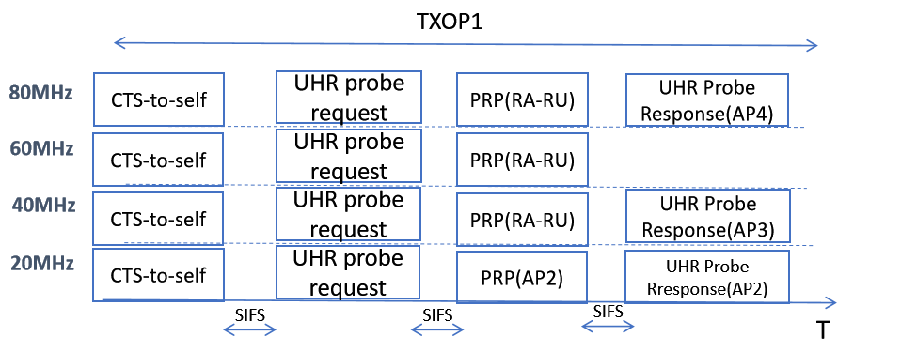
The following figure depicts one approach of Trigger Based actively scan procedure(RU size=242-tone)
Note: RU size in PRP may smaller or larger than 242-tone

Slide 7
Summary
Analysis the characteristic of discovery procedure in MAPC scheme
Propose to define a TB probe request/response frame exchange to avoid overhead issue.
  Only the responding APs that are capable of transmitting TB PPDU can make the response.
  AID12 field in the Trigger frame can set to RA-RU or set to the responding AP’s AP ID

Slide 8
THANK YOU ☺

Slide 9
Reference
24/209r6 TGbn Specification Framework for TGbn
24/1762r13 PDT-MAC-NPCA

Slide 10
SP1
Do you agree to define Trigger based actively scan procedure in MAPC discovery?

