Slide 1
AMP relay topology and operations
Date: 2024-12-20
Authors:

Slide 2
Background
In the TIG/SG phase, [1] and [2] presented the results of link budget analysis for different AMP use cases. The conclusion includes，
  there are significant downlink and uplink coverage imbalances
  Relay devices maybe required
[3] and [4] proposed a method for AMP-only IoT STAs to access DS through AMP capable non-AP STAs, with link establishment following a relay topology.
Motion #13 and Motion #20 describe the clock accuracy of AMP devices. For latency insensitive services, communication through relay links can effectively improve transmission distance and link quality.

Slide 3
Abstract
In this contribution, we discuss the relay architecture and method for AMP devices.
Notes:
目前还没有统一的功能实体命名

Slide 4
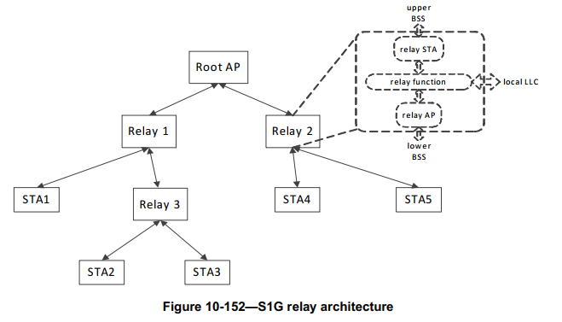
Recap-S1G relay architecture and operation[5]
The AP is referred to as the root AP.
An S1G relay consists of an S1G relay AP and an S1G relay STA. An S1G relay forwards frames between STAs associated to its S1G relay AP and the AP to which its S1G relay STA is associated.
For individually addressed relay frames, taking uplink transmission as an example,
  Address 1 is the MAC address of the AP (the receiver of the MPDU)
  Address 2 is either the MAC address or the AID of the S1G relay STA (the transmitter of the MPDU)
  Address 3 is the DA of the MSDU (the destination address of the MSDU)
  Address 4 is the SA of the MSDU (the source address of the MSDU)
associated
associated
Notes:
A relay STA is a non-AP STA associated to a root AP or the relay AP of another relay. A relay AP is an AP that offers the relay function to its associated non-AP STAs, and provides access to the DS indirectly through the relay STA’s path to the root AP. The relay function performs local reception or selective forwarding of MSDUs between the relay STA and relay AP, based on the destination address

Slide 5
AMP relay
AMP relay topology:
The root node can be a legacy AP in .11 DS.
The relay node can be an AMP capable non-AP STA, such as AMP-assisted STA, AMP reader, etc. The terminology is yet TBD.
  STAs with AMP capability can voluntarily declare themselves as relay nodes.
AMP non-AP STA can communicate with AP through relay nodes,
  AMP non-AP STAs should report their capabilities or existence to a relay node to support their identification.
associated
identified
AMP relay operation:
Setup: Select the relay node to complete the link establishment, and the nodes participating in the link will default to forwarding UL or DL signaling
  No longer need four address fields for addressing
Suspend and resume: Relay nodes can decide whether to suspend or resume the AMP relay link based on their own buffer load state
Teardown: The removal of links can be initiated by AP or relay nodes
Zhanjing Bao, TCL

Slide 6
AMP relay operation-setup and teardown
For different types of AMP functional entities, two options of AMP relay operation can be considered
Option 1:
AMP non-AP STAs do not need to be aware of the establishment or removal of relay links, they only need to complete the uplink of data based on the triggering of relay nodes;
A link should be established between the relay node and the AP. The AP requests data from the relay node, which triggers the AMP non-AP STA data UL and then forwards the data to the AP.
Option 2:
AMP non-AP STAs can participate in the establishment of relay links, such as the selection, recommendation, and negotiation of relay nodes.
AMP non-AP STAs can receive notifications of link establishment or teardown.
Considering the capabilities of AMP devices and the efficiency of relay transmission, after the link is established, data requests and reports can be based on AP triggering and TXOP sharing.

Slide 7
AMP relay operation-suspend and resume
Taking data UL transmission as an example, the channel access of AMP non-AP STA can be triggered or based on (r-)TWT periodic channel access.
Relay nodes can suspend relay transmission based on their buffer load status.
After forwarding the data to AP and releasing the buffer, R node can resume its relay transmission.
  Explicit: The resume of the link can be indicated by a frame
  Implicit: A certain time duration can be indicated when the suspend declaration is made, and the link will automatically resume after the timer expires.
When the relay link is suspended, AMP non-AP STAs can switch to power saving mode.

Slide 8
Summary
We discussed the AMP relay architecture and operations.
  For AMP-only devices, the complex process of authentication and association is not necessary.
  No longer need four addresses to complete frame exchange.
Relay operation can effectively solve the problem of imbalanced coverage between uplink and downlink, while improving the transmission distance and link quality of AMP communication.
We plan to further discuss the frame sequence for AMP relay operations based on different AMP STAs’ capabilities and corresponding MAC frame formats in the future

Slide 9
SP
Do you agree to add the following text to TGbp FRD?
11bp shall support AMP relay topology as follows
- Root node: legacy AP or AMP AP
- Relay node: STAs with AMP capability voluntarily declare themselves as relay nodes
- AMP non-AP STA can communicate with root node through relay node(s)
Note: The details of AMP relay operation are TBD.
Y/N/A

Slide 10
References
[1] 11-23-2013-00-0amp-discussions-on-amp-link-budgets
[2] 11-24-0075-00-0amp-follow-up-on-amp-link-budgets
[3] 11-24-1180-02-00bp-reference-model-of-amp-only-iot-devices
[4] 11-24-1537-02-00bp-wireless-connectivity-challenges-for-amp-only-iot-devices-under-802-11-specification
[5] Draft P802.11REVme_D7.0

