Slide 1
Frame Sequence for CSR and CBF
Date: 2024-11-21
Authors:
Name | Affiliations | Address | Phone | email
Jason Yuchen Guo | Huawei Technologies |  |  | guoyuchen@huawei.com
Arik Klein
Mahmoud Hasabelnaby
Yunbo Li
Ming Gan

Slide 2
Introduction
Coordinated spatial reuse (Co-SR) and coordinated beamforming (Co-BF) are considered as two multi-AP schemes that can improve system throughput and latency performance.
Both of the two schemes are performed at a TXOP level.
This contribution discusses the frame exchange sequence of Co-SR and Co-BF.

Slide 3
Part I: Co-BF Sequence

Slide 4
Introduction
In [1], the following sequence is proposed for the Co-BF transmission phase
    Step 1: Co-BF invite/response between the sharing AP and the shared AP
    Step 2: ICF/ICR between sharing AP and its associated STAs
    Step 3: ICF/ICR between shared AP and its associated STAs
    Step 4: Co-BF Trigger

Slide 5
Introduction
The proposed sequence is based on the following assumptions:
  The Shared AP can always successfully overhear that the triggered non-AP STAs associated with the Sharing AP have completed transmitting their ICR or BA frames.
  The Sharing AP can always successfully overhear that the triggered non-AP STAs associated with the Shared AP have completed transmitting their ICR frames.
  Both the Sharing AP and the Shared AP always successfully receive the ICR frames from their respectively solicited non-AP STAs.
However the above assumptions might not be always valid due to factors such as:
  interference, signal attenuation, and device limitations/locations
There is a chance that the APs may miss or fail to overhear critical transmissions

Slide 6
Issues of the current Co-BF sequence
Issue 1: the shared AP may fail to decode the sharing AP’s ICF/ICR exchange, and doesn’t know when to send ICF to its STAs
Issue 2: the sharing AP may fail to decode the shared AP’s ICF/ICR exchange, and doesn’t know when to send the Co-BF Trigger
Issue 3: if only part of one AP’s STA responds ICR, the other AP still thinks that all the STAs will participate in the Co-BF transmission, and hence will do nulling to them
Issue 4: each AP is required to parse frames that are not intended to it (overhearing issue).
Issue 5: sharing AP may lose its control of the channel, if error happens at the shared AP side
Issue 6: shared AP just uses the channel to exchange ICF2/ICR2, without a grant from the sharing AP

Slide 7
Proposal
We propose two options to solve the issues mentioned in the previous slide
Option 1: Change the order of Co-BF invite/response and ICF/ICR
Option 2: based on the sequence in [1], add explicit Timing Indication for Co-BF Transmission Phase

Slide 8
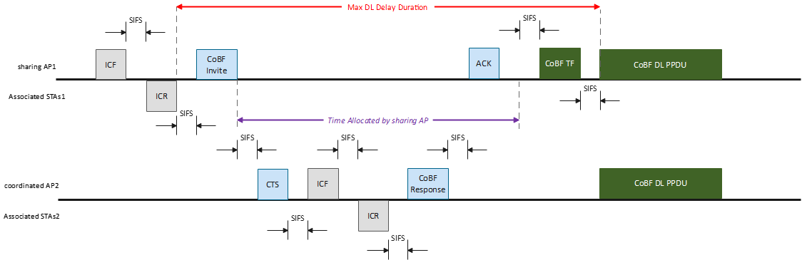
Option 1
Step 1: ICF/ICR between sharing AP and its STAs
Step 2: Co-BF Invite with time allocation
Step 3: ICF/ICR between shared AP and its STAs
Step 4: Co-BF Response with time return

Slide 9
Option 1
The sharing AP needs to transmit ICF/ICR to its EMLSR/DPS associated non-AP STA regardless of coordinated AP’s decisions
If EMLSR non-AP STAs associated with the sharing AP BSS are not available, there is no need to begin the Co-BF sequence
The coordinated AP needs to perform ICF/ICR exchange within its BSS before transmitting the Co-BF Response frame
If EMLSR STAs associated with the coordinated AP BSS are not available, the coordinated AP may decline participating in the Co-BF data transmission

Slide 10
Option 1
Benefits:
The entire sequence is fully controlled by the sharing AP (as expected by a TXOP holder – see 802.11 REVmeD7.0 10.23.2), so it can be either continued with a single PPDU transmission to the intended non-AP STAs (associated with the sharing AP) or terminated if one of the internal sub-phases has not successfully completed
It allows to avoid negotiation when STAs in sharing AP BSS are not available
It allows to transmit Co-BF data PPDUs only when STAs of both APs are available – more efficient resource allocation

Slide 11
Option 1
Other details:
The ICF should include an indication for the maximal time delay till the DL PPDU will start
  Delayed switch back for eMLSR/DPS STAs associated with the sharing AP
The Invite frame should include an “Allocation Duration” field
  Indicates the allocated time to the Coordinated AP (shared AP) within the TXOP obtained by the Sharing AP for its OBSS operations
Co-BF Response frame should include a “Return Status” field
    Successful / ready for Co-BF transmission
    Deny due to incomplete STA response
    Deny due to lack of allocated time

Slide 12
Option 2
Within the Co-BF invite ICF frame, the Sharing AP indicates to the Shared AP:
  Whether ICF/ICR frames between sharing AP and its scheduled eMLSR/DPS non-AP STAs are needed in the sequence.
  The duration of this ICF/ICR exchange (if exists).
Within the Co-BF Response ICR frame, the Shared AP indicates to the Sharing AP:
  Whether ICF/ICR frames between Shared AP and its scheduled eMLSR/DPS non-AP STAs are needed in the sequence.
  The duration of this ICF/ICR exchange (if exists).
This explicit timing exchange in the Co-BF Invite and Co-BF Response frames allows the Shared AP to determine when to initiate its ICF/ICR exchange (if exists), and enables the Sharing AP to determine when to transmit the Co-BF Sync frame.
If none of the Sharing AP’s scheduled non-AP STAs respond to its ICF within SIFS, the Sharing AP shall transmit a Co-BF termination frame, before the Shared AP initiates its ICF/ICR with its scheduled non-AP STAs.
Similarly, If none of the Shared AP’s scheduled non-AP STAs respond to its ICF within SIFS, the Shared AP shall transmit a Co-BF termination frame, before the Sharing AP initiates transmitting Co-BF Sync. frame.

Slide 13
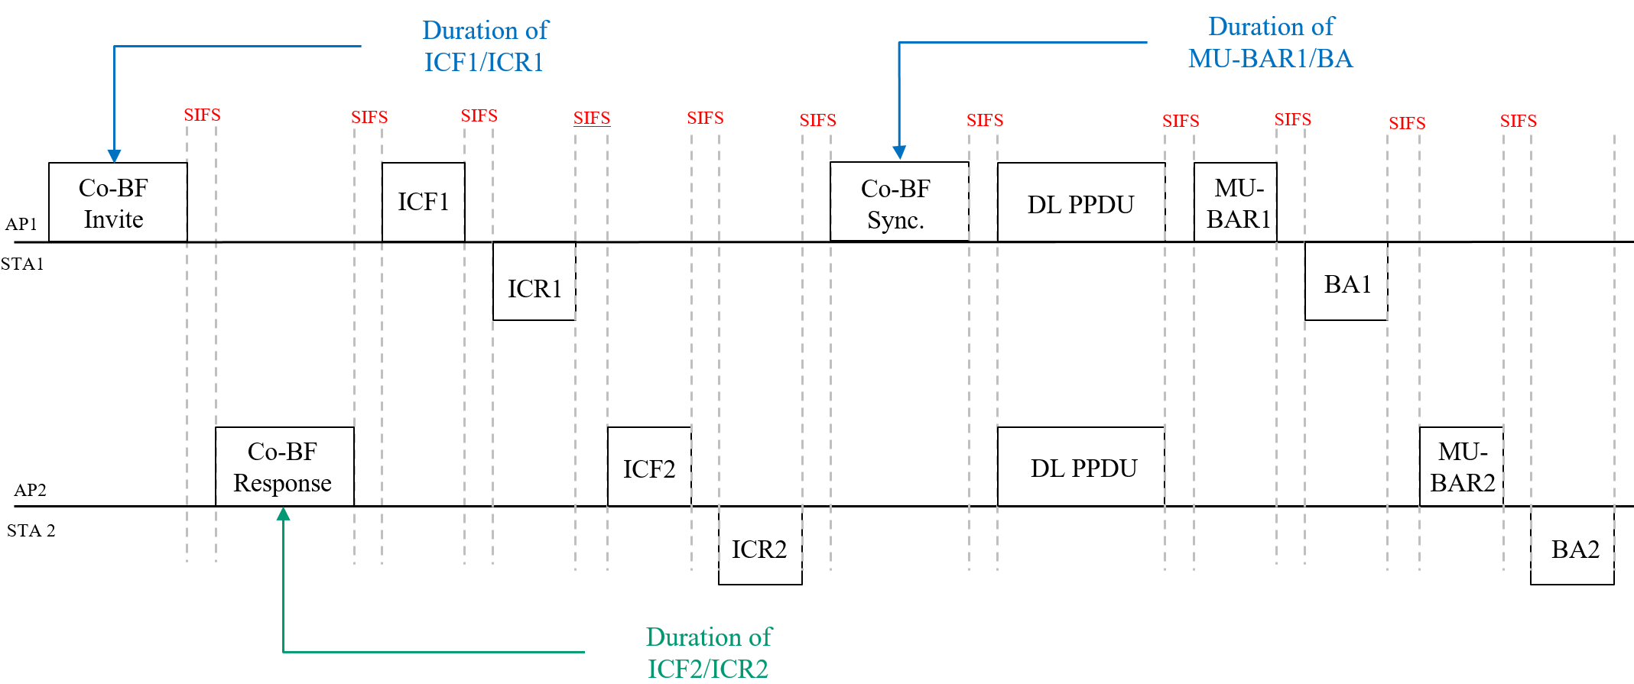
Option 2
Similarly, within the Co-BF Sync frame, the Sharing AP indicates the duration of its MU-BAR and BA exchange to the Shared AP, enabling the Shared AP to determine when to initiate its own MU-BAR/BA exchange.
An example of the Explicit Timing Indication for Co-BF Transmission Phase is as follows:

Slide 14
Summary
We raised 6 issues of the current CoBF sequence, and propose two candidate solutions to solve them
Option 1 can solve all 6 issues with some modifications of the frame sequence
Option 2 can solve issues 1,2,4,5 without modifying the current sequence
  Extra process may be needed to solve issue 3,6.

Slide 15
Part II: Co-SR Sequence

Slide 16
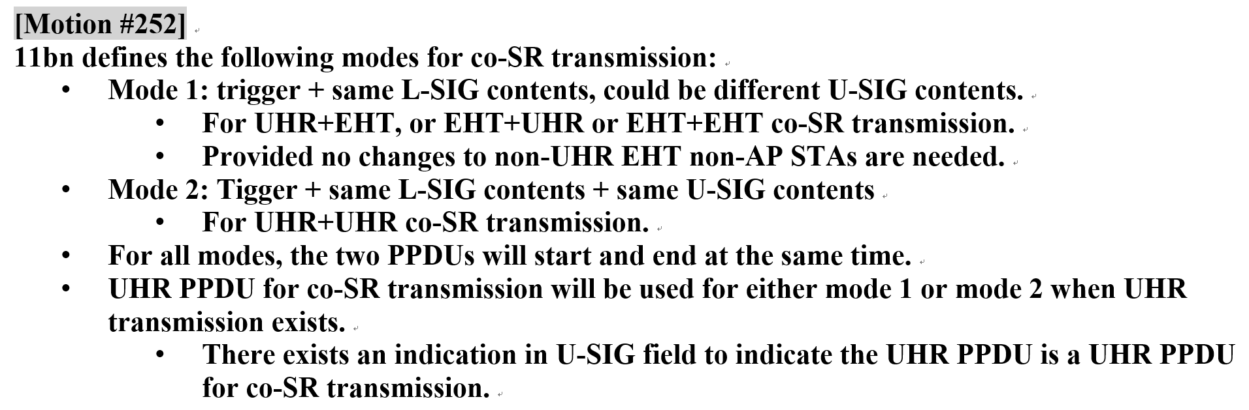
Introduction
We have agreed to define two modes for Co-SR
In mode 1: EHT non-AP STAs can participate in Co-SR transmission
In mode 2: only UHR STAs can participate

Slide 17
Co-SR sequence
In mode 2, only UHR non-AP STAs are involved, the switch back rules for UHR eMLSR STAs can be changed, e.g., to have a delayed switch back
Hence the CBF sequence proposed in part I can be used in Co-SR mode 2

Slide 18
Co-SR sequence
In mode 1, EHT eMLSR STAs will be involved, since we can not change the switch back rules for the EHT eMLSR STAs, we need a different sequence as below.
AP1
Invite
Trigger
ICF1
Data1
STA1
ICR1
AP2
Response
ICF2
Data2
STA2
ICR2

Slide 19
Co-SR sequence
Invite frame indicates whether ICF1/ICR1 is needed, the length of ICF1 and ICR1
Response frame indicates whether ICF2/ICR2 is needed, the length of ICF2 and ICR2
The max {ICF1 length ; ICF2 length} will be used as the final length of ICF1 and ICF2
The max {ICR1 length ; ICR2 length} will be used as the final length of ICR1 and ICR2
Invite frame also indicates the RU allocation for ICR2 so that ICR1 and ICR2 can be transmitted on different RUs
AP1
Invite
Trigger
ICF1
Data1
STA1
ICR1
AP2
Response
ICF2
Data2
STA2
ICR2

Slide 20
Summary
Co-SR mode 2 can use the same sequence as CBF
A new sequence is proposed for Co-SR mode 1 which can support EHT eMLSR STAs

Slide 21
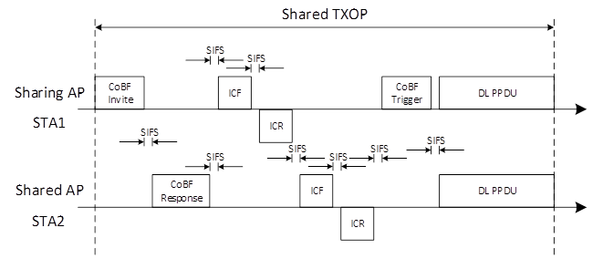
SPs
SP1:Do you support to use the following CoBF transmission sequence to support STAs requiring ICF/ICR before data frame exchanges?
  The frame sequence consists of:
    A CoBF Invite/CoBF Response frame exchange between the sharing and shared APs.
    Follows ICF/ICR frame exchanges between the APs and their associated STAs happening sequentially across the two APs; sharing AP then shared AP.
      The presence of the ICF/ICR frame exchange from each AP is conditional on the CoBF PPDU being addressed to one or more STA.
      The presence of the ICF/ICR frame exchange from each AP is indicated in the CoBF Invite/Response frames.
      The duration of the ICF/ICR frame exchange from each AP is indicated in the CoBF Invite/Response frames
      ICF1-ICR1 are exchanged between the sharing AP and its STAs
      ICF2-ICR2 are exchanged between the shared AP and its STAs
    Finally, a CoBF Trigger frame preceding the data PPDUs sent by the two APs simultaneously.
    Frame sequence for Ack information polling is TBD.
  Whether the CoBF-invite and ICF1 can be merged and CoBF-response and ICF2 can be merged as below is TBD.

Slide 22
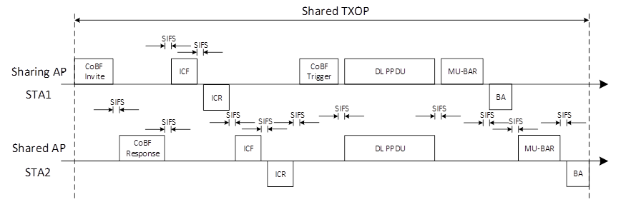
SPs
SP2:Do you support to use the following sequence for acknowledgement information polling from STAs scheduled in a CoBF transmission sequence?
  MU-BAR/BA frame exchanges are used by each AP separately, i.e., sequentially.
  The duration of MU-BAR/BA frame exchange between the Sharing AP and its associated non-AP STAs is indicated in the CoBF Trigger frame.
NOTE-The first MU-BAR frame (transmitted by the sharing AP) can be replaced with a basic trigger that is aggregated with the DL PPDU as in baseline.

Slide 23
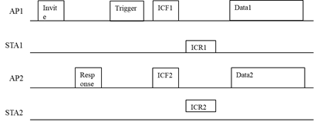
SPs
SP3: Do you agree to use the following transmission sequence in CoSR Mode1 to support EHT eMLSR STAs?
  The frame sequence consists of:
    A CoSR Invite/CoSR Response frame exchange between the sharing and shared APs.
    Follows a CoSR Trigger frame sent by the sharing AP
    Follows ICF/ICR frame exchanges between the APs and their associated STAs happening simultaneously.
      The presence of the ICF/ICR frame exchange from each AP is conditional on the CoSR PPDU being addressed to one or more STA.
      The presence of the ICF/ICR frame exchange from each AP is indicated in the CoSR Invite/Response frames.
      ICF1-ICR1 are exchanged between the sharing AP and its STAs
      ICF2-ICR2 are exchanged between the shared AP and its STAs
      The length of the ICF1 and ICR1 frames are indicated in the CoSR Invite frame
      The length of the ICF2 and ICR2 frames are indicated in the CoSR Response frame
      The max {ICF1 length ; ICF2 length} will be used as the final length of ICF1 and ICF2
      The max {ICR1 length ; ICR2 length} will be used as the final length of ICR1 and ICR2
      The RU to be used to transmit ICR2 is indicated in the CoSR Invite frame
    Finally, data PPDUs sent by the two APs simultaneously.

Slide 24
References
[1] 11-25/0412r0 CoBF Frame Sequences and Signaling Details

