Slide 1
Frame Sequence for CSR and CBF
Date: 2024-11-21
Authors:
Name | Affiliations | Address | Phone | email
Jason Yuchen Guo | Huawei Technologies |  |  | guoyuchen@huawei.com
Yunbo Li
Guogang Huang
Ming Gan
Yue Zhao
Maolin Zhang
Zhenpeng Shi
Lyutianyang Zhang

Slide 2
Introduction
Coordinated spatial reuse (CSR) and coordinated beamforming (CBF) are considered as two multi-AP schemes that can improve system throughput and latency performance.
Both of the two schemes are performed at a TXOP level.
This contribution discusses the MAC procedure of CSR and CBF during a TXOP, especially the frame exchange sequence.

Slide 3
Part I: Co-BF Sequence

Slide 4
Introduction
In [1], the following sequence is proposed for the CoBF transmission phase
Step 1: CoBF invite/response between the sharing AP and the shared AP
Step 2: ICF/ICR between sharing AP and its associated STAs
Step 3: ICF/ICR between shared AP and its associated STAs
Step 4: CoBF Trigger

Slide 5
Introduction
The proposed sequence is based on the following assumptions:
The Shared AP can always successfully overhear that the triggered non-AP STAs associated with the Sharing AP have completed transmitting their ICR or BA frames.
The Sharing AP can always successfully overhear that the triggered non-AP STAs associated with the Shared AP have completed transmitting their ICR frames.
Both the Sharing AP and the Shared AP always successfully receive the ICR frames from their respectively solicited non-AP STAs.
However the above assumptions might not be always valid due to factors such as:
interference, signal attenuation, and device limitations/locations
There is a chance that the APs may miss or fail to overhear critical transmissions

Slide 6
Issues of the current CoBF sequence
Issue 1: the shared AP may fail to decode the sharing AP’s ICF/ICR exchange, and doesn’t know when to send ICF to its STAs
Issue 2: the sharing AP may fail to decode the shared AP’s ICF/ICR exchange, and doesn’t know when to send the Co-BF Trigger
Issue 3: if only part of one AP’s STA responds ICR, the other AP still thinks that all the STAs will participate in the CoBF transmission, and hence will do nulling to them
Issue 4: each AP is required to parse frames that are not intended to it (overhearing issue).
Issue 5: sharing AP may lose its control of the channel, if error happens at the shared AP side
Issue 6: shared AP just uses the channel to exchange ICF2/ICR2, without a grant from the sharing AP

Slide 7
Proposal
We propose two options to solve the issues mentioned in the previous slide
Option 1: Change the order of CoBF invite/response and ICF/ICR
Option 2: based on the sequence in [1], add explicit Timing Indication for Co-BF Transmission Phase

Slide 8
Option 1
Step 1: ICF/ICR between sharing AP and its STAs
Step 2: CoBF Invite with time allocation
Step 3: ICF/ICR between shared AP and its STAs
Step 4: CoBF Response with time return

Slide 9
Option 1
The sharing AP needs to transmit ICF/ICR to its EMLSR/DPS associated non-AP STA regardless of coordinated AP’s decisions
If EMLSR non-AP STAs associated with the sharing AP BSS are not available, there is no need to begin the CoBF sequence
The coordinated AP needs to perform ICF/ICR exchange within its BSS before transmitting the Co-BF Response frame
If EMLSR STAs associated with the coordinated AP BSS are not available, the coordinated AP may decline participating in the CoBF data transmission

Slide 10
Option 1
Benefits:
The entire sequence is fully controlled by the sharing AP (as expected by a TXOP holder – see 802.11 REVmeD7.0 10.23.2), so it can be either continued with a single PPDU transmission to the intended non-AP STAs (associated with the sharing AP) or terminated if one of the internal sub-phases has not successfully completed
It allows to avoid negotiation when STAs in sharing AP BSS are not available
It allows to transmit CoBF data PPDUs only when STAs of both APs are available – more efficient resource allocation

Slide 11
Option 1
Other details:
The ICF should include an indication for the maximal time delay till the DL PPDU will start
Delayed switch back for eMLSR/DPS STAs associated with the sharing AP
The Invite frame should include an “Allocation Duration” field
Indicates the allocated time to the Coordinated AP (shared AP) within the TXOP obtained by the Sharing AP for its OBSS operations
CoBF Response frame should include a “Return Status” field
Successful / ready for CoBF transmission
Deny due to incomplete STA response
Deny due to lack of allocated time

Slide 12
Option 2
Within the Co-BF invite ICF frame, the Sharing AP indicates to the Shared AP:
Whether ICF/ICR frames between sharing AP and its scheduled eMLSR/DPS non-AP STAs are needed in the sequence.
The start time for the Shared AP to start exchanging ICF/ICR with its scheduled eMLSR/DPS non-AP STAs (if needed).
The Maximum Duration for the Shared AP to complete exchanging ICF/ICR with its scheduled eMLSR/DPS non-AP STAs (if needed).
Within the Co-BF Response ICR frame, the Shared AP indicates to the Sharing AP:
Whether ICF/ICR frames between Shared AP and its scheduled eMLSR/DPS non-AP STAs are needed in the sequence.
The duration of this ICF/ICR exchange (if exists).
If none of the Sharing AP’s scheduled non-AP STAs respond to its ICF within SIFS, the Sharing AP shall transmit a Co-BF termination frame, before the Shared AP initiates its ICF/ICR with its scheduled non-AP STAs. Similarly, If none of the Shared AP’s scheduled non-AP STAs respond to its ICF within SIFS, the Shared AP shall transmit a Co-BF termination frame, before the Sharing AP initiates transmitting Co-BF Sync. frame.
Similarly, within the Co-BF Sync. frame, the Sharing AP may indicate to the Shared AP both the start time and the duration during which the Shared AP is allowed to exchange MU-BAR/BA frames.

Slide 13
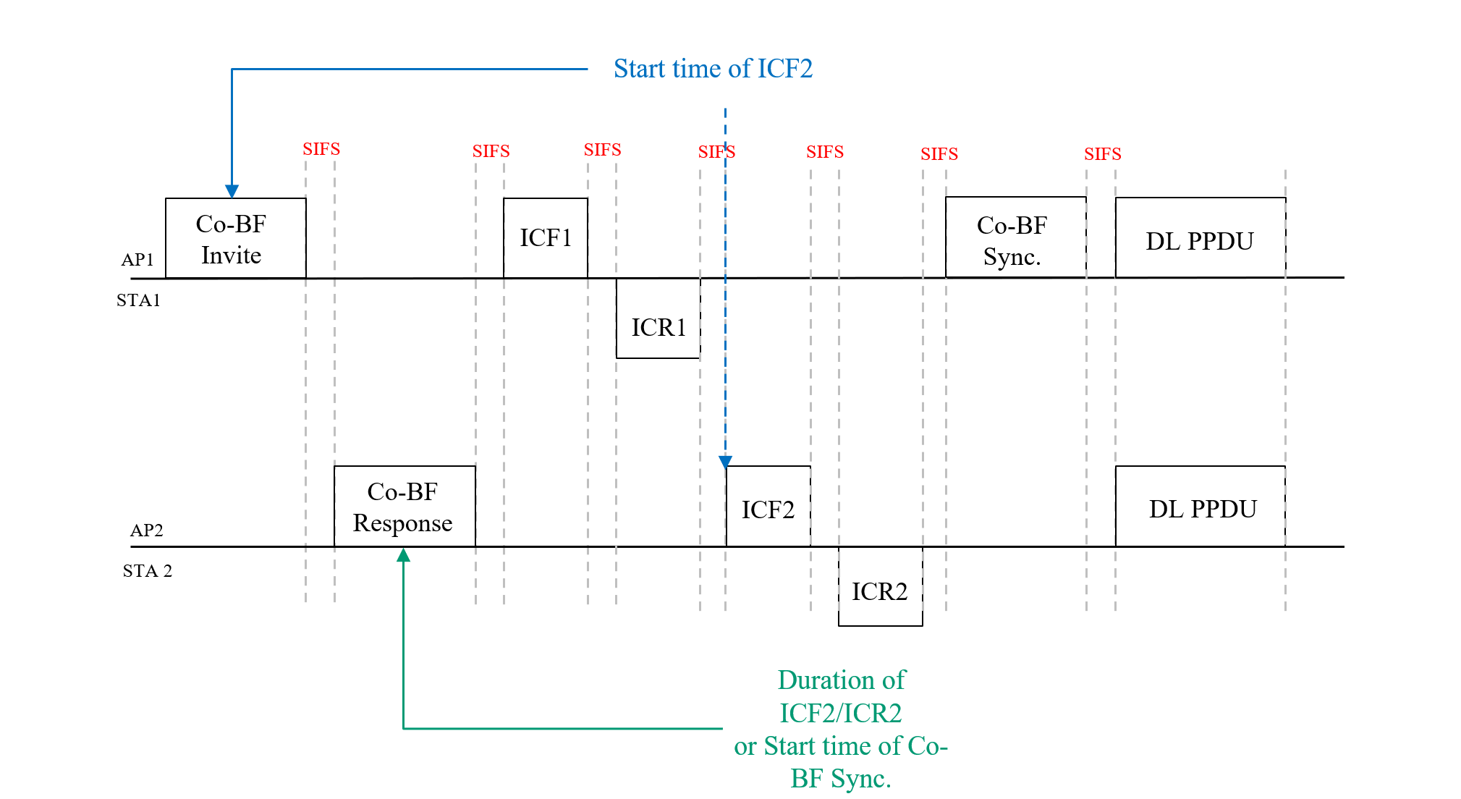
Option 2
An example of the Explicit Timing Indication for Co-BF Transmission Phase is as follows

Slide 14
Summary
We raised 6 issues of the current CoBF sequence, and propose two candidate solutions to solve them
Option 1 can solve all 6 issues with some modifications of the frame sequence
Option 2 can solve issues 1,2,4,5,6 without modifying the current sequence
Extra process may be needed to solve issue 3.

Slide 15
Part II: Co-SR Sequence

Slide 16
Introduction
We have agreed to define two modes for Co-SR
In mode 1: EHT non-AP STAs can participate in Co-SR transmission
In mode 2: only UHR STAs can participate

Slide 17
Co-SR sequence
In mode 2, only UHR non-AP STAs are involved, the switch back rules for UHR eMLSR STAs can be changed, e.g., to have a delayed switch back
Hence the CBF sequence proposed in part I can be used in Co-SR mode 2

Slide 18
Co-SR sequence
In mode 1, EHT eMLSR STAs will be involved, since we can not change the switch back rules for the EHT eMLSR STAs, we need a different sequence as below.
AP1
Invite
Trigger
ICF1
Data1
STA1
ICR1
AP2
Response
ICF2
Data2
STA2
ICR2

Slide 19
Co-SR sequence
In mode 1, EHT eMLSR STAs will be involved, since we can not change the switch back rules for the EHT eMLSR STAs, we need a different sequence as below.
AP1
Invite
Trigger
ICF1
Data1
STA1
ICR1
AP2
Response
ICF2
Data2
STA2
ICR2

Slide 20
Co-SR sequence
Invite + Response:
Announce intension for sharing + determine shared AP’s interest to participate
Indicates whether ICF1/ICR1 and ICF2/ICR2 are needed
Sync the length of ICF1 and ICF2 (also ICR1 and ICR2) if needed
Determine the RU allocation for ICR1 and ICR2
AP1
Invite
Trigger
ICF1
Data1
STA1
ICR1
AP2
Response
ICF2
Data2
STA2
ICR2

Slide 21
Summary
We propose that Co-SR mode 2 can use the same sequence as CBF
We propose a new sequence for Co-SR mode 1 which can support EHT eMLSR STAs

Slide 22
References
[1] 11-25/0412r0 CoBF Frame Sequences and Signaling Details

