Slide 1
Uplink RSSI and AP Transmit Power for Effective Roaming
Date: 2024-12-18
Authors:

Slide 2
Abstract
Highlight the importance of knowledge of uplink RSSI at a client device to make effective roaming decisions
Propose that AP transmit power is included in the Beacon / Probe Response frames to facilitate estimation of uplink RSSI at client

Slide 3
Motivating Scenarios – Importance of Uplink RSSI (1)
Advent of new use-cases like augmented reality and virtual reality has imposed stringent Quality-of-Service (QoS) requirements on the uplink (UL) traffic
    Example: 11-22/779r0 indicates that the target e2e delay for AR/VR applications may be as low as 20 ms
UL QoS requirements (throughput, latency) translate to data rate requirements and hence RSSI / SNR target in the uplink
Downlink (DL) RSSI may not be a good proxy for the achieved UL RSSI, i.e., high DL RSSI does not necessarily translate to an equivalently high UL RSSI
    This is especially the case in 6 GHz bands in which transmit power of AP and client devices may be different owing to different regulatory limits; AP max PSD is 6 dB higher than client max PSD
    Knowledge of the difference in max PSD between AP and client is not sufficient and will lead to inaccurate estimations of uplink RSSI
Desirable to devise a scheme that allows a client device to gauge uplink RSSI to roaming candidate AP(s) to make more informed roaming decisions
    Desirable for the scheme to entail low overhead and provide reasonable accuracy of RSSI

Slide 4
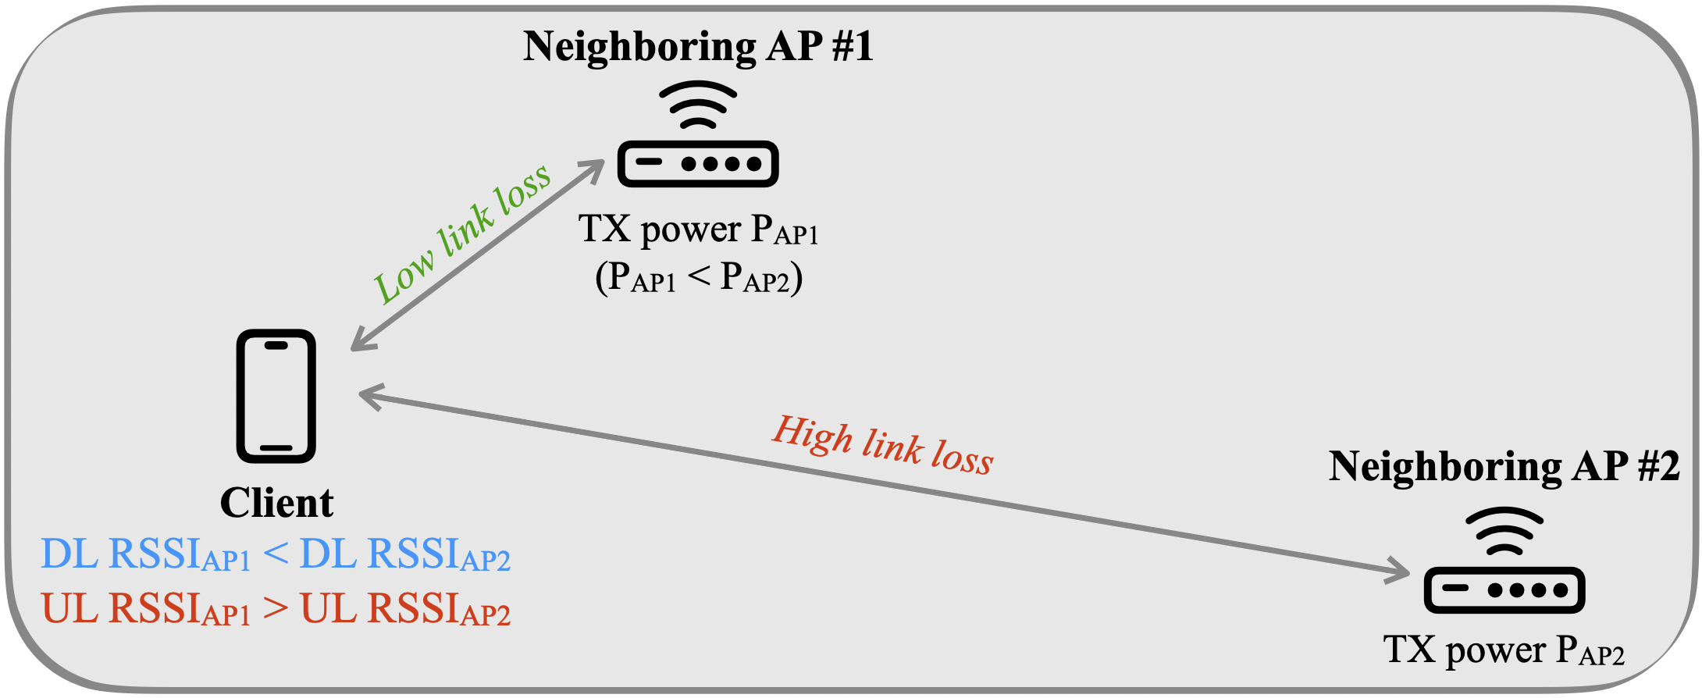
Motivating Scenarios – Importance of Uplink RSSI (2)
  Refer to the illustration to the above for an example topology
  It is possible that AP #1 operates at a transmit power lower than AP #2 (e.g., Transmit Power Control (TPC) in enterprise environments)
  UL RSSI may not follow the same trend as DL RSSI
  If STA is aware of the uplink RSSI at AP #1 and AP #2, then it can make educated roaming decisions instead of relying exclusively on DL RSSI measurements

Slide 5
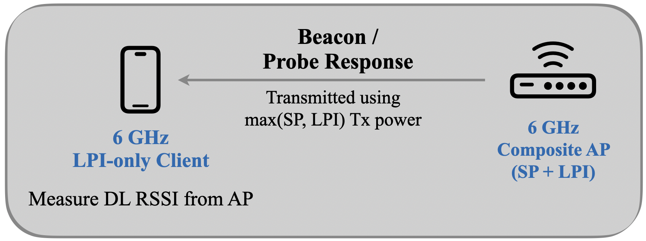
Motivating Scenarios – Importance of Uplink RSSI (3)
A 6 GHz AP may be a composite AP – i.e., it can support standard power (SP) and low-power-indoor (LPI) modes
Such an AP may choose to transmit beacon / probe response frames using max (LPI, SP) Tx power; typically, SP Tx power is higher than LPI Tx power
A 6 GHz LPI-only client may receive such frames and record a high DL RSSI from the AP because high AP Tx power in SP mode
The client may choose to associate with the AP based on DL RSSI only and may run into ramifications like association failures, unsatisfactory UL performance, etc.
    Client Tx power in LPI mode << AP Tx power in SP mode ➔ UL RSSI << DL RSSI
Knowledge of uplink RSSI empowers client to make more intelligent AP selection

Slide 6
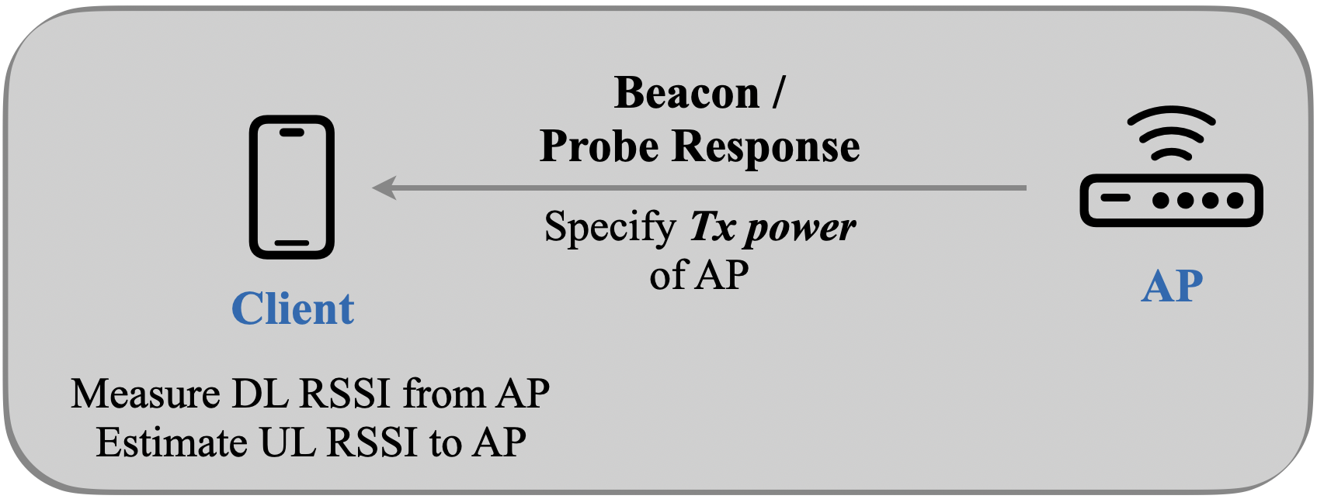
Estimation of Uplink RSSI by Client
Proposal #1 – AP advertises the transmit power (P_{TX, AP}) used to transmit beacon and probe response frames
  P_{Tx,AP} is normalized to 20 MHz
  Notations:
  P_{TX,AP} = TX power of AP (advertised by the AP)
    TX power is measured at the output of the antenna connector; aggregated over all antenna connectors in case multiple antennas are used for frame transmission
  G_{TX,AP} = G_{RX,AP} = AP antenna gain
  P_{TX,STA} = TX power of the STA
  G_{TX,STA} = G_{RX,STA} = STA antenna gain
  PL = Path loss between AP and STA
  DL_{RSSI} = Measured DL RSSI at STA from AP
  UL_{RSSI} = Estimated UL RSSI by STA
Math for Estimation
DL_{RSSI} = P_{TX, AP} + G_{TX, AP} – PL + G_{RX, STA}
⇒ PL = P_{TX, AP} + G_{TX, AP} + G_{RX, STA} – DL_{RSSI}
UL_{RSSI} = P_{TX, STA} + G_{TX, STA} – PL + G_{RX, AP}
⇒ UL_{RSSI} ≈ P_{TX, STA} – P_{TX, AP} + DL_{RSSI}

Slide 7
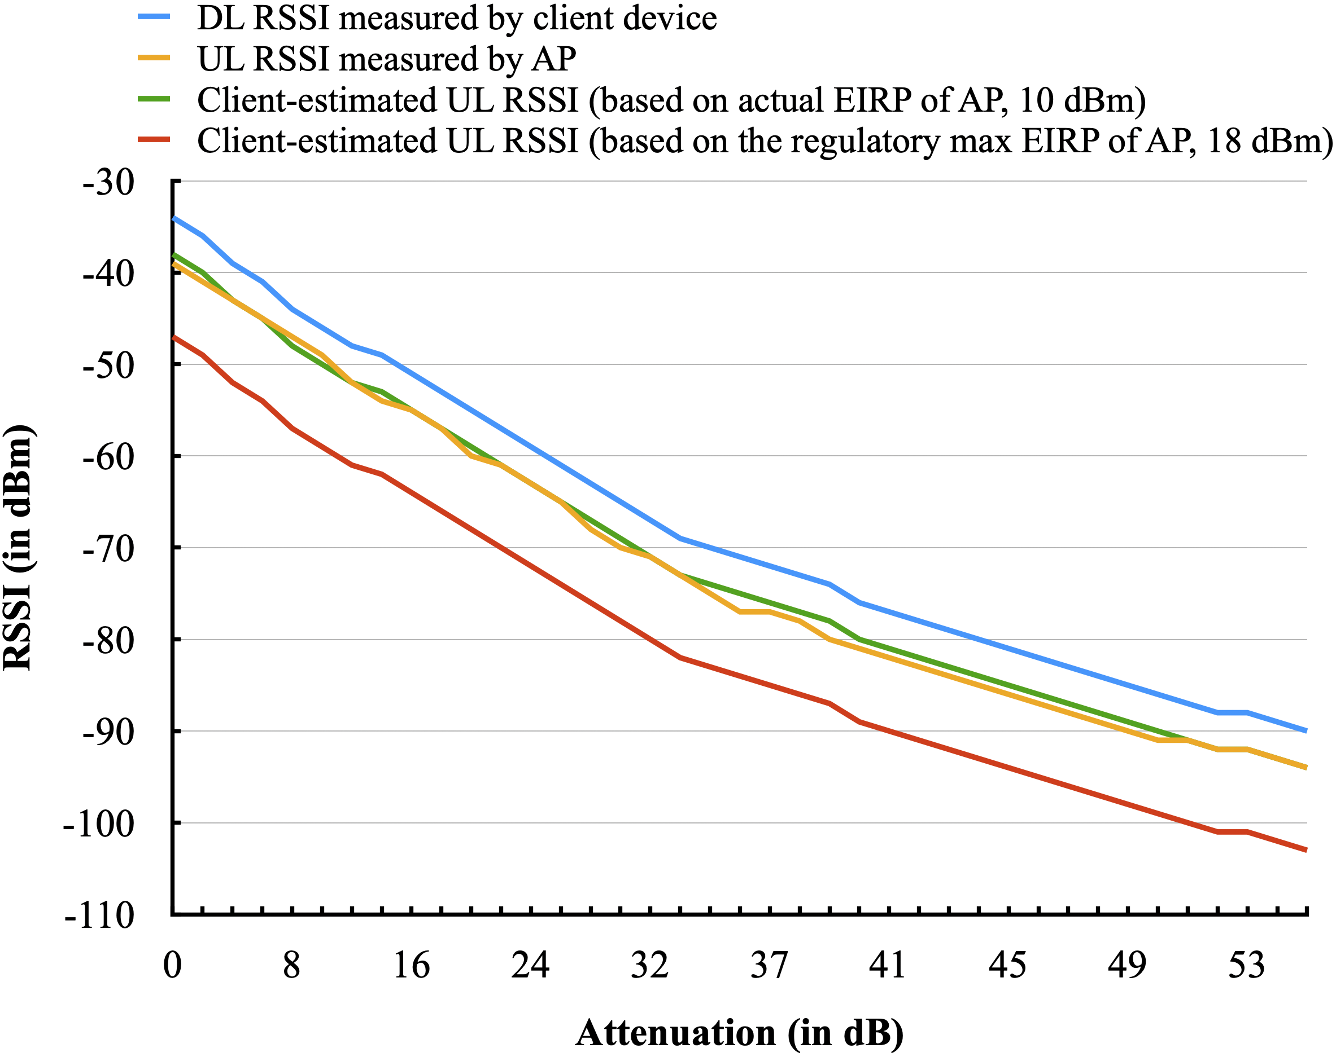
Results from Experiments
Experiment setup:
Channel: 6 GHz, Channel 37 (20 MHz)
One AP, one client device (both are single-link devices)
Attenuation between the two devices was controlled by a programmable attenuator
Experiments were performed in a shield room
Butler channel
Two key upshots:
Knowledge of actual Tx power used by AP greatly improves the accuracy of the estimated UL RSSI
Lightweight estimation of UL RSSI by client matches closely with the actual measured UL RSSI
Notice the gap between red and green curves

Slide 8
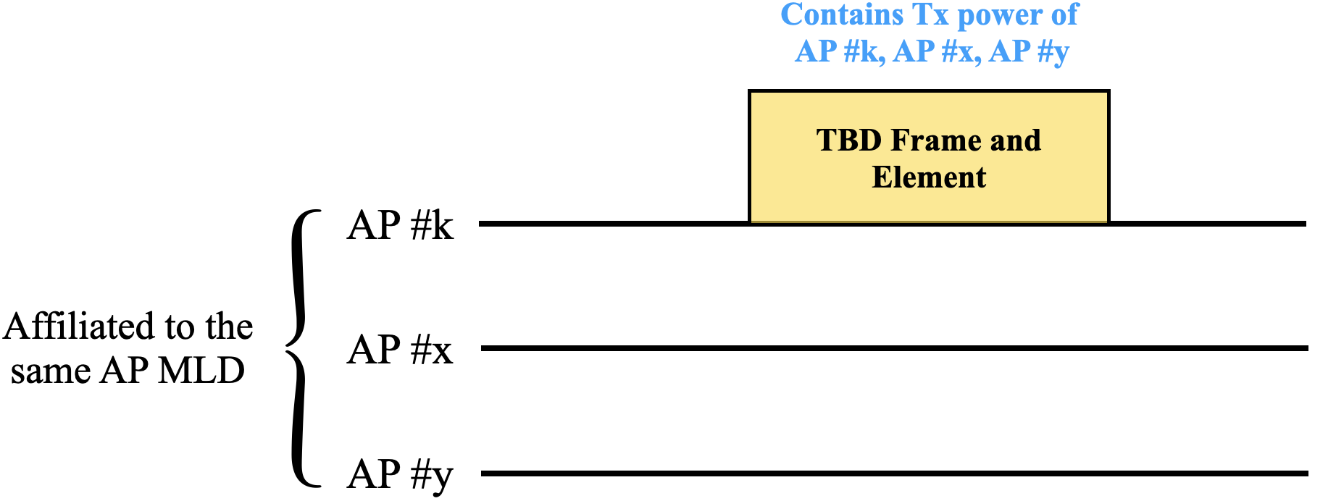
Estimation of RSSI by Client in Other Links
Proposal #2 – AP #k advertises the Tx power of other APs (AP #x, AP #y) affiliated with the same AP MLD
  Tx power of AP #x is the transmit power used by AP #x to transmit beacon / probe response frames in Link #x (normalized to 20 MHz)
  AP #k may include this information in multi-link (ML) probe response frames, neighbor report, RNR etc.; this is TBD
Motivation:
Based on Rx of ML probe response frame in Link #k, a STA MLD may perform the following operations:
  Measure DL RSSI in Link #k
  Estimate UL RSSI in Link #k
  Estimate DL and UL RSSI in Link #x and Link #y (by translating PL in Link #k to other links by applying a fudge factor dependent on the center frequencies of the links)
Key upshot – STA MLD can estimate RSSI in multiple links with minimal overhead (reduces STA power consumption)

Slide 9
Conclusion
  Elucidated the importance of knowledge of uplink RSSI (Client → Roaming candidate AP) at client-side to facilitate effective roaming decisions
  Proposed a lightweight scheme that allows local estimation of uplink RSSI at client-side based on reception of beacon / probe response frames from AP
  Proposed that AP include the transmit power (measured at the output of the antenna connector) used to transmit beacon / probe response frames
      The transmit power is normalized to 20 MHz
  Proposed that an AP include the transmit power (normalized to 20 MHz) of other APs affiliated with the same AP MLD
      For e.g., AP #k affiliated with an AP MLD may include the information about other APs affiliated with the same AP MLD

Slide 10
SP #1
An AP (referred to as the reporting AP) affiliated with an AP MLD includes the following information in a TBD frame:
Transmit power used by the reporting AP to transmit the frame
Difference in Beacon transmit power of the Reporting AP and other AP(s) affiliated to the same AP MLD as the Reporting AP
Note 1: Transmit power is the combined transmit power at the transmit antenna connector of all the antennas, expressed in units of dBm / 20 MHz
Note 2: The reported difference in transmit power may be positive, negative, or zero
Note 3: Element format to carry this information is TBD
Note 4: The tolerance for the reported transmit power is TBD

