Slide 1
Channel Correction in Long Range Bistatic Backscatter
Date: 2025-01-13
Authors:

Slide 2
Abstract
This contribution introduces the concept of channel correction in long range bistatic backscatter.
We also review training sequences already defined in 802.11, and how they can be reused in a long range bistatic backscatter use case.

Slide 3
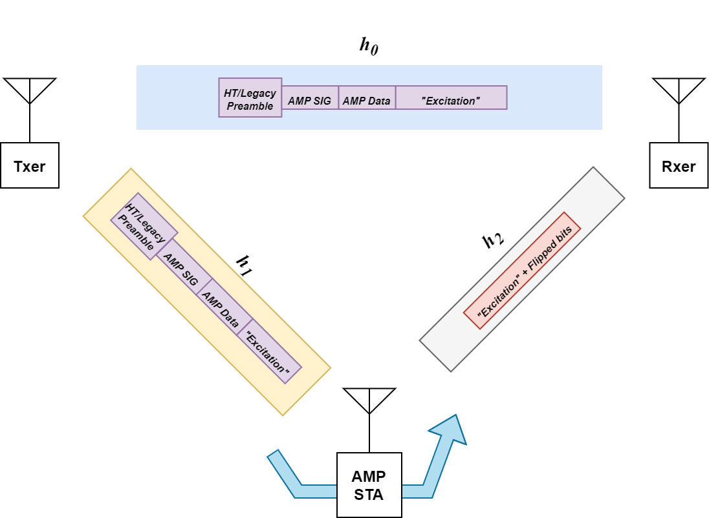
Long Range Bistatic Backscatter
In addition to compensating from radio impairments, we need to compensate for channel impairments.
In a bistatic topology, there are three physical channels, or paths represented by the impulse responses h₀, h₁, h₂.
Ideally, an impulse response describes a path’s transfer function across all frequencies.
  This is important because the Txer “transmits” energy outside of its center frequency, and the Rxer “listens” to energy outside of its center frequency.

Slide 4
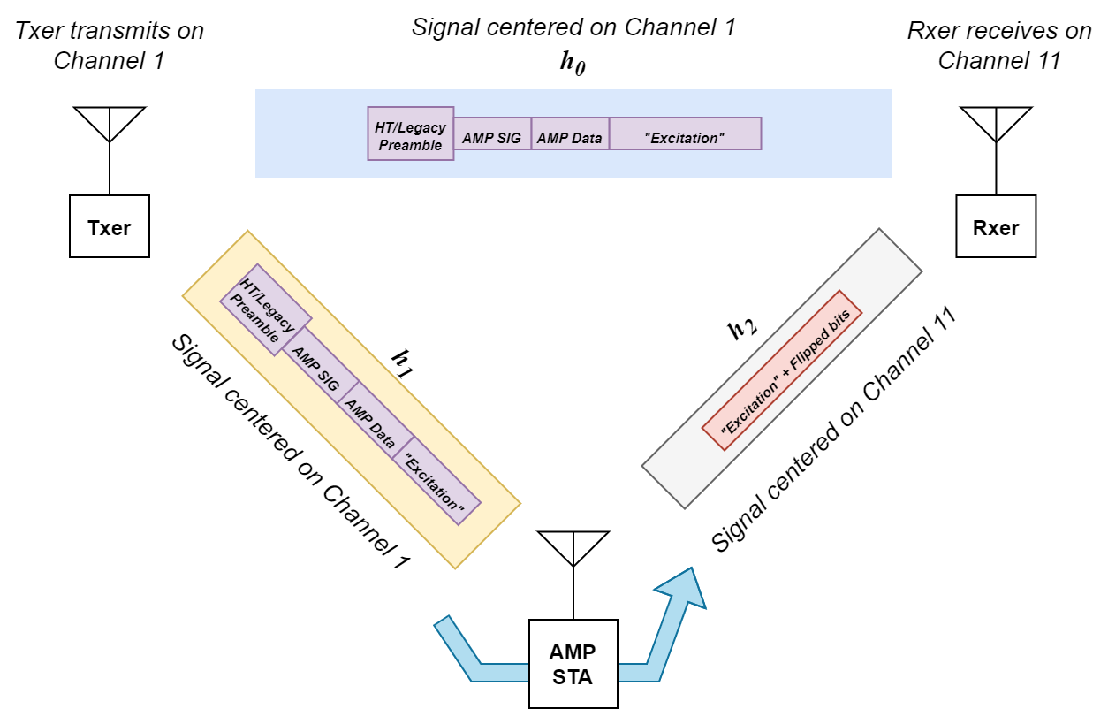
Long Range Bistatic Backscatter
h₀
  The path from transmitter to receiver.
  This carries the AMP DL PPDU, centered at channel 1.
  This represents the interfering “self-jamming” signal.
h₁
  The path from the transmitter to AMP STA.
  This also carries the AMP DL PPDU, centered at channel 1.
h₂
  The path from the AMP STA to receiver.
  In the case of channel shifting, the signal carried here is centered on a different frequency from the transmitter. (e.g. channel 11)

Slide 5
Long Range Bistatic Backscatter
The only surviving portion in h₂ is the modified “Excitation” field.
The only way to train the receiver on the AMP STA’s uplink signal is using training symbols within this excitation field.
The Rxer hears a concatenation of signals from all three physical channels.
Excitation signal through h₁
Rxed signal
The resulting signal through the uplink h₂
txed signal through h₀
Modulated to a different channel by the AMP STA

Slide 6
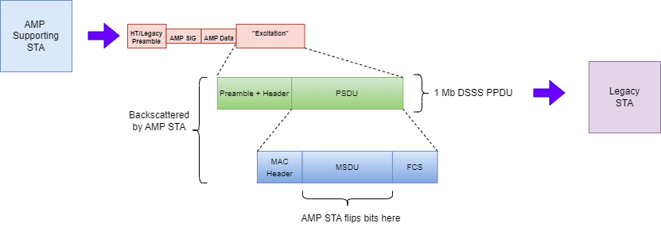
Proposed “Excitation” Waveform
As discussed in [2], there are benefits to using the 802.11b/g 1 or 2 Mb DSSS waveform.

Slide 7
Existing Training Sequences for Channel and Radio Impairments
There are already many well-defined training schemes defined for 802.11 PHYs.
It is important to note that, without penalty to the AMP STA, the transmitter can encode any training sequence in the “Excitation” field.
  The AMP STA only has to flip bits to encode new data.
  Most of the complexity and power consumption for a given PPDU format is consumed at the transmitter, not the AMP STA.
Reusing existing training sequences has several advantages
  Existing 802.11 receivers will recognize the backscattered PPDU format. (Receiver diversity, market acceptance)
  Existing training sequences are already proven useful in mitigating radio and channel impairments.

Slide 8
Preambles and Training Sequences: Comparison
Amendment | Preamble Modulation | BWs (MHz) | Training | Preamble Durations | Notes
11a (Clause 17) | OFDM | 5, 10, 20 | STF, LTF | 24 µs
11 (Clause 15) | DSSS | 22 | Barker | 144 µs | No STF, LTF. Training comes from repeated Barker sequence. Each occurrence of the Barker sequence can be combined (averaged) to get a better estimate of channel and radio impairments. The Barker sequences enable very simple estimation techniques.
11b (Clause 16) | DSSS | 22 | Barker | 144 µs, 72 µs (2 Mb and above)
11g (Clause 18) | DSSS | 22 | Barker
 | OFDM | 20 | L-STF, L-LTF | T_SHORT and T_LONG | Depending on BW, T_SHORT = 8, 16, 32 µs T_LONG = 8, 16, 32 µs
11n | OFDM | 20, 40 |  |  | HT_MF: HT mixed format
11ac | OFDM | 20, 40, 80, 160 |  |  | VHT and HT include more training after the legacy fields (L-STF, L-LTF, L-SIG) that involve a variable length field (VHT-LTF) or variable number of fields (HT-LTFs).
11ah | OFDM | 1, 2, 4, 8, 16 | STF, LTF1
11ax | OFDM | 20, 40, 80, 160 | L-STF, L-LTF | 8 + 8 = 16 µs | Each Tx mode has its own PPDU format, but same preamble.
11ba | OOK | 20 (WUR Basic) 40, 80 (WUR FDMA) | L-STF, L-LTF
11be | OFDM | 20, 40 , 80, 160, 320 | L-STF, L-LTF

Slide 9
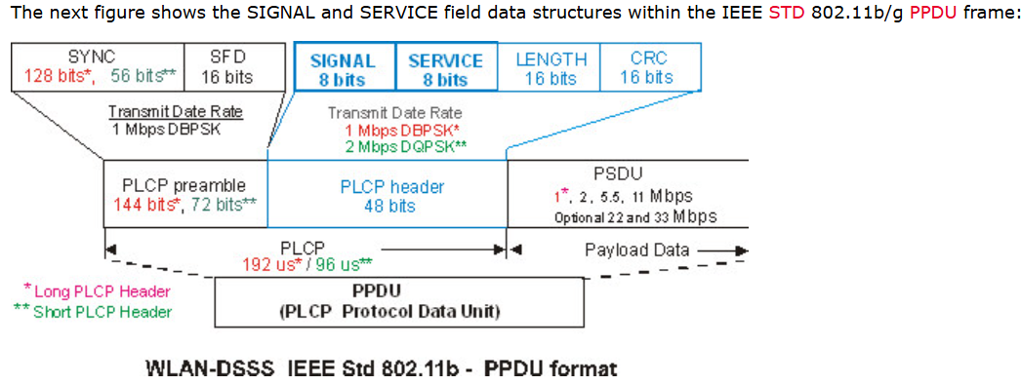
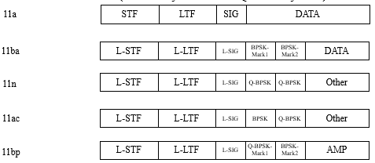
802.11b Versus Other Training Sequences
11b DSSS PHYs have different preamble format than HT or “Legacy” preambles.
DSSS PHYs rely on the Barker sequence for detection, recovery and channel estimation.
Using 11b preambles keeps backward compatibility with a wide variety of already deployed WLAN networks.

Slide 10
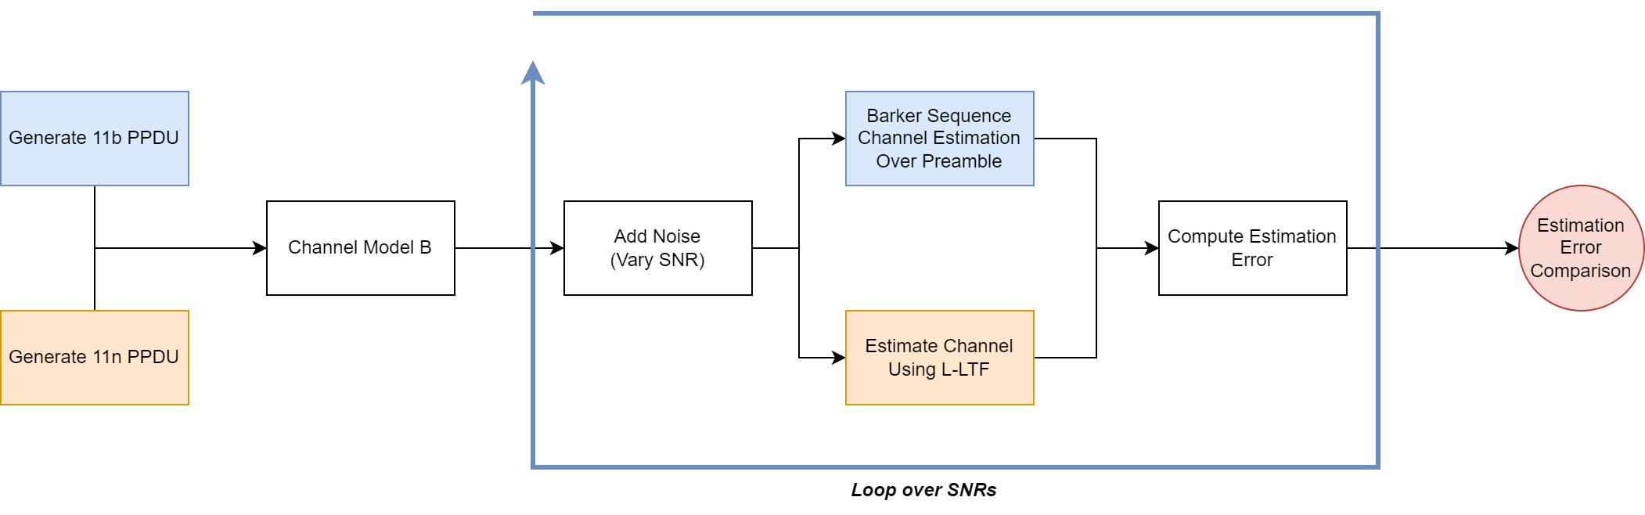
Estimation Accuracy: 11b Preamble Versus HT (L-LTF)
Consider the case where we’d like to compare the estimation accuracy of the 11b preamble (Barker sequence-based training) to an HT or Legacy preamble.

Slide 11
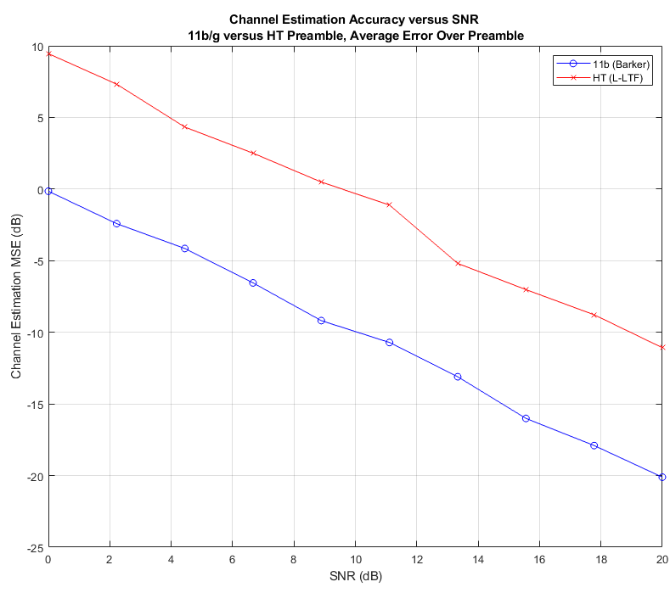
Estimation Accuracy: 11b Preamble Versus HT (L-LTF)
The Barker sequence channel estimate is always more accurate than using the L-LTF.
  This is largely because the channel estimate can be averaged over the longer 11b preamble.
The estimation error is roughly 10 dB less for 11b versus HT.
How this translates to actual performance benefits in real implementations is yet to be determined.

Slide 12
Conclusions
To help enable long range backscatter, we need training sequences embedded in the backscattered waveform.
  As for any PPDU, the receiver uses these training sequences to correct for channel and radio impairments.
Depending on implementation, estimation accuracy can improve link margins.
  Largely due to the preamble length, 11b waveforms can enable much more accurate channel estimation.
In backscatter operations, the AMP STA does not have to create the training sequences!
  The transmitter (AMP Supporting STA) can embed training in the Excitation field.

Slide 13
Straw Polls
SP1:
Do you agree that, in order to enable long range bistatic backscatter, there must be training symbols in the excitation field?

Slide 14
References
[1] Qi et al., Further Discussion on AMP PPDU Design, 11-24/1780, November 2024.
[2] Kezys et al, Low Complexity Backscatter AMP STA, 11- 24/2002, December 2024.
[3] Costa et al., Follow-up on Channel Shifting in Backscatter Operations, 11-24/2128, January 2025.

