Slide 1
802.11 WG January 2025 Session Report
Date: 2025-01-15
Authors:

Slide 2
Abstract
This document is a digest of the closing reports of all 802.11 sub-groups for presentation at the January 2025 closing plenary meeting. Liaison reports (including liaison reports from the mid-week plenary) are also included.

Slide 3
January 2025 Editors’ Meeting Agenda and Report
Roll Call / Contacts / Reflector
Brief status report
Amendment alignments and draft development snapshot
Review Publication Process
Form the publication review committees
Editorial Style Guide updates and issues for feedback
ANA number spaces

Slide 4
Volunteer Editor Contacts
  WG – Robert Stacey – robert.stacey@intel.com, Emily Qi – emily.h.qi@gmail.com
  TGbe – Edward Au – edward.ks.au@gmail.com
  TGbh – Carol Ansley – carol@ansley.com
  TGbi – Po-kai Huang – po-kai.huang@intel.com
  TGbn- Ross Jian Yu ross.yujian@huawei.com
TGbk – Roy Want RoyWant@google.com
TGbf – Claudio da Silva – claudiodasilva@meta.com
  REVme – Emily Qi – emily.h.qi@gmail.com, Edward Au – edward.ks.au@gmail.com
  REVmf - Po-kai Huang – po-kai.huang@intel.com, Edward Au – edward.ks.au@gmail.com

Slide 5
January meeting roundtable status report (to be updated)
REVme – D7.0, approved by IEEE SASB, will be published as IEEE Std 802.11™-2024
11bh – D6.0, approved by IEEE SASB, will be published as IEEE Std 802.11bh™-2024
11be – D7.0, approved by IEEE SASB, will be published as IEEE Std 802.11be™-2024
11bk – Completed initial SA ballot on D3.0. All 78 Comment resolved. D4.0 should be ready end of the week.
11bf – Currently in SA recirc 2; closes Friday on D7.0. Most likely the final recirc. Then waiting for 11bk to move forward.
11bi – D0.7 is available. 58 comments need to be resolved, 24 ready for motion. Still expect D1.0 to go to initial WG ballot out of January.
11bn – Plan to run a motion to approve D0.1 this session. Should be available February.
REVmf – Plan to have the initial draft 0.0 from published version. Then have D0.1 with 11bh and D0.2 with 11be. Implement approved changes to date in D1.0 coming out of May session (might be July).

Slide 6
Editor Amendment Ordering
See http://grouper.ieee.org/groups/802/11/Reports/802.11_Timelines.htm
Changes are usually based on MDR readiness.
As discussed in November 2024
Amendment Number | Task Group | Page Count | Projected RevCom Date (submission)
REVme | TGm | 6213 | September 2024 - Approved
802.11-2024 Amendment 1 | TGbh | 34 | September 2024 - Approved
802.11-2024 Amendment 2 | TGbe | 1089 | September 2024 – Approved
802.11-2024 Amendment 3 | TGbk | 111 | March 2025
802.11-2024 Amendment 4 | TGbf | 220 | March 2025
802.11-2024 Amendment 5 | TGbi | 138 | ?
802.11-2024 Amendment 6 | TGbn | ? | May 2028
REVmf | TGm | 6000+ | Feb 2028

Slide 7
Draft Development Snapshot
Changes from last report shown in red.
January 2025
TG | Published or Draft Baseline Document |  |  |  |  |  |  | Source | MDR | Editor | Snapshot Date
 | Published | me | bh | be | bk | bf | bi
me | Y | 7.0 |  |  |  |  |  | FrameMaker 2020 | Yes | Emily Qi, Edward Au | July 29, 2024
bh | Y | 7.0 | 6.0 |  |  |  |  | FrameMaker | Yes | Carol Ansley | July 16, 2024
be | Y | 7.0 | 6.0 | 7.0 |  |  |  | FrameMaker (old) | Yes | Edward Au | July 15, 2024
bk | Y | 5.0 | 4.0 | 5.01 | 3.0 |  |  | Word | No | Roy Want | January 14, 2025
bf | Y | 7.0 | 6.0 | 7.0 | 3.0 | 7.0 |  | FrameMaker 2020 | Yes | Claudio da Silva | January 14, 2025
bi | Y | 7.0 | 6.0 | 7.0 | 1.0 | 3.0 | 0.7 | FrameMaker 2020 |  | Po-kai Huang | January 14, 2025
bn | Y | 5.0 | 2.0 | 5.0 | 1.0 | 3.0 | 0.1 |  |  | Ross Jian Yu | January 14, 2025
mf

Slide 8
Publication process
Publication editor creates a marked-up PDF with editorial changes highlighted
802.11 WG technical editor forms a review committee, which includes:
- TG editor(s) +WG editor(s) + TG chair + others.
Each member of the committee should review each change proposed by the publication editor
Pay particular attention to
  Reconstructed sentences
  Tables with number changes
  - for example, the order in the Beacon frame body table should not be changed
  ANA assignments
The review process is complete when all publication changes have been reviewed

Slide 9
Publication Review Committees
REVme Review Committee
Emily Qi (lead): emily.h.qi@gmail.com
Edward Au: edward.ks.au@gmail.com
Mike Montemurro: montemurro.michael@gmail.com
Robert Stacey: robert.stacey@intel.com
Carol Ansley: carol@ansley.com
Po-kai Huang: po-kai.huang@intel.com
?
11bh Review Committee
Carol Ansley (lead);
Mark Hamilton: mark.hamilton2152@gmail.com
Emily Qi;
Robert Stacey;
?
11be Review Committee
Edward Au (lead);
Alfred Asterjadhi: aasterja@qti.qualcomm.com
Emily Qi;
Robert Stacey;
Carol Ansley
?

Slide 10
ANA managed number space
Protocol Version subfield: 9.2.4.1.2
Frame types and subtypes: 9.2.4.1.3, Tables 9-1 and 9-2
Element ID and Element ID extension: Table 9-128
Capability Information field: 9.4.1.4
Extended Capabilities: 9.4.2.25, Table 9-190
Reason codes: 9.4.1.7, Table 9-77
Status codes: 9.4.1.9, Table 9-78
Action frame categories: 9.4.1.11, Table 9-79
Authentication algorithm: 9.4.1.1
RSNE: 9.4.2.23
Cypher suites: Table 9-186
AKM suites: Table 9-188
RSN Capabilities: Figure 9-345
RSNXE Capabilities: 9.4.2.240, Table 9-365
ANQP-element (Info ID): 9.4.5.1, Table 9-412
Neighbor Report subelements: 9.4.2.35, Table 9-210
FTE subelements: 9.4.2.46, Table 9-219
Public Action frames: 9.6.7.1, Table 9-450
WMN-Notification Types: 9.6.13.29, Table 9-516
Mesh Configuration Active Path: 9.4.2.96.2, Table 9-277
TLV encodings: 9.4.4
KDE Selector Data Type: 12.7.2
Operating classes: Annex E
global, USA, Europe, Japan
MIB objects: Annex C
ieee802dot11, dot11smt, dot11phy, dot11mac, dot11StationConfigEntry, dot11OperationEntry, dot11Compliances, dot11Groups

Slide 11
ANA
No report

Slide 12
AIML SC (AI and ML)
No report

Slide 13
ARC SC (Architecture)
No report

Slide 14
Coex SC (Coexistence)
No report

Slide 15
PAR Review SC
No report

Slide 16
WNG SC (Wireless Next Generation)
No report

Slide 17
JTC1 802 SC
No report

Slide 18
TGmf (Maintenance)
No report

Slide 19
Task Group BF
January 2025 Closing Report
Date: 2025-01-15
Authors:
Name | Affiliation | Address | Phone | Email
Tony Xiao Han | Huawei Technologies Co., Ltd. | F3, Huawei Base, Shenzhen, China |  | Tony.hanxiao@huawei.com

Slide 20
TGbf (WLAN Sensing)– January 2025
Progress during January 2025 session
  1 slots scheduled for TGbf
  Approve meeting minutes
  Discuss and confirm the plan for teleconference and March Plenary, for the next round (3rd SA Ballot Recirculation )
Goals for the next two months
  Release IEEE802.11bf D6.0
  Complete the 3rd SA Ballot Recirculation (D7.0)
  Start comment resolution for D7.0
  Requested 2 calls

Slide 21
TGbf Timeline
  PAR approved Sep 2020
  First TG meeting Oct 2020
  Comment Collection (D0.1) Jan 2022→Mar 2022 → April 2022
  Initial Letter Ballot (D1.0) Jul 2022→ Sep 2022→ Nov 2022→ Jan 2023
  Recirculation LB (D2.0) Jan 2023 → Mar 2023 → July 2023
  Recirculation LB (D3.0) May 2023 → Nov 2023
  Conditional EC Approval–SA Ballot Mar 2024
  Recirculation LB (D4.0) July 2023 à Jan 2024à Apr 2024
  SA Ballot pool formation Apr 2024
  Initial SA Ballot (D4.0) Sep 2023 à Mar 2024à May 2024
  1st SA Ballot Recirculation (D5.0) Sep 2024
  2nd SA Ballot Recirculation (D6.0) Jan 2025
  3rd SA Ballot Recirculation (D7.0) Mar 2025
  Final 802.11 WG approval July 2024à Jan 2025à Mar 2025
  802 EC approval July 2024à Jan 2025à Mar 2025
  RevCom and SASB approval Sep 2024à Mar 2025à Jun 2025
PAR modification approved by the WG Nov 2023
802EC approval Mar 2024
NesCom/SASB approval Mar 2024

Slide 22
Teleconference Times (plan after January Interim)
  Confirmed:
    Jan 23 (Thursday) 22：00 - 00:00 ET
    Feb 4 (Tuesday) 09：00 - 11:00 ET
    Feb 18 (Tuesday) 09：00 - 11:00 ET
    Feb 28 (Thursday) 22：00 - 00:00 ET

Slide 23
TGbi (Enhanced Data Privacy)
No report

Slide 24
TGbk (320 MHz Positioning)
No report

Slide 25
TGbn (Ultra High Reliability)
No report

Slide 26
TGbp (Ambient Power)
No report

Slide 27
TGbq (Integrated mmWave)
No report

Slide 28
ELC SG (Enhanced Light Communications)
No report

Slide 29
Automotive TIG Closing Report
Date: 2025-01-17
Authors:

Slide 30
Abstract
Closing report for AUTO TIG
November 2024 mixed-mode plenary meeting

Slide 31
Summary
Final Agenda
  https://mentor.ieee.org/802.11/dcn/24/11-24-2082-00-auto-agenda-for-automotive-tig-2025-january.pptx
Presentation of submissions
  “Field Considerations on WiFi for Vehicles,” Javier Contreras (Cisco Systems)
    https://mentor.ieee.org/802.11/dcn/25/11-25-0070-00-auto-field-considerations-on-wifi-for-vehicles-8203.pptx
  “Mobile-Wi-Fi,” Lili Hervieu, Steve Arendt (CableLabs)
    https://mentor.ieee.org/802.11/dcn/25/11-25-0017-00-auto-mobile-wi-fi.pptx
  “Follow-up of Automotive WLAN use case study,” Jing Ma (Toyota)
    https://mentor.ieee.org/802.11/dcn/25/11-25-0069-01-auto-follow-up-of-automotive-wlan-use-case-study.pptx
Minutes
  https://mentor.ieee.org/802.11/dcn/25/11-25-0159-00-auto-january-2025-kobe-auto-tig-meeting-minutes.docx
Plans for March
  Presentations on use cases, requirements and KPIs
No motions or teleconferences, 3 straw polls

Slide 32
802.15 liaison
No report

Slide 33
802.18 Liaison Report – January 2025
Date: 15 January 2025
Author:
Name | Company | Address | Phone | Email
Edward Au | Huawei Technologies |  |  | edward.ks.au@gmail.com
Gaurav Patwardhan | Hewlett Packard Enterprise |  |  | gauravpatwardhan1@gmail.com

Slide 34
RR-TAG at a glance
Membership as of 15 November 2024
  68 voters (including 10 on LMSC)
  2 nearly voters
  10 aspirants
Officers
  Chair: Edward Au (Huawei Technologies)
  Co-Vice Chair: Gaurav Patwardhan (Hewlett Packard Enterprise)
  Co-Vice Chair: Al Petrick (Jones-Petrick Associates)
  Secretary (for this interim): Chenhe Ji (Huawei Technologies)
  IEEE SA Program Manager: Jodi Haasz (IEEE SA)

Slide 35
Progress since the 2024 November plenary
Reviewed the latest ongoing consultations
Approved the following IEEE 802 LMSC submissions:
  Japan MIC: Call for opinions on the proposed ministerial ordinance to amend part of the Radio Law Enforcement Regulations: Addition of systems and bands to the special exemption system for non-technical equipment
  Saudi Arabia CST: Light Licensing Regulations Annex for the 6 GHz Frequency Band
  Vietnam MIC: Draft Circular amending and supplementing a number of articles of Circular No. 08/2021/TT-BTTTT dated October 14, 2021 of the Minister of Information and Communications stipulating the List of radio equipment exempted from radio frequency use licenses, technical conditions and accompanying exploitation
Discussed the latest topics related to spectrum and regulation in Europe, North America, and Asia Pacific.

Slide 36
Objectives this week (1)
Review and approve draft responses to the following consultations:
  France ARCEP: Draft decision repealing decision no. 2007-0683 of 24 July 2007 as amended and setting the conditions for use of radio frequencies for equipment operating using ultra-wideband technology
  UK Ofcom: Ofcom’s Plan of Work 2025/26
Review draft responses to the following external liaisons:
  ITU-R Working Party 5C liaison re 450 GHz to 1000 GHz
  ITU-R Working Party 5A and 5C re IEEE Std 802.15.3-2023
Discuss the latest topics related to spectrum and regulation in Europe, North America, and Asia Pacific, including ETSI BRAN update and ETSI ISG THZ liaison

Slide 37
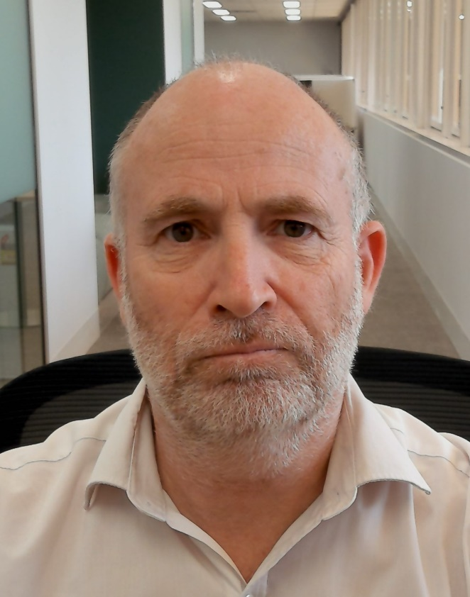
Objectives this week (2)
Invited presentation from Australia ACMA
  Title: ACMA Spectrum planning for Wi-Fi
  Author: Andrew Stewart (Senior Manager, Spectrum Planning Section, Australian Communications and Media Authority)
  Document: 18-25/0001

Slide 38
802.19 WG January 2025 Liaison Report
Date: 2025-1-14
Authors:

Slide 39
IEEE 802.19 Overview
IEEE 802.19 group reviews coexistence assessment documents (CAD) produced by working groups developing new wireless standards for unlicensed devices.
IEEE 802.19 develops standards for coexistence between wireless standards of unlicensed devices.
Meeting times: Monday PM3 and Thursday PM3 (6:30 PM).
Position | Person
Working Group Chair | Tuncer Baykas (Ofinno)
Working Group Vice Chair | Steve Shellhammer (Qualcomm)
Work Group Secretary | Yukimasa Nagai (Mitsubishi Electric)
Task Group 3a Chair | Ben Rolfe (Blind Creek Associates)
Liaison To/From 802.11 | Tuncer Baykas (Ofinno)

Slide 40
Coexistence Assessment Documents
No ballots before November meeting.

Slide 41
802.19.3a Task Group
Scope of the project: This amendment updates and expands coexistence recommendations to address new market requirements, increasing data traffic, greater device density of devices, and increased potential for congestion based on both IEEE Std 802.11-2020 and IEEE Std 802.15.4 sub-1 GHz standards.
Thursday 6:30 PM:
IEEE 802.11ah and IEEE 802.15.4g SUN OFDM PHY Coexistence Simulation, Takenori Sumi

Slide 42
IEICE Conference in Kyoto
Fri, Jan 17 AM Special Session on IEEE 802 Standardization (Maskawa Hall, Kyoto University) 11:00 - 17:30
(1) | 11:00-11:50 | IEEE 802.19 Wireless Coexistence Working Group | Tuncer Baykas (Ofinno)
(2) | 13:00-13:50 | Latest trends in IEEE 802.15 and Wi-SUN Alliance | Phil Beecher (Wi-SUN Alliance)
(3) | 13:55-14:45 | Latest trends in In-Body CA Localization and IEEE 802.15.6ma | Daisuke Anzai (Nagoya Inst. of Tech.)
(4) | 15:00-15:50 | Latest trends of wireless LAN standardization in IEEE 802.11, and development of system-level simulator for evaluating reliability of cybernetic avatar operation | Kazuto Yano (ATR)
(5) | 16:00-17:30 | Discussion session
For more info: https://ken.ieice.org/ken/program/index.php?tgs_regid=58056984cfac617843301b8c7cd5c46dd6c281f7addbd8c4f4245a7de3ec65e9&tgid=IEICE-SRW&lang=eng

Slide 43
802REVc Status January 2025 Update
Date: 2025-01-12
Authors:

Slide 44
Abstract
This document intended to be a status report for the 802.11 WG and the 802.11 ARC SC.

Slide 45
IEEE Std 802-REVc Overview
PAR was approved on 24 March 2022 to create:
802-REVc - “Standard for Local and Metropolitan Area Networks: Overview and Architecture”
A maintenance roll up of the outstanding amendments of IEEE std 802-2014 – 802.c, 802d, 802f
  Assigned to 802.1 Maintenance – Mark Hantel Maintenance TG Chair, Glenn Parsons 802.1 Chair
  Status/documents/comments are available: https://1.ieee802.org/maintenance/802-revc/
  Files available: https://www.ieee802.org/1/files/private/802-REVc-drafts/ (members only, .11 members)
  Editor: James Gilb
Draft Status Overview:
  WG ballot phase has completed.
  SA ballot phase has completed.
  RevCom recommended and SASB approved publication December 2024
  Final draft of IEEE Std 802-REVc is available IEEE Std 802-REVc-d2.2
  IEEE Std 802-REVc will be published as IEEE Std 802-2024 in Q1 of 2025

Slide 46
Next Steps
Awaiting IEEE publication of IEEE Std 802-2024
802.11 next steps:
  Align 802.11 to be consistent with the updated IEEE Std 802
  It is anticipated work will be done in 802.11 ARC SC and implemented in 802.11 TGmf.
  802.11 ARC SC has identified the following potential topics to be addressed:
          EPD and LPD terms are going away – we need to update 802.11 to align
          Review MAC address ordering discussion, and 802.11 assumptions (1-24/0034r0)
          Review 802.1AC mapping from ISS to 802.11 MAC SAP interface
          Consider any changes to remove 802.2/LLC terms?
          802.11’s “Portal”, and mapping to/usage of IEEE Std 802 terminology
          Access Domains: “802 Access Domains”?
          What if we make the DS a bridge (small ‘b’)?
          Adding something about VLANs (just informational?) into 802.11?

Slide 47
References

Slide 48
Wi-Fi Alliance (WFA) Liaison January 2025 Update
Date: 2025-01-15
Authors:

Slide 49
Abstract
This presentation contains the Wi-Fi Alliance (WFA) liaison update for January 2025 IEEE 802.11 meeting

Slide 50
Meetings
This year marks the 25th Anniversary of the WFA
Celebration of W-Fi future at Malaga, Spain in the Europe member meeting, Oct 15-17 after covering future earlier in the year in Singapore and Austin, TX
  Keynote speeches by industry experts
  Panel discussions on expanding enterprise opportunity, innovation, connected healthcare, market segment insights and demos
  Meeting reports available for members
The next WFA F2F (Asia) member meeting will take place on Feb 18th-20th, 2024, in Tokyo, Japan

Slide 51
Activities
Technical activity at WFA that has recently led to certification
  Wi-Fi 7
  QoS Management
  EasyMesh
  WPA3
  Wi-Fi proximity ranging
Technical activity at WFA that is expected to lead to certification
  Wi-Fi 7 R2
  6 GHz standard power
  Wi-Fi Direct
  XR (Augmented / Virtual / Mixed Reality)
  QoS Management
Increased use of interoperability events with commercial products after program launches

Slide 52
Additional Work Areas
Examples of additional WFA technical work
  Security
  Customer Experience
  EasyConnect
  Wi-Fi HaLow
  Wi-Fi Data Elements
  Wi-Fi Aware
Examples of additional WFA activity that may lead to technical work
  Sensing
  Automotive
  Healthcare
  Internet of things
  Operators
Spectrum regulatory

Slide 53
Recent publications
Wi-Fi Alliance® and Faculty of Medicine Ramathibodi Hospital drive 6 GHz Wi-Fi® innovation in Thailand
Propelling innovation: 6 GHz and AFC drive advancements in outdoor Wi-Fi® deployments
Podcasts:
  Episode 72: Wi-Fi® brings connection to communities with Curtis Hill of Open Broadband
  Episode 71: 6 GHz Wi-Fi® and AFC improves connectivity for all with Jussi Kiviniemi of Hamina Wireless

Slide 54
Further information
For more information on current areas of work, see http://www.wi-fi.org/who-we-are/current-work-areas
If these sound like interesting topics, please plan to sign up and participate
Further general information at http://www.wi-fi.org/

Slide 55
Wireless Broadband Alliance (WBA) Liaison Report – January 2025
Date: 2025-01-15
Authors:
Name | Company | Address | Phone | Email
Necati Canpolat | Intel |  |  | necati.canpolat@intel.com

Slide 56
Wireless Broadband Alliance (WBA)
Drives enabling seamless & interoperable Wi-Fi services
Addresses business and technical issues, as well as opportunities in the industry
IEEE 802.11 (std dev) WFA (cert) WBA (enablement)

Slide 57
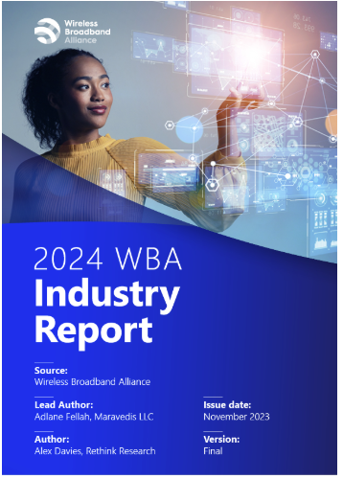
WBA Annual Industry Report 2024
Highlights significant trends and developments in the Wi-Fi and connectivity sector
Based on insights from 200 global industry executives
It is publicly available at: https://wballiance.com/resource/annual-industry-report-2024/

Slide 58
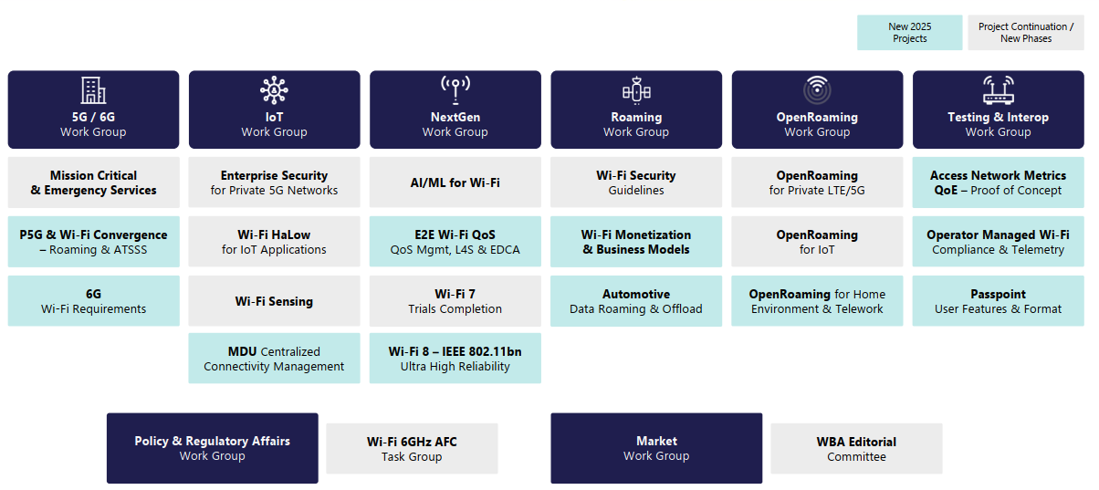
WBA Technical Activities & Roadmap for 2025
https://wballiance.com/wba-program-overview-2025/
https://wballiancec.com/proejcts-details

Slide 59

Wireless Global Congress & Members Meeting
https://www.wirelessglobalcongress.com/apac2025/

Slide 60
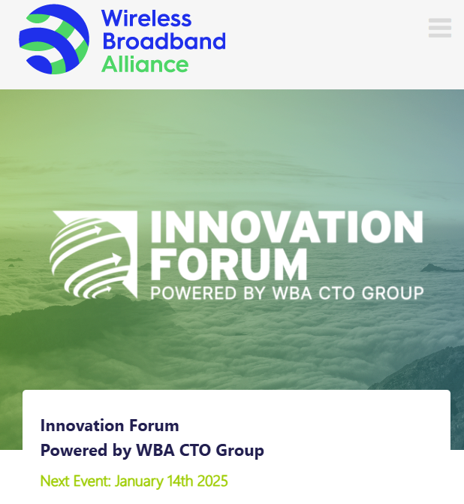
WBA Innovation Forum
https://wballiance.com/innovation-forum/
Focus on key themes sharing perspectives that will shape the future of connectivity for the next decade and beyond

Slide 61
WBA 6G/Wi-Fi Vision Statement
Launched WBA 6G/Wi-Fi Vision Statement on Jan’14
Calls for greater collaboration and among standard bodies all stakeholders for 6G to deliver on its promise
Details five key vision points for 6G, to achieve ubiquitous connectivity that comprises Wi-Fi and cellular

Slide 62
Further information
WBA information at https://wballiance.com/
Current work areas https://wballiance.com/wba-program-overview-2025/
WBA resource center https://wballiance.com/resource/
WBA events https://wballiance.com/events-awards/
WBA memberships: https://wballiance.com/membership/

Slide 63
Backup

Slide 64






WBA ORGANIZATION
WBA IS A NONPROFIT ASSOCIATION WITH THE VISION TO ACCELERATE THE DEVELOPMENT OF
“SEAMLESS AND INTEROPERABLE WI-FI SERVICES”
Seamless, Secure and Interoperable Wi-Fi
Convergence and Coexistence of Wireless Technologies
Accelerate Next Generation Wi-Fi Networks
Established
in 2003
+200 MEMBERSHIP
COMMUNITY
PROJECTS &
PROGRAMS
3 ANNUAL
EVENTS
PROMOTION AND
GO-TO-MARKET
THOUGHT LEADERSHIP &
MARKET RESEARCH

Slide 65


WBA Focus Areas
WBA MEMBERS SOLVE
REAL BUSINESS ISSUES
Fosters success for its members
WBA’s mission is to enable collaboration between service providers, technology companies and organizations to drive positive change and enable opportunities for growth.
Standards & Specifications - Setting the scene, requirements and creating specifications
Testing & Interoperability - Creating test plans to showcase the technology capabilities
End-to-End Trials - Running field trials/ proof of concept on real-world environment
Guidelines & Best Practices – Accelerate deployments of services and technologies
Certification & Plug Fests - Addressing gaps and helping the industry to maximizing biz opportunities
Think Thank & Advocacy – Industry leaders roundtables and targeted verticals analysis

Slide 66
IEEE 802.11-IETF Liaison Report
Date: 2025-01-15
Authors:

Slide 67
Abstract
This presentation contains the IEEE 802.11 – IETF liaison report for January 2025.

Slide 68
IETF Meetings
Upcoming Meetings:
  March 15-21, 2025 – Bangkok, TH
  July 19-25, 2025 – Madrid, ES
IETF meeting fee waivers
http://www.ietf.org
  Newcomer training: https://www.ietf.org/about/participate/get-started/
  April 2016: Wireless Tutorial (Donald Eastlake), 802.11 & 802.15 tutorials (Dorothy Stanley, Charlie Perkins), see 11-16/500, September 2016: Pat Thaler & Juan Carlos – 802.1E (Privacy Considerations) and 802c (Local MAC address usage) https://datatracker.ietf.org/group/edu/materials/

Slide 69
IETF- IEEE 802 Liaison Activity
Joint meetings, agenda and presentations
  http://www.iab.org/activities/joint-activities/iab-ieee-coordination/
  Proceedings: https://datatracker.ietf.org/iabasg/ietfieee/meetings/
  Coordination topics include: Capability Discovery, Data Center Bridging, use of Local Address in virtualization and IoT, MAC address randomization, DETNET/TSN/RAW, YANG models, pervasive monitoring
  IETF-IEEE 802 coordination teleconferences: October 23, 2024

Slide 70
IETF protocol use with 802.11 technology
RFC 9672 (RFC 8110 to IEEE) has been published.

Slide 71
BOFs at IETF 121 November 2-8, 2024
See https://datatracker.ietf.org/wg/bofs/
alldispatch | IETF-Wide "Dispatch" Session
diem | Digital Emblems
nasr | Network Attestation for Secure Routing
hpwan | High Performance Wide Area Network
rpp | RESTful Provisioning Protocol
deepspace | Deep Space

Slide 72
IETF/IRTF groups being (re-)chartered
See https://datatracker.ietf.org/group/chartering/
ccamp | Common Control and Measurement Plane
diem | Digital Emblems
ianabis | Update to IANA Considerations
ipsecme | IP Security Maintenance and Extensions
opsawg | Operations and Management Area Working Group
roll | Routing Over Low power and Lossy networks
rpp | RESTful Provisioning Protocol
spring | Source Packet Routing in Networking
tiptop | Taking IP To Other Planets

Slide 73
YANG Model Catalog
YANG catalog development
  A YANG model catalog and registry that allows users to find models relevant to their use cases from the large and growing number of YANG modules being published.
  YANG Catalog was developed through a collaboration between the IETF and the Broadband Forum, and contains many data models, including from other Standards Development Organizations (SDOs) such as the IEEE, as well as some vendor-specific data models. Interest and participation from other SDOs, equipment vendors, open-source projects and network operators is encouraged.
See https://www.ietf.org/blog/yang-catalog-latest-developments-ietf-100-hackathon/
See https://yangcatalog.org/ and https://1.ieee802.org/yangsters/

Slide 74
IoT-related work
6LO
  Working Group website: https://datatracker.ietf.org/wg/6lo/
  Focus: IPv6 over Networks of Resource-constrained Nodes
Updates
  Revised: Path-Aware Semantic Addressing (PASA) for Low power and Lossy Networks: https://datatracker.ietf.org/doc/draft-ietf-6lo-path-aware-semantic-addressing/ (November 2024)
  New and revised: Generic Address Assignment Option for 6LowPAN Neighbor Discovery: https://datatracker.ietf.org/doc/draft-ietf-6lo-nd-gaao/ (November 2024)

Slide 75
IoT-related work (cont.)
ROLL: Working Group website: https://datatracker.ietf.org/wg/roll/
  Focus: Routing over Low Power and Lossy Networks
CORE: (Constrained RESTful Environments) Working Group website: http://datatracker.ietf.org/wg/core/
  Focus: framework for resource-oriented applications intended to run on constrained IP networks.
IoT Directorate:
  Reviews IETF drafts that are IoT related
  See: https://datatracker.ietf.org/group/iotdir/about/

Slide 76
MADINAS WG
See https://datatracker.ietf.org/wg/madinas/
MAC Address Device Identification for Network and Application Services
  This is the IETF’s equivalent of IEEE 802.11bh – how to deal with the implications of the deployment of random and changing MAC addresses.
Updates
  In RFC Editor’s queue: Randomized and Changing MAC Address Use Cases and Requirements: https://datatracker.ietf.org/doc/draft-ietf-madinas-use-cases/ (December 2024)

Slide 77
EAP Method Update (EMU)
See https://datatracker.ietf.org/wg/emu/
  This working group has been chartered to provide updates to some commonly used Extensible Authentication Protocol methods including of EAP-TLS, EAP-AKA, EAP-AKA’ (for 5G), EAP-SIM, etc.
  The group should document any recently gained new knowledge on vulnerabilities or the possible implications of pervasive surveillance or other new concerns.
Updates
  Submitted to IESG for publication: The eap.arpa domain and EAP provisioning: https://datatracker.ietf.org/doc/draft-ietf-emu-eap-arpa/ (January 2025)
  Revised and still in RFC Editor’s queue and waiting on other document: Tunnel Extensible Authentication Protocol (TEAP) Version 1: https://datatracker.ietf.org/doc/draft-ietf-emu-rfc7170bis/ (January 2025)

Slide 78
Operations Area Working Group
https://datatracker.ietf.org/wg/opsawg/
Updates
  In IESG Review: A YANG Data Model for Augmenting VPN Service and Network Models with Attachment Circuits: https://datatracker.ietf.org/doc/draft-ietf-opsawg-ac-lxsm-lxnm-glue/ (January 2025) [noted as being one of several related YANG attachment circuit Internet-Drafts in progress]
Background
  Of interest: RFC 6632, An Overview of the IETF Network Management Protocols, see https://tools.ietf.org/html/rfc6632
  Automated network management, including YANG data models, see https://www.ietf.org/topics/netmgmt/

Slide 79
Internet Area Working Group
https://datatracker.ietf.org/wg/intarea/
Updates
  No updates noted over the preceding two months

Slide 80
Transport Layer Security (TLS)
See: https://datatracker.ietf.org/wg/tls/
Updates
  Held for formal analysis: TLS 1.3 Extension for Using Certificates with an External Pre-Shared Key: https://datatracker.ietf.org/doc/draft-ietf-tls-8773bis/ (January 2025)
  Waiting for AD go-ahead: TLS 1.2 is in Feature Freeze: https://datatracker.ietf.org/doc/draft-ietf-tls-tls12-frozen/ (January 2025)
  Adopted: The Datagram Transport Layer Security (DTLS) Protocol Version 1.3: https://datatracker.ietf.org/doc/draft-ietf-tls-rfc9147bis/ (December 2024)

Slide 81
Deterministic Networking (DETNET)
DETNET: https://datatracker.ietf.org/wg/detnet/
  The Deterministic Networking (DetNet) Working Group focuses on deterministic data paths that operate over Layer 2 bridged and Layer 3 routed segments, where such paths can provide bounds on latency, loss, and packet delay variation (jitter), and high reliability.
  The IEEE 802.11be activities seem like they may fit in with DetNet and there was a joint IEEE-IETF DetNet discussion in Bangkok (November 2018).
  Addresses Layer 3 aspects in support of applications requiring deterministic networking.
  The Working Group collaborates with IEEE 802.1 Time Sensitive Networking (TSN), which is responsible for Layer 2 operations, to define a common architecture for both Layer 2 and Layer 3.
  Example applications for deterministic networks include professional and home audio/video, multimedia in transportation, engine control systems, and other general industrial and vehicular applications being considered by the IEEE 802.1 TSN Task Group.
Updates:
  (Still) In WGLC: Reliable and Available Wireless Architecture: https://datatracker.ietf.org/doc/draft-ietf-raw-architecture/ (November 2024)
  In IESG evaluation: Reliable and Available Wireless Technologies: https://datatracker.ietf.org/doc/draft-ietf-raw-technologies/ (October 2024)

Slide 82
Autonomic Networking Integrated Model and Approach (ANIMA)
ANIMA: https://datatracker.ietf.org/group/anima/
  ANIMA designs protocols to allow network operations (e.g., on-boarding) to be carried out without requiring low-level management of individual devices
Updates:
  In WG Last Call: Constrained Bootstrapping Remote Secure Key Infrastructure (cBRSKI): https://datatracker.ietf.org/doc/draft-ietf-anima-constrained-voucher/ (January 2025)
  Submitted to IESG for publication and in AD evaluation: BRSKI with Pledge in Responder Mode (BRSKI-PRM): https://datatracker.ietf.org/doc/draft-ietf-anima-brski-prm/ (January 2025)
  Revision requested by IESG: JWS signed Voucher Artifacts for Bootstrapping Protocols: https://datatracker.ietf.org/doc/draft-ietf-anima-jws-voucher/ (November 2024)

Slide 83
References
RFC 7241, “The IEEE 802/IETF Relationship” (RFC 4441 update)
  https://datatracker.ietf.org/doc/rfc7241/
IEEE 802 Liaisons list is available
  http://ieee-sa.centraldesktop.com/802liaisondb/FrontPage

