Slide 1
P-EDCA SP TBDs resolution
Date: 2025-03-03
Authors :

Slide 2
Do you agree to define P-EDCA in UHR where a STA with Low Latency traffic may be allowed, based on TBD conditions, to send a Defer Signal (it is TBD whether CTS frame or RTS is used) to start a protected short contention for pending LL data
Conditions to be allowed to send a Defer Signal is TBD
STA in P-EDCA always use RTS/CTS as initial frame exchange and retry.
Duration of protected short contention is TBD.
Access parameters (AIFSN, CW and the expansion rules) used to transmit the Defer Signal are TBD.
The retry count where the Defer Signal is allowed to be sent is TBD
Contention parameters for the protected short contention are TBD. The STAs that transmitted a Defer Signal but did not win the protected short contention will initiate a new retry.
Low Latency traffic is treated as AC_VO traffic. Other cases are TBD.
The solution would provide control on the degree of collisions that may occur while using it and, allows for autonomous randomness or/and controlled by the AP
No new mandatory synchronization requirement on STA side
P-EDCA is used by the STAs in a BSS only when this feature is enabled by the AP

Slide 3
Send a Defer Signal (e.g. CTS frame or RTS) to start protected short contention
The P-EDCA proposal use CTS frame to start protected contention
“To start protected contention” – a STA with LL traffic use protected contention to obtain the medium, the period starts at the end of DS frame
CTS frame can be defined as common frame with duration and/or address field set to a predefined value
Unlike RTS that has to carry unique info
CTS frame is compliant with ETSI regulations which allow SCS transmission w/o performing medium check, i.e. not following regular channel access procedure (backoff)
RTS on the other hand shall follow ETSI and baseline IEEE spec as in case of successful transmission originator will continue the sequence with DATA transmission (i.e. obtain TXOP). For that to happen a STA shall use defined channel access procedure described both in ETSI and IEEE
We propose to use CTS as a short control frame to announce P-EDCA period
We propose to use non-HT PPDU format and 6Mbps TX rate
Notes:
Further thinking/steps:
Need to fix RA address to AP/BSSID
Need to fix scrambler seed

Slide 4
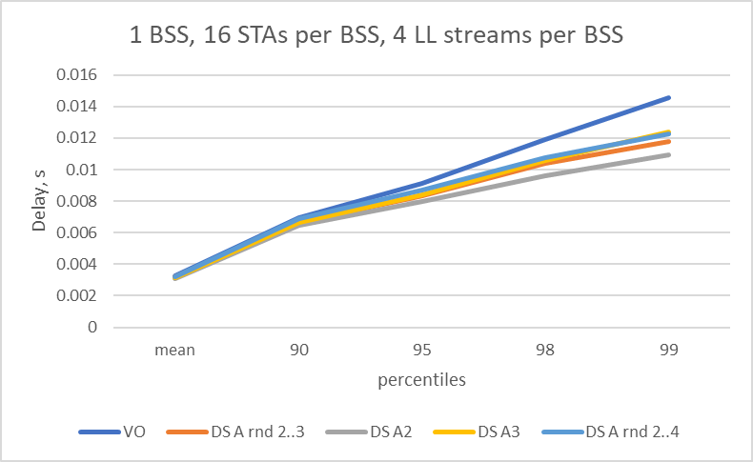
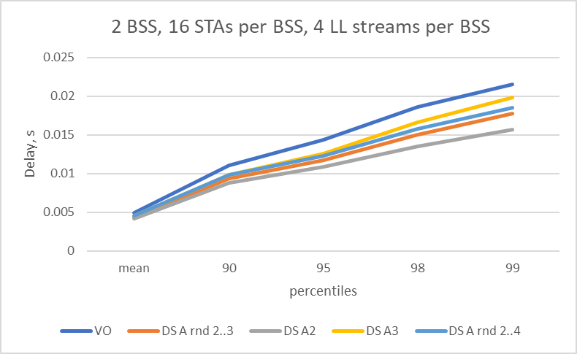
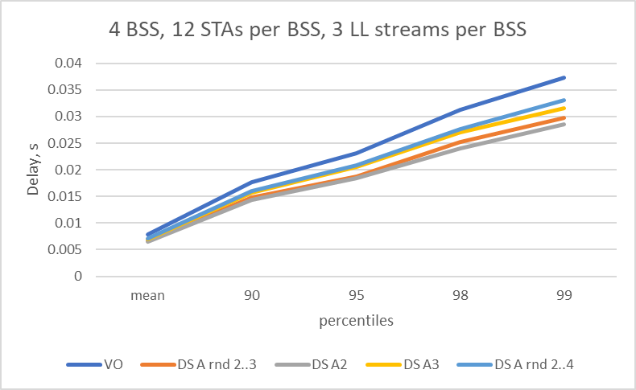
Access parameters to TX the Defer Signal are TBD
Contributions 11-23/2126r0, 11-23/1065r0, 11-24/0467r1 and 11-24/0840r0 provided results for fixed AIFSN=2 and for randomized TX times for the DS frame transmission
AIFSN=2 provides best opportunity to cut vast majority of STAs from initiating transmission or initiating contention process
Delaying transmission time of the short control frame decrease STAs chances to obtain TXOP
Larger values, AIFSN=4+ degrades P-EDCA performance
There were multiple concerns expressed about collisions of multiple DS frames sent at the same time
A simple solution w/o adding complicated synchronization requirements in a distributed channel mechanism is to provide limited randomness to the DS transmission time
Additional random CW in a range (0..CW_DS) value added to default AIFNS value
Limited impact is observed when randomization within 0..1 or 0..2 additional slots is used
For simplicity we propose to use define default value of AIFSN=2 for short control frame transmission and default CW_DS=0
*Plots on the right obtained with DS transmission time equal to AIFSN=2, AIFSN=3, AIFSN = RND(2..3) and AIFSN = RND(2..4)
DS sent after 2 failures; Number of consecutive DS retires = 2

Slide 5
Duration of protected short contention is TBD
Contributions 11-23/2126r0, 11-23/1065r0, 11-24/0467r1, 11-24/0840r0 and 11-24/0864r1 use EIFS as a _reference_ to determine duration for protected short contention
EIFS, depending on parameters have a range of values (Table 10-8):
EIFS = aSIFSTime + AcktTxTime + DIFS = 16 + (28-68)+34 =78-118us
We propose to fix duration in the protected short contention to the value 97us which is close to EIFS = 16+44+34=94us where:
44us is AckTxTime @ non-HT BPSK rate
97us is time equal to short contention of AIFSN2 + 7 SLOTs
This value used to establish protection for the short contention

Slide 6
Contention parameters are TBD The retry count where the Defer Signal is allowed to be sent is TBD
The protected short contention starts after the end of Defer Signal transmission
The short contention follow existing rules as described in 10.23.3 HCF contention, channel access (EDCA)
Only EDCAF[VO] and TBD EDCAF (if agreed) are allowed for the contention during short contention period
Assuming duration of protected short contention of 97us and contention overhead of SIFS + AIFSN2 = 34us
It is reasonable to define range for BK selection as min(0..7)..
Three possible outcomes of short protected contention:
STA may win TXOP and successfully TX data. In such a case the condition to use P-EDCA is no longer valid, and STA return to legacy operations. Best possible outcome
STA may lose the contention to some other STA. In such a case STA may be able to announce P-EDCA again subject to number of possible attempts defined in a spec, for example – no more that 1 or 2 or 3.
STA may win contention, but new collision may happen (e.g. STA send RTS but did not get response CTS). In such a case a STA may again announce P-EDCA subject to number of possible attempts defined in a spec, for example – 1 or 2 or 3.

Slide 7
Enablement
The condition(s) “to be allowed to send Defer Signal” require discussion:
It should include traffic based (STA side) condition as well as enablement-based conditions (AP side)
Examples of traffic-based conditions may include:
Retransmission counter
Channel access time
Traffic bounded delay/queueing delay
Examples of enablement-based conditions
AP enable/disable P-EDCA
Number of DS transmissions per time interval (as in ETSI – max 50 TXes per 50ms but no more that 2.5ms in total)
Frequency of transmission
Negotiation/request to use or notification of use initiated from a STA side

Slide 8
Enablement
Multiple individuals expressed concerns about scope of use for P-EDCA - whether P-EDCA enabled by default for any environments or controlled by a central entity
Default mode: Define conservative “default” P-EDCA Parameters.
UHR STA capable of P-EDCA may use it in any environment for the traffic buffered into AC_VO
Controlled mode: A P-EDCA capable UHR STA will use parameters provided by UHR AP
P-EDCA enabled by default with default parameters
AP may advertise different parameters, including disable P-EDCA functionality
When enabled, all STAs can use P-EDCA for the traffic in AC_VO
Motion 272 suggest that P-EDCA is used when enabled by the AP
P-EDCA is used by the STAs in a BSS only when this feature is enabled by the AP
Usually a feature, when enabled, is available for all clients that support the feature
AP can control P-EDCA via advertised parameters as already proposed in a few passed motions
A unified enablement procedure (i.e. similar to EDCA – for example, if “P-EDCA parameter set is present in a beacon frame”) simplify the design

Slide 9
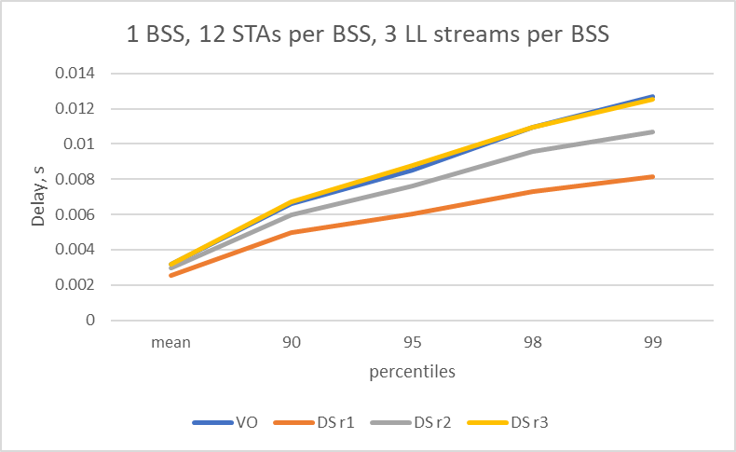
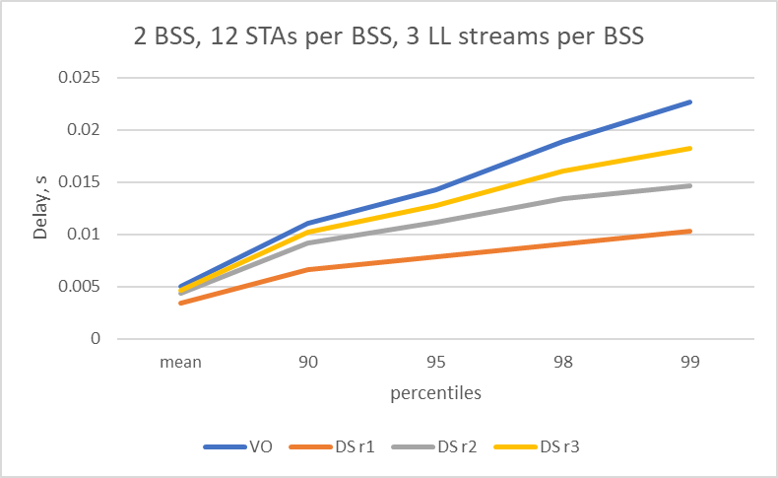
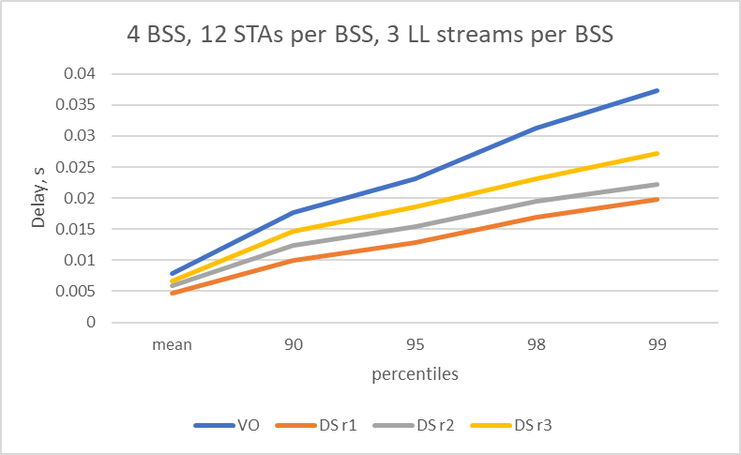
Conditions to send.
… a STA … may be allowed, based on TBD conditions, to send a DS-CTS
Conditions to be allowed to send a Defer Signal is TBD
Numerous simulation results provided in contributions 11-23/2126r0, 11-23/1065r0, 11-24/0467r1 and 11-24/0840r0 use “QSRC[AC] counter” as criteria for a STA to be eligible to use HiP EDCA in a following way
IF QSRC[AC_VO] == 1 THEN eligible for HiP EDCA
Simulation results show that value == 1 has best performance vs 2 or comparing with legacy behavior
*Additional conditions may include on a number of control frame send both consecutively or accumulatively
**similar trend observed with other # of STAs and LL streams
We suggest to use QSCR[VO] as a condition to enable STA to transmit DS

Slide 10
SP Type of a frame for DS
SP: Do you support to define CTS as Defer Signal to start protected short contention for the pending LL data?

Slide 11
SP – P-EDCA duration
SP: Do you support to define the default value equal to 97us for the Protected Duration of the protected short contention
The value of 97us allow for AIFSN[2] + 7 slot contention
The Defer Signal frame carry that Protected Duration in the Duration field
UHR AP may advertise values other than default
Notes:
prefer not to tie contention with EIFS, like AIFSN + contention window…

Slide 12
SP – P-EDCA contention parameters
SP: Do you support to define default parameters for P-EDCA for AC_VO to be used during protected short contention period as follows:
P-EDCA CWMin=7, P-EDCA CwMAX=7
P-EDCA AIFSN=2
An UHR AP may advertise values other than default

Slide 13
SP DS access parameters rules
SP: Do you support to define a default AIFSN value equal to 2 and CW_DS (contention window for DS) default value equal to 0 for the transmission of Defer Signal frame of P-EDCA
A STA transmit DS on a slot boundary equal to AIFSN + CW, where CW is selected uniformly in (0.. CW_DS) interval each time for the transmission of DS frame
UHR AP may advertise values other than default and if advertised, the associated STAs follow the advertised values
The transmission of the Defer Signal frame occurs after detecting medium IDLE using both PHY and virtual CS mechanisms

Slide 14
SP - enablement
SP: Do you support that STA may use P-EDCA
If P-EDCA is enabled by the AP in a BSS that the STA is the member of
Enablement procedure TBD
STA shall not transmit more than 50 (default value) of DS-CTS frames with up to 2.5 ms of total transmission time to start P-EDCA contention over 50ms interval
Note: reference values “50” and “2.5 ms” obtained from ETSI regulation for Short Control Signaling transmission
Shall not initiate more than TBD number of transmissions of DS to start P-EDCA consecutively.
Note: consecutive DS transmission are multiple attempts to perform P-EDCA contention w/o falling back to regular EDCA operation

