Slide 1
Recap of Compact Secure Transaction Methods for AMP
Date: 2024-11-8
Authors:

Slide 2
Summary
A set of secure transaction methods for AMP devices have been presented.
11-24/0178, a shared secret-based secure transaction method (for long-range backscatter, active UL TX AMP, legacy preamp AMP).
11-24/0526, a server-managed secure transaction method (for active UL TX AMP, legacy preamp AMP).
11-24/0871, AMP device-initiated secure transaction methods (for legacy preamp AMP).
11-24/1242, add privacy to above methods using random MAC addresses.
The reasons
Current 802.11 security protocol such as WPA3 SAE defines 10+ frame exchanges to setup a secure link between two STAs, requiring the STAs to maintain the secure link, which consumes energy that may not be affordable by power-constrained AMP STAs.
Current 802.11 secure links are designed to support multiple applications running on STAs, possibly with large data volume over a long period. AMP STAs are most likely designed for single purposes and very likely exchange small amount of data for every transaction.
Secure transaction methods condense WPA3 SAE into 3-4 frame exchanges to finish a secure communication session with privacy protection between a normal Wi-Fi STA and an AMP STA, then the AMP STA can power off.
These secure transaction methods are good fit for power-constrained AMP devices. They can also co-exist with current 802.11 security protocols run by more powerful AMP devices.
Notes:
https://unit42.paloaltonetworks.com/iot-threat-report-2020/

Slide 3
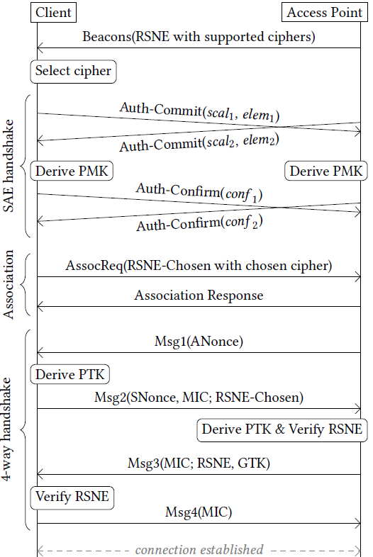
What is a suitable communication model for AMP devices?
If an AMP device follows current Wi-Fi MAC (maintaining a secure link for layered networking model)
It will take 10+ frames to establish a secure association.
The AMP device needs to have sufficient power to maintain the secure association and low power operating mode (e.g., TSF timer).
Questions
Do AMP devices have sufficient power for such overhead?
The layered networking model was designed to support many applications, possibly with large-volume data exchanges over long time. Do AMP devices need these?
Arguments
Layered networking model over conventional Wi-Fi MAC may not be the best fit for AMP devices that are often designed for a single application.
Compact transaction-based communication model may be better.
Notes:
https://unit42.paloaltonetworks.com/iot-threat-report-2020/

Slide 4
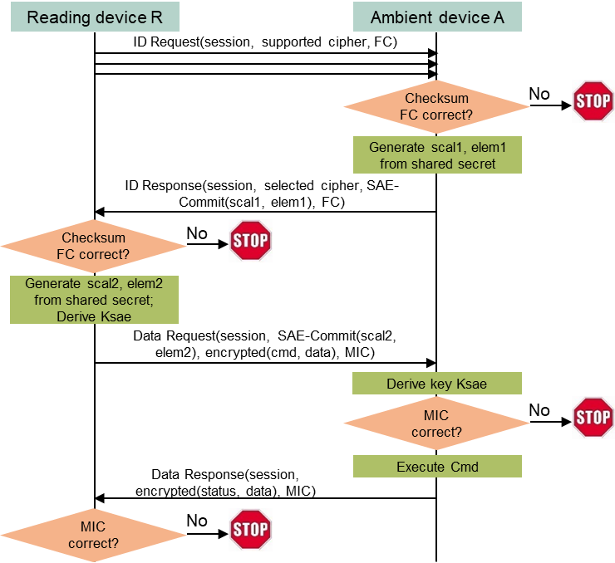
A shared secret-based secure transaction method for AMP devices (long-range backscatter, active UL TX AMP, legacy preamp AMP)
Assumptions
AMP devices typically support one application (function).
AMP devices do not have large data volume to exchange at each transaction.
AMP devices do not need to maintain association and/or low power mode (they can simply power off or lose the power after communication).
Key ideas
A simple Request (by regular STA) + Response (by AMP device) transaction model.
Integrated security based on a shared secret between the requester (regular STA) and the respondent (AMP device).
Absolutely minimize exchanged messages.
Highlights
4 frame exchanges are needed to finish secure transaction.
32B DL, 96B UL, 128B DL, 64B UL ±16B (assuming minimum data)
Notes:
https://unit42.paloaltonetworks.com/iot-threat-report-2020/

Slide 5
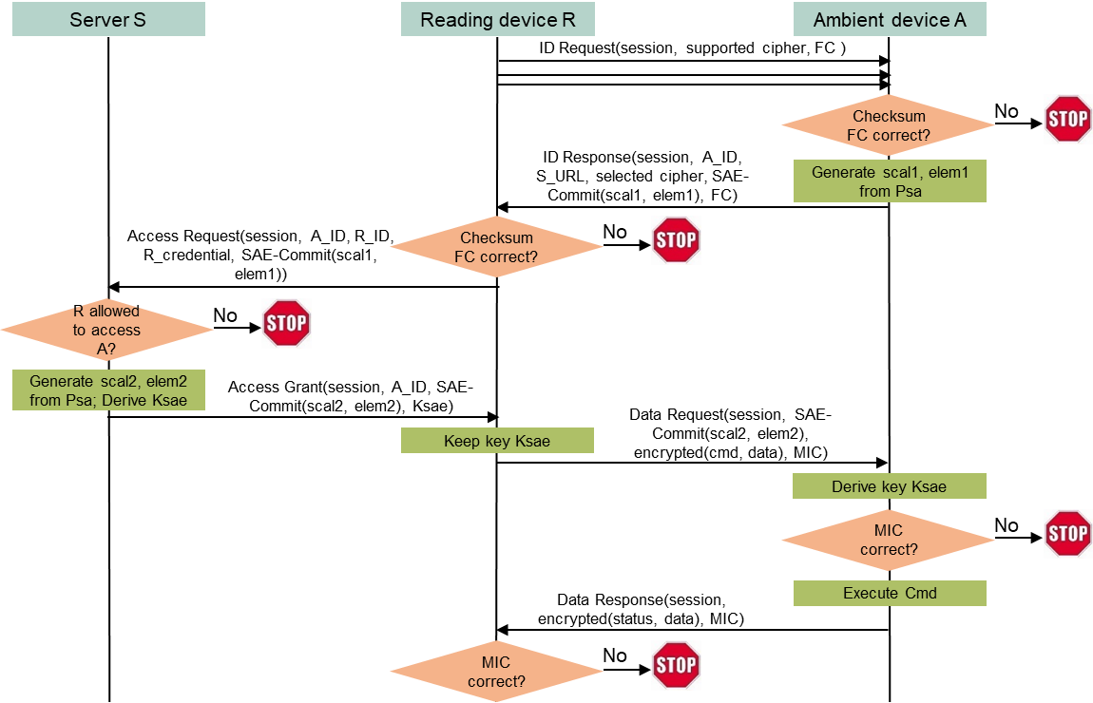
A server-managed secure transaction method for AMP devices (active UL TX AMP, legacy preamp AMP)
Use case
An entity owning many deployed AMP devices may want to dynamically allow/disallow reading devices to access deployed AMP devices.
Example: a contractor’s reading device may need the access, and the access right should be removed after finishing the contract.
Shared secret between a reading device and an AMP device is no longer suitable.
It is impractical to maintain and update identifiers and shared secrets for different reading devices on every AMP device, especially deployed AMP devices.
Let a server manage access rights dynamically without touching deployed AMP devices.
Highlights
4 frame exchanges.
32B DL, 160B UL, 128B DL, 64B DL ±16B (assume minimum data).
Notes:
https://unit42.paloaltonetworks.com/iot-threat-report-2020/

Slide 6
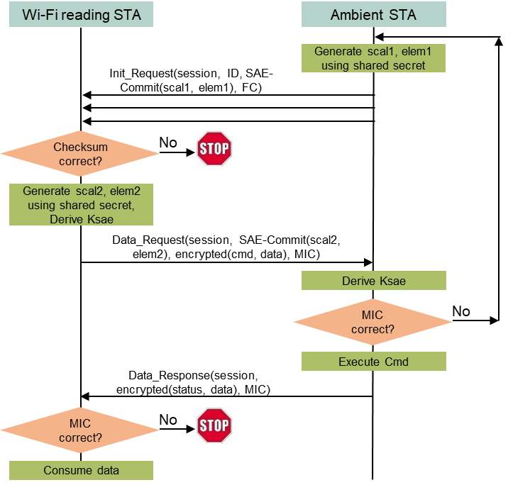
A shared secret-based AMP device-initiated secure transaction method (for legacy preamp AMP)
Use case
The AMP device could be a glass breaking sensor, must initiate the communication to report an alarm.
Assumptions
The Wi-Fi reading device and the AMP device share a secret code, which is the foundation of the secure transaction.
The AMP device can afford the energy of repeatedly sending a “complicated” Init_Request message until the message is detected by the reading device.
Highlights
3 frame exchanges are needed to finish mutual authentication and encrypted data exchange.
96B UL, 128 DL, 64B UL ±16B (assuming minimum data)
Notes:
https://unit42.paloaltonetworks.com/iot-threat-report-2020/

Slide 7
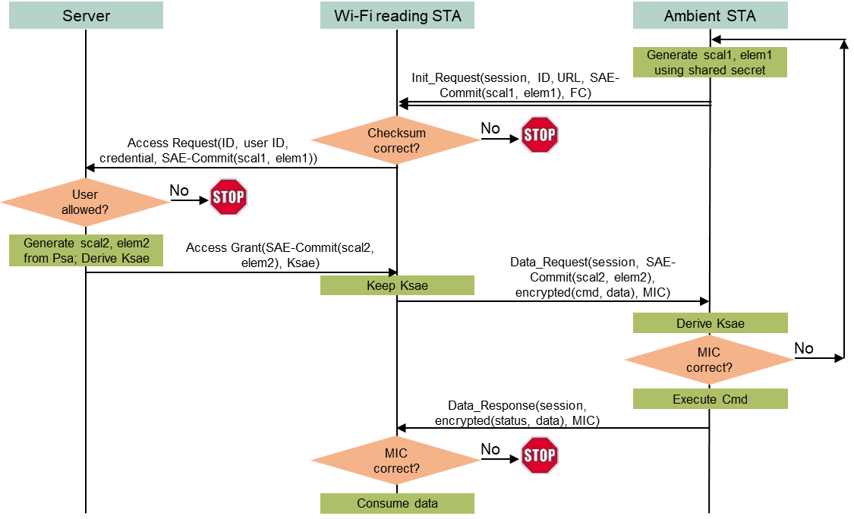
A server-managed AMP device-initiated secure transaction method (for legacy preamp AMP)
Use case
An entity (e.g., a mall) owning many deployed AMP sensors may want to dynamically allow/disallow reading devices (e.g., stores’ reading devices) to access those AMP devices based on contract terms, without changing anything in the deployed AMP devices.
Assumptions
The owner’s server and every AMP device share a secret code, which is the foundation of the secure transaction. The reading device cannot know the secret code.
Every reading device has a user id and a credential managed by the server. The server determines if a reading device can access any AMP device based on such information.
Highlights
3 frame exchanges.
160B UL, 128B DL, 64B UL ±16B (assuming minimum data)
Notes:
https://unit42.paloaltonetworks.com/iot-threat-report-2020/

Slide 8
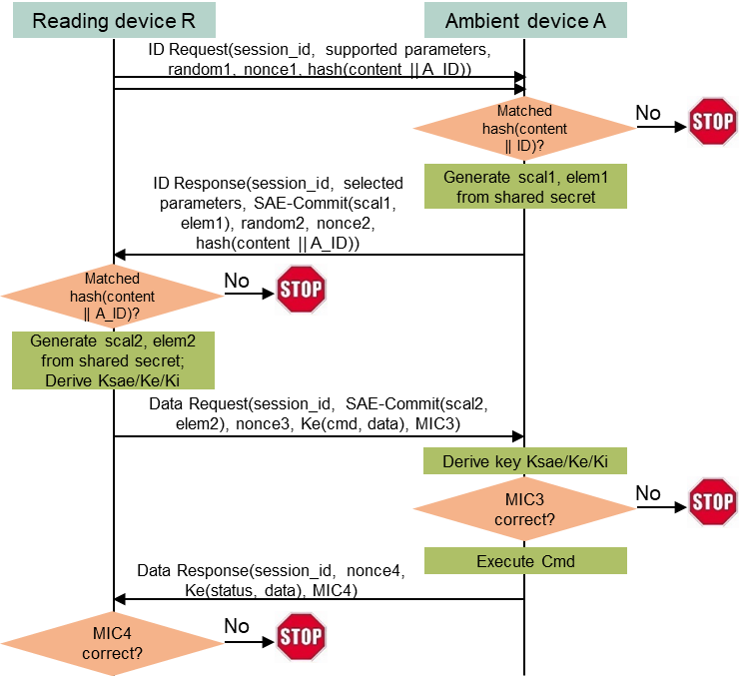
A shared secret-based reading device-initiated secure transaction method with privacy (long-range backscatter, active UL TX AMP, legacy preamp AMP)
Assumptions
A reading device R and an AMP device A has a shared secret.
A has a confidential name A_ID. R knows A_ID.
Solution
R sends the hash value of A_ID in ID_Request using random address R1 as source address and broadcast address as destination address.
Every AMP device near R receives ID_Request and computes the hash value using its own name. Only A finds the computed hash value matches the received hash value. A sends back ID_Response using random address R2 as source address and R1 as destination address.
R and A follow the shared secret-based reading device-initiated secure transaction method to finish the communication, with R1 and R2 as their MAC addresses.
Highlights
4 frame exchanges to finish secure transaction with privacy.
96B DL, 160B UL, 128B DL, 64B UL ±16B (assuming minimum data)
Notes:
https://unit42.paloaltonetworks.com/iot-threat-report-2020/

Slide 9
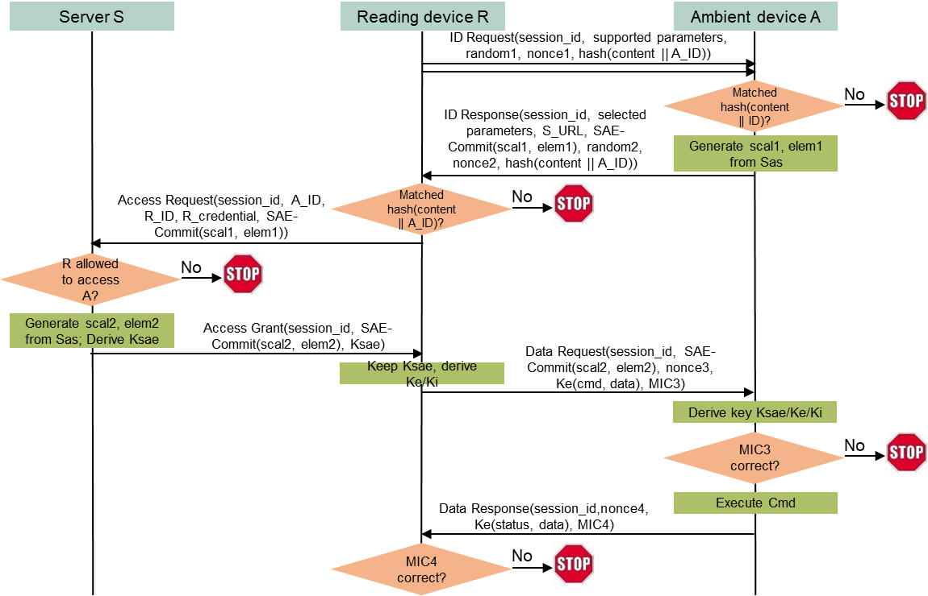
A server-managed reading device-initiated secure transaction method with privacy (for active UL TX AMP, legacy preamp AMP)
Assumptions
A server S owns many deployed AMP devices, including A.
S and A shares a secret. A has a confidential name A_ID.
A reading device R has registered on S with R_ID and R_credential. S manages whether R can access A based on such registered information. R knows A_ID.
Solution
R sends the hash value of A_ID in ID_Request using random address R1 as source address and broadcast address as destination address.
Every AMP device near R receives ID_Request and computes the hash value using its own name. Only A finds the computed hash value matches the received hash value. A sends back ID_Response using random address R2 as source address and R1 as destination address.
R and A follow the server-managed reading device-initiated secure transaction method to finish the communication using R1 and R2 as their MAC addresses.
Highlights
4 frame exchanges
96B DL, 160B UL, 128B DL, 64B UL ±16B (assuming minimum data)
Notes:
https://unit42.paloaltonetworks.com/iot-threat-report-2020/

Slide 10
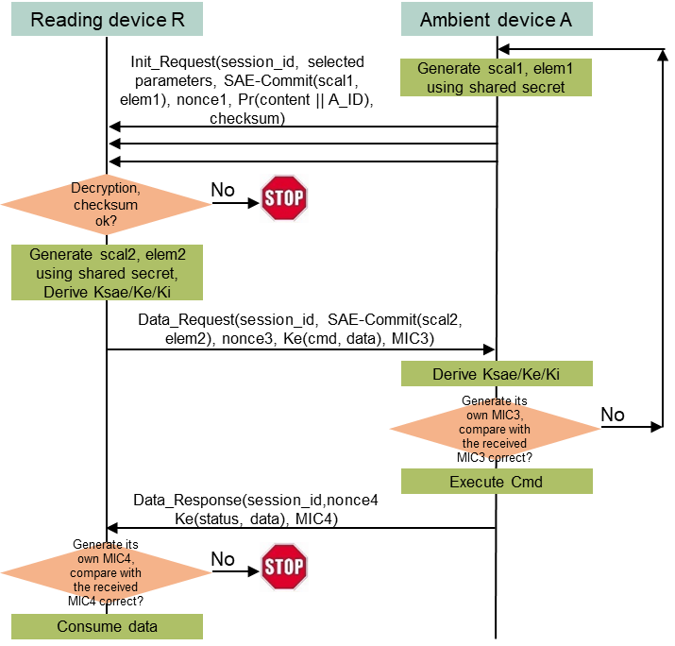
A shared secret-based AMP device-initiated secure transaction method with privacy (for legacy preamp AMP)
Assumptions
A reading device R and an AMP device A has a shared secret.
A has a confidential name A_ID. R knows A_ID. A may has R’s public key if R has share secrets with a lot of AMP devices (otherwise it is not needed).
Protocol
A sends Init_Request with A_ID encrypted using R’s public key or hashed, using a random address R1 as source address and a broadcast address as destination address.
Every reading device near A tries to decrypt A_ID or matches the hashed value using AMP device names stored in memory. Only R can decrypt A_ID or find the match. R then sends Data_Request using a random address R2 as source address and R1 as destination address.
R and A follow the shared secret-based AMP device-initiated secure transaction method to finish the communication, with R2 and R1 as their MAC address.
Highlights
3 frame exchanges
160B UL, 128B DL, 64B UL ±16B (assuming minimum data)
Notes:
https://unit42.paloaltonetworks.com/iot-threat-report-2020/

Slide 11
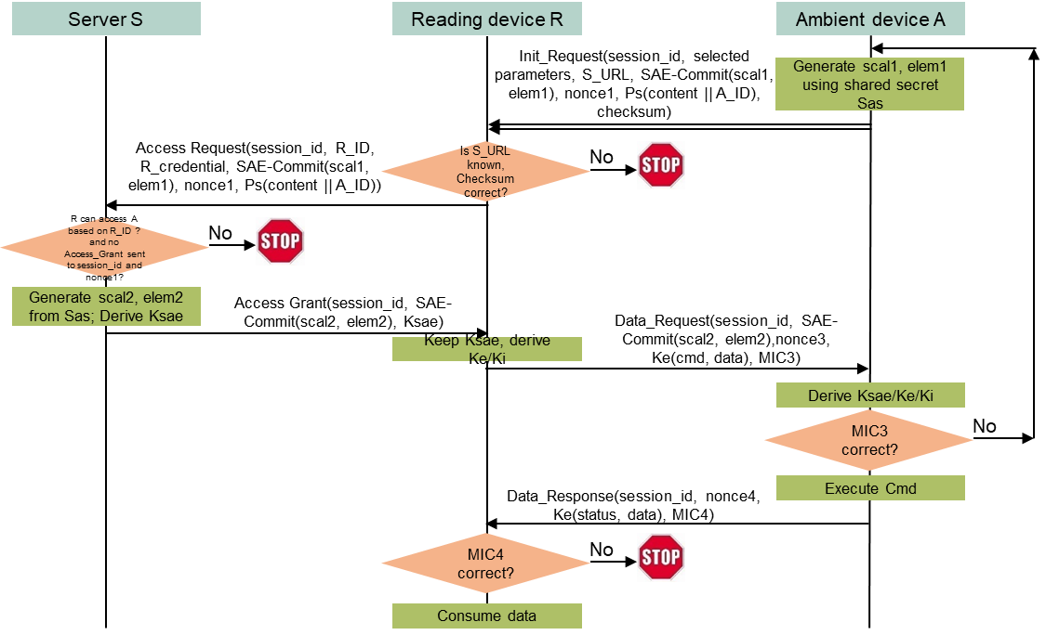
A server-managed AMP device-initiated secure transaction method with privacy (for legacy preamp AMP)
Assumptions
A server S identified as S_URL owns many deployed AMP devices, including A. A stores S_URL and S’s public key in its non-volatile memory.
S and A shares a secret. A has a confidential name A_ID.
A reading device R has registered on S with R_ID and R_credential. S manages whether R can access A. R does not know A_ID.
Protocol
A sends Init_Request with a session_id, S_URL, and A_ID encrypted using S’s public key, using a random address R1 as source address and a broadcast address as destination address.
Every reading device near A and registering on S forwards the content of Init_Request to S.
S only responds to the first reading device based on session_id, assuming it is R without loss of generality. S decrypts A_ID, generates security parameters needed by Data_Request based on the secret shared with A, and sends the parameters to R.
R then sends Data_Request using a random address R2 as source address and R1 as destination address.
R and A follow the server-managed AMP device-initiated secure transaction method to finish the communication, with R2 and R1 as their MAC address.
Highlights
160B UL, 128B DL, 64B UL ±16B (assuming minimum data)
Notes:
https://unit42.paloaltonetworks.com/iot-threat-report-2020/

Slide 12
Straw poll
Do you agree to insert the following text in the security sub-clause of the SFD?
IEEE 802.11bp will specify transaction-based secure data communication methods that do not require maintaining security associations.
Note:
The methods will be based on existing 802.11 security protocols.
The methods will coexist with existing 802.11 security protocols.
The details are TBD.
Notes:
https://unit42.paloaltonetworks.com/iot-threat-report-2020/

