Slide 1
Further Considerations on NPCA
Date: 2025-01-12
Authors:
Name | Affiliation | Address | Phone | Email
Dongju Cha | LG Electronics | 19, Yangjae-daero 11gil, Seocho-gu, Seoul 137-130, Korea |  | dongju.cha@lge.com
Insun Jang
 |  |  |  | insun.jang@lge.com
Jinsoo Choi
 |  |  |  | js.choi@lge.com
Hongwon Lee |  |  |  | hongwon.lee@lge.com
Sunhee Baek |  |  |  | sunhee.baek@lge.com
Geonhwan Kim |  |  |  | geonhwan.kim@lge.com
Yelin Yoon |  |  |  | yl.yoon@lge.com
Eunsung Park |  |  |  | esung.park@lge.com
Dongguk Lim |  |  |  | dongguk.lim@lge.com
Jinyoung Chun |  |  |  | jiny.chun@lge.com
Insik Jung |  |  |  | insik0618.jung@lge.com
HanGyu Cho |  |  |  | hg.cho@lge.com
Sanggook Kim |  | 10225 Willow Creek Rd, San Diego, CA, USA |  | sanggook.kim@lge.com

Slide 2
Recap
Non-Primary Channel Access (NPCA) allows the STAs to switch to the NPCA primary channel for performing backoff when PCH is busy due to the OBSS traffic [1]~[15]
Many NPCA feature motions has been agreed in last November meeting [15]
  Some conditions to switch to the NPCA primary channel
    Triggering condition for NPCA operation (e.g., OBSS HE+ PPDU or OBSS Control frame exchange)
    Where to switch
  How to initiate TXOP on the NPCA primary channel
    EDCA backoff procedure
    Initiate frame exchange w/ NPCA ICF
    Set of channels used when initiating TXOP on the NPCA primary channel

Slide 3
Introduction
Some of discussions are needed to make NPCA operation more complete
  For how long NPCA STAs perform NPCA operation
  NPCA ICF in perspective of delivered information and which frame to use

Slide 4
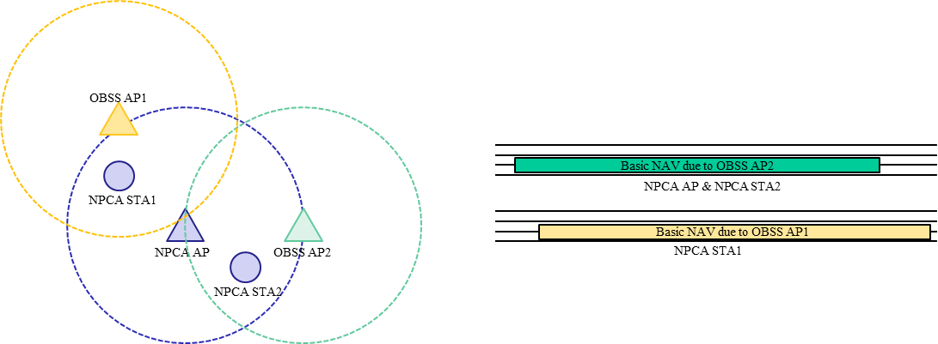
Misaligned Duration of NPCA Operation
We have agreed that initiating FE on NPCA Primary channel w/ NPCA ICF to check whether the recipient STAs have completed the switch
Even though recipient STAs response to the NPCA ICF, we can not guarantee that they perform the NPCA operation for the same duration since NPCA operation can be triggered due to different OBSS traffic
  Some NPCA STAs may stay on the NPCA Primary channel for a longer duration than AP while others may stay for a shorter duration

Slide 5
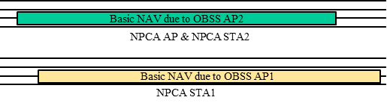
Case 1) Non-AP STAs that stay for longer duration than AP
Case 1)
  Issue 1) May try to initiate wastefule and meaningless TXOP while AP has switched back to the BSS Primary channel
  Issue 2) Switches back to the BSS Primary channel later than AP may lead to lost of medium synchonization on the BSS Primary channel
For the Non-AP STAs that see longer OBSS traffic than AP, nothing can be achieved when Non-AP STAs stay solely on the NPCA Primary channel
  Non-AP STAs need to switch back to the BSS Primary channel earlier than what it see, following the view of AP
Meaningless FE can be happened
Medium sync. can be lost on the PCH

Slide 6
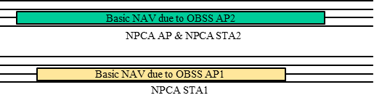
Case 2) Non-AP STAs that stay for shorter duration than AP
Case 2)
  Non-AP STAs switching back to the BSS Primary channel earlier than AP (based on what non-AP STAs see) can be an option, but similarly, nothing can be achieved even if Non-AP STAs switch to the BSS Primary channel alone
To maximize the performance of NPCA operation, Non-AP STAs can stay on the NPCA Primary channel longer than what it see, following the view of AP
  However, those non-AP STAs can loss the medium synchonization (blindness issue) which requires medium access recovery procedure after switching back to the BSS Primary channel

Slide 7
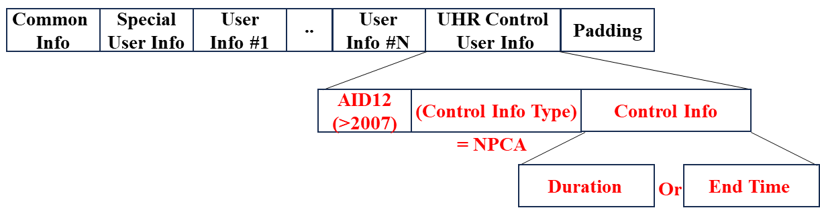
Delivered Info in NPCA ICF
We have agreed that NPCA STA shall initiate frame exchange on the NPCA Primary channel w/ NPCA ICF
To deal with the issue mentioned previously (Misaligned duration of NPCA operation), AP can transmit NPCA ICF including Delivered Info, for example,
  Duration (Remaining duration that AP stays on the NPCA Primary channel)
  Or, End time (When OBSS Traffic ends that AP sees)
  It can be included in User Info fields w/ a Special AID [16]
  In case of non-AP STA transmitting NPCA ICF, it need to solicit these info. (Duration, or End Time) to be included in the NPCA ICR transmitted by AP (e.g., using M-STA BA)

Slide 8
Which frame to use as NPCA ICF
BSRP Trigger frame can be one of strong candidate for NPCA ICF
  Able to check whether multiple non-AP STAs has done switched to the NPCA Primary channel (RU-based response)
  Aligned w/ some mechanism using ICF
    E.g., non-AP MLD operating in EMLSR mode may operate NPCA
  MU-RTS can be another option for SU case
RTS may not be an optimal for NPCA ICF in perspective of no space to include any information needed
  In case of AP being TXOP holder, not able to include Control Info (e.g., Duration, or End Time)
  In case of non-AP STA being TXOP holder, not able to include Solicit Info (e.g., Duration or End Time) and AP cannot carry the Solicted Info in CTS
    Also, Non-AP STA also may need to indicate whether it is transmitting ICF in NPCH
      W/o this, unneccsary NAV can be set on the NPCH that leads to wastage of NPCA operation [appendix]
      Some additional rule may need to be defined, e.g., while AP staying on the NPCH, response only when receives ICF that indicates that it is trasmitted on the NPCH

Slide 9
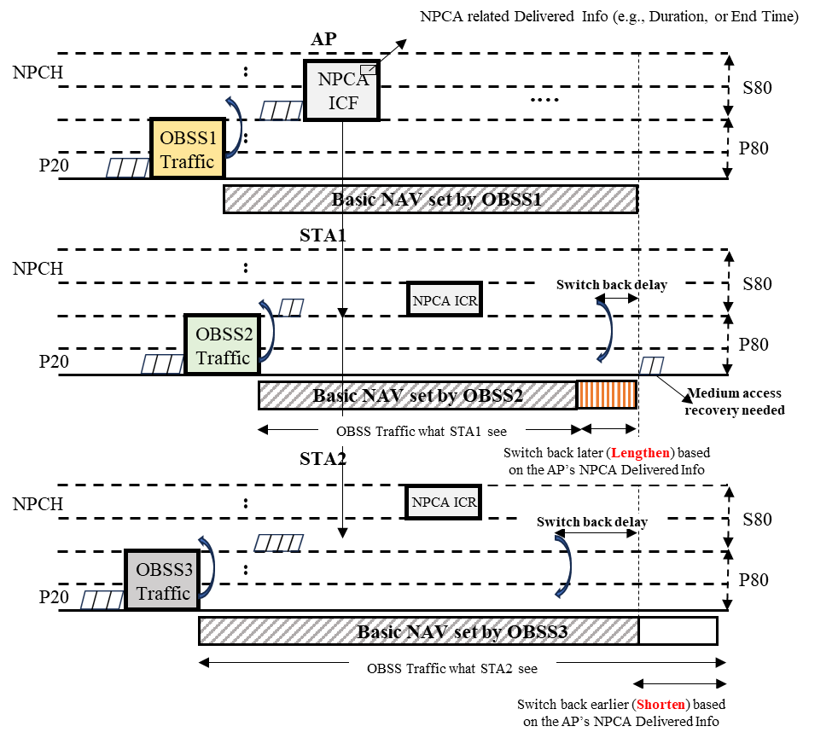
NPCA Overall Procedure based on
Delivered Info in ICF

Slide 10
Conclusion
In this contribution, we shared some misalignment issues when performing NPCA
  Detecting different OBSS traffic (Misaligned Duration of NPCA Operation)
Furthermore, to deal with issues above, we proposed some details regarding
  Indicating its Delivered Info (e.g., Duration, or End Time) in ICF/ICR and candidate type of NPCA ICF

Slide 11
Reference
[1] 11-23/2005r1 Non-primary channel access (NPCA) (Minyoung Park, Intel)
[2] 11-23/2023r0 Further discussion on Non-primary Channel Access (Sindhu Verma, Broadcom)
[3] 11-24/0070r2 Some details about non-primary channel access (Yunbo Li, Huawei)
[4] 11-24/0458r2 Considerations on Non-Primary Channel Access (Salvatore Talarico, Sony)
[5] 11-24/0498r0 Non-Primary Channel Access (NPCA) – Follow Up (Minyoung Park, Intel)
[6] 11-24/0496r1 Secondary Channel Usage Follow Up (Liwen Chu, NXP)
[7] 11-24/0670r0 Different view problems of NPCA (Sanghyun Kim, WILUS)
[8] 11-24/1104r0 Some details on NPCA (Seongho Byeon, Samsung Electronics)
[9] 11-24/1115r0 Channel switching rules for NPCA (Vishnu Ratnam, Samsung Electronics)
[10] 11-24/1155r0 Further discussions on NPCA (Shawn Kim, WILUS)
[11] 11-24/1218r0 NPCA – Next level discussions (Gaurang Naik, Qualcomm)
[12] 11-24/1259r2 SP-based non-primary channel access follow-up (Yue Zhao, Huawei)
[13] 11-24/1403r1 Some thoughts on NPCA Operation (Si-Chan Noh, Newracom)
[14] 11-24/1585r0 Non-primary channel access operation (NPCA) follow-up (Jeongki Kim, Ofinno)
[15] 11-24/1762r13 PDT-MAC-NPCA (Matthew Fisher, Broadcom)
[16] 11-24/1464r2 Discussion on ICF (Insun Jang, LGE)

Slide 12
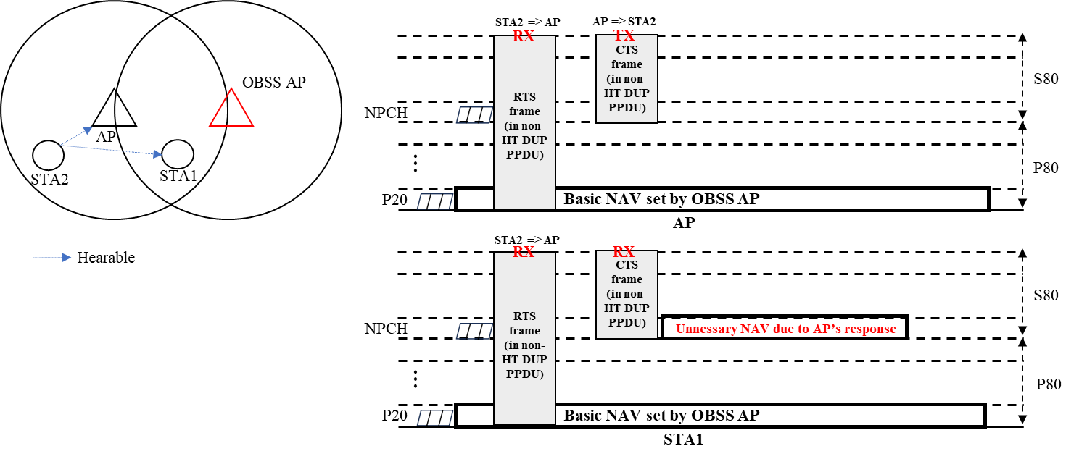
Appendix

Slide 13
Straw Poll 1
Do you agree to include the following into the 11bn SFD?
  An NPCA STA can transmit a BSRP Trigger frame as an initial control frame (ICF) to initiate frame exchange on the NPCA Primary channel
  Other frames as ICF are TBD

Slide 14
Straw Poll 2
Do you agree to include the following into the 11bn SFD?
  NPCA AP that obtains a TXOP on the NPCA Primary channel shall ensure that the TXOP ends before the end time of OBSS activity that makes the BSS Primary channel busy minus channel switch back delay

Slide 15
Straw Poll 3
Do you agree to include the following into the 11bn SFD?
  NPCA AP which performs channel access on the NPCA Primary channel shall be switched back to the BSS Primary channel before the duration of the OBSS activity that makes the BSS Primary channel busy ends

