Slide 1
Signaling details in seamless roaming
Date: November 10th, 2024
Authors:
Name | Affiliations | Address | Phone | email
Abhishek Patil | Qualcomm
Gaurang Naik
Giovanni Chisci
Duncan Ho
George Cherian
Alfred Asterjadhi
Sanket Kalamkar
Sherief Helwa

Slide 2
Introduction
Previous contributions have explained the high-level phases involved in facilitating seamless transition of a client from one AP MLD to another:
  Discovery phase
    During this phase, the client discovers the serving AP MLD’s neighborhood
  Candidate set formation / Recommendations
    During this phase, the serving AP MLD and client work together to prepare candidate set of AP MLD(s) that are suitable for the client.
  Preparation phase
    During this phase, the client selects one of the candidate AP MLD for roaming and makes a request to add links of that candidate AP MLD to its ML setup.
      The static context related to the client is made available to the candidate AP MLD
  Transition phase
    During this phase, the client roams to the target AP MLD (i.e., the candidate AP MLD).
      The dynamic context related to the client is made available at the target AP MLD

Slide 3
Objective
The objective of this document is
  to examine the signaling requirements during each phase,
  provide one or more mechanisms to realize them while leveraging existing frameworks,
  while minimize signaling overhead (esp. beacon bloating)
This document will look at signaling details for each of the phases.
For each phase, the document lays out the requirement, challenges and potential signaling options while proposing minimal deviation from baseline standard.

Slide 4
Discovery Phase
Purpose: As the non-AP moves from one AP MLD to another AP MLD, it needs to determine the new neighborhood so that it can make roaming related preparations.

Slide 5
Discovery phase: Issue of beacon bloating
Traditionally, RNR has been the mechanism to provide basic information of a reported AP.
Brief background on RNR (see appendix for RNR format).
  Defined by 11af for reporting neighborhood. However, commonly employed for reporting collocated APs
    mandated by 11ax (for 6 GHz discovery) and then by 11be (for MLO)
    The standard puts no requirements about reporting non-collocated APs
  Each entry for a reported AP requires 16 bytes.
Now, each AP MLD in a seamless mobility domain (SMD) is expected to have at least 2 links
  If TGbn were to require reporting of non-collocated AP MLDs in the neighborhood that belong to the same SMD, it will result in significant incase in beacon size
  For example, with 5 AP MLDs in the neighborhood, each having just 2 link, and assuming TGbn adds no new fields to RNR, the beacon size grows by (10x16=) 160 bytes.

Slide 6
Discovery phase: Issue of beacon bloating
Over the years, there have been several issues identified due to a large beacon size
  E.g., legacy STAs disconnect (and start probing) when beacon length exceeds a certain size
  As a result, there are on-going efforts to curb the size of a Beacon frame.
In other words, traditional RNR based discovery via Beacon frames does not scale for non-collocated AP MLD discovery
Proposal:
  TGbn must provide alternatives to RNR for a non-AP MLD to discovery APs in the neighborhood that belong to the same SMD and must not require reporting of non-collocated APs in the RNR IE.

Slide 7
Alternatives to Beacon based discovery
Today, a client device sends a probe request when it enters a new neighborhood.
  TGbn will continue with this procedure – i.e., pre-SMD association, a TGbn client can determine neighborhood information via existing (ML) probing procedures.
  (ML) probe response can, via RNR, include information about other AP MLDs in the neighborhood
    See appendix for additional considerations for RNR and AP MLD ID.
  Client can also gather specific information (i.e., partial profile) for links belonging to another AP MLD by including (Extended) Request element in the ML probe request [see 35.3.4.2]
Post SMD association, a client solicits information of the neighborhood by transmitting a BTM Query frame to its serving AP MLD
  The frame may indicate, via a field (such as the BTM Transition Query Reason), that it is soliciting basic information of neighboring AP MLD(s) that belong to the same SMD.
    The BTM Request frame from the AP provides basic information about each neighbor (i.e., limited or no subelements in NR IE).
Alternatively, or in addition, the serving AP MLD can send an unsolicited BTM Request frame to provide information about the neighborhood
  Such unsolicited BTM Request frame could be broadcasted periodically by the serving AP MLD to help multiple non-APs
In conclusion, leverages baseline framework
  No new mechanism need to be defined and minimal extensions to baseline (if needed)

Slide 8
Roaming Recommendation phase
When the client wants to prepare for roaming, it can send a BTM Query frame to its serving AP MLD to determine suitable candidate AP MLD(s).
  The client may include the BSS Transition Candidate List Entries field if it has a preferred set.
  A new value for the BSS Transition Query Reason field can be defined to convey the intention of the non-AP’s query.
The serving AP MLD’s BTM Request frame provides information about one or more candidate AP MLDs that are recommended for the non-AP.
  The Preference field in the Neighbor Report element provides a status of the candidate AP MLD
    0 = AP MLD is not available for roaming
      i.e., client must refrain from transitioning to this AP MLD
    The values between 1 and 255 provide an indication of order, with 255 indicating the most suitable AP MLD within the given candidate list.
The above fields and procedures are defined in baseline standard and apply directly to the intended functionality.
See appendix for format details

Slide 9
Adding link of target AP MLD
When client is getting ready to roam to the target AP MLD, it transmits a Link Reconfiguration Request frame to its serving AP MLD carrying a Reconfiguration Multi-Link (RML) element.
  Need minor extensions to the RML element to identify the target AP MLD
    E.g., include MLD MAC address of the target AP MLD
  Per-STA Profile subelement is always present
    A value 15 (all 1s) in the Link ID subfield indicate that all links of the target AP MLD are requested; while a non-15 value indicates the link that is being requested.
      The link ID values are with respect to the target AP MLD.
    The Reconfiguration Operation Type field indicates ADD operation.
Link Reconfiguration Response frame from the serving AP carries information indicating which links are successfully added
The above procedures are baseline behavior with minimal extensions.

Slide 10
Transition phase
A client sends a roam request (exact signaling TBD) to roam to the target AP MLD.
  Potential signaling: Link Reconfiguration Request, T2LM link enablement, or PM (awake/available) notification
    Assumes added links are in disabled and/or PS state.
  Invokes dynamic context transfer (e.g., SN/PN).
  Triggers a DS mapping switch.
Cleanup: Links to the old serving AP MLD are deleted either implicitly after a certain time out period or explicitly (before the timeout period expires).
  Use baseline Link Reconfiguration procedures for the deletion
  Explicit deletion after receiving an indication from old serving AP MLD that it has finished draining pending DL BUs.

Slide 11
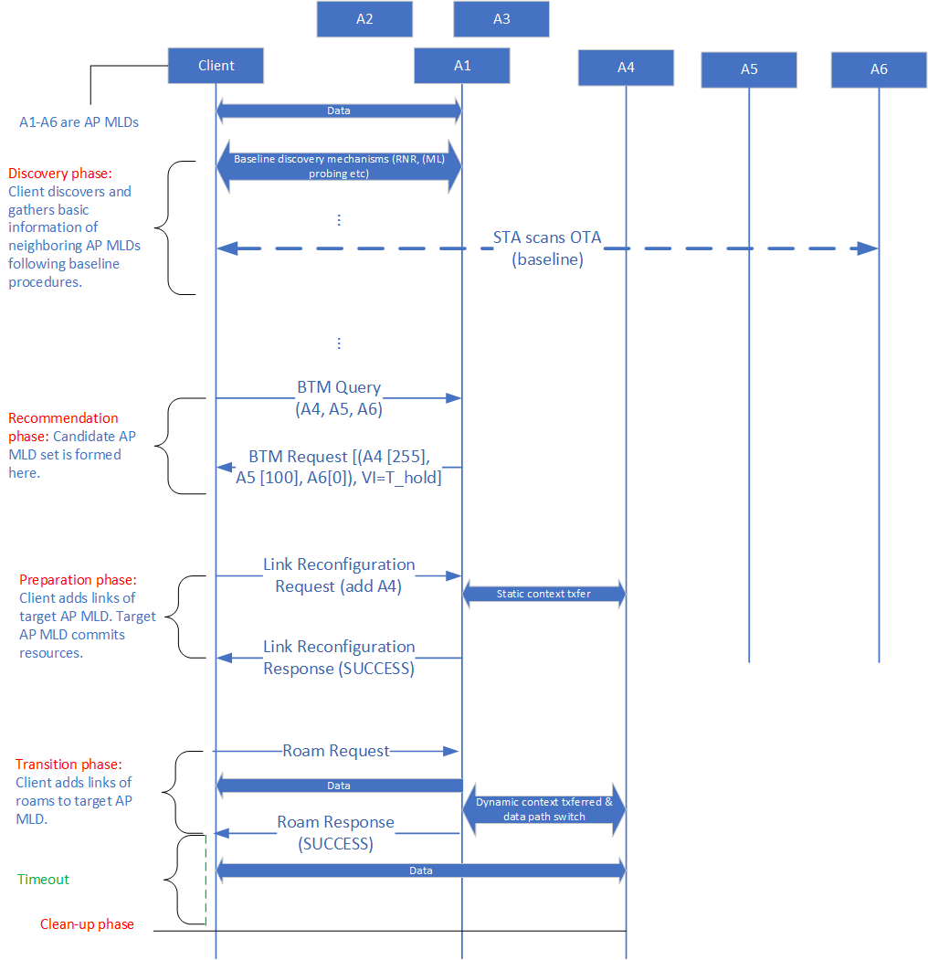

Slide 12
Summary
This explains why TGbn must not mandate reporting of non-collocated APs in a RNR element carried in an AP’s Beacon frame.
The contribution also provides alternatives and the next level signaling details involved during the discovery, roaming preparation, and roaming operation for the seamless roaming feature.
The proposed signaling leverages existing baseline procedures which results in minimal changes to the standard to enable the functionality.

Slide 13
Appendix

Slide 14
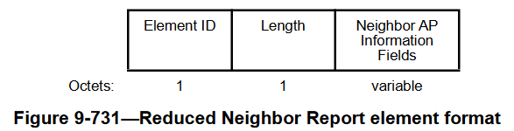
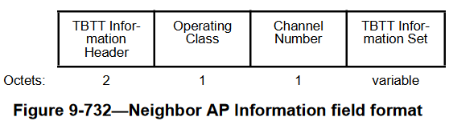
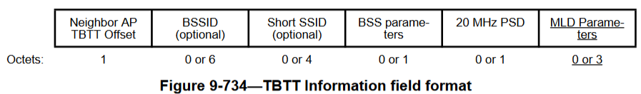
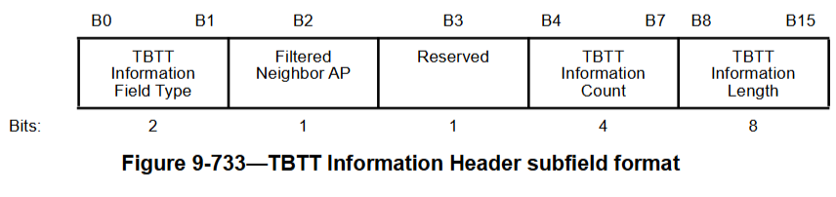
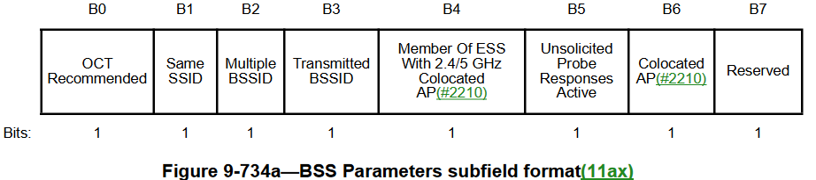
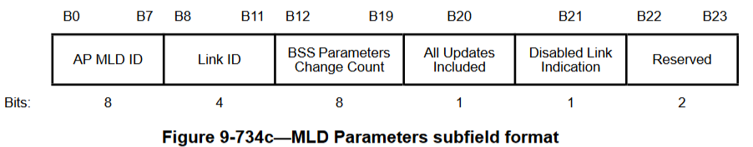
Reduced Neighbor Report element
BACK

Slide 15
RNR considerations
Strongly discourage inclusion of non-collocated AP MLD information in RNR IE carried in a Beacon frame (to prevent bloating of the beacon)
RNR IE carried in (ML) probe response may include information of non-collocated AP MLDs belonging to the same SMD
  A bit field could be used to identify a report AP (MLD) as belonging to the same SMD
    e.g., B7 in BSS Parameters subfield
  The MLD Parameters subfield of the RNR IE corresponding to a reported AP provide the AP MLD ID and the Link ID for a reported non-collocated AP MLD.
    The value carried in the AP MLD ID field is based on the rules in 9.4.2.169.2
    All affiliated APs of an AP MLD refer to a neighboring (reported) AP MLD with the same AP MLD ID.
      Keeps the AP MLD ID consistent regardless of which link is used for performing ML probing.
    The same AP MLD can be assigned a different AP MLD ID when a different AP MLD reports it.
      For example, AP MLD 1 can be referred to with an AP MLD ID of 25 by all affiliated APs of AP MLD 2 and by AP MLD ID of 56 by all affiliated APs of AP MLD 3.

Slide 16
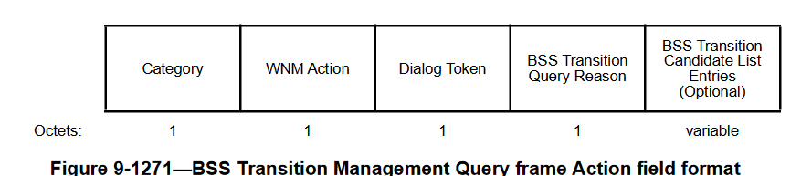
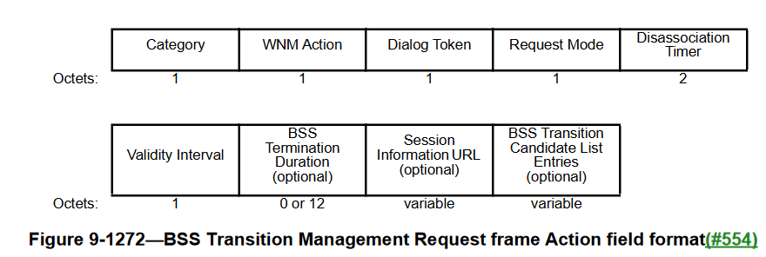

BTM frame formats
BACK

Slide 17
Straw-Polls

Slide 18
SP 1
Do you support that a UHR (AP/non-AP) MLD shall reuse BTM framework for identifying/recommending candidate AP MLD(s) to perform seamless roaming?

Slide 19
SP 2
Do you support that TGbn shall reuse the ML Reconfiguration framework for the following?
  Adding links of the target AP MLD.
  Removing links of the current AP MLD (after completely transitioning to the target AP MLD).

