Slide 1
Key Derivation in Roaming Preparation
March 2025
Date: 2025-03-10
Authors:
Name | Affiliations | Address | Phone | email
Chittabrata Ghosh | Apple, Inc. |  |  | chitto.ghosh@apple.com
Pooya Monajemi
Jarkko Kneckt
Yong Liu
Anuj Batra
Chittabrata Ghosh, Apple

Slide 2
Abstract
March 2025
In the context of seamless roaming, this contribution proposes
  Details of PTK derivation between a non-AP MLD and Target AP MLD during roaming preparation
Chittabrata Ghosh, Apple

Slide 3
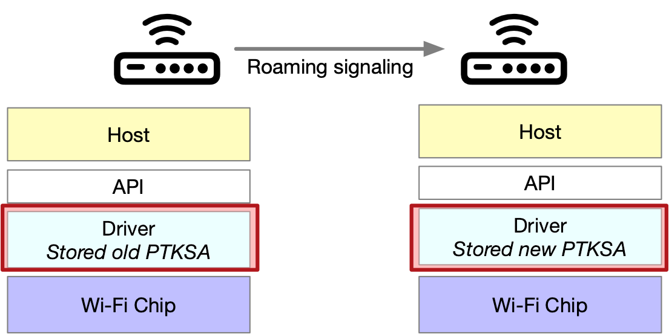
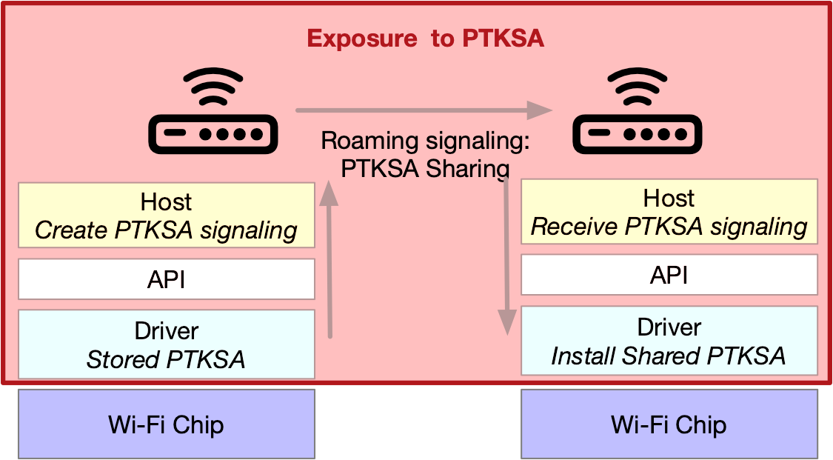
Comparison of Specific PTK vs. PTK Sharing
March 2025
doc.: IEEE 802.11-24/1882r2
New PTKSA creation
PTKSA is isolated to driver
Currently, Each AP MLD has separate PTKSA. PTKSA is stored in the device driver
PTKSA sharing has new attack surfaces:
  PTKSA in host level, i.e., in user space, leaks more likely if the AP is hacked
    PTKSA in driver level, i.e., kernel space, is protected even if the AP is hacked
  PTKSA transmissions between AP MLDs require secure channel, exposing PTKSA to attacks on secure channel
    AP vendors have proprietary secure channel implementations
    STA blindly trusts on the secure channel implementation. STA gets no information of the secure channel implementation
PTKSA sharing makes 802.11 devices more vulnerable
  One device compromise will also compromise an MLMD as opposed to compromising only the device
PTKSA sharing has high complexity and without substantial performance gains
  Target AP MLD specific PTKSA can be derived in advance during Add link signaling
  PTKSA sharing requires packet number space coordination making roaming fragile and complicated
802.11 has partitioned keys in different domains for better protection:
  AAA Server Authentication keys,
  Mobility domain PMKr0 keys,
  Device specific PMKr1, PMK and PTK keys
PTKSA sharing
Large PTKSA exposure
Submission
3
Chittabrata Ghosh, Apple

Slide 4
Discussion: PTK Sharing vs. PTK Renegotiation
March 2025
PTK sharing as STA requirement: PTK is shared as static context with Target AP MLD as explained in Slide 3
  Pros: Data frames are encrypted by non-AP MLD using same PTK – simplifying STA and AP operation and allows encrypted frame forwarding to Roaming target AP MLD
  Cons:
    Insecurity of the PTK forwarded to new AP
    Risk of the PTK lifetime extending for too long
PTK renegotiation [1]: A new PTK is derived with target AP MLD
  Pros:
    PTK separation avoids exposing security (temporal) keys with intermediate AP MLDs as pointed out in Slide 3
  Cons:
    If STA supports concurrent DL PPDU reception, then it requires non-AP MLD to maintain 2 PTKs
PTK renegotiation for seamless roaming is preferred
  PTK separation avoids exposing security (temporal) keys with intermediate AP MLDs
Chittabrata Ghosh, Apple

Slide 5
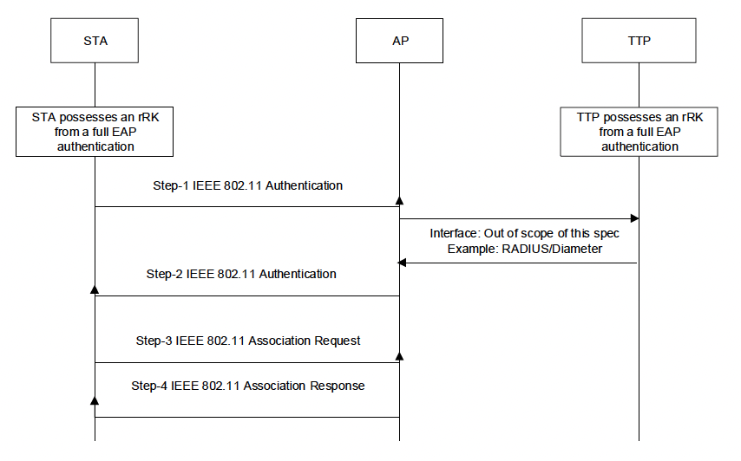
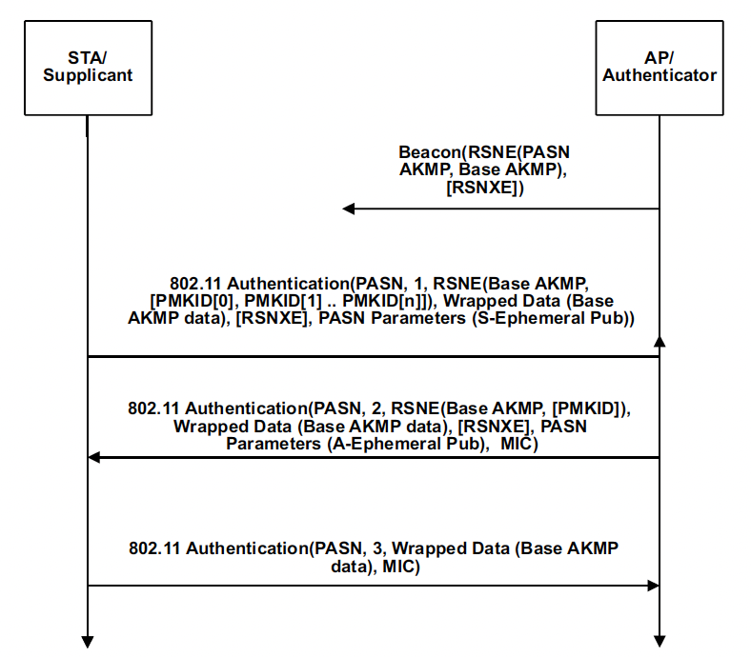
Discussion: Existing Authentication Protocols for Consideration in Seamless Roaming
March 2025
FILS shared key authentication
Signaling | PTK input | PTK equation | Number of messages
Legacy FT-based authentication: | PTK is derived from PMK, ANonce, and SNonce | PTK = PRF-Length(PMKR1, “Pairwise key expansion”, Min(AA,SPA) || Max(AA,SPA) || Min(ANonce,SNonce) || Max(ANonce,SNonce)) | 4 messages
Pre-association security negotiation (PASN) | PTK derived from PMKR1, BSSID, and Diffie-Hellman shared secret (DHss) ephemeral public and private keys | PTK = KDF-HASH-NNN (PMKR1, “PASN PTK Derivation”, SPA || BSSID || DHss) | 3 messages
FILS authentication | PTK derived from ANonce, SNonce and Diffie-Hellman shared secret (DHss) ephemeral public and private keys | PTK = PRF-X(PMK, “FILS PTK Derivation”, SPA || AA || SNonce || ANonce [ || DHss ]) | 4 messages
PASN authentication
PASN authentication is preferred:
  No reliance on ANonce and SNonce for PTK derivation (see next slide)
  Less number of messages for authentication
Chittabrata Ghosh, Apple

Slide 6
Proposal: New PTK Derivation during Link Add Phase
March 2025
A non-AP MLD and Roaming Target AP MLD use PASN authentication to derive new temporal key (PTK) during the roaming preparation phase
Assumptions:
  Ephemeral private keys of non-AP MLD and Roaming target AP MLD are not shared with Serving AP MLD
  Non-AP MLD and Roaming target AP MLD share their ephemeral public key (EPK) with Serving AP MLD
  Roaming target AP MLD uses non-AP MLD’s EPK and its own ephemeral private key to derive an ephemeral Diffie-Hellman shared secret (DHss)
  Non-AP MLD uses AP MLD’s EPK and its own ephemeral private key to derive an ephemeral Diffie-Hellman shared secret (DHss)
Benefits:
  Maintain the communication with Serving AP MLD while adding link with the Target AP MLD
  Serving AP MLD cannot derive PTK without knowledge of non-AP MLD and Target AP MLD’s private keys
Chittabrata Ghosh, Apple

Slide 7
Proposal: PTK Negotiation during Roaming Preparation Phase
March 2025
Propose that security context is carried in Link addition request and response frames of roaming preparation phase
Security context:
  Non-AP MLD’s EPK (EPK-1) in Link addition request frame as 1st message
  Target AP MLD’s EPK (EPK-2) in Link addition response frame as 2nd message
Upon receipt of the security context, non-AP MLD and Target AP MLD compute PTK
PTK derivation is complete after completion of the link setup
Propose to define a link handshake timeout interval in Link addition response frame
    If the Route switch request frame for roaming execution is not received from the non-AP MLD within the indicated link handshake timeout interval, the derived new PTK and context for link setup are expired
Non-AP MLD 1
AP MLD 1
AP MLD 2
Serving AP MLD
Target AP MLD
Query/Scan to discover Target AP MLD
M1: Link addition request
[EPK-1]
Link setup request
Static context (EPK-1))
Link setup response [EPK-2]
M2: Link addition response
[EPK-2, link handshake timeout]
Link setup complete (PTK established)
Link handshake timeout
M3: Route switch request
Logical
OTA
Over-the-DS
Chittabrata Ghosh, Apple

Slide 8
Conclusions
March 2025
For seamless roaming, PTK renegotiation is preferred during the link add procedure
  PTK separation avoids exposing security (temporal) keys with intermediate AP MLDs
    Discussed different authentication protocols and preference is to use public and private keys for PTK renegotiation
    Proposed that security context with respect to PASN authentication is exchanged between non-AP MLD and Serving AP MLD during link add procedure
    A handshake timeout value is proposed for PTK verification, and after timeout interval, PTK renegotiation and metrics for link setup expire
Chittabrata Ghosh, Apple

Slide 9
Reference
March 2025
[1] G. Chischi, et. al., “11-24/1883r3 Seamless Roaming”
9
Chittabrata Ghosh, Apple

Slide 10
Straw Poll
March 2025
Do you support that
TBD request frame initiating roaming preparation carries the DH parameter element of the non-AP MLD when new PTK is derived
TBD response frame during roaming preparation carries DH parameter element generated by the target AP MLD when new PTK is derived
Non-AP MLD and the target AP MLD derive the PTK based on the shared PMK and DHss in TBD request and TBD response frames?
10
Chittabrata Ghosh, Apple

