Slide 1
Solutions for Beacon Bloating
Authors:

Slide 2
Problem Statement (1)
Beacon frames grow by each 802.11 generation
Pre-11be, or even pre-11ax, Beacon sizes of 300-400 bytes per BSSID are common
11be adds about additional 100-200 bytes
If no Beacon design change in 11bn, more IEs would be added to Beacon frame
Support of Multi-BSSID is mandatory in 6GHz
With 2-7 BSSIDs, Beacon frame could get as large as 880 to 1700 bytes
Due to large Multi-BSSID Beacons, enterprise AP vendors have resorted to temporary solutions, e.g. splitting multi-BSSIDs Beacon into multiple Beacons
Channel inefficiency: Beacon frames consume more medium time
Particularly when transmitted lowest MCS and when there are multiple BSSIDs per AP
Large Beacons increase (associated/scanning) STAs power consumption

Slide 3
Beacon Content
Legacy approach: Include all the legacy IEs and UHR IEs in the Beacon frame
No limit for Beacon bloating
Proposal: Do not add new UHR-related IEs in Beacon
Short UHR capability bit(s) are added to the beacon
A STA obtains the complete UHR parameters during Probing/Association
Candidate UHR Parameters:
UHR Capabilities IE
UHR Operation IE
IEs maybe defined in relation to newly-proposed UHR features:
DSO
NPCA
DPS
ELR
Multi-AP
…

Slide 4
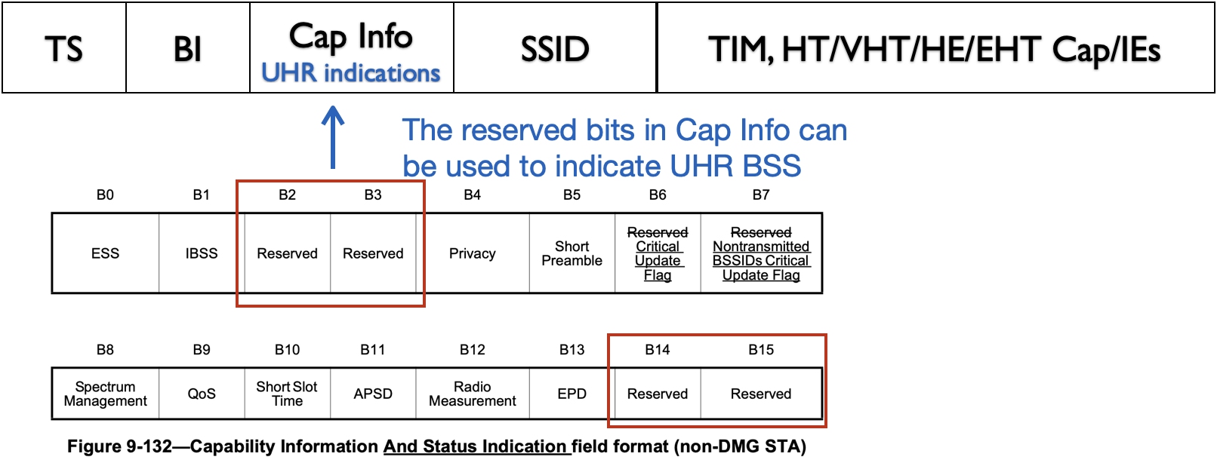
Proposal – UHR IE Classification
Short discovery mechanism for unassociated STAs
Repurpose a reserved bit in the Capability Info to indicated UHR BSS:
UHR BSS (1 bit): indicates that the AP supports UHR
Reduced Neighbor Report (RNR) signal also whether the reported AP supports UHR
To obtain complete set of UHR parameters
An unassociated STA may send a (ML) Probe Request and obtain the complete set of UHR parameters from (ML) Probe Response
Or a STA may obtain the complete set of UHR parameters during authentication or association
Or as part of pre-roaming procedure, the STA may obtain a min set of capabilities of the UHR AP from its serving AP

Slide 5
Proposal: UHR Parameters Update for Associated STAs
Beacon frame signals critical BSS parameter change by:
Setting BSS Critical Update flag to 1
Increasing BSS Parameter Change Count (BPCC) by 1. (BPCC value is modulo(256))
Associated STAs shall obtain the BSS parameters before the STA send data frames to the AP
After a critical update, the Beacon carry the updated IEs for multiple DTIM intervals
The updated UHR IEs are carried for multiple DTIM intervals, to make sure associated STAs that may be in power save also obtain the updated IEs from Beacon frame. For efficiency, only the updated UHR IEs are carried
Proposal: To efficiently help associated STAs that modified UHR IEs are carried, we propose to define a separate critical update flag, by repurposing a reserved bit in the Capability Info, to indicate that the Beacon frame carries the UHR IEs
Note: Per baseline spec, a STA may exchange ML Probe Req/Response to acquire modified UHR parameters. However, this is less desirable due to additional STA power consumption.

Slide 6
Problem Statement (2)
Beacon signals BSS parameter changes which helps STA to detect when parameters are updated
Critical Update Flag (1 bit) in Capabilities Information field
Stays on until the next DTIM only
Early in the Beacon, received by STAs using early termination
BSS Parameter Change Count (BPCC) (1 octet)
BPCC of transmitting AP is in Multilink element and BPCCs of affiliated APs are in RNR
A complete Beacon frame must be received to obtain BPCC values
BSS Parameter change

Slide 7
Proposal
Proposal: include an indication of BPCC of all links in an element that appears early in the Beacon frame:
Sum of BSS Parameter Change Counts (SBPC): The sum of BPCC fields of all links and all BSSs
Example: Links 1 and 2 have Multiple-BSSID Beaconing
BSS22 gets critical parameter update
SBPC signals the updated Sum of all BSS Parameter Change Counts Modulo(255) on all Beacons
STA cannot miss critical parameter update. The SBPC is visible on all beacons
Before Critical Parameter Update
After Critical Parameter Update
AP MLD1
AP MLD2
AP MLD1
AP MLD2
BPCC 26
SBPC 94
BSS 11
BPCC 60
SBPC 94
BSS 21
BPCC 26
SBPC 95
BSS 11
BPCC 60
SBPC 95
BSS 21
Link 1
Link 1
BPCC 108
SBPC 94
BSS 12
BPCC 155
SBPC 94
BSS 22
BPCC 108
SBPC 95
BSS 12
BPCC 156
SBPC 95
BSS 22
Link 2
Link 2

Slide 8
Summary
Increasing Beacon size over many 802.11 generations is a problem, and it will become even worse in upcoming generations
802.11bn shall provide means for beacon size reduction for UHR and all following 802.11 generations
The proposals are:
1) to add to Beacon frame a short indication of presence of a UHR BSS, and
2) avoid adding static UHR BSS parameters to Beacon. A STA may obtain the UHR parameters during probing or association

Slide 9
Straw Poll 1
Do you agree that no UHR defined elements carrying static BSS parameters are included in Beacon frames, except for a field indicating that the AP is a UHR AP
The UHR BSS parameters are obtained by STAs pre-association through Probe Response and (Re)Association Response frames
Whether certain dynamic BSS parameters can also be excluded is TBD

Slide 10
Straw Poll 2
If there is a change to one or more UHR parameters, then a UHR AP provides an indication of the update.
The indication that an update exists follows a similar TGbe mechanism, but using a different (TBD) set of fields
It is TBD how UHR non-AP STAs obtains the updates.

Slide 11
References
[1] 23-1938r1: Beacon design with and without multiple BSSID support, Liwen Chu

