Slide 1
Proposals for AP Discovery and Evaluation for
Initial Association and Roaming
Date: 2024-12-02
Authors:

Slide 2
Abstract
Discuss some considerations and proposals to facilitate effective and expedited discovery of neighborhood APs by a client device (Non-AP STA) for initial association and roaming

Slide 3
Motivation (1)
Discovery and evaluation of neighbor APs / AP MLDs by a Non-AP device is a crucial component in choosing target APs for initial association / roaming
Conventionally, a Non-AP device performs autonomous channel scans (active / passive) to discover neighbor APs / AP MLDs; some limitations below:
  Channel scans are expensive in time and power consumption; executing channel scans in 2.4/5/6 GHz bands may take a few seconds to complete
  Disruption of activities in the home channel of the Non-AP while performing off-channel scans
  Full information present in Beacons / Probe Responses is likely not necessary to evaluate the favorability of the discovered APs for association / roaming
Hence, it is desirable to devise schemes that enable an efficient discovery of neighbor APs / AP MLDs by a Non-AP while mitigating the overhead entailed by channel scans
Key idea – An AP (referred to as Reporting AP) provides necessary information about non-co-located neighbor APs / AP MLDs to a Requesting Non-AP device

Slide 4
Motivation (2)
Some mechanisms already exist in baseline spec that somewhat address our goal:
  Reduced Neighbor Report (RNR)
  Neighbor Report in BSS Transition Management
  Multi-link Probe Request / Response
However, a few key limitations exist for the existing schemes, as described below:
  Information contained is either too little (forcing Non-AP to perform additional channel scans) or too much (resulting in wastage of precious medium airtime)
  Reporting AP includes information about only those APs that are co-located with the same AP MLD as the Reporting AP (a behavior that we have observed in the field, even though spec does not impose such a limitation)
Our objectives are two-fold:
  Motivate AP vendors to communicate information about non-co-located neighboring APs / AP MLDs in response to a Request received from a Requesting Non-AP
  Identify a set of attributes that are relevant for initial link setup / roaming and communicate only that set to the Requesting Non-AP to minimize overhead

Slide 5
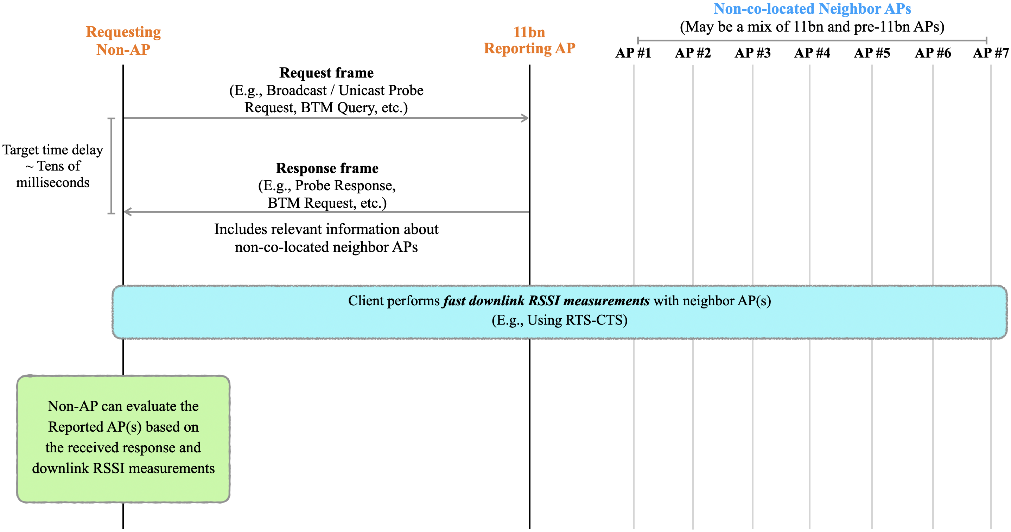
Overarching Goal
Key takeaway — A Non-AP can discover multiple neighbor APs, obtain relevant information about the APs, and create / maintain candidate AP(s) with a single frame exchange with Reporting AP

Slide 6
Key Considerations
The Reporting AP provides the information about neighbor APs / AP MLDs only in response to a request received from a Non-AP
  We do not envision this information to be carried always in Beacons, etc., of the Reporting AP, which may otherwise result in gratuitous bloating of such frames
The response from the Reporting AP contains only those attributes about neighboring APs / AP MLDs that are necessary for a Non-AP to perform candidate AP selection for initial link setup, roaming, etc.
  A client device likely does not need the full information about neighbor APs / AP MLDs (present in Beacons / Probe Response frames) to perform selection of candidate AP(s) for initial association / roaming
The content of the response from the Reporting AP should be applicable to both unassociated and associated client devices
  The information may be carried in any frame – Probe Response, (unsolicited) BTM Request, etc. sent by the Reporting AP
  The attributes of interest to a Non-AP for evaluation of neighbor APs / AP MLDs are listed in Slide 12
The response from the Reporting AP may include information about legacy (pre-11bn) neighbor APs / AP MLDs, in addition to 11bn AP MLDs
  Providing such information is useful for a Non-AP, especially in the context of initial association

Slide 7
Enhanced RNR Format (Example)
Example of how Reduced Neighbor Report (RNR) can be enhanced to carry relevant information about neighbor APs / AP MLDs
Define a new type of RNR information format (TBTT information field type = 2) with the following fields (more details in Slide 14):
TBTT Offset (1 byte)
BSSID (6 bytes)
Short SSID (4 bytes)
Neighbor AP Static Attributes (5 bytes)
  Co-located
  PHY Type
  Security Protocol Support Bitmap
  IP Address Continuity
  Highest NSS
  UPR Active
  20 MHz PSD
Neighbor AP Dynamic Attributes (3 bytes)
  BSS Operating BW
  BSS Load + Station Count
  Association Disallowed
MLD Parameters (1 byte)
  AP MLD ID
SMD Parameters (1 byte)
  SMD ID

Slide 8
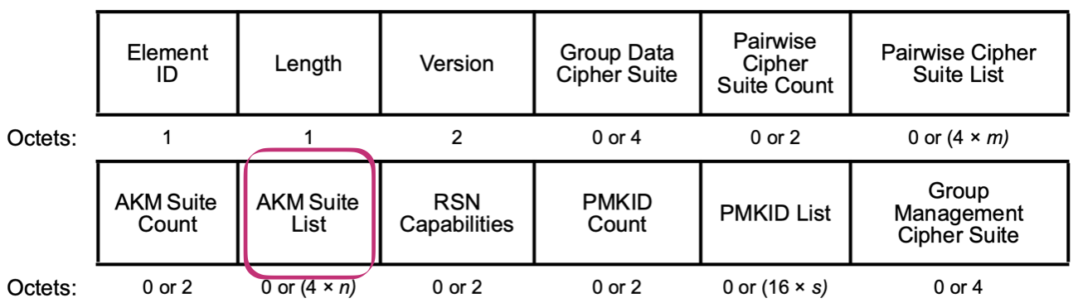
Security Protocol Support of Neighbor APs
Goal: Communicate the security protocol (WPA3, WPA2, etc.) supported by each Neighbor / Reported AP
  WPA2, WPA3, etc., are terms used by the Wi-Fi Alliance; need to indicate the corresponding AKM Suite Selector(s) for each Reported AP
A Client device typically uses security protocol supported by discovered APs / networks to evaluate them for favorability for initial association and roaming
  Example order of preference: Enterprise > PSK > Open, WPA3 > WPA2 > WPA > WEP
An AP may indicate support for several AKM Suites in RSN element; each AKM Suite is represented using 4 octets (see figure below) → Signaling all supported AKM suites (N) entails a high overhead (4*N octets)
To rank/evaluate/select candidate APs, knowledge of security protocols / AKM Suites supported by Neighbor AP(s) should suffice
Problem Statement: Efficiently communicate the list of AKM Suites supported by each neighbor AP
RSNE format

Slide 9
Proposal: Security Protocol Support Bitmap
Security Protocol ID | Wi-Fi Security Protocol | AKM Suite ID (Table 9-190 in REVme_D7.0)
1 | WPA-Enterprise / WPA2-Enterprise (802.1X) | 00-0f-ac-01
2 | WPA-Personal / WPA2-Personal (PSK) | 00-0f-ac-02
3 | WPA2-Enterprise with FT (802.1X + FT) | 00-0f-ac-03
4 | WPA2-Personal with FT (PSK + FT) | 00-0f-ac-04
5 | WPA3-Personal (SAE) | 00-0f-ac-08
6 | WPA3-Enterprise (SAE) | 00-0f-ac-12
7 | WPA3-Personal with FT (SAE + FT) | 00-0f-ac-09
8 | WPA3-Enterprise with FT | 00-0f-ac-13
9 | WPA3-Enterprise Suite-B (192 bit) | 00-0f-ac-14
10 | WPA3-Enterprise Suite-B (192 bit) with FT | 00-0f-ac-24
11 | Opportunistic Wireless Encryption (OWE) | 00-0f-ac-25
Assign a unique ID (named Security Protocol ID) that identifies an AKM Suite supported by the Reported AP
Reporting AP includes a bitmap (3 octets) named Security Protocol Support Bitmap for each Reported AP
Set 1 for each bit position (starting from LSB) corresponding to the Security Protocol ID(s) supported by the Reported AP
Example: Security Protocol Support Bitmap set as 0x8 0x8 01010101 → Reported AP supports WPA2-Enterprise (with and without FT), WPA3-Personal (with and without FT)
Set Security Protocol Support Bitmap as all 0s if the Reported AP does not support any of the listed security protocols
Client device can deduce the AKM Suite(s) supported by the Reported AP by inspecting the bitmap

Slide 10
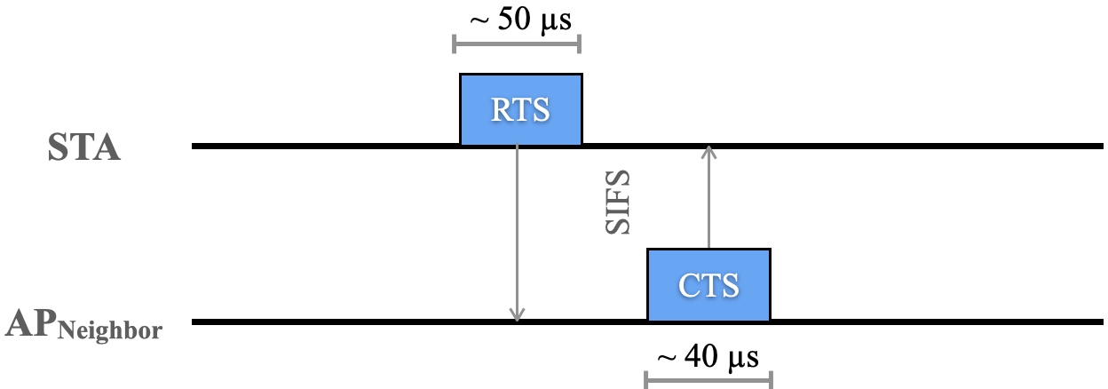
Fast RSSI Measurements
An important attribute of interest to Non-AP pertaining to neighbor APs / AP MLDs is the downlink RSSI from each of those APs
  The Non-AP must perform measurements with the neighbor APs to obtain this information and cannot rely on the Reporting AP
Proposal: Use RTS-CTS frames to enable rapid measurements of DL RSSI from each Reported AP at the STA
RTS-CTS are Class-1 control frames that can be exchanged between a STA and an unassociated (and unauthenticated) AP
STA sends RTS to AP_{Neighbor}; STA measures RSSI _{APNeighbor → STA} from the CTS response
Benefits:
  Simple framework, supported in current standards
  Overhead of RSSI measurement is minimal; ~100s of microseconds per neighbor AP
  Similar RSSI measurement accuracy as beacon / probe response frames; RSSI measured over the preamble (L-LTF field) of the frames (in the PHY header) and all these frames are transmitted with robust rates

Slide 11
Conclusion
The purpose of this contribution is two-fold:
  Motivate AP vendors to communicate information about non-co-located neighbor APs / AP MLDs to a Non-AP requesting this information
  Identify a set of attributes that are relevant to Non-AP to choose target AP(s) for initial association / roaming and include only those attributes in the response from Reporting AP
  Such information aids client devices in making educated decisions during initial-link-setup, roaming, etc., while entailing minimal overhead
We explained these concepts with an enhanced version of RNR, as an example
Potential enhancements:
  Reporting AP may include a measure of “freshness / staleness” of the information of a Reported AP
  Reporting AP may restrict information in the response to non-co-located neighbor AP MLDs with the same SSID as the Reporting AP

Slide 12
Straw Poll
Do you agree that an AP (referred to as Reporting AP) communicates information it has about non-co-located neighbor APs / AP MLDs (referred to as Reported APs) in response to a request received from a Non-AP device to help the Non-AP device in discovery and evaluation of the Reported APs as targets for initial association / roaming?
Note: The Non-AP device requesting such information may or may not be associated with the Reporting AP
Y:
N:
A:

Slide 13
Appendix

Slide 14
Relevant Attributes of Neighbor APs / AP MLDs
Assumption – Reporting AP may be aware of Legacy AP(s) in its neighborhood, not just 11bn AP MLD(s)
Roaming Phase | Attributes of interest | Notes
Discovery | TBTT Offset | Client may receive Beacon from Reported AP, if needed
 | BSSID | Identity of the Reported AP
 | Short SSID
 | Co-located AP | Reported AP is co-located (or not) with the Reporting AP
 | IP Address Continuity | Client can maintain the same IP address when moving from Reporting AP to Reported AP
 | UPR Active | Client may receive UPR from Reported AP in 6 GHz, if needed
 | 20 MHz PSD | Governs the transmit power of the Non-AP when transmitting frames to the Reported AP prior to association
 | AP MLD ID | Identity of AP MLD with which the Reported 11be AP is affiliated
 | SMD ID | Identity of the Seamless Mobility Domain (SMD) to which the Reported 11bn AP is affiliated
Evaluation | PHY Type (11bn, 11be, 11ax, …) | Estimate achievable DL throughput from Reported AP
 | BSS Operating BW
 | Highest NSS
 | BSS Load + STA Count
 | Association Disallowed | Eliminate Reported AP as a candidate if association is disallowed
 | Security Protocol Support (Support of AKM Suites) | Indicate the security protocols / AKM suites supported by the Reported AP

