Slide 1
Performance Benefits of DSO
Date: 2025-03-05
Authors:
Name | Affiliations | Address | Email
Kerstin Johnsson | Nokia Tech | 520 Almanor Ave, Sunnyvale, CA 94085 | Kerstin.Johnsson@nokia.com
Klaus Doppler
Salvatore Talrico
Behnam Dezfouli
Juhyung Lee
Prabodh Varshney
Okan Mutgan
Mikhail Liubogoshchev
Mika Kasslin
Mario Costa
Eda Genc
Notes:
November 2012

Slide 2
Outline
DSO resolves gap in current bandwidth utilization
Remaining gap in DSO

Slide 3
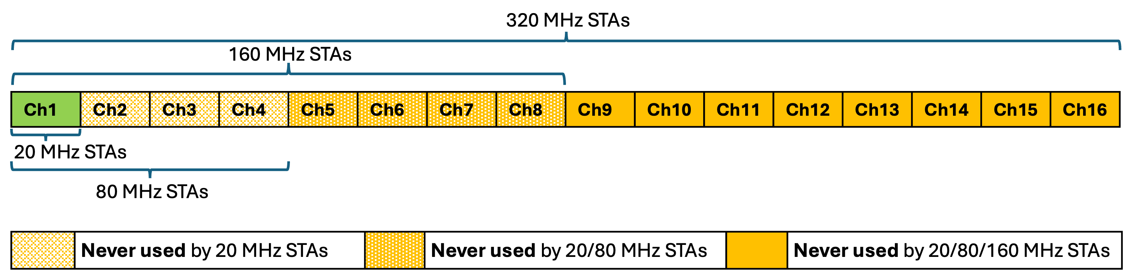
Unused bandwidth
802.11be supports APs/BSSs with up to 320MHz operating bandwidth
However, non-AP STAs are often limited to much smaller bandwidths (e.g., 80 MHz)
Since a STA’s operating BW must include the primary channel, a BW mismatch between an AP and its associated non-AP STAs can result in large parts of BSS operating BW going unused

Slide 4
Dynamic Sub-band Operation (DSO)
DSO enables APs to utilize more of its available bandwidth by allowing them to create allocations that don’t include the primary 20 MHz channel
DSO has already been proposed in many contributions:
  2204 and 0843r1 from SG
  1496, 2027r2, 2141r3, 0517, 0783r1, 0949r1, 1244, 1474, 1553, 1564r2, 1587r1, 1588r1, 2054 from TG
Contributions generally cover one/both of the following:
  Pre-negotiation between AP and its associated non-AP STAs of DSO capabilities (turn on/off DSO, sub-bands available for DSO, switching time per sub-band, etc.)
  DSO trigger (either in a standalone control frame or enabled via existing control frames like MU-RTS/BSRP) along w/ required contents/changes to said frames
Proposed spec impacts are minimal, while performance gains can be substantial

Slide 5
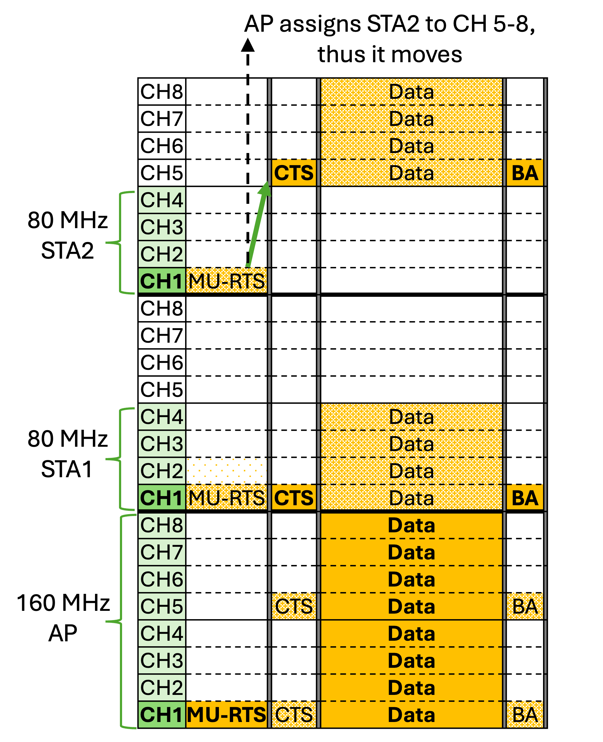
Example of proposed DSO protocol
  AP and non-AP STAs exchange DSO parameters during association and/or separate DSO setup procedure.
  DSO parameters include whether to engage in DSO, potential DSO channel(s) and their switching times, etc.
  When allocating resources, AP transmits a modified MU-RTS or BSRP that includes:
    RU allocations specifying where each non-AP STA should move (some non-AP STAs may not be moved)
    Intermediate FCS that allows non-AP STAs to decode MU-RTS/BSRP before end of the frame
    Padding that gives non-AP STAs time to move to their RU allocations
Non-AP STAs move to their RU allocations for current TxOP, then return to their primary locations.

Slide 6
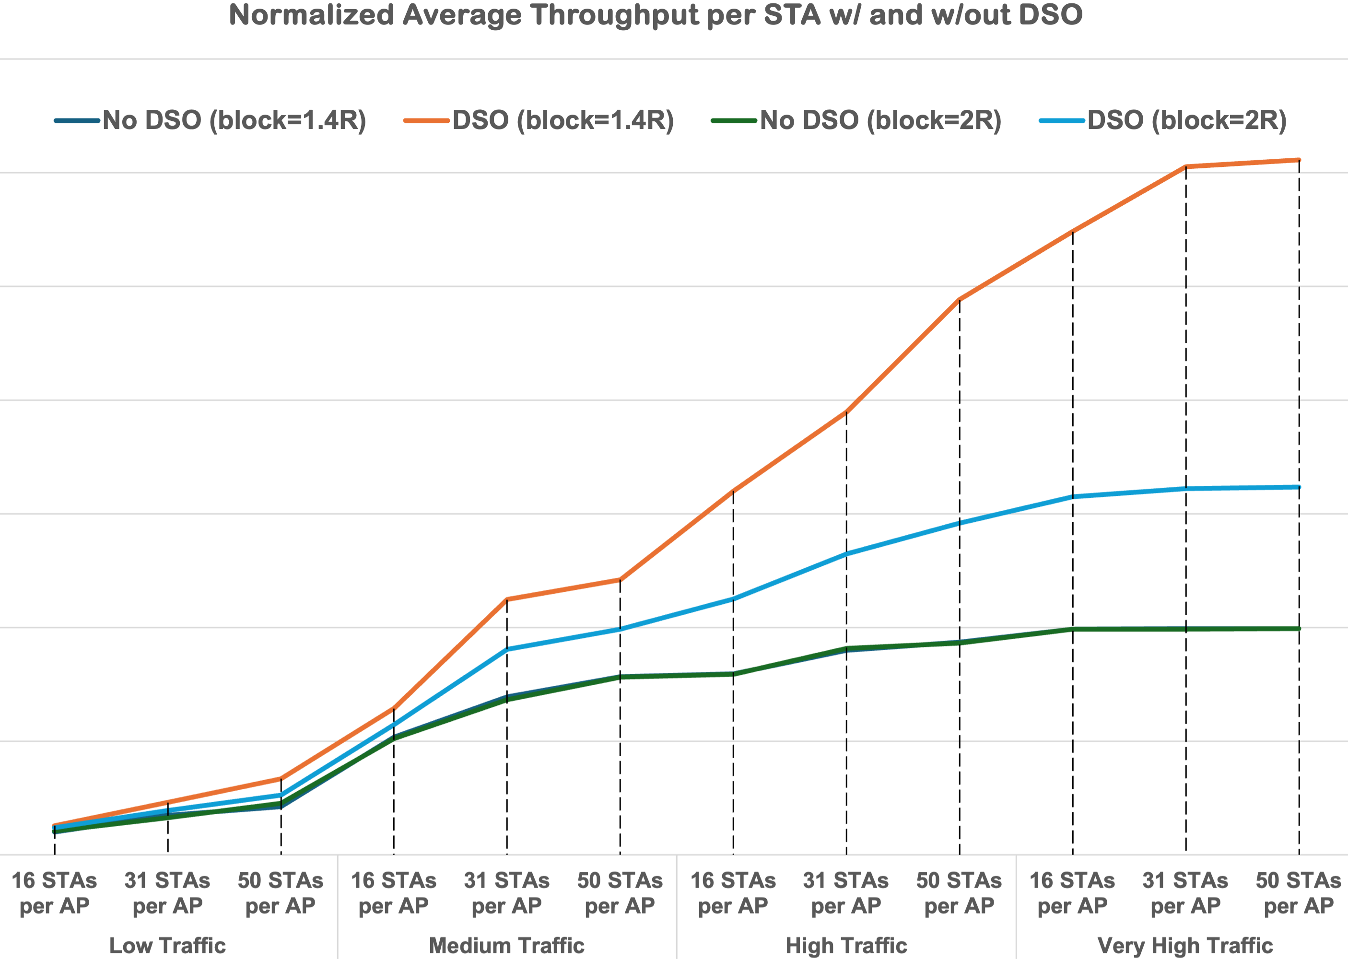
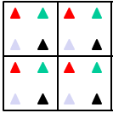
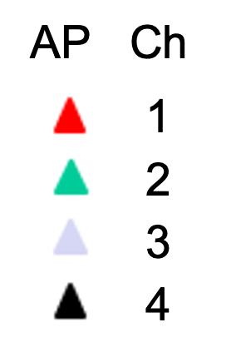
DSO performance benefits
Statistical model of Wi-Fi
4x4 BSS Wi-Fi deployment
320 MHz APs, 80 MHz STAs
Reuse 4, i.e., in cluster of 4 APs, each is assigned diff primary 80 MHz from 320 MHz BW
W/out DSO, AP/STA can only use primary 80 MHz
W/ DSO, AP/STA can use any available part of 320 MHz; but when non-primary 80MHz used, TXOP reduced by 1/5 to account for switch time
STAs per AP = [16, 31, 50]
Avg UL/DL traffic per STA = [low, med, high, very high]
Blocking range = [1.4R, 2R], where APs are 2R distance apart
3x
1.6x
➢ DSO gains increase w/traffic load, reaching ~1.5x-3x baseline throughput depending on blocking range

Slide 7
Outline
DSO resolves gap in current bandwidth utilization
Remaining gap in DSO

Slide 8
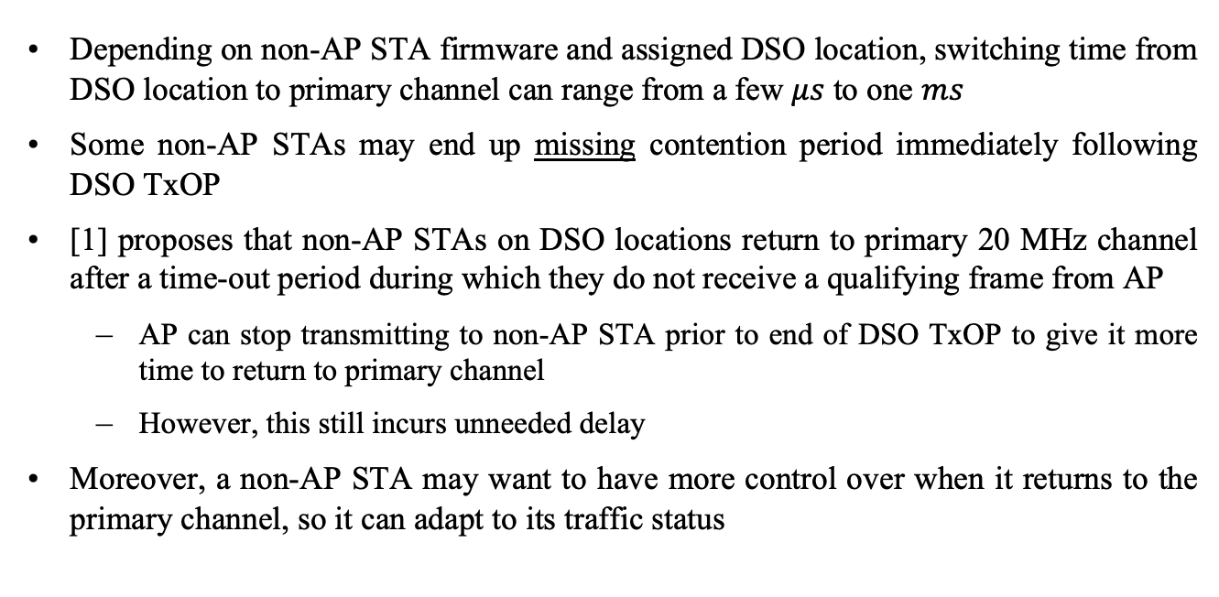
Some non-AP STAs miss contention period post DSO TxOP
Depending on non-AP STA firmware and assigned DSO location, switching time from DSO location to primary channel can range from a few $μs$ to one $ms$
Some non-AP STAs may end up missing contention period immediately following DSO TxOP
[1] proposes that non-AP STAs on DSO locations return to primary 20 MHz channel after a time-out period during which they do not receive a qualifying frame from AP
  AP can stop transmitting to non-AP STA prior to end of DSO TxOP to give it more time to return to primary channel
  However, this still incurs unneeded delay
Moreover, a non-AP STA may want to have more control over when it returns to the primary channel, so it can adapt to its traffic status

Slide 9
Proposed solution
1-bit flag in header of data/BA frame indicating an end to DSO frame exchange releases non-AP STA to return to primary channel prior to end of DSO TxOP
Flag only has this meaning while AP/non-AP STAS on DSO locations
Non-AP STA can set flag to inform AP it will return to primary channel upon completion of current frame exchange, allowing STA to adapt to its traffic status
  E.g., non-AP STA sets flag in next data/BA frame when it has urgent UL traffic and needs remaining TxOP time to switch back to primary channel
  E.g., if non-AP STA has no urgent UL traffic, it leaves flag unset to inform AP that it can remain on DSO location for any/all DL traffic until end of DSO TxOP
AP can set flag to tell a non-AP STA there will be no more frame exchanges, releasing non-AP STA to return to primary channel immediately rather than wait for time-out

Slide 10
Straw Poll #1
As part of 802.11bn, do you agree to enable a UHR AP to temporarily move a UHR non-AP STA away from its primary location to a predefined part of the BSS operating BW that does not include the primary channel?
Y/N/A

Slide 11
Straw Poll #2
As part of 802.11bn, do you agree to add a 1-bit flag in the data and BA frame headers that indicates an end to frame exchanges on the DSO channel?
Y/N/A

Slide 12
Reference
[1] 11-24/2054 “Detailed text proposal for Dynamic Subband Operation (DSO)”, Morteza Mehrnoush

