Slide 1
Enhancements for Roaming Process
Date: 2025-1-7
Authors:

Slide 2
Introduction
Roaming is one of the main topics discussed by the TGbn group.
Multiple presentation have focused on how to enable seamless/improved roaming [1-12].
In this presentation, some of the enhancements for the roaming is discussed.

Slide 3
Draining Uplink Data by STA before Roaming
In some contributions, it is suggested that the STA should drain the Uplink Data before roaming execution [2,5].

Slide 4
Uplink Data Transmission after Roaming Request
January 2025
If the buffer of the STA is full or there is a heavy traffic in the network, draining the UL DATA may take a considerable time, thus delaying the roaming process. In [14, 15] it is suggested, there could be cases where UL transmission could be allowed for special cases.

Slide 5
Proposal 1 Providing Total Size for UL Data
January 2025
When a STA decides to roam, STA requests for a total size of the AP-MLD for UL draining and transmits UL data according to the information it receives.

Slide 6
Proposal 2 Providing Duration for UL Data
January 2025
When a STA decides to roam, STA requests for a total size of the AP-MLD for UL draining and transmits UL data according to the information it receives.

Slide 7
QoS Requirements and Roaming
January 2025
For many applications QoS requirements can dynamically change E.g. changes to throughput and/or latency requirement based on events/triggers experienced
It is proposed enhancements to support dynamic updates to QoS requirements for flows, to enable efficient scheduling for UL and DL resources by the AP. [13]
STAs may request roaming not only for keeping connection but to satisfy new QoS requirements.
Tuncer Baykas (Ofinno)

Slide 8
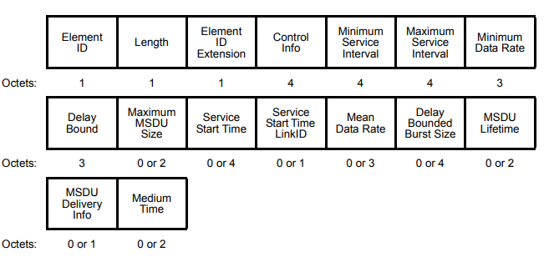
Current QoS exchange in 802.11be
January 2025
The network uses Stream classification service (SCS) descriptor with QoS Characteristics element to indicate its requirements. There is a change request for each stream qualification service.
Note —A QoS Characteristics element provided by a non-AP EHT STA is used by a receiving EHT AP to facilitate the creation of a schedule for contention based channel access (EDCA) or MU operation. How the AP uses the information provided by the non-AP STA QoS Characteristics element that do not have corresponding normative requirements is beyond the scope of the standard.
Tuncer Baykas (Ofinno)

Slide 9
Proposal 1
January 2025
The roaming is initiated with a roaming notification frame by the STA.
Serving AP sends all SCS QoS requirements to the Target AP
Target AP indicates which SCS QoS, Target AP can support, if Target AP cannot support all QoS’s
Serving AP informs the STA.
If the STA decides to continue with the roaming process, STA sends a roaming request.

Slide 10
Proposal 2
January 2025
The roaming is initiated with a roaming request frame by the STA with a specific SCS QoS requirement,
Source AP send the SCS QoS requirements to the Target AP.
If the Target AP can support QoS Requirements source AP sends a positive response.
Target AP informs STA

Slide 11
Conclusion
January 2025
In this presentation we presented two methods to improve the possible roaming process.

Slide 12
References
January 2025
[1] 11-24/1595r0 Scope of MAPC and Roaming Standardization (Brian Hart, Cisco Systems)
[2] 11-23/2157r2 Seamless Roaming within a Mobility Domain (Binita Gupta, Cisco Systems)
[3] 11-24/0396r1 Seamless Roaming within a Mobility Domain – Follow Up (Binita Gupta, Cisco Systems)
[4] 11-24/398r0 Coordinated Roaming through Target AP MLD (Binita Gupta, Cisco Systems)
[5] 11-24/0052r0 Seamless Roaming Details (Duncan Ho, Qualcomm)
[6] 11-24/0679r3 Thoughts on Functionality and Security Architecture for UHR Seamless Roaming (Thomas Derham, Broadcom)
[7] 11-23/0322r0 Improve Roaming between MLDs (Po-Kai Huang, Intel)
[8] 11-23/1996r0 Improve Roaming between MLDs (Po-Kai Huang, Intel)
[9] 11-24/0830r1 Improve Roaming between MLDs follow up (Po-Kai Huang, Intel)
[10] 11-24/0881r0 Improving Stability during Roaming Process (Tuncer Baykas, Ofinno LLC)
[11] 11-23/1897r0 Thought on Improving Roaming under Existing Architecture (Guogang Huang, Huawei)
[12] 11-23/1908r0 Seamless Roaming Procedure (Yelin Yoon, LG Electronics)
[13] 11-24/660r0 Dynamic QoS profiles with SCS (Binita Gupta)
[14] 11-24/1740r1 UL Data Transmission for Seamless Roaming Kyosuke Inoue (SHARP)
[15] 11-24/1820r1 UL Data Continuity Improvement for Seamless Roaming (Yudai Morikawa)

