Slide 1
Follow Up on UEQM Stream Parser
Date: 2024-11-11
Authors:

Slide 2
Introduction
Unequal modulation (UEQM) is accepted as a feature for 11bn
  TGbn SFD [1]
    “TGbn defines unequal modulation over different spatial streams.”
    “UHR defines unequal modulation only for LDPC.”
A unified stream parser that supports both EQM/UEQM is preferred
  The authors propose to reuse the stream parser formulas used for 802.11n with some small changes in 802.11bn [2]
  Some concerns have been expressed regarding the 802.11n stream parser not being able to handle BPSK in UEQM streams

Slide 3
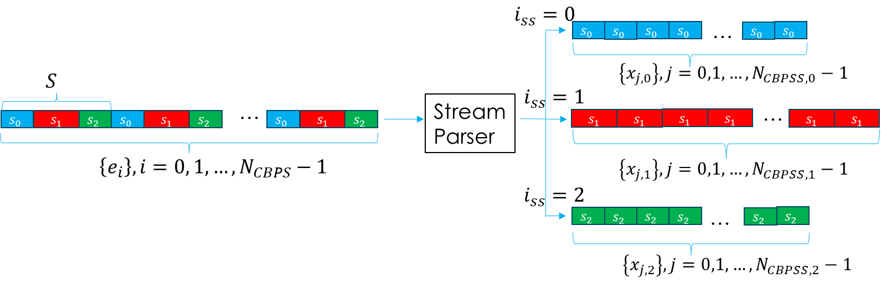
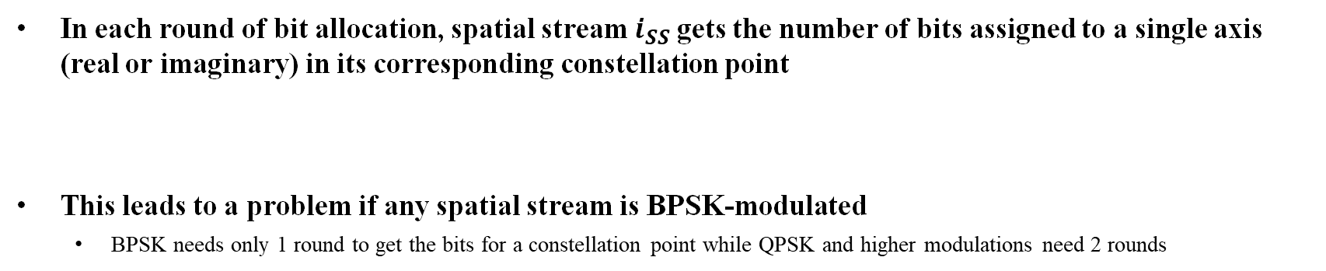
Brief Recap on the 802.11n Stream Parser
In each round of bit allocation, spatial stream $i_{SS}$gets the number of bits assigned to a single axis (real or imaginary) in its corresponding constellation point
This leads to a problem if any spatial stream is BPSK-modulated
  BPSK needs only 1 round to get the bits for a constellation point while QPSK and higher modulations need 2 rounds

Slide 4
UEQM Stream Parser With BPSK
In this contribution, three UEQM stream parsers that can parse BPSK streams are proposed
  11n stream parser with a new bit allocation unit size
  11n stream parser with leftover bits
  11n stream parser with skipped rounds for BPSK
Given these possible solutions, agreement should be reached on if BPSK stream parsing should be supported
  If no, 11n stream parser should be reused
  If yes, a stream parser that supports BPSK stream parsing should be chosen

Slide 5

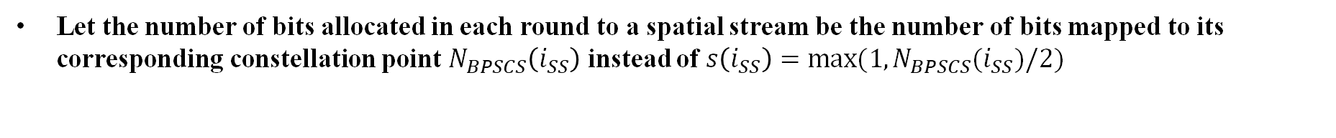
Option 1: New Bit Allocation Unit Size (1)
Let the number of bits allocated in each round to a spatial stream be the number of bits mapped to its corresponding constellation point $N_{BPSCS}\left(i_{SS}\right)$ instead of $s\left(i_{SS}\right)=max⁡(1,N_{BPSCS}(i_{SS})/2)$

Slide 6
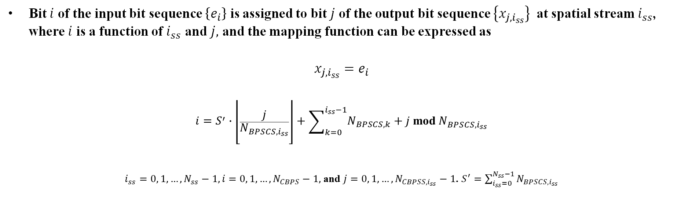
Option 1: New Bit Allocation Unit Size (2)
Bit $i$ of the input bit sequence $\left\{e_{i}\right\}$ is assigned to bit $j$ of the output bit sequence $\left\{x_{j,i_{ss}}\right\}$ at spatial stream $i_{ss}$, where $i$ is a function of $i_{ss}$ and $j,$ and the mapping function can be expressed as
$$x_{j,i_{ss}}=e_{i}$$
$$\begin{aligned}i=S^{′}∙\left\lfloor \frac{j}{N_{BPSCS,i_{ss}}}\right\rfloor +\sum_{k=0}^{i_{ss}−1}{N_{BPSCS,k}}+j \text{mod}{ N}_{BPSCS,i_{ss}}\end{aligned}$$
$i_{ss}=0, 1,…, N_{ss}−1, i=0, 1,…,N_{CBPS}−1,$ and $j=0, 1,…,N_{CBPSS,i_{ss}}−1$. $S^{′}=\sum_{i_{ss}=0}^{N_{ss}−1}{N_{BPSCS,i_{ss}}}$

Slide 7



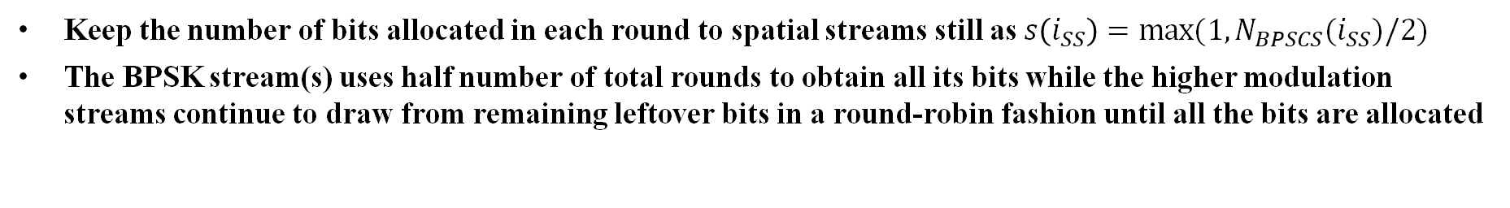






























Option 2: Leftover Bits (1)
$$i_{ss}=0$$
…
Leftover bits
$$s_{0}$$
$$s_{0}$$
$$s_{0}$$
$$s_{0}$$
BPSK
$$S′′$$
$$\left\{x_{j,0}\right\},j=0,1,…,N_{CBPSS,0}−1$$
$$S$$
$$i_{ss}=1$$
…
…
Stream Parser
…
…
$$s_{0}$$
$$s_{1}$$
$$s_{2}$$
$$s_{0}$$
$$s_{1}$$
$$s_{2}$$
$$s_{1}$$
$$s_{2}$$
$$s_{1}$$
$$s_{2}$$
$$s_{1}$$
$$s_{1}$$
$$s_{1}$$
$$s_{1}$$
$$s_{1}$$
$$s_{1}$$
$$s_{1}$$
$$\left\{e_{i}\right\}, i=0, 1,…,N_{CBPS}−1$$
$$\left\{x_{j,1}\right\},j=0,1,…,N_{CBPSS,1}−1$$
$$i_{ss}=2$$
…
…
$$s_{2}$$
$$s_{2}$$
$$s_{2}$$
$$s_{2}$$
$$s_{2}$$
$$s_{2}$$
$$s_{2}$$
$$\left\{x_{j,2}\right\},j=0,1,…,N_{CBPSS,2}−1$$
Keep the number of bits allocated in each round to spatial streams still as $s\left(i_{SS}\right)=max⁡(1,N_{BPSCS}(i_{SS})/2)$
The BPSK stream(s) uses half number of total rounds to obtain all its bits while the higher modulation streams continue to draw from remaining leftover bits in a round-robin fashion until all the bits are allocated

Slide 8
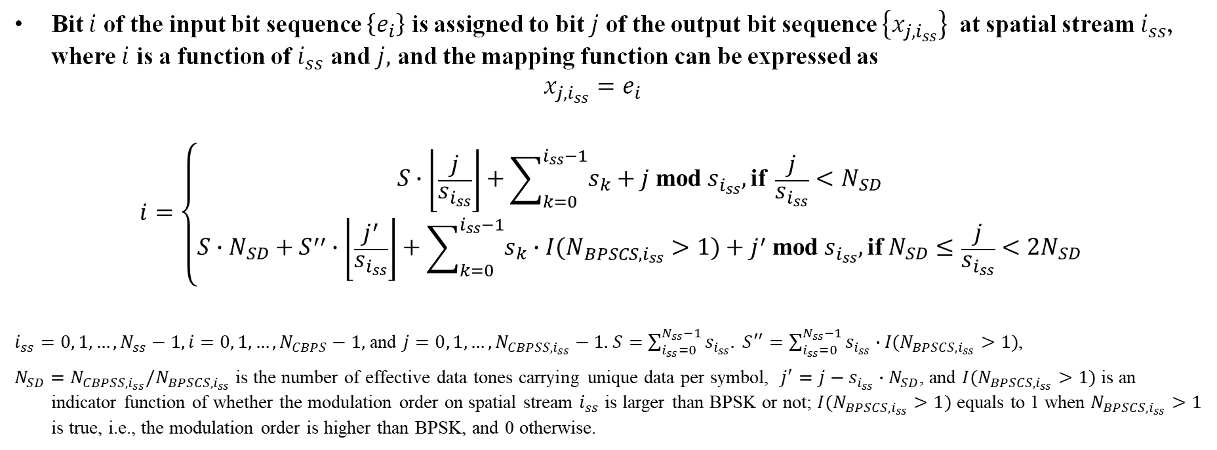
Option 2: Leftover Bits (2)
Bit $i$ of the input bit sequence $\left\{e_{i}\right\}$ is assigned to bit $j$ of the output bit sequence $\left\{x_{j,i_{ss}}\right\}$ at spatial stream $i_{ss}$, where $i$ is a function of $i_{ss}$ and $j,$ and the mapping function can be expressed as
$$x_{j,i_{ss}}=e_{i}$$
$$\begin{aligned}i=\left\{\begin{matrix}S∙\left\lfloor \frac{j}{s_{i_{ss}}}\right\rfloor +\sum_{k=0}^{i_{ss}−1}{s_{k}}+j \text{mod}{ s}_{i_{ss}}, \text{if} \frac{j}{s_{i_{ss}}}<N_{SD} \\ S∙N_{SD}+S^{′′}∙\left\lfloor \frac{j^{′}}{s_{i_{ss}}}\right\rfloor +\sum_{k=0}^{i_{ss}−1}{s_{k}∙I(N_{BPSCS,i_{ss}}>1)}+j^{′} \text{mod}{ s}_{i_{ss}}, \text{if} N_{SD}≤\frac{j}{s_{i_{ss}}}<2N_{SD}\end{matrix}\right.\end{aligned}$$
$i_{ss}=0, 1,…, N_{ss}−1, i=0, 1,…,N_{CBPS}−1,$ and $j=0, 1,…,N_{CBPSS,i_{ss}}−1.$ $S=\sum_{i_{ss}=0}^{N_{ss}−1}{s_{i_{ss}}.} S^{′′}=\sum_{i_{ss}=0}^{N_{ss}−1}{s_{i_{ss}}∙}I(N_{BPSCS,i_{ss}}>1)$,
$N_{SD}=N_{CBPSS,i_{ss}}/N_{BPSCS,i_{ss}}$ is the number of effective data tones carrying unique data per symbol, $j^{′}=j−s_{i_{ss}}∙N_{SD}$, and $I(N_{BPSCS,i_{ss}}>1)$ is an indicator function of whether the modulation order on spatial stream $i_{ss}$ is larger than BPSK or not; $I(N_{BPSCS,i_{ss}}>1)$ equals to 1 when $N_{BPSCS,i_{ss}}>1$ is true, i.e., the modulation order is higher than BPSK, and 0 otherwise.

Slide 9

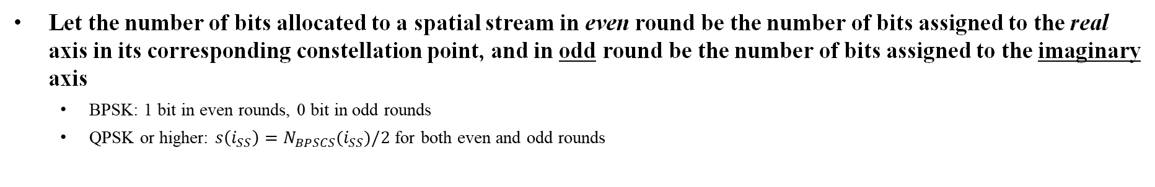





















Option 3: Skipping Rounds for BPSK (1)
$$i_{ss}=0$$
$$S′′′$$
$$s_{0}$$
$$s_{0}$$
$$s_{0}$$
$$s_{0}$$
…
$$s_{0}$$
$$s_{0}$$
BPSK
$$S$$
$$\left\{x_{j,0}\right\},j=0,1,…,N_{CBPSS,0}−1$$
Stream Parser
$$i_{ss}=1$$
…
…
$$s_{0}$$
$$s_{1}$$
$$s_{2}$$
$$s_{1}$$
$$s_{2}$$
$$s_{0}$$
$$s_{1}$$
$$s_{2}$$
$$s_{1}$$
$$s_{2}$$
$$s_{0}$$
$$s_{1}$$
$$s_{2}$$
$$s_{1}$$
$$s_{2}$$
$$s_{1}$$
$$s_{1}$$
$$s_{1}$$
$$s_{1}$$
$$s_{1}$$
$$s_{1}$$
$$\left\{e_{i}\right\}, i=0, 1,…,N_{CBPS}−1$$
$$\left\{x_{j,1}\right\},j=0,1,…,N_{CBPSS,1}−1$$
$$i_{ss}=2$$
$$s_{2}$$
$$s_{2}$$
$$s_{2}$$
$$s_{2}$$
…
$$s_{2}$$
$$s_{2}$$
$$\left\{x_{j,2}\right\},j=0,1,…,N_{CBPSS,2}−1$$
Let the number of bits allocated to a spatial stream in even round be the number of bits assigned to the real axis in its corresponding constellation point, and in odd round be the number of bits assigned to the imaginary axis
  BPSK: 1 bit in even rounds, 0 bit in odd rounds
  QPSK or higher: $s\left(i_{SS}\right)=N_{BPSCS}(i_{SS})/2$ for both even and odd rounds

Slide 10
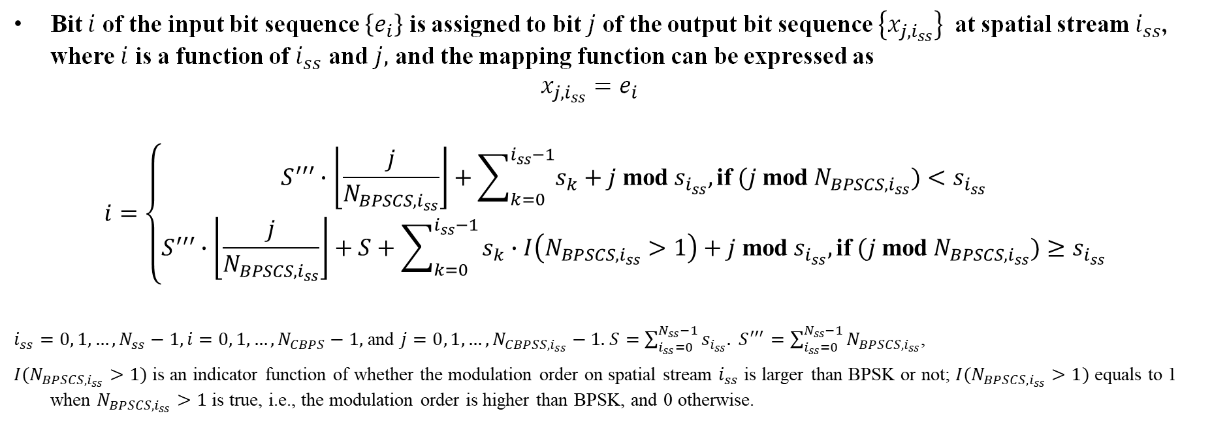
Option 3: Skipping Rounds for BPSK (2)
Bit $i$ of the input bit sequence $\left\{e_{i}\right\}$ is assigned to bit $j$ of the output bit sequence $\left\{x_{j,i_{ss}}\right\}$ at spatial stream $i_{ss}$, where $i$ is a function of $i_{ss}$ and $j,$ and the mapping function can be expressed as
$$x_{j,i_{ss}}=e_{i}$$
$$\begin{aligned}\begin{aligned}i=\left\{\begin{matrix}S^{′′′}∙\left\lfloor \frac{j}{N_{BPSCS,i_{ss}}}\right\rfloor +\sum_{k=0}^{i_{ss}−1}{s_{k}}+j \text{mod}{ s}_{i_{ss}}, \text{if} (j \text{mod} N_{BPSCS,i_{ss}})<s_{i_{ss}} \\ S^{′′′}∙\left\lfloor \frac{j}{N_{BPSCS,i_{ss}}}\right\rfloor +S+\sum_{k=0}^{i_{ss}−1}{s_{k}∙I\left(N_{BPSCS,i_{ss}}>1\right)}+j \text{mod}{ s}_{i_{ss}}, \text{if} (j \text{mod} N_{BPSCS,i_{ss}})≥s_{i_{ss}}\end{matrix}\right.\end{aligned} \end{aligned}$$
$i_{ss}=0, 1,…, N_{ss}−1, i=0, 1,…,N_{CBPS}−1,$ and $j=0, 1,…,N_{CBPSS,i_{ss}}−1.$ $S=\sum_{i_{ss}=0}^{N_{ss}−1}{s_{i_{ss}}.} S^{′′′}=\sum_{i_{ss}=0}^{N_{ss}−1}{N_{BPSCS,i_{ss}}}$,
$I(N_{BPSCS,i_{ss}}>1)$ is an indicator function of whether the modulation order on spatial stream $i_{ss}$ is larger than BPSK or not; $I(N_{BPSCS,i_{ss}}>1)$ equals to 1 when $N_{BPSCS,i_{ss}}>1$ is true, i.e., the modulation order is higher than BPSK, and 0 otherwise.

Slide 11
Summary
To decide if BPSK is allowed in UEQM streams
  Stream parser options provide members a consideration point when making decisions
  Further throughput performance simulations may be needed to compare the effect of including or excluding BPSK in UEQM streams
Three options are proposed for stream parser to handle UEQM with BPSK
  All options are unified stream parser that can handle both EQM and UEQM with/without BPSK
  Option 1 has the least complexity, but has a coarser bit allocation unit, meaning more consecutive bits clustered on the same tone/stream
  Option 2 and 3 have about the same slightly higher complexity, and Option 3 is better in terms of evenly spreading bits across tones and streams
  Option 3 is preferred

Slide 12
References
IEEE 802.11-24/0209r4, “Specification Framework for TGbn,” July 2024.
IEEE 802.11-24/1451r2, “UEQM Transmission Over Spatial Streams,” September 2024.

Slide 13
SP #1
Do you agree that the 11bn stream parser should support BPSK in UEQM spatial streams?
  Yes
  No
  Need further study
  Abstain

Slide 14
SP #2
Assuming BPSK is supported for UEQM spatial streams in 11bn, which options do you prefer for the stream parser (multiple choices):
1) New Bit Allocation Unit Size, as described in 11-24/1807r0
2) Leftover Bits, as described in 11-24/1807r0
3) Skipping Rounds for BPSK, as described in 11-24/1807r0
4) Others

