Slide 1
AMP time-based channel access discussions
Date: 5 November 2024
Name | Affiliation | Address | Phone | Email
Rojan Chitrakar | Huawei | Singapore |  | rojan.chitrakar@huawei.com
Lei Huang
Ian Bajaj
Notes:
Jul 12, 2010
Page 1

Slide 2
Recap: Encapsulated UHF command based channel access
In [1] we shared our thoughts on AMP dual-mode RFID tags and proposed to encapsulate UHF commands in AMP frames.

Slide 3
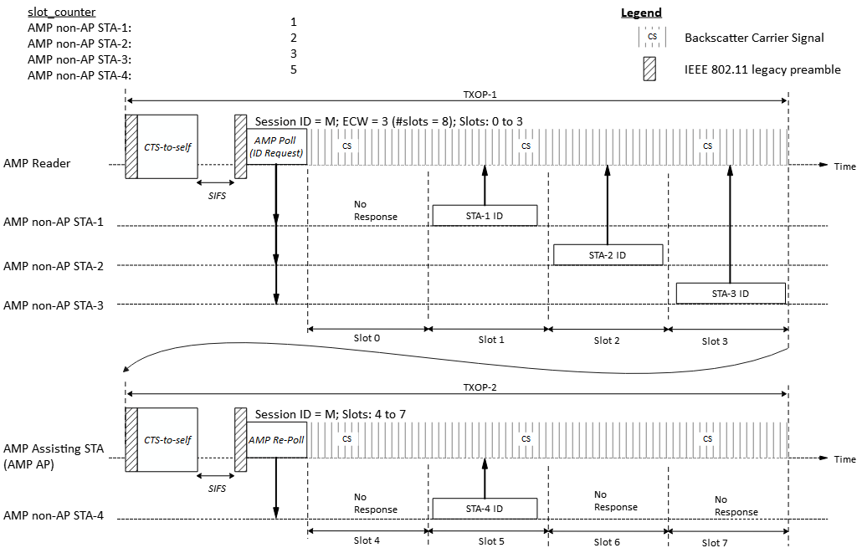
Recap: Time-slot based random access
In [2], we shared a potential time-slot based random access scheme:
AMP AP gains access to wireless medium and transmits an AMP Poll frame to starts a random access session with 2^{ECW} time slots.
Upon receiving the AMP Poll frame, eligible AMP STAs randomly choose a slot and transmit in the slot.
A second AMP frame (AMP Re-Poll) continues the random access session in a different TXOP.
Example: 8 slots spread across two TXOPs and four backscattering AMP STAs contending:

Slide 4
Targeted AMP non-AP STAs
Active transmitter non-AP AMP STAs (Active AMP tags)
Do not require carrier signal
Clock accuracy ±10³ ppm
Dual-mode backscatter non-AP AMP STAs (Dual-mode backscatter AMP tags)
Require carrier signal
Clock accuracy ±10⁵ ppm
Supports UHF protocol
AMP only backscatter non-AP AMP STAs (Single-mode backscatter AMP tags)
Require carrier signal
Clock accuracy ±10⁵ ppm
Assumption: Also supports UHF protocol

Slide 5
Discussion
Since the UHF RFID standard [4] is the de facto standard for passive UHF RFID tags, it is reasonable for backscatter AMP tags to support the logical interface of the UHF protocol.
The physical interface (i.e., air interface) will likely be different.
UHF Logical interface defines Tag memory, flags, states, selection, inventory, and access. [4]
The backscatter AMP tags are expected to have lower hardware capabilities compared to active AMP tags:
Clock accuracy ±10⁵ ppm => Cannot rely on clock count for scheduled/polled events [3]
Small energy capacity => One read transaction needs to be finished within one PPDU or TXOP [3]
Proposal: Two different channel access mechanisms for Active AMP tags and Backscatter AMP tags:
For backscatter AMP tags, the logical interface of the UHF protocol is reused (using 802.11 frames that encapsulates UHF commands).
For active AMP tags, more efficient time-slot based channel access scheme may be used.

Slide 6
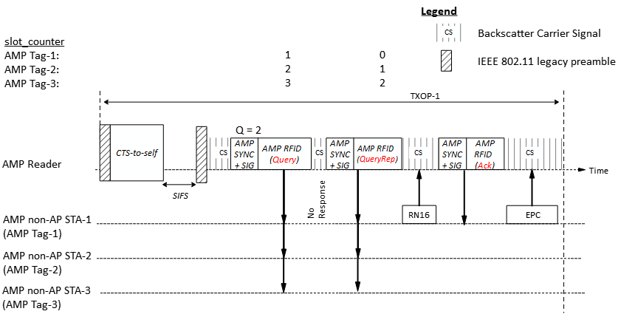
Backscatter AMP tags (1)
1. For backscatter AMP tags, the logical interface of the UHF protocol is reused:
AMP frames encapsulates UHF commands.
AMP tags respond to the UHF commands as per the UHF RFID standard [4].

Slide 7
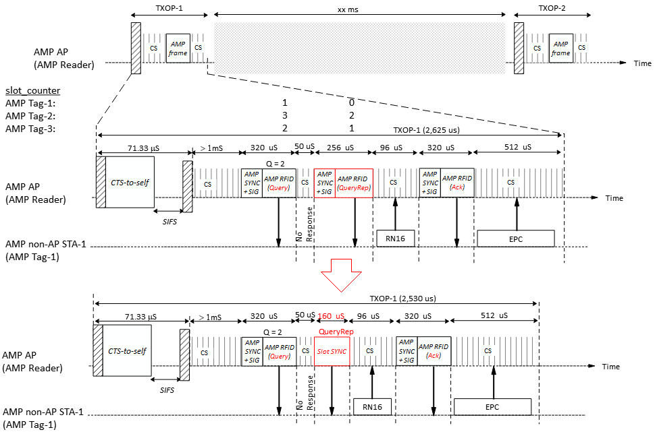
Backscatter AMP tags (2)
The default TXOP limit for AC_BK in 2.4 GHz is 2.528ms; it may be challenging to complete one read transaction within one TXOP.
Some optimization may be made to improve the air-time efficiency:
E.g., the QueryRep UHF command may be replaced by a shorter transmission (Slot SYNC) instead of being encapsulated within a AMP frame.
Note: assuming @250kbps for both DL and UL
Notes:
1)
assuming @250kbps for both DL and UL (4 us per bit):
Query, Ack (10 octet PPDU) = 320 uS/PPDU
QueryRep (8 octet PPDU) = 256 uS
RN16 (24 bits) = 96 uS
EPC (128 bits) = 512 uS
2)
QueryRep (5 octet PPDU = 160 uS

Slide 8
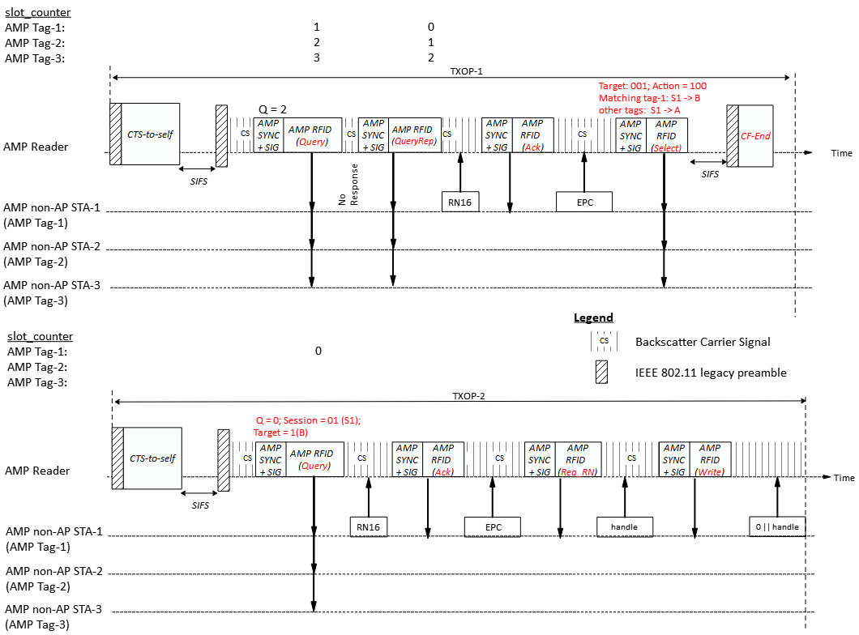
Backscatter AMP tags (3)
In case one read/write transaction cannot be completed within one TXOP, existing UHF protocol mechanisms (e.g. select, session flags) may be leveraged to continue the transaction in subsequent TXOPs.
An example of singulating an AMP tag in a first TXOP and performing a write operation in a second TXOP.

Slide 9
Summary
We discussed the different capabilities of active AMP tags and backscatter AMP tags and proposed that two different channel access mechanisms be considered for active AMP tags and backscatter AMP tags:
For backscatter AMP tags, the logical interface of the UHF protocol is reused (using 802.11 frames that encapsulates UHF commands).
Some optimization may be made to improve the air-time efficiency.
For active AMP tags, more efficient time-slot based channel access scheme may be used.

Slide 10
SP 1
Do you agree that:
For backscatter non-AP AMP STAs, the logical interface of the UHF protocol is reused (using 802.11 frames that encapsulate UHF commands).
Note: The logical interface of the UHF protocol is defined by the EPC® Radio-Frequency Identity Generation-2 UHF RFID Standard.

Slide 11
References
[1] 24/0836r0, Thoughts on AMP RFID tags (Rojan Chitrakar et. al.)
[2] 24/1212r0, Discussions on AMP Channel access (Rojan Chitrakar et. al.)
[3] 11-24/1237, AMP Tag-STA Requirements for Close-Range Backscattering (Rui Cao et. al.)
[4] EPC® Radio-Frequency Identity Generation-2 UHF RFID Standard V3.0 (GS1)

