Slide 1
Consideration on the signaling method of intermediate FCS
Date: 2024-9-4
Authors:

Slide 2
Introduction
According to earlier discussion, the intermediate FCS has been accepted in the 11bn SFD[1],
TGbn defines a way in 11bn to include in an initial control frame an intermediate FCS for UHR STA(s) that precedes padding and the FCS field.
In this contribution, we try to analyze the potential issues for the current IMFCS signaling method under discussion.

Slide 3
Recap: Intermediate FCS
In references [2][3], The IMFCS(intermediate FCS) has been proposed for DPS.
The below figure in [2] illustrates the basic concept of the IMFCS. This new Intermediate FCS field, inserted before the padding allows the STA to use the padding time to change BW and use SIFS to check CCA on TxOP BW
There are also discussions about how to signal/indicate the IMFCS in frame. In [3], three different signaling of IMCS in the Trigger frame are proposed
(option 1) within the several User Info fields
(option 2) within a User Info field
(option 3) within the Padding field
FCS calculated on whole data portion up to FCS2 User Info field
Frame control
Duration
RA
TA
Common info
User info
STA1
User info
STA2
Intermediate FCS
Padding User Info
…
Padding User Info
FCS
20MHz operation: listen mode
Transition from 20 to 80MHz
80MHz operation: power mode

Slide 4
Recap: Intermediate FCS
The current discussions, including the three options in [3], are mostly intended to use specific “pattern bits” to signal the IMFCS fields
In [3][4], one option is to use specific User Info field to contain the IMFCS. i.e. the IMFCS field is signaled with a specific 12 bits AID12
In [3], another option is to put the IMFCS immediately after the Trigger frame padding field (identified by all 1s bits).

Slide 5
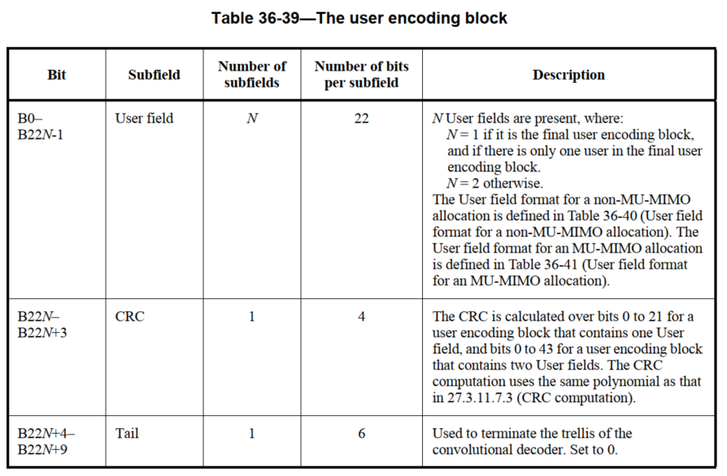
Analysis of the potential issues
All the current options of IMFCS signaling are not to put the IMFCS in a “fixed” location in a frame
When the recipient tries to decode the Trigger frame in MAC level, it cannot know the exact location of the IMFCS. It can only try to search for the specific “pattern bits” to identify the IMFCS fields
By contrast, the conventional MAC FCS is always located in the fixed location of a frame. i.e. it’s always located in the end of the MPDU
Typically, not only (802.11) MAC, but many others will also put their FCS(or CRC) field in a fixed position.
For example, in 802.11 PHY,
The EHT PHY U-SIG has fixed length of 52bits, and the corresponding CRC fields
are always at Bit16~Bit19
The User Block field in EHT PHY E-SIG also have fixed length, and the CRC fields
are always at the fixed position

Slide 6
Analysis of the potential issues
There are many benefits to put FCS/CRC in fixed position. For example,
Be friendly for the implementation to calculate the CRC, as the CRC calculation is based on bit-stream. Especially when the CRC bits are placed in the end of data stream bits
Recipient can always locate the FCS/CRC bits, no matter if there is error bits or not in the received frame
Recipient can avoid the false detect and miss detect of FCS/CRC fields
False detect : due to existence of error bits in received frame, the non-FCS bits with errors are being falsely considered as FCS bits
Miss detect : The recipient cannot locate which bits are FCS/CRC bits
In this proposal, we try to analyze the case of “miss detect” issue, if the IMFCS is not being put in a fixed position in a frame

Slide 7
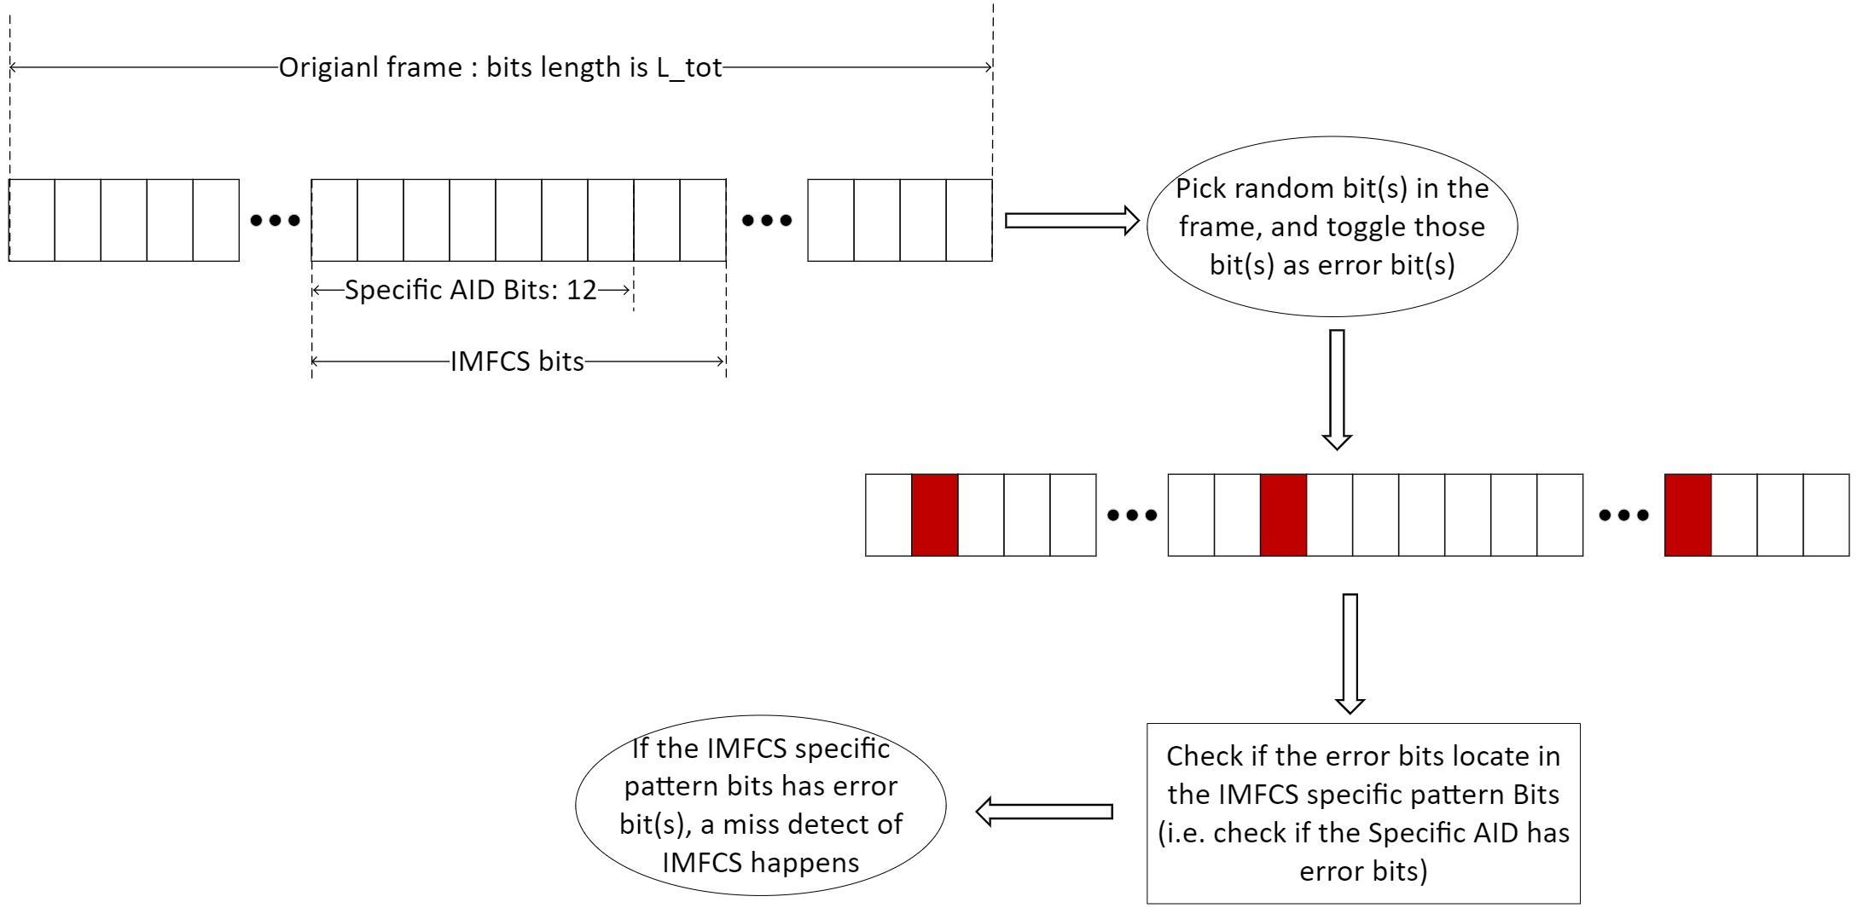
Analysis of the potential issues
The “miss detect” issue happens when the original IMFCS field has error bits in the “pattern bits”.
To simplify the analysis procedure, we use following model to evaluate the probability of miss detect of IMFCS field in a received frame with error bits,

Slide 8
Analysis of the potential issues
The parameters for the analysis
Trigger frame:
5B for each User Info field, 5 Users, 256us Padding, MCS0
IMFCS occupies a 5B User Info field, in which the first 12 bits (AID12) are used as pattern bits to signal IMFCS
This configuration results in a trigger frame with length of ~230 Bytes (We use a value of 230Bytes/1840bits)
Assume each bit in the Trigger frame bits has the same error rate, and the bit error rate of each bit is independently
Figure of Merit
Check the probability of the following case:
the IMFCS pattern bits has at least one error bit, when specific number of bits are wrong in the original frame

Slide 9
Analysis of the potential issues
To further simplify the simulation , the above probability can be simply represented as a math combination problem
$$P\left(IMFCS Pattern Bits has error\right)=1 − \frac{Set\left(All combinations that error bits do not locate in IMFCS pattern bits\right)}{Set\left(All combinations that error bits happen in total frame bits\right)}$$
Assume
the total frame bits is n
the IMFCS pattern bits is m
the number of error bits is k
So the above equation can be (for the case that k <= (n-m))
$$P\left(IMFCS Pattern Bits has error\right)=1 − \frac{C_{n−m}^{k}}{C_{n}^{k}}$$

Slide 10
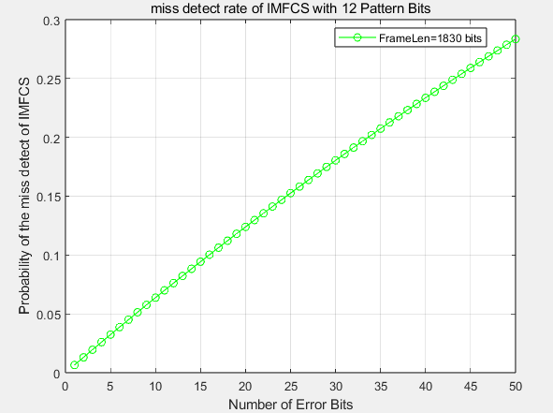
Analysis of the potential issues
Simulation Result:
If there are more than 16 error bits in the 230B frame length, the probability that the original IMFCS cannot be detected exceeds 10%
And the probability increases quickly as the number of error bits increases
The result shows if the received frame (or MPDU) cannot be correctly received, the probability that recipient cannot find the original IMFCS is high
In other words, if the received frame is wrong, it’s highly possible that recipient cannot find the IMFCS filed. And the recipient must need keep receiving/decoding all the entire frame

Slide 11
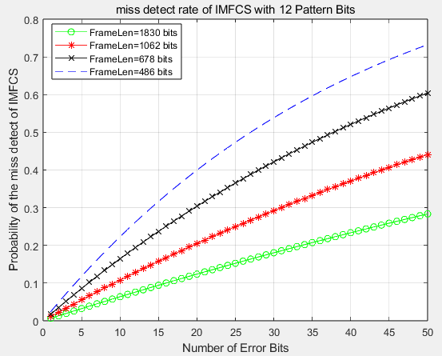
Analysis of the potential issues
For different Padding length (256/128/64/32us), the simulation results are shown in the figure
The shorter padding length results in short Trigger frame
The shorter frame results in higher miss detect probability under the same condition of IMFCS Pattern Bits and Error Bits Number

Slide 12
Summary
In this contribution, we discuss the potential shortcomings of the IMFCS signaling method with non-fixed position in a frame.
And we provide a simple model/simulation to evaluate the miss detect probability of the IMFCS field, when the received frame has error bit(s)
The simulation result shows the miss detect probability seems a little higher
If this higher miss detect probability is considered as an issue, additional mechanisms on the current possible signaling methods of IMFCS should be considered. For example,
To lower the miss detect probability, multiple IMFCS fields can be included in the Trigger frame.
Or, to further avoid this issue, other additional mechanisms that can implicitly or explicitly indicate the position of the IMFCS to recipient should be considered

Slide 13
References
[1] 11-24-0209-05-00bn-specification-framework-for-tgbn
[2] 11-24-1227-01-00bn-some-usage-of-intermediate-fcs
[3] 11-24-1129-01-00bn-discussion-on-intermediate-fcs-signaling
[4] 11-24-1256-00-00bn-the-padding-after-intermediate-fcs

