Slide 1
Dynamic Subband Operation, Follow Up
Date: 2024-09-06
Authors:

Slide 2
Introduction
In current deployments, APs typically support a larger BW than STAs:
  Ex: 802.11ax APs shall support 160 MHz, while non-AP STAs shall only support up to 80 MHz
  Utilizing upper 80 MHz (secondary channel) will improve the QoS for STA
802.11ax defines a mechanism to support secondary channels: SST+TWT
  HE STAs are scheduled on the secondary channels using SST
  Usage of secondary channel is restricting as it’s static based on the TWT schedule
  SST lacks wide adoption
Dynamic subband operation (DSO) leverages the EMLSR like procedure to support STA operation on the secondary channel
  EMLSR is widely supported in EHT which enables fast switching of channels based on the received ICF
  EMLSR like procedure which is per TXOP basis is more flexible than TWT for secondary channel usage
  DSO mechanism by efficiently using the spectrum provides KPI improvement

Slide 3
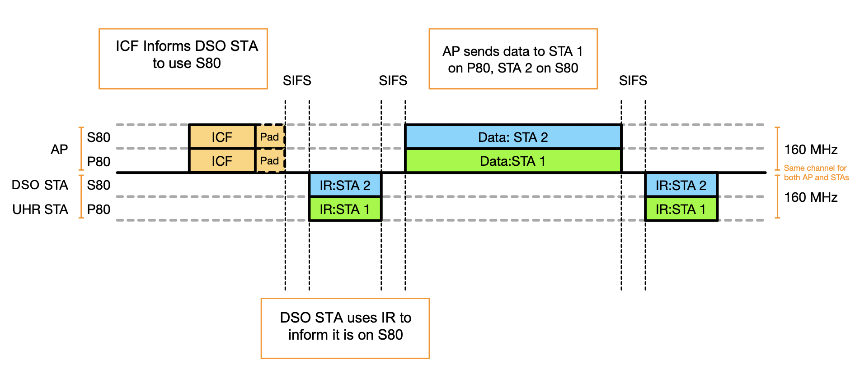
DSO Basic Idea
ICF informs DSO STAs to switch channel to the secondary channel
Immediate response (IR) indicates that STA switched channels, and is ready for DL/UL operation
AP synchronizes DL/UL TB frame exchange – no misalignments between AP and STAs
Reuse all existing EMLSR rules, e.g. switching procedure after receiving ICF and switch back after the end of TXOP

Slide 4
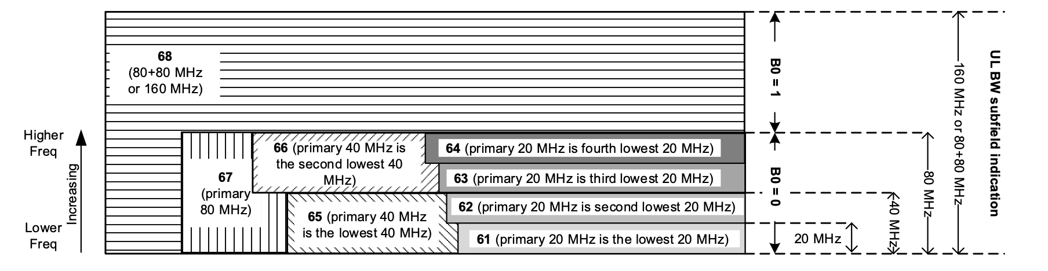
DSO ICF and Channel Switching
Use MU-RTS or BSRP as ICF with padding to inform DSO STA to switch to secondary channel
  User Info Field can be used to indicate RU index for secondary channel
  Ex: Set RU index = 67 and B0 = 1 ➞ tells STA to switch to S80
DSO STA can use CTS or BSR to indicate channel switch is complete
  Ex: CTS is transmitted only on S80

Slide 5
Bandwidth of DSO STAs
Allowing 80MHz and larger BW STAs to use secondary channel in DSO operation
  This simplifies the scheduling at AP side
  Avoids performance degradation of larger BW STAs because of scheduling smaller BW STAs on secondary channel (DSO sub-band)
DSO STAs need to store calibration data of DSO sub-bands, which consumes UHR STA’s memory
  There could be 80/160MHz STAs which may not be able to store the calibration data for all DSO sub-bands due to memory limitation
  Such STAs can request 80/160MHz DSO sub-band(s) that AP may assign to them
  Then, AP assigns the DSO sub-band to those STAs for DSO operation, based on the STA’s request

Slide 6
Summary
DSO mechanism provides spectrum efficiency by scheduling the narrower bandwidth STAs on the secondary channel outside of STA’s operation BW
  DSO STAs are scheduled on the secondary channel, i.e. DSO sub-band, for DL and UL TB frame exchange
  Enough padding is provided in ICF to allow the switching of DSO STAs from primary to DSO sub-band
  This mechanism provides throughput and latency gain
Allowing 80MHz and larger BW STAs to perform DSO operation simplifies the procedure

Slide 7
Straw Polls
1. [M#332] Do you support that TGbn will define a mechanism where a non-AP STA can be allocated frequency resources dynamically (i.e., on a per-TXOP basis) outside of the non-AP STA's current operating bandwidth and within the associated AP's BSS bandwidth?
  [Modified]For a non-AP STA, the channel with bandwidth equaling its operating bandwidth and including the BSS primary channel is referred to as primary sub-band
  For a non-AP STA, a channel with the bandwidth equaling its operating bandwidth outside of its primary sub-band where it can be allocated resources by the AP is referred to as DSO sub-band
  A non-AP STA that supports this mechanism is referred to as a DSO non-AP STA

Slide 8
Straw Polls
2. Do you support that a non-AP STA shall indicate the following parameters to its associated AP when enabling the DSO mode?
  DSO Switching delay
    time required by the DSO non-AP STA to switch from the primary sub-band to the DSO sub-band
  DSO Switch Back delay
    time required by the DSO non-AP STA to switch from the DSO sub-band to the primary sub-band
  Other parameters TBD

