Slide 1
Considerations on the CBF smoothing
Date: 09/06/24
Name | Affilations | Address | Email
Xiaogang Chen | Spreadtrum Communications, USA | 2680 N 1st St. San Jose, CA. 95134 | Xiaogang.chen1@unisoc.com
Chunyu Hu
William Li

Slide 2
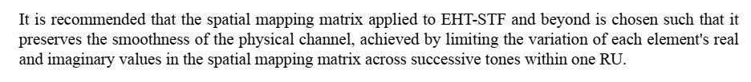
Some background on the beamformed channel smoothing
The recommendation above was proposed in 11ax but not really adopted in the field AFAIK.
  Bfee doesn’t feedback smoothed CBF (compressed Bfing feedback);
  Bfer set “beamformed” to true in preamble, such that Bfee turn off channel smoothing (at least vendor A bfing to vendor B)
So far the 1.5dB~2dB smoothing gain is mostly not harvested yet in the field. It leaves 2x2 solution not quite motivated as BFer…
  Bfing gain is mostly offset by CE smoothing gain.
This deck study further on the benefit of CBF smoothing gain in both SU Bfing and 2x LTF interpolation.

Slide 3
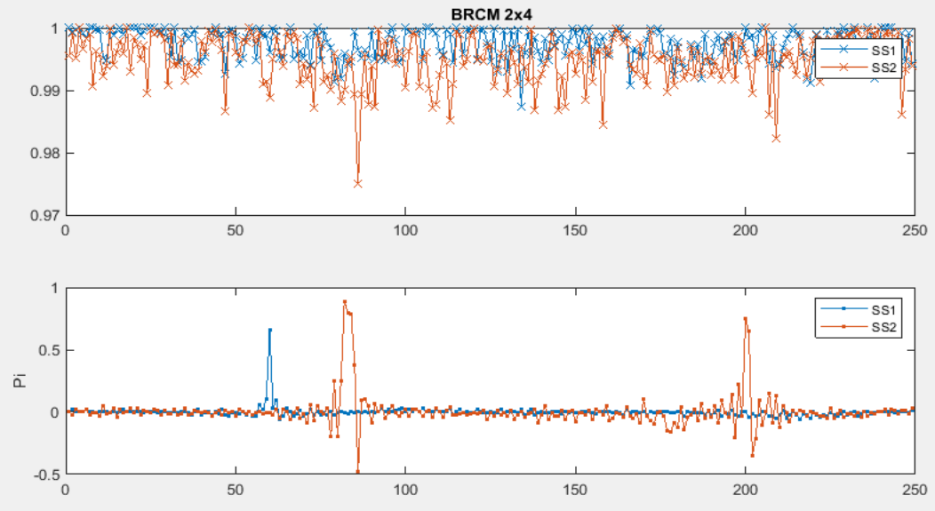
Phase discontinuity in the CBF
The phase discontinuity in CBF is introduced by:
  Bfing matrix compression algorithm (left figure: OTA capture of 4Tx AP -> 2Rx STA)
    E.g. [1 1 1 0.01]’ and [1 1 1 -0.01]’ become [1 1 1 0.01]’ and [-1 -1 -1 0.01]’ after compression and decompression due to the current compression algorithm.
  Similar singular value/rank reversal (right figure: Sims)
    The chance of discontinuity due to similar singular value is relatively low based on our simulation and OTA capture.
    This contribution doesn’t optimize this case due to the complexity of implement.

Slide 4
Performance Evaluation on the benefit of enabling CBF smoothing
Sims assumptions:
80MHz, ChB/D/F, nTx*nRx*nSS -> 4x2x1, 4x2x2, 2x2x1;
4x LTF; 2048 Bytes;
CBF cfg: Ng=4, SU CBF with codebook{6,4};
Bfing vector is compressed by Bfee and recovered by Bfer;
  CBF smoothing is done by Bfer;
Non-ideal CE with MMSE CE smoothing;
  CE smoothing filter is applied assuming PDP is pre-known (fixed 32/16/8 tap for ChB/D/F);

Slide 5
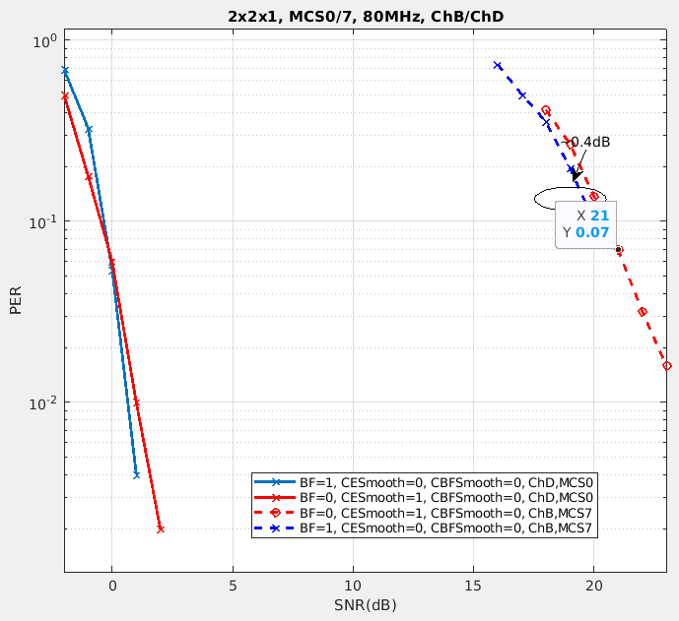
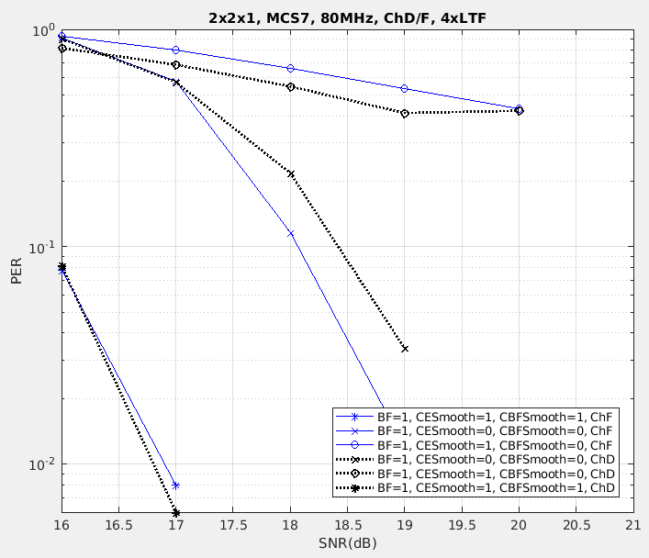
2x2x1
Left figure:
  “Bfing w/o CE smoothing” is on par or worse than “No Bfing w/ CE smoothing” for low MCS where noise is dominated.
  “Bfing w/o CE smoothing” has marginal gain over “No Bfing w/ CE smoothing” for medium MCS.
Right figure:
  CBF smoothing harvest the CE smoothing gain in Bfing.

Slide 6
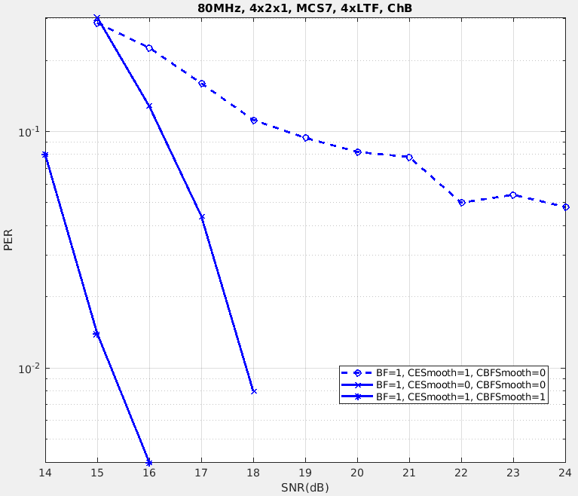
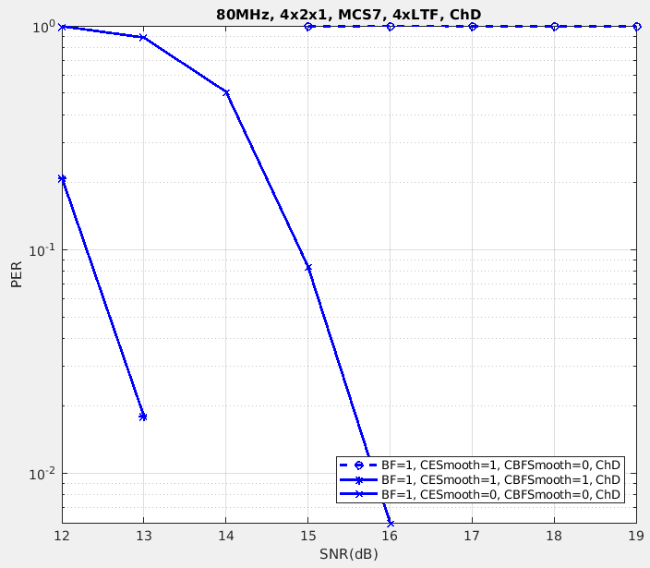
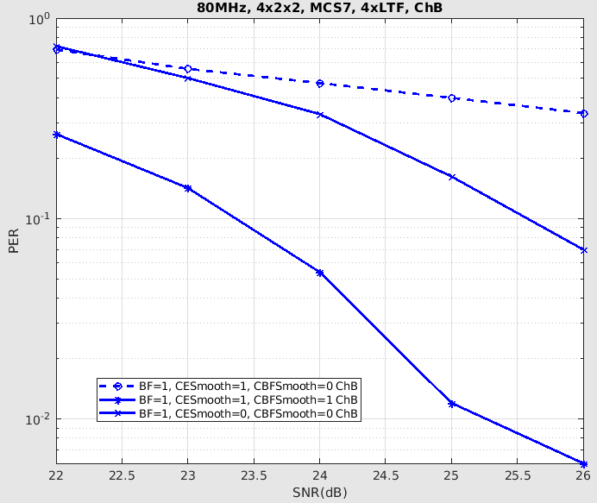
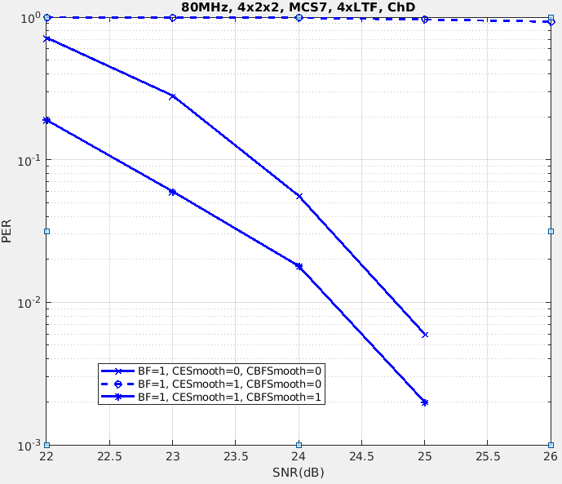
4x2x1, 4x2x2 (1/2)
Consistent CBF smoothing gain (~2dB) is observed for different channel models;
If CBF smoothing is not applied, enable CE smoothing significantly degrade the performance (dashed line).

Slide 7
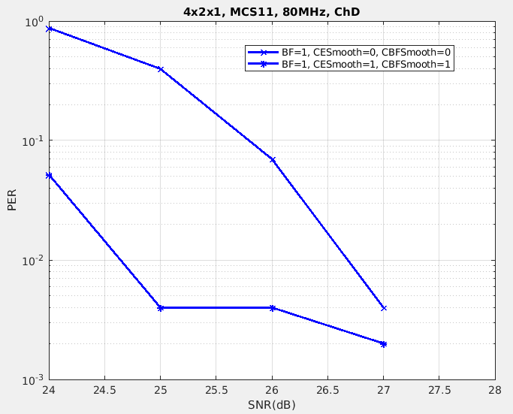
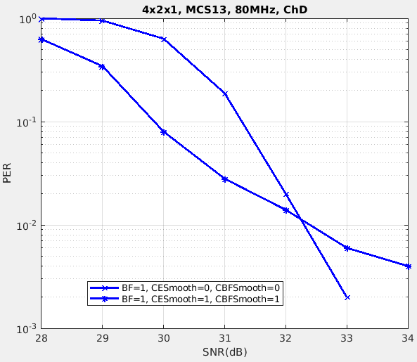
4x2x1, 4x2x2 (2/2)
CBF smoothing gain start to fade out for high SNR region ( ~30dB and above).

Slide 8
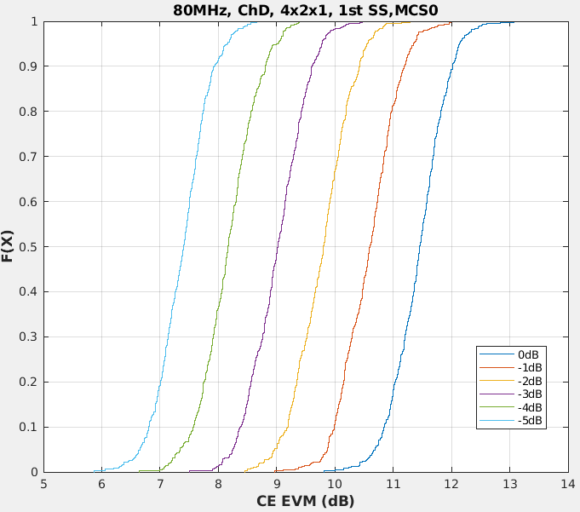
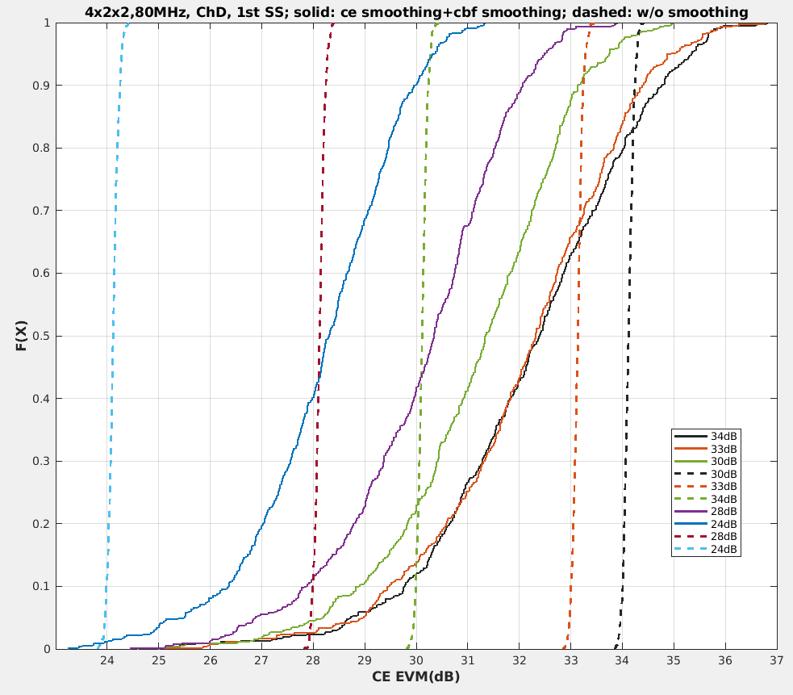
Sim results explanations with CE EVM (1/2)
CBF smoothing mitigates channel estimation (CE) EVM until ~30dB SNR
  Left figure shows CE EVM for CE+CBF smoothing for low SNR;
  Right figure compares CE EVM for two options at high SNR.
CE EVM capped at high SNR because:
  Phase jump is not fully fixed;
  CBF smoothing may not be fully optimized in the current sims.
CBF smoothing shows most CE EVM gain for up to SNR region of MCS11 or even MCS13 depends on the nSS.

Slide 9
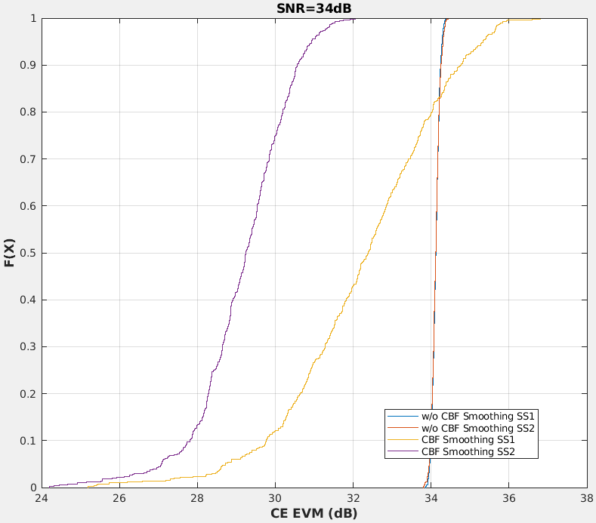
Sim results explanations (2/2)
Phase jump in CBF is relatively larger if:
Delay spread is larger;
Number of Tx antennas is larger;
Singular value is smaller.
Right most figure is a proof of the observations 3) above.

Slide 10
Gap in the protocol
AFAIK, Bfee won’t do CE smoothing if a PPDU is indicated as “beamformed”…
If Bfer do CBF smoothing and want to enable CE smoothing by BFee, Bfer needs to spoof the Bfee and indicate the current PPDU as “not beamformed”.
  However, verification specifically verify the “beamformed” bits is set in Bfing test.
Suggest to have another indication such as “CE smoothing is recommended” when beamforming is conducted.
  Q: How a Bfer know the Bfed channel is smooth enough for Bfee’s smoothing algorithm??
  A:
    1. Similar question can be asked: how Bfer can guarantee the interpolation algorithm in Bfee can handle 1x/2x LTF? Reasonable Bfer who intends to enable CE smoothing will be serious on CBF smoothing. No standardization on the smoothness is required.
    2. Algorithm to enable CBF smoothing has been well studied.

Slide 11
Another advantage of CBF smoothing even CE smoothing is not applied
- 2x LTF (1/3)
Interpolation algorithm mismatch between Tx and Rx may degrade sensitivity as long as 4x LTF is not used in BFing;
Sims assumptions:
  CE smoothing is not conducted;
  80MHz, ChD, 4x2x1;
  MCS 7/11; 2x LTF; 2048 Bytes;
  CBF cfg: ng=4, SU CBF with codebook{6,4};
  Bfing vector is compressed by Bfee and recovered by Bfer;
  CBF smoothing is done by Bfer;
  Interpolation algo:
    Linear at the BFer
    Linear/Spline/Copy at the BFee.

Slide 12
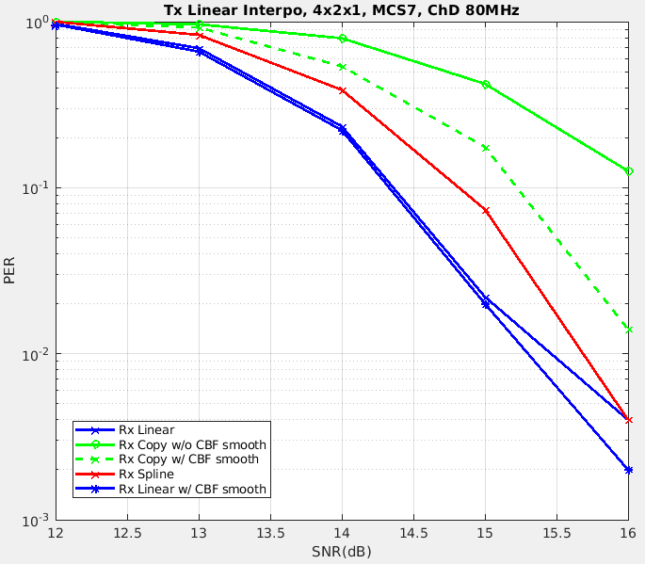
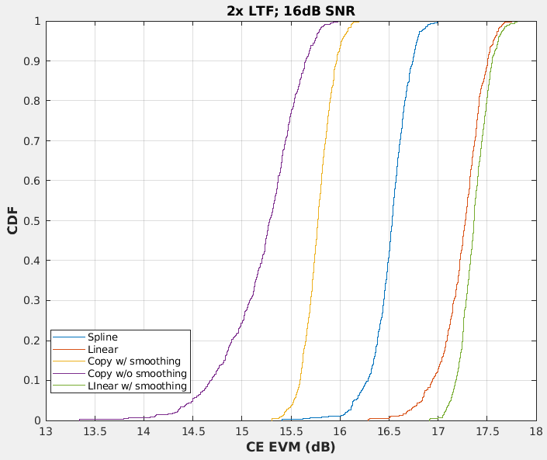
Another advantage of CBF smoothing even CE smoothing is not applied
- 2x LTF (2/3)
“Copy” with smoothed CBF can still survive but “Copy” alone cannot;
CBF smoothing doesn’t gain much on medium SNR.
Interpolation algorithm mismatch introduces some degradation (linear vs spline).

Slide 13
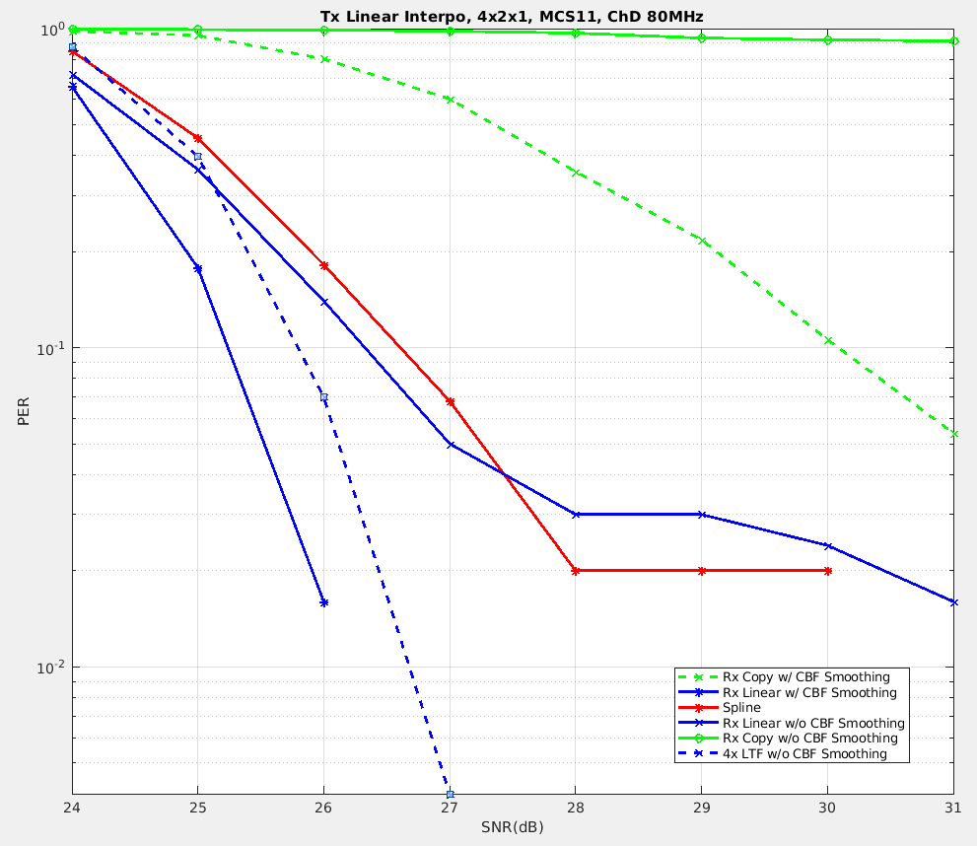
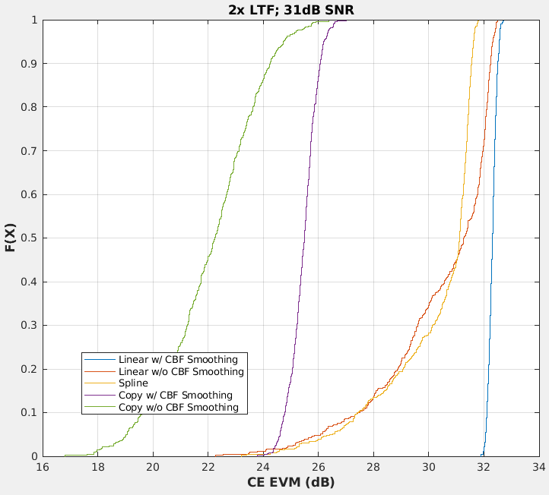
Another advantage of CBF smoothing even CE smoothing is not applied
- 2x LTF (3/3)
High MCS is more sensitive to CE EVM introduced by the interpolation mismatch at Tx and Rx.
  “Copy” doesn’t work regardless CBF smoothing is applied or not;
  CBF smoothing provide obvious gain (~1dB@10%) and even eliminate the error floor;
  4x LTF also eliminate the error floor.

Slide 14
Summary
Observations:
  CBF smoothing harvest low hanging gain up to 30dB SNR;
    Further fine tune is possible to reach even high SNR region.
  CBF smoothing also eliminate the error floor of Bfing with 2x LTF which is widely used in the field.
Recommendations:
  Recommend to close the gap in protocol to give Bfer the flexibility of indicating Bfee to do CE smoothing or not.
    CE smoothing can be done if CBF smoothing is enabled by Bfer.
  Recommend to promote the 4x LTF+0.8us GI as mandatory feature in UHR.

Slide 15
SP1
Do you agree to indicate (in the UHR SIG field) that “channel smoothing is recommended or not” when Bfing is enabled in a PPDU?

Slide 16
SP2
Do you agree to promote 4x LTF + 0.8us GI as mandatory mode in UHR?

Slide 17
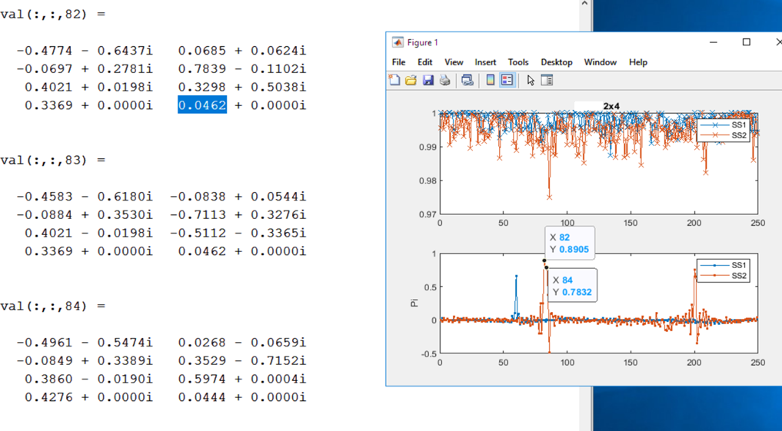
Backup: OTA captured CBF 2x4
Upper subfigure: amplitude of tone by tone correlation;
Lower subfigure:
phase of tone by tone correlation.

Slide 18
Backup: explanations of the phase jump elimination with CBF smoothing
Bfing introduces artificial phase jumps which may present on tones with large amplitude which contribute more or even dominate the accuracy of the CE smoothing.
CBF smoothing removes the artificial effect and only conserve the nature phase jump of the raw channel which could be covered by reasonably implemented CE smoothing algorithm.

Slide 19
Backup: Phase discontinuity MUMIMO
MUZF operation can also introduce phase jump depends on how correlated these two users are.
  MUZF won’t change the original bfing matrix if two users orthogonal.
w = [v₁; v₂];
wzf = (w^{H}*w)⁻¹*w^{H};
wzf = w if v₁’*v₂ = 0;

