Slide 1
Enhanced Long Range (ELR) PPDU Design
Date: 2024-09-xx
Authors:
Name | Affiliations | Address | Phone | Email
Lin Yang | Qualcomm
Henry Chou
Bin Tian
Youhan Kim
Notes:
September 2012

Slide 2
Introduction
Enhanced Long Range (ELR) PPDU was recently proposed in 802.11bn [1-3]
To improve link budget by 6 dB
DL and UL in 2.4GHz and UL only in 5/6 GHz bands
Motion on introducing ELR PPDU was passed
In this presentation we will talk about our thoughts on the ELR PPDU design to reach this goal
ELR preamble format
ELR packet detection
ELR mode classification
ELR-STF and ELR-LTF
High level thoughts on ELR signaling

Slide 3
Legacy Compliant ELR Preamble Structure
L-STF
L-LTF
L-SIG
RL-SIG
U-SIG1
U-SIG2
ELR-mark1
ELR-mark2
ELR-STF
ELR-LTF
ELR-SIG
ELR-Data
Propose to keep legacy preamble up to U-SIG in ELR PPDU
Unified format with other PPDUs
ELR mode classification takes place after all other legacy 11n/ac/ax/be detections, no need to carry multiple PPDU format hypothesis
Propose to have two ELR-Mark symbols after U-SIG for ELR mode classification
ELR-Mark symbols carry a known sequence to the receiver to facilitate detection
Two signature symbols are needed for 6dB+ improvement
Propose to have ELR-SIG right after ELR-LTF
ELR-SIG carries required information for receiver data demod and deferral
To get required channel estimation quality and SNR boosting, ELR-SIG follows ELR-LTF
ELR-SIG and ELR-Data have same tone plan and duplication method to reduce implementation complexity

Slide 4
ELR Packet Detection – Design Philosophy
L-STF
3dB
L-LTF
3dB
L-SIG
RL-SIG
U-SIG1
U-SIG2
ELR-mark1
ELR-mark2
ELR-STF
ELR-LTF
ELR-SIG
ELR-Data
ELR packet detection should be done @ L-STF
Otherwise AP/STA needs to wait for at least 32us till ELR-STF to get the ELR packet detection result
During this waiting time
There could be more cases where other STA (including AP) transmits on top of the ELR PPDU (collision)
If AP/STA choose not to transmit but wait, even it gets channel earlier than other in-BSS STAs or OBSS STAs, this AP/STA will have significant disadvantage @ contention
Same L-STF length as legacy to keep compatible with legacy Rx processing

Slide 5
ELR-Mark Based Mode Classification
Two symbols for ELR-Mark are needed to ensure reliable mode detection performance at ELR operating SNR
Prefer two symbols without boosting, as too many boosting is not good
Low PAPR on known ELR-mark symbols may be desired
Propose QBPSK modulation on both ELR-Mark symbols to reduce false alarm
No existing PPDU transmits signal with QBPSK modulation at this location, most of them are BPSK modulated, like SIG field, LTF, …

Slide 6
ELR and Legacy Preamble Formats
11a
L-STF
L-LTF
L-SIG
Data
11n - HT GF
HT-STF
HT-LTF1
HT-SIG1
HT-SIG2
HT-STF
HT-LTFs
Data
11n - HT MF
L-STF
L-LTF
L-SIG
HT-SIG1
HT-SIG2
HT-STF
HT-LTFs
Data
LEN%3 = 0
11ac - VHT
L-STF
L-LTF
L-SIG
VHT-SIG-A1
VHT-SIG-A2
VHT-STF
VHT-LTFs
Data
LEN%3 = 0
11ax - HE SU/TB
L-STF
L-LTF
L-SIG
RL-SIG
HE-SIG-A1
HE-SIG-A2
HE-STF
HE-LTFs
Data
PE
LEN%3 = 1
11ax - HE MU
L-STF
L-LTF
L-SIG
RL-SIG
HE-SIG-A1
HE-SIG-A2
HE-SIG-Bs
HE-STF
HE-LTFs
Data
PE
LEN%3 = 2
11ax - HE ER SU
L-STF
L-LTF
L-SIG
RL-SIG
HE-SIG-A1
HE-SIG-A2
HE-SIG-A3
HE-SIG-A4
HE-STF
HE-LTFs
Data
PE
LEN%3 = 2
11ba - WUR
L-STF
L-LTF
L-SIG
Mark1
Mark2
OOK
LEN%3 = 0
-1*L-SIG
-1*L-SIG
11be - EHT MU
L-STF
L-LTF
L-SIG
RL-SIG
U-SIG1
U-SIG2
EHT-SIGs
EHT-STF
EHT-LTFs
Data
PE
LEN%3 = 0
PHY version = X1 EHT PPDU Type = Y1
11be - EHT TB
L-STF
L-LTF
L-SIG
RL-SIG
U-SIG1
U-SIG2
EHT-STF
EHT-LTFs
Data
PE
LEN%3 = 0
PHY version = X1 EHT PPDU Type = Y2
ER SU
L-STF
L-LTF
L-SIG
RL-SIG
U-SIG1
U-SIG2
U-SIG3
U
BPSK modulated
LEN%3 = 0
PHY version = TBD1
QBPSK modulated
Post-11be
L-STF
L-LTF
L-SIG
RL-SIG
U-SIG1
U-SIG2
Variable modulation
LEN%3 = 0
PHY version = TBD2
ELR PPDU
L-STF 3~6dB+
L-LTF 3~6dB+
L-SIG
RL-SIG
U-SIG1
U-SIG2
ELR-Mark1
ELR-Mark2
ELR-STF
ELR-LTFs
ELR-SIG
Data
PE
PHY version = 1

Slide 7
ELR-Mark Tone Plan
Prefer to have regular pilots in ELR-Mark symbols as in other frame formats
Keep consistent format and more compatible with legacy processing
4 regular pilots as EHT-SIG
Prefer to use legacy 48 data tones x 2 symbols to carry ELR-Mark sequences
Note that ELR-Mark symbols maintain the same total TX power as the U-SIG symbols

Slide 8
Carrying BSS Color in ELR-Mark Sequence
ELR capable devices is more prone to packet detection FA from OBSS STAs
It may have enhanced packet detection sensitivity
It takes more time to determine whether the packet is intended to it
Having BSS color info in the ELR-Mark sequence, ELR capable receiver can decide early the following to enable early drop if needed
If the received packet is an ELR packer or not
If this packet is from in-BSS or not
Mapping BSS color to ELR-Mark sequence
6-bit BSS color can be mapped to 64 orthogonal sequences and transmitted over two ELR-Mark symbols
One such example is using Hadamard sequence of order 96
Each device having its own BSS color would know what its ELR-mark sequence is, and uses it for the sequence match in the ELR detection

Slide 9
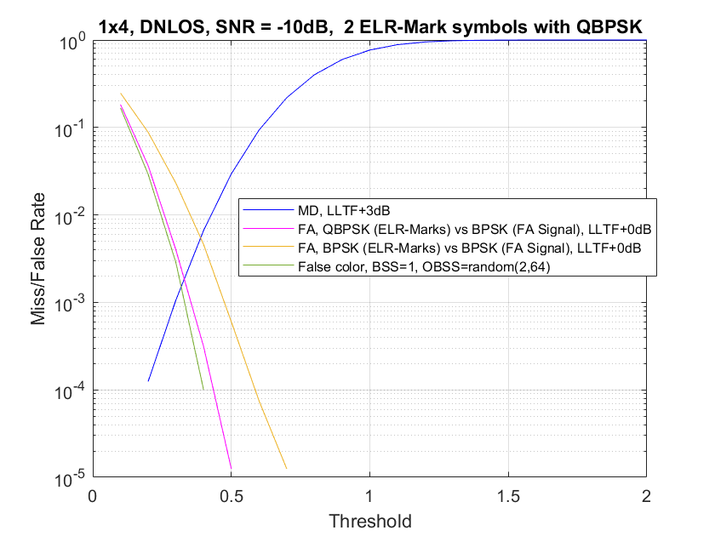
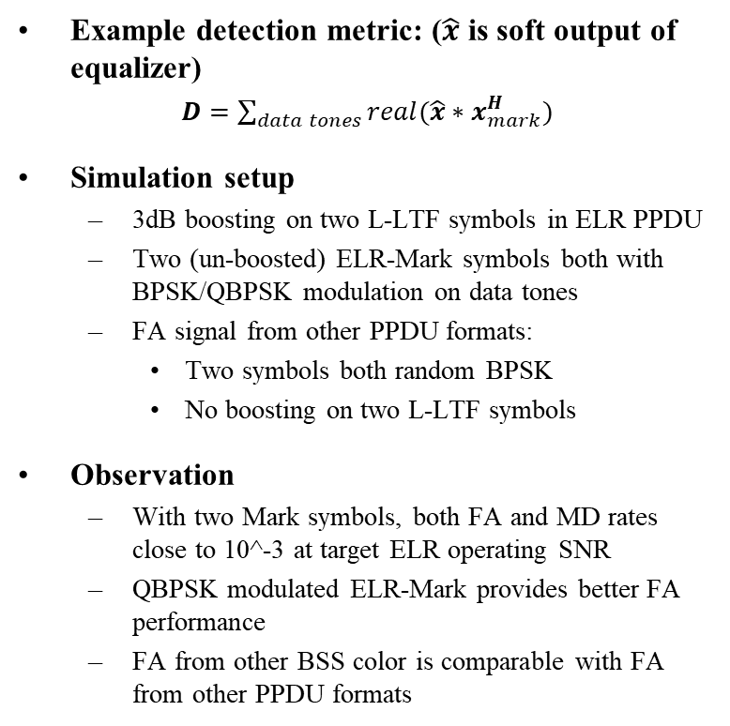
ELR Mode Classification Performance
Example detection metric: ($\hat{x}$ is soft output of equalizer)
$D=\sum_{data tones}{real(\hat{x}∗x_{mark}^{H})}$
Simulation setup
3dB boosting on two L-LTF symbols in ELR PPDU
Two (un-boosted) ELR-Mark symbols both with BPSK/QBPSK modulation on data tones
FA signal from other PPDU formats:
Two symbols both random BPSK
No boosting on two L-LTF symbols
Observation
With two Mark symbols, both FA and MD rates close to 10^-3 at target ELR operating SNR
QBPSK modulated ELR-Mark provides better FA performance
FA from other BSS color is comparable with FA from other PPDU formats

Slide 10
ELR-STF
Prefer to keep ELR-STF for implementation consistency with other PPDU formats and processing time margin
ELR-STF duration and sequence are the same as that of UHR DL SU/MU PPDU
4us using EHT-STF sequence
ELR-STF has same boosting as ELR-LTF
Note that ELR-STF is the short name of UHR-STF for ELR PPDU

Slide 11
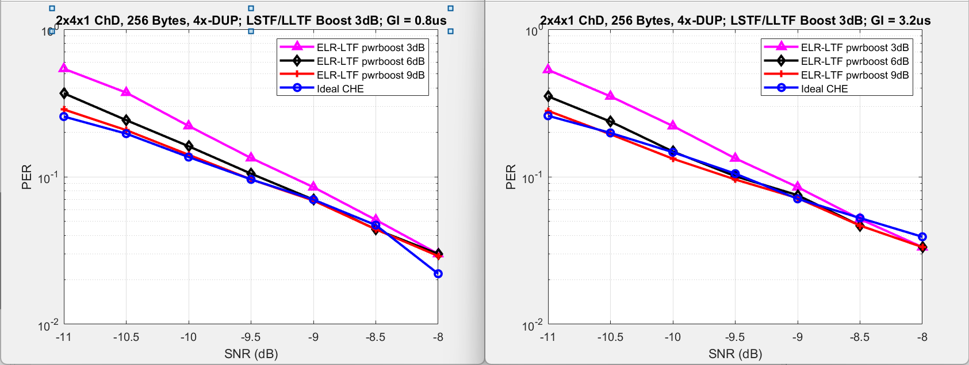
ELR-LTF (1)
Mainly to decide ELR-LTF duration and boosting, GI length
Data demod simulation setup
2x4x1 DNLOS, 4x-LTF with GI = 0.8us or 3.2us
Practical timing/frequency/channel estimation
Observations:
One 4x-LTF with 3 dB boosting is enough
Equivalently, two 2x ELR-LTF+3 dB boosting or four 2x ELR-LTF without boosting
Loss is within 0.5dB to ideal channel estimation
GI = 0.8us works well

Slide 12
ELR-LTF (2)
ELR PPDU may need a fixed/single mode of LTF+GI
There is no good way to indicate the LTF+GI type upfront
ELR-SIG is after ELR-LTF
Candidate LTF+GI modes for ELR PPDU
Option 1: 2x LTF + 0.8/1.6us GI
Existing modes
Comparing to 0.8us GI, 1.6us GI has more margin for timing offset error at very low SNR
Option 2: 4x LTF + 0.8/3.2us GI
Existing modes
3.2us GI is overkill
Option 3: 4x LTF + 1.6us GI
Not an existing mode
Recommendation:
Two 2x-LTF symbols with 1.6us GI + 3 dB boosting
Note that ELR-LTF is the short name of UHR-LTF for ELR PPDU

Slide 13
ELR Signaling
Rotation pattern in ELR mode:
L-STF
+3dB
L-LTF
+3dB
L-SIG
RL-SIG
U-SIG1
U-SIG2
ELR-mark1
ELR-mark2
ELR-STF
+3dB
ELR-LTF
+3dB
ELR-SIG
ELR-Data
ELR Signaling
U-SIG design
ELR-SIG design

Slide 14
U-SIG Design for ELR PPDU Format
For EHT/UHR but non-ELR capable devices, they rely on U-SIG content to defer or terminate decoding from ELR packet
Relevant fields (existing): PHY version ID, UL/DL bit, BSS color, TXOP
Relevant fields (new for ELR mode): ELR indication
Assume ELR shares same version ID with 11bn
For a new ELR capable device, if it can detect USIG, then may perform early drop based on STA-ID and BSS color or prepare to receive ELR packet targeting to it
Propose to carry ELR indication and STA-ID in U-SIG for ELR PPDU

Slide 15
ELR-SIG Design Consideration
ELR-SIG carries required info for receiver data demod and deferral
E.g. MCS, LDPC/BCC coding, length, STA-ID, …..
Given the low data rate and duplication, one ELR-SIG symbol may not be enough, let us assume two symbols for ELR-SIG
Need to keep the decoding delay for ELR-SIG manageable, to meet receiver timelines
Unlike most other WiFi PPDU formats, no symbol between ELR-SIG and ELR-Data
More tones as ELR-SIG sent at 4x symbol
Propose separately encoded two symbols for ELR-SIG
To buy some time for configuring the Data Rx processing
Carry MCS, LDPC/BCC coding bits as well as length field in the symbol 1, so Rx has more time to prepare the switch in MCS and coding, and calculate LDPC parameters

Slide 16
Summary
Proposed legacy compatible ELR PPDU format to support 6dB+ link budget improvement
Keep legacy preamble up to U-SIG
Two known ELR-Mark symbols with QBPSK modulation for ELR mode detection
Also carrying BSS color info to enable early drop
ELR packet detection @ L-STF with 3dB boosting
3 dB boosted ELR-STF and ELR-LTF for reliable ELR data reception
Carrying ELR indication and STA-ID in U-SIG in ELR PPDU to allow early drop at bystander devices
Separately encoded two symbol design for ELR-SIG to buy some time to configure the Data Rx processing

Slide 17
References
[1] 24/0873, design-targets-and-considerations-for-enhanced-long-range
[2] 24/0875, enhanced-long-range-support
[3] 24/0921, an-enhanced-long-range-ppdu

Slide 18
SP 1
Do you agree to include the following into the 11bn SFD?
ELR PPDU includes legacy preamble up to U-SIG

Slide 19
SP 2
Do you agree to include the following into the 11bn SFD?
ELR packet detection is done at L-STF, which has same length as legacy with 3dB power boosting
L-LTF also has same length as legacy with same power boosting as L-STF

Slide 20
SP 3
Do you agree to include the following into the 11bn SFD?
U-SIG carries ELR indication in ELR PPDU

Slide 21
SP 4
Do you agree to include the following into the 11bn SFD?
U-SIG carries STA-ID in ELR PPDU

Slide 22
SP 5
Do you agree to include the following into the 11bn SFD?
Define two ELR-Mark symbols for ELR mode classification
ELR-Mark symbols carry a known sequence to receiver
ELR-Mark symbols carry BSS color info in ELR-Mark sequence
No power boosting on ELR-Mark symbols
Two ELR-Mark symbols are both QBPSK modulated on data subcarriers
ELR-Mark symbols use the following tone plan
4 regular pilots as EHT-SIG + 48 data tones

Slide 23
SP 6 (combine with other SPs)
Do you agree to include the following into the 11bn SFD?
No power boosting on ELR-Mark symbols

Slide 24
SP 7 (combine with other SPs)
Do you agree to include the following into the 11bn SFD?
Two ELR-Mark symbols are both QBPSK modulated on data subcarriers

Slide 25
SP 8 (combine with other SPs)
Do you agree to include the following into the 11bn SFD?
ELR-Mark symbols use the following tone plan
4 regular pilots as EHT-SIG + 48 data tones

Slide 26
SP 9 (combine with other SPs)
Do you agree to include the following into the 11bn SFD?
ELR-Mark symbols carry BSS color info in ELR-Mark sequence

Slide 27
SP 10
Do you agree to include the following into the 11bn SFD?
11bn defines the following PPDU frame format for ELR
PE TBD
L-STF
L-LTF
L-SIG
RL-SIG
U-SIG1
U-SIG2
ELR-mark1
ELR-mark2
ELR-STF
ELR-LTF
ELR-SIG
ELR-Data
Note that ELR-STF/ELR-LTF are the short names of UHR-STF/UHR-LTF for ELR PPDU

Slide 28
SP 11 (combine with other SPs)
Do you agree to include the following into the 11bn SFD?
ELR PPDU has ELR-STF duration and sequence same as that of UHR DL SU/MU PPDU
4us using EHT-STF sequence
Note that ELR-STF is the short name of UHR-STF for ELR PPDU

Slide 29
SP 12
Do you agree to include the following into the 11bn SFD?
ELR PPDU has 3dB boosting applied on both ELR-STF and ELR-LTF
ELR PPDU has ELR-STF duration and sequence same as that of UHR DL SU/MU PPDU
4us using EHT-STF sequence
ELR PPDU defines a fixed/single mode of LTF+GI
11bn supports 2x LTF+1.6us GI only for ELR PPDU
11bn uses two UHR-LTF symbols for ELR PPDU
Note that ELR-STF/ELR-LTF are the short names of UHR-STF/UHR-LTF for ELR PPDU

Slide 30
SP 13 (combine with other SPs)
Do you agree to include the following into the 11bn SFD?
ELR PPDU defines a fixed/single mode of LTF+GI
11bn supports 2x LTF+1.6us GI only for ELR PPDU

Slide 31
SP 14 (combine with other SPs)
Do you agree to include the following into the 11bn SFD?
11bn uses two UHR-LTF symbols for ELR PPDU

Slide 32
SP 15
Do you agree to include the following into the 11bn SFD?
ELR PPDU defines two symbols for ELR-SIG, specifically
ELR PPDU defines separately encoded two symbols for ELR-SIG
Each symbol has separate CRC and tail bits (6 bits)
ELR-SIG has same tone plan and duplication scheme as ELR-data and BCC encoded with MCS0

Slide 33
SP 16 (passed)
Do you agree to include the following into the 11bn SFD?
ELR-SIG is located right after ELR-LTF in ELR PPDU
Note that ELR-LTF is the short name of UHR-LTF for ELR PPDU

Slide 34
SP 17 (combine with other SPs)
Do you agree to include the following into the 11bn SFD?
ELR PPDU defines separately encoded two symbols for ELR-SIG
Each symbol has separate CRC and tail bits (6 bits)

Slide 35
SP 18 (combine with other SPs)
Do you agree to include the following into the 11bn SFD?
ELR-SIG has same tone plan and duplication scheme as ELR-data and BCC encoded with MCS0

Slide 36
Appendix

