Slide 1
Discussion on aspects in DRU operation – follow up
Date: 2024-07-10
Authors:
Name | Affiliations | Address | Phone | email
Arik Klein | Huawei |  |  | Arik.Klein@huawei.com
Genadiy Tsodik |  |  |  | Genadiy.tsodik@huawei.com
Shimi Shilo |  |  |  | Shimi.Shilo@huawei.com
Oded Redlich |  |  |  | Oded.Redlich@huawei.com

Slide 2
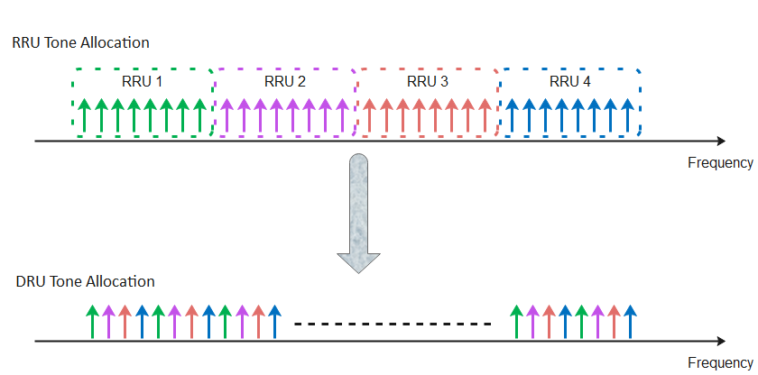
Recap – Distributed RU (DRU)
The Distributed tone RU (DRU) feature is widely discussed in TGbn PHY and has been accepted as a solution for the limit of maximal EIRP PSD regulation in the 6GHz band (TGbn SFD, Motion #1)
DRU is currently defined for UL transmissions (TB PPDUs)
This results in smaller number of tones within each 1MHz and thus the total transmitted power of the STA may increase while keeping the maximal (regulated) EIRP PSD value

Slide 3
Recap – DRU allocation Problem Statement
In [1], [2] it has been shown that:
In an uplink MU transmission, the HE STA sets its actual transmit power, as the minimal value between the calculated Tx power ${Tx}_{pwr}^{STA}$ and the maximum Tx power defined by the Max EIRP PSD within the allocated BW (we denote it as ${Tx}_{max_pwr_PSD}^{STA}$)
The transmit power calculations are carried out only at the non-AP STA side whereas the AP has no indication that the STA’s transmit power is uniquely bounded by the Max EIRP PSD
The UL Power Headroom is 0 in this case.
Target RSSI setting is bounded and may affect optimal <MCS, NSS> setting.

Slide 4
Inefficient RU allocation options for UHR AP
DRU allocation mandates all triggered UHR non-AP STAs to use this mode.
It is preferred to efficiently allocate the DRU, only if is really needed by the UHR non-AP STA (i.e. the maximal TX power of the UHR non-AP STA is limited by the Max EIRP PSD within the allocated BW).
However, if we keep maintaining the AP unaware of the case when the UHR non-AP STA’s TX power is limited by the Max EIRP PSD, the following inefficient options can be considered by the UHR AP for RRU or DRU allocation:
Option 1: Always DRU - Simple and inflexible
Drawbacks:
The same TF can’t include non-UHR non-AP STAs (that do not support DRU allocation).
Less flexible for channel conditions and real traffic needs of each UHR non-AP STA
Option 2: trial and error for DRU allocation - Increase flexibility of link adaptation mechanism
Drawbacks:
Complicates the AP scheduling, while convergence is not assured
Sub optimal solution: long convergence to the optimal size of DRU for the UHR non-AP STAs.
If not converged – it is not clear if the transition to DRU is the factor (for non-convergence).

Slide 5
PSD Limit Request/ Response Action frames
In order to allow flexibility in RRU and DRU allocation and efficiently allocate the DRU only if it is required by the UHR non-AP STA, we propose to enable a UHR AP to use the following management frames with a UHR non-AP :
PSD Limit Request Action frame
PSD Limit Response Action frame
The above management frames may assist the UHR AP with a DRU allocation for the UHR non-AP STA

Slide 6
PSD Limit Request/Response Action frame
The PSD Limit Request Action frame will include the following parameters:
RU Size
The PSD Limit Response Action frame will include the following parameters:
“EIRP PSD limit flag” field (exact name – TBD)
Set to 1, if the maximal allowed transmit power equals to the value o$f {Tx}_{max_pwr_PSD}^{STA}$ (maximum Tx power defined by the Max EIRP PSD within the allocated BW ):
${{Tx}_{max_pwr_PSD}^{STA}=MAX_EIRP}_{PSD}+10log10RU_Size[MHz]$
Otherwise, this field should be set to 0.
Power Headroom
Indicates the gap (in dB) between the TX Power value of the transmitted PSD Limit Response Action frame and the Maximal allowed transmit power.
The value is required since the PSD Limit Response Action frame is not transmitted on the Max Power allowed for the non-AP STA.

Slide 7
Summary
The DRU feature is accepted in TGbn PHY as a solution for bounded uplink transmit power due to Maximal EIRP PSD regulation in the 6GHz band
In order to assist the UHR AP in allocating the DRU for a UHR non-AP STA efficiently, we suggest to use PSD Limit Request/ Response Action frames
The management frame do not require real-time response.
The UHR AP will send the PSD Limit Request frame and the UHR non-AP STA will send the PSD Limit Response frame
The “EIRP PSD limit flag” field (exact name – TBD) may assist the AP in RRU/DRU allocation for the non-AP STA.
The Power Headroom value may assist the AP MLD in setting the Target RSSI for the non-AP STA in the next Triggered UL transmission.

Slide 8
SP1
Do you support adding the following to the TGbn SFD?
The 802.11bn amendment defines a mechanism for a UHR non-AP STA to assist a UHR AP with a DRU allocation.
NOTE: The mechanism will be based on management frames exchange
Supporting submissions: 11-24/1405r3

Slide 9
SP2
Do you support adding the following to the TGbn SFD?
The 802.11bn amendment defines the following management action frames to assist the UHR AP with a DRU allocation for the UHR non-AP STA
PSD Limit Request Action frame
PSD Limit Response Action frame
NOTE: the exact details of management frames - TBD
Supporting submissions: 11-24/1405r3

Slide 10
Reference
[1] 11-24/1058r0 Discussion on aspects in DRU operation - Arik Klein, Huawei
[2] 11-24/1124r2 Headroom Reason Reporting– B. Hart et al., Cisco
[3] IEEE 802.11 REVme D6.0, section 27.3.15.2 Power Precorrection

