Slide 1
Joint Medium Access and TXOP Sharing
Date: 2024-07-14
Authors:

Slide 2
Abstract
The spec defines mechanisms to get medium access for UL/DL/P2P traffic
Each STA/AP tries to get medium access by CSMA/CA.
For a group of STAs, e.g., P2P group, there might be two levels of contention/backoff from both inter-group and intra-group STAs.
This submission presents joint medium access and TXOP sharing
Medium access for DL data initiated from non-AP STA
Trigger/polling frame initiated from non-AP STA
TXOP sharing initiated from non-AP STA

Slide 3
Introduction: TXOP for UL/DL/P2P Traffic (1/2)
The spec defines mechanisms to get medium access for UL/DL/P2P traffic
Each STA/AP tries to get medium access by CSMA/CA.
UL/DL/P2P traffic may be in the same TXOP, e.g., using TXS, RDG and MU cascading.
If AP gets medium access:
AP may use trigger frame to initiate UL/DL transmissions with certain STA(s).
AP may use trigger based TXOP sharing (TXS) to allow the non-AP STA (TXOP responder) to send UL data to AP (sharing mode 1) or send P2P data to another peer STA (sharing mode 2).

Slide 4
Introduction: TXOP for UL/DL/P2P Traffic (2/2)
TXOP holder | Primary traffic direction | Procedures and examples
AP | UL | AP adds trigger/poll in TX queue -> AP gets TXOP and sends trigger/poll to STA(s) -> STA(s) sends UL data to AP Note: DL data can be accommodated by RDG
 | DL | AP adds data in TX queue -> AP gets TXOP -> AP sends DL data to STA(s) Note: UL data can be accommodated by RDG, TXS, or MU cascading
 | P2P | AP uses TXS sharing mode 2 for P2P transmission from the TXOP responder to another P2P STA
Non-AP STA | P2P | STA adds data in TX queue -> STA gets TXOP by CSMA/EDCA or TXS -> STA sends data to another P2P STA Other options: medium access as a group and TXOP sharing within the group
 | UL | STA adds data in TX queue -> STA gets TXOP -> STA sends UL data to AP Note: DL data can be accommodated by RDG Other options to accommodate DL data, e.g., indication in MAC header of UL data (from non-AP STA) or BA (from AP)
 | DL | Non-AP STA wants to receive DL data or wants poll for DL data: RX/L2 buffer status at non-AP STA or more DL data indication from AP or non-AP STA -> non-AP STA tries to get channel access by EDCA or TXOP sharing -> non-AP STA gets TXOP and sends poll/request to AP -> AP sends DL data to non-AP STA Non-AP STA adds a poll/request frame in TX queue (similar to BSRP) -> non-AP STA gets TXOP and sends poll/request to AP -> AP sends DL data or CF-END to non-AP STA

Slide 5
Non-AP STA as TXOP Holder for DL Data (1/2)
Use cases when a non-AP STA wants to get TXOP for DL data
AP has DL data (cannot be finished in the previous TXOP) and indicates more DL data across TXOP.
Non-AP STA sends UL data in the previous/current TXOP and expects DL data, e.g., bidirectional traffic.
Non-AP STA has pending data in RX/L2 buffer and needs to get the remaining DL data from AP.
Non-AP STA adds poll/request frame in TX queue (before/after getting TXOP) and asks AP for DL data.
The indication/poll/request can be cross-link for MLDs.

Slide 6
Non-AP STA as TXOP Holder for DL Data (2/2)
Potential benefits:
AP gets TXOP for DL data with the help from non-AP STA: non-AP STA performs CSMA/CA for DL data, more data indication from AP/non-AP and MLO.
Instead of waiting for AP to get the TXOP, non-AP STA also tries to get TXOP for DL data, sends/ receives more data indications to/from AP for more DL data, or polls from AP for more DL data.
Both non-AP STA and AP try to get medium access for DL data. If non-AP STA gets the TXOP before the AP, DL data can be delivered faster, without increasing the chance of collision or backoff.
More data indication is sent in the obtained TXOP, so AP and non-AP STA can take actions quickly.
Can take advantage of MLD with cross-link medium access: more data indication on one link and data transmissions on another link.
Similar concept for other cases for a group of STAs (more details on following slides)

Slide 7
Joint Medium Access and TXOP Sharing (1/2)
Existing: for a group of STAs, e.g., P2P, relay, soft AP, multi-AP:
Each STA tries to get medium access by CSMA/CA.
AP may share the TXOP with certain STA(s), e.g., TXS, MU TXS [1, 2, 3] and data forwarding [4].
There might be two levels of contention/backoff from both inter-group and intra-group STAs, which may increase the chance of collisions and wasted/unused TXOP.
Proposal: medium access as a group with TXOP sharing
Each STA tries to get medium access by CSMA/CA.
If group leader gets the TXOP, it may use trigger based transmissions to serve peer STA(s).
If any group STA other than group leader gets the TXOP, it may transfer the TXOP to group leader and group leader initiates DL/UL/P2P transmissions with peer STA(s).
Medium access is done in a semi-distributed way and does not require participation/initiation from AP.
It helps to avoid in-group contention/backoff and therefore avoid collisions and wasted/unused TXOP.
It helps to get medium access quicker for high priority STA/traffic, reduce latency, and have grouped DL/UL/P2P traffic in the same TXOP.

Slide 8
Joint Medium Access and TXOP Sharing (2/2)
Use Case | Current | Proposed
DL from AP to Non-AP STA | AP tries to get TXOP for DL data AP shares UL TXOP for DL data, e.g., RDG, TXS | Non-AP STA helps to get TXOP for DL data, similar as reverse TXOP sharing [6].
P2P | Each group STA tries to get TXOP. If a group STA gets TXOP, it may initiate TX/RX with peer STA(s) or AP. If AP shares TXOP with a group STA, the group STA may transmit to another group STA or AP. Each group STA needs EDCA or wait for frame from peer STA to get access to the channel. Can extend TXS with help from AP [1, 2, 3, 4, 5] for bidirectional traffic and P2P/relay STAs. | If group leader gets TXOP, it may use trigger/polling frame to initiate TX/RX with peer STA(s) and/or initiate TX/RX with AP. If any group STA gets TXOP, it may share the TXOP to the group leader and the group leader may initiate TX/RX with peer STA(s), similar as non-AP STA initiated TXOP sharing [7, 8]
Proxy
Mesh
Relay
Soft AP
Multi-AP

Slide 9
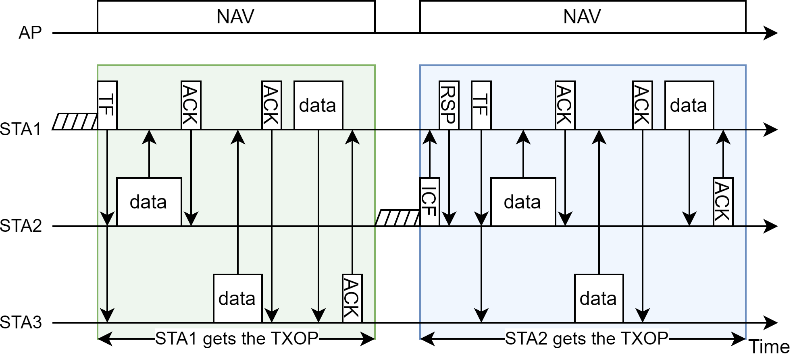
Example 1: TF from STA1 and TXOP Sharing from STA2
STA1 gets TXOP
STA1 sends trigger frame (plus polling if needed) to STA2 and STA3
STA2 and STA3 transmit/receive with STA1 based on the scheduling/RU allocation in TF
STA2 gets TXOP
STA2 sends control frame to STA1 to share the TXOP with STA1
STA1 sends trigger frame to STA2 and STA3
STA2 and STA3 transmit/receive with STA1

Slide 10
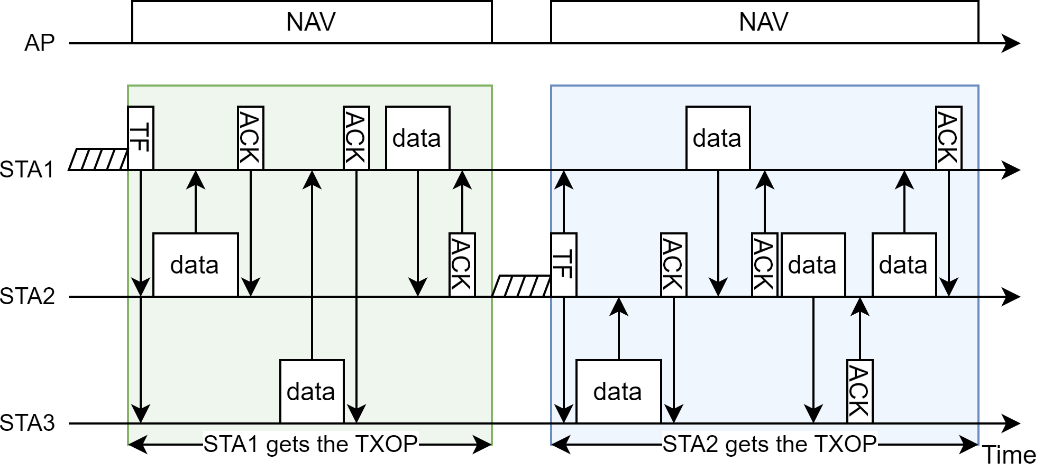
Example 2: TF from STA1 and STA2
STA1 gets TXOP
STA1 sends trigger frame to STA2 and STA3 and initiates transmissions with STA2 and STA3
STA2 gets TXOP
STA2 sends trigger frame to STA1 and STA3 and initiates transmissions with STA1 and STA3
Example 1: only STA1 can send TF
Example 2: STA1 and STA2 can send TF

Slide 11
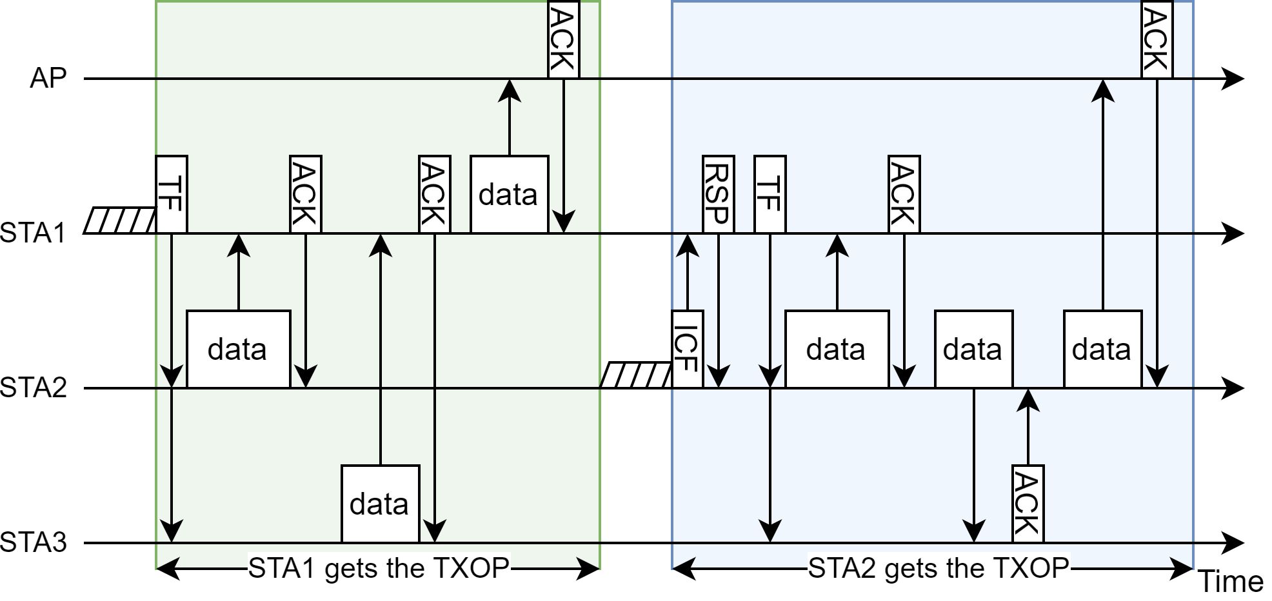
Example 3: P2P TXOP Shared for UL/DL Traffic
STA1 gets TXOP
STA1 sends trigger frame to STA2 and STA3
STA1 initiates transmissions with STA2, STA3, and AP
STA2 gets TXOP
STA2 sends control frame to STA1 to share the TXOP with STA1
STA1 sends trigger frame to STA2 and STA3
STA1 initiates transmissions with STA2, STA3, and AP

Slide 12
Conclusion
This contribution presents joint channel access and TXOP sharing
Medium access for DL data initiated from non-AP STA
Trigger/polling frame initiated from non-AP STA
TXOP sharing initiated from non-AP STA
It helps to avoid in-group contention/backoff and hence to avoid potential collisions and wasted TXOP.
It allows channel access being done in a semi-distributed way and does not require participation or initiation from the AP.
It provides additional options to get medium access for a group of STAs and can coexist with other options, e.g., EDCA, trigger-based access, TXS, and multi-STA TXOP sharing.

Slide 13
References
[1] 802.11-24/0403r0, Managed on-channel P2P communication, Inaki Val
[2] 802.11-24/0536r0, Multi-user triggered TXOP sharing, Ronny Yongho Kim
[3] 802.11-24/0105r0, TXOP for Relay communication in 11bn, Dongguk Lim
[4] 802.11-24/0668r1, Data Forwarding within TXOP for XR Use Cases, Seongho Byeon
[5] 802.11-24/0393r0, Enhancements on Off-Channel P2P Communications, Rubayet Shafin
[6] 802.11-23/1874r0, Reverse TXOP Sharing, Sindhu Verma
[7] 802.11-24/0686r0, STA initiated TXOP Sharing via Unicast CF-End, Pei Zhou
[8] 802.11-23/1847r0, Non-AP initiated TXOP sharing follow-up, Sanghyun Kim

