Slide 1
WUR for Integrated Energizer Case
Date: 2024-07-10
Authors:
Name | Affiliations | email
Steve Shellhammer | Qualcomm | shellhammer@ieee.org
Bin Tian |  | btian@qti.qualcomm.com
Pooria Pakrooh |  | ppakrooh@qti.qualcomm.com

Slide 2
Introduction
In [1] we brought up that the link budget for the case where the AMP Reader has an Integrated Energizer, is significantly less than the case when there is either the Energizer is a separate device or the case where there is another energy source (e.g., light, thermal, etc.)
Here we provide some ideas on how the WUR design can be adapted to this case when the link budget is limited by the Integrated Energizer

Slide 3
Integrated Energizer Case
AMP AP
Here the AMP AP integrates
Energizer
Downlink Transmitter
Uplink Receiver
The wireless communication links only need to meet the Energizer link budget
Note: The AMP AP can be a soft AP in a mobile device
AMP Downlink
RF Energy
AMP Uplink
AMP STA

Slide 4
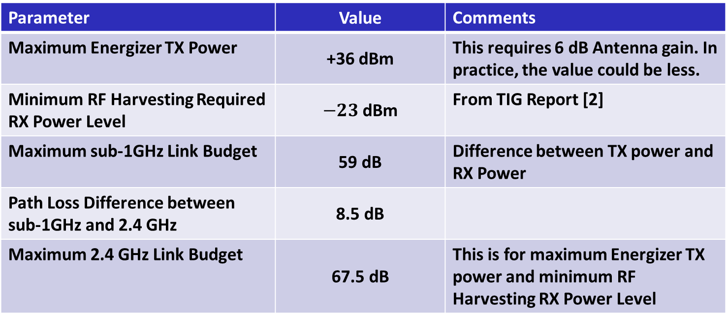
Estimated Link Budget for Integrated Energizer
Parameter | Value | Comments
Maximum Energizer TX Power | +36 dBm | This requires 6 dB Antenna gain. In practice, the value could be less.
Minimum RF Harvesting Required RX Power Level | $−23$dBm | From TIG Report [2]
Maximum sub-1GHz Link Budget | 59 dB | Difference between TX power and RX Power
Path Loss Difference between sub-1GHz and 2.4 GHz | 8.5 dB
Maximum 2.4 GHz Link Budget | 67.5 dB | This is for maximum Energizer TX power and minimum RF Harvesting RX Power Level
In practice, the link budget for the Integrated Energizer case may be less

Slide 5
Rough 802.11ba Link Budget – For Reference
Parameter | HDR Value | LDR Value | Comments
TX Power | 16 dBm | 16 dBm | Regulatory Limits in ETSI and China
Thermal Noise Floor | -101 dBm | -101 dBm | Measured in 20 MHz
Noise Figure | 15 dB | 15 dB | Implementation decision. Large NF for Low-Power.
Noise Power Level | -86 dBm | -86 dBm
Required SNR (LDR) | -1.5 dB | -7.5 dB | 802.11ba AWGN Simulations
Receiver Sensitivity | -87.5 | -93.5
Link Budget | 103.5 | 109.5 | Difference of TX Power and RX Power
This link budget is much larger than what is required for the Integrated Energizer case, by around 36 dB for the HDR and 42 dB for the LDR
The choice of the Noise Figure is up to the implementer. The Task Group may want to discuss a reference value that can be used for calculations like this.

Slide 6
Possible modifications for Integrated Energizer Case
One modification is to increase the data rate since the SNR is higher
Note, a higher Noise Figure is possible in an implementation
That will lead to much shorter packet duration
We can also use a shorter Sync Field, since the SNR is higher

Slide 7
Modulation
In 802.11ba we used Multicarrier OOK (MC-OOK) so we could have both a low symbol rate and a 4 MHz Bandwidth
We will move to a single-carrier OOK, so the bandwidth is now based on the symbol rate
Here we keep the bandwidth at 4 MHz, but we can also consider a different bandwidth

Slide 8
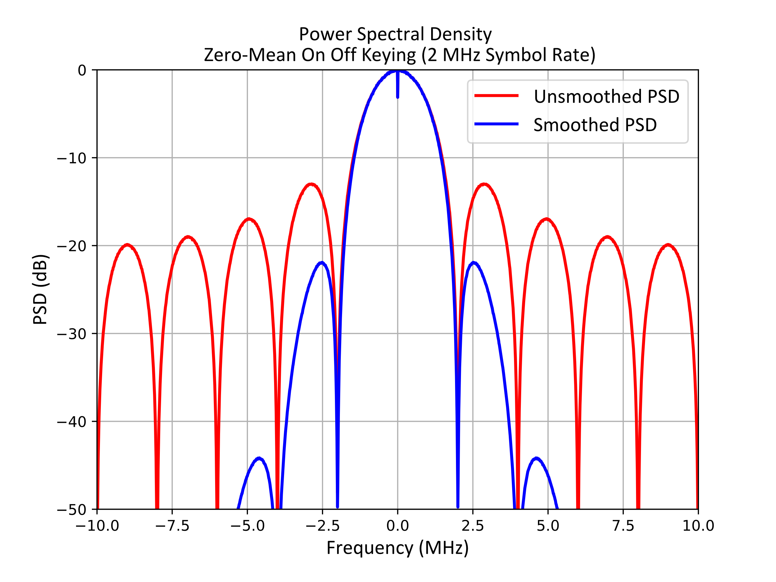
Power Spectral Density
Single carrier OOK with a symbol rate of 2 MHz
Note: It is also possible to consider higher symbol rates
Smoothed PSD with a simple Butterworth filter for spectral filtering

Slide 9
Sync Field and Data Field
Since the SNR is much higher than in 802.11ba, the Sync Field can likely be shorter than in 802.11ba
Here we suggest that an 8-bit Sync Field could be used
More study would be needed
Here we suggest keeping the Manchester encoding to simplify the receiver design

Slide 10
Comparison with 802.11ba (HDR and LDR)
Parameter | Possible New Design | 802.11ba HDR | 802.11ba LDR
Symbol Duration | 0.5 µs | 2 µs | 2 and 4 µs
Number of Symbols in Sync Field | 8 | 32 | 64
Data Rate | 1 Mb/s | 250 kb/s | 62.5 kb/s
Sync Field Duration | 4 µs | 64 µs | 128 µs
Data Field Duration (6 Octet Payload) | 48 µs | 192 µs | 768 µs
Sync & Data Field Duration (6 Octet Payload) | 52 µs | 256 µs | 896 µs
Receiver Sampling Rate (Three samples per OOK Symbol) | 6 MHz | 1.5 MHz | 1.5 MHz
Because of the higher data rate, the packet duration of this proposed design is much shorter than that of the 802.11ba HDR or LDR packet

Slide 11
Observations
The PPDU is much shorter than in 802.11ba
This leads to a shorter decoding time
However, as we increase the sample rate at the receiver so that must also be considered

Slide 12
Power Consumption Comparison
Here we make some observations about the Receiver power consumption for the two specifications: Possible New Design and 802.11ba (HDR)
Circuits | Comparison | Comments
RF Circuits | Similar | Since both designs operate in 2.4 GHz it is expected that the RF power consumption would be similar
LNA Noise Figure | Similar | In the high SNR case, the LNA Noise Figure could be quite high for both designs.
Analog Baseband | Similar | Given that the bandwidths are the same the analog baseband circuits would be similar.
Sampling Rate | Higher Rate for Possible New Design, but similar number of total samples | Unclear if this would be similar or different with the new design.
Sync Field Detection | This should be lower in the Possible New Design due to the shorter Sync Field | Sync Field detection is one of the major digital power consumption factors. So, this maybe a significant factor.
Data Field Decoding | Similar | Use of Manchester encoding would be similar in both cases. Similar number of samples per symbol.

Slide 13
SNR Feasibility
The difference between the Possible New Design data rate and the 802.11ba LDR data rate is 16x
This correspond to a required higher SNR of 12 dB
According to the SNR link budget comparison we have approximately 40 dB higher SNR
Hence, this well within feasibility range
It is possible to even consider a higher data rate/symbol rate, if the PSD fits well within the 20 MHz spectral mask
For example, 2 Mb/s with 0.25 µs symbol duration
However, that will also increase the receiver sampling rate

Slide 14
Harmonization
This possible new downlink design would be harmonized to work with all the various possible uplink designs, for the case when we have an Integrated Energizer
This is not focused to pair with any specific uplink design

Slide 15
Conclusions
We have proposed several modification relative to 802.11ba for the Integrated Energizer case. These include:
Changing from MC-OOK to single-carrier OOK
Increasing the symbol rate to 2 MHz
Increase data rate to 1 Mb/s
Shortening the Sync Field to 8 bits or something similar
This would reduce the PPDU duration significantly
It may also lead to lower power receiver implementations

Slide 16
References
Pooria Pakrooh, Steve Shellhammer and Bin Tian, “Thoughts and Questions on AMP PHY,” IEEE 802.11-24/0867r0, May 2024
Weijie Xu, et. al., “Technical Report on support of AMP IoT devices in WLAN,” IEEE 802.11-23/2203r1, November 2023

