Slide 1
Multi-AP Coordination for Low Latency Traffic Transmission
Date: 2024-08-13
Authors:
Name | Affiliations | Address | Phone | email
Shirley Yin | Clourney Semiconductor |  |  | shy166@clourneysemi.com
Jerome Gu | Clourney Semiconductor
Jason Sheng | Clourney Semiconductor

Slide 2
Introduction
“Enabling at least one mode of operation capable of improving the tail of the latency distribution and jitter compared to EHT MAC/PHY operation, with mobility between BSSs” is one of the objectives of 802.11bn[1].
A Motion on Multi-AP operation was approved [2]
Move to add the following text to the TGbn SFD:
Define a multi-AP Coordinated Spatial Reuse at TxOP-level with power control
Define multi-AP Coordinated Beamforming
Other multi-AP coordination modes are TBD
Currently, most of the contributions for low-latency traffic focus within a single BSS[3-7]. Multi-AP preemption for LL traffic has been proposed in [8].
The introduction of multi-AP coordination to LL can reduce inference and prioritize LL transmission, thus make sure the timely and reliable transmission of low-latency traffic. In this contribution, we would like to discuss the support of low latency traffic transmission in Multi-AP coordination.

Slide 3
How The Multi-AP Coordination Works with LL traffic?
LL latency traffic? Preemption?
Supporting LL traffic does not mean supporting preemption.
Support LL traffic in multi-AP coordination with low complexity
The LL traffic enjoys the gain from Multi-AP coordination.
Four kinds of Multi-AP coordination
C-SR: Allow spatial reuse decisions which are low latency traffic oriented → reducing latency & enhancing reliability.
C-Beamforming: Whether account for the non-STA to be nulled, or to be covered by beamforming. → Prioritize LL traffic tranmissions.
C-OFDMA: Sharing AP prioritizes TXOP allocation to shared AP with low latency traffic → reducing latency .
Joint transmission: Prioritizing multi-AP coordination scenarios with less protocol impacts, we would address this method later.
Preemption
?
Complexity

Slide 4
Support LL Traffic in C-SR
ICF/ICR frame could be adopted for C-SR.
One simple option, introduce one bit for LL traffic notification in ICF/ICR.
Decide the C-SR policy according to LL traffic indication
When there is no LL traffic indicated in each related AP, the ordinary co-ordination is applied, e.g., one AP reduces its transmission power to an acceptable level.
When there is LL traffic indicated in one of the related APs, the AP with LL traffic gets sufficient power(also a proper MCS) in order to transmit LL traffic in time and reliably.
When both related APs are with LL traffic, decide the C-SR policy according to the priority of LL traffic.
AP1
AP2 (LL)
AP1
AP2
(LL)
STA2
STA2
STA1
STA1
AP2 performs power backoff
AP1 performs power backoff

Slide 5
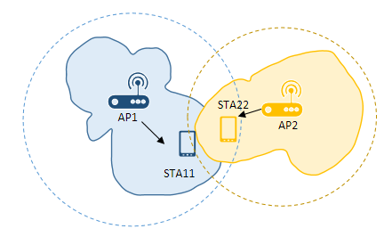
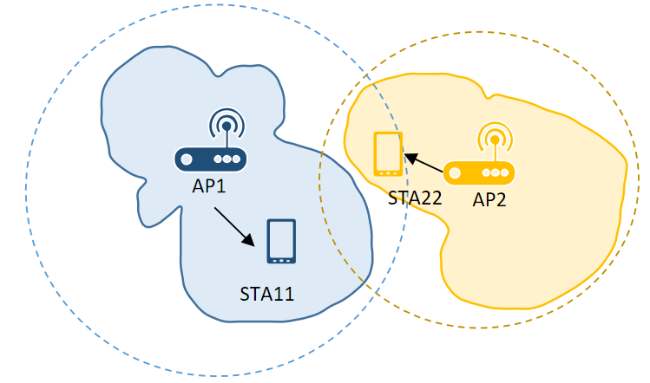
Support LL Traffic in C-BF
C-BF: An AP beamnulling to protect a neighbor AP’ transmission, while completing its beamformed transmission.
Nulling protects neighbor AP’s STA, also brings shrunk coverage.
Decide which AP performs C-BF.
When there are multiple STAs,
Decide which STA(s) to be covered by beamforming.
Decide which STA(s) to be nulled (for protection or interference reduction).

Slide 6
Support LL Traffic in C-OFDMA
MU-RTS/CTS frame exchange for LL traffic notification
The MU-RTS/CTS frame exchange can be applied to multi-AP coordination [9]. Similarly, one bit can be introduced for LL traffic notification.
Sharing AP transmitting an MU-RTS frame to poll LL notification from Shared AP.
CTS frames could be simultaneously transmitted by Shared APs, to indicate whether there is LL traffic in queue and LL traffic related information could be transmitted either.
AP1’s TXOP
......
MU-RTS
LL
poll
Trigger
......
AP1
(Sharing AP)
AP2
(Shared AP)
CTS
AP2 uses the TXOP later
AP3
(Shared AP)
CTS
AP3 uses TXOP for LL Transmission at first.
BA
LL
Notification
LL arrives

Slide 7
Discussions
After LL notification:
Detailed design
TXOP sharing for the AP with LL traffic is prioritized.
Decide the C-SR policy. Biased to the AP with LL traffic.
Decide the C-BF policy to cover a non-AP STA and null a non-AP STA.
How to enjoy more benefits from Multi-AP coordination?
Interference reduction.
Make sure accurate and efficient LL transmission.
Complexity
Support LL in Multi-AP Coordination has a manageable complexity. Keep it low at current stage.
More LL traffic supports?
Pre-emption in Multi-AP coordination leads to more complexity. Work on it, if time allows.
Study the joint transmission scenario, follow this methodology.
Notes:
Complexity?
1.不复杂，加一点东西，很容易就收敛了；
2.

Slide 8
Summary
Multi-AP coordination benefits the timely delivery of low latency traffic.
Low latency traffic indication is with low complexity. It is necessary to indicate the presence of low latency traffic in multi-AP coordination.

Slide 9
References
[1] 23/0480r3, UHR Proposed PAR
[2] 24/0171r12,TGbn Motions List
[3] 24/0390r0, A Uniform Procedure for Preemption
[4] 24/0389r0, Preemption for Low Latency
[5] 24/0168r0, TXOP preemption in 11bn
[6] 24/0625r0, Thoughts on Low Latency traffic transmission
[7] 24/0811r0, Overlapped indication for aperiodic low latency traffic
[8] 24/0636r0, Multi-AP Preemption for Low-Latency Traffic
[9] 24/0941r0 TXOP Sharing Group - Shared AP Selection

