Slide 1
ns-3: Wi-Fi Model Updates & Network Simulation
Date: 2024-07-16
Authors:
This work was supported by the U.S. National Science Foundation (award CNS-2016379)

Slide 2
Abstract
An annual update on the status of the WiFi module in the open-source network simulator ns-3 (http://www.nsnam.org/) with focus on contributions from U. Washington FUNLab (https://wp.ece.uw.edu/funlab/)
new features added to protocol stack implementations tracking .11ax/.11be as well as enabling use of AI/ML models
Latency first analysis for Wi-Fi 7 examples in ns-3
Acknowledgement: ns-3 WiFi Working Group corporate members - Cisco, Intel, Apple and MaxLinear – and academic collaborators, whose support contributes to the ongoing enhancements of ns-3 802.11.

Slide 3
Outline
Summary: ns-3 WiFi project activity via rel 40-42 (Tom Henderson)
Summary: ns-3 WiFi multi-BSS network simulation progress rpt (Hao Yin, S. Roy)

Slide 4
ns-3 Project Overview
Free, open source software (FOSS) project with GPLv2 license
Collection of C++ libraries, with optional Python bindings
  Optional libraries are found on the ns-3 App Store
ns-3 is about 16 years old (first release 2008)
  Original funding from U.S. National Science Foundation (Univ. of Washington and Georgia Tech) in collaboration with Inria, France
  360 authors credited with software contributions to date
Actively maintained by a small core team (~ 10 maintainers) and some additional technology-specific maintainers
  Three annual releases are typically made
  Latest release was ns-3.42 in May 2024

Slide 5
ns-3 is a "system simulator" with emulation capabilities
High degree of abstraction at the application and PHY layers
Application
Application
More
abstraction
TCP/UDP
TCP/UDP
Less
abstraction
IP
IP
IP
Wi-Fi MAC
other MAC
Wi-Fi PHY
other PHY
More
abstraction
Wireless channel
(propagation)

Slide 6
Wi-Fi module development
Stefano Avallone (Univ. of Naples, Italy), and Sebastien Deronne (Deronne Software Engineering) have maintained ns-3 Wi-Fi for roughly the past decade
  Past maintainers: Mathieu Lacage, Nicola Baldo, Ghada Badawy, Getachew Redietab, Matias Richart
  Many other significant contributors over the years
Muyuan Shen (Huazhong Univ. of Science and Technology) and Hao Yin (Univ. of Washington) maintain the ns3-ai framework for machine learning in ns-3
Industry and research grants fund most new feature additions
  Current Univ. of Washington NSF award has focused on next-G wireless with emphasis on PHY abstraction

Slide 7
Features in ns-3 Wi-Fi models
Portions of 802.11a, 802.11b, 802.11g, 802.11n (both 2.4 and 5 GHz bands), 802.11ac, 802.11ax (2.4, 5 and 6 GHz bands) and 802.11be physical layers
Legacy support (802.11ac and earlier)
  Basic 802.11 DCF with infrastructure and adhoc modes
  QoS-based EDCA and queueing extensions of 802.11e
  MSDU aggregation and MPDU aggregation extensions of 802.11n, and both can be combined together (two-level aggregation)
  Various rate control algorithms including Aarf, Arf, Cara, Onoe, Rraa, ConstantRate, Minstrel and Minstrel-HT (2012)
  Support for multiple channel widths and spatial streams
  AWGN PER curves for all MCSes
  802.11s (mesh module)

Slide 8
802.11ax/be support in ns-3
DL OFDMA (three ack sequences)
UL OFDMA (Basic TF, BSRP TF, Multi-STA Block Ack)
MU EDCA Parameter Set
Spatial Reuse (OBSS-PD) but without rate control awareness
Per-20 MHz channel sensing and dynamic bandwidth operation
6 GHz band operation
Multi-Link Operation (MLO) Discovery and Setup
MLO multi-radio in STR mode
EMLSR (Enhanced Multi-link Single Radio)
MU-MIMO at PHY layer (minimal MAC functionality)
EHT PPDU formats
EHT PHY support (320 MHz channels) and Ideal rate control support

Slide 9
What's missing?
Detailed MIMO PHY and energy consumption models
MU-MIMO at the MAC layer
Managed multi-BSS deployments and seamless roaming
Power save operation
Modeling of processing delays
802.11 PCF/HCF/HCCA are not implemented
Channel Switch Announcement is not supported
Authentication and encryption are missing
Cases where RTS/CTS and ACK are transmitted using HT/VHT/HE/EHT formats are not supported
802.11ax preamble puncturing is supported by the PHY but is currently not exploited by the MAC
Error models (link-to-system mapping) for IEEE fading channel models

Slide 10
How is ns-3 used by industry?
Case study: MaxLinear use cases
  Courtesy of Marcos Martinez Vazquez, June 2024 Workshop on ns-3
Objectives | Investigate deployments of current (Wi-Fi 6/7) networks Adapt ns-3 Wi-Fi models to be close to hardware Conduct detailed, feature-rich simulations Use as a reference for other simulations and for design specifications | Investigate new approaches for the next Wi-Fi generation Provide performance trends Focus on a feature (or set of features) Conduct fast simulations Require low effort to include new features
Limitations | Simulations are relatively slow Model design for new features takes a long time | Cannot be used as reference for specification Generic hardware model
Algorithmic exploration (products)
Feature exploration (standards)

Slide 11
How is ns-3 used by industry?
Multi-company effort to study the adaptation of the Low Latency, Low Loss, Scalable Throughput (L4S) architecture to Wi-Fi
  White and Hervieu, "End-to-End Congestion Control, L4S and Implications for Wi-Fi," IEEE 802.11-23/2065r0
ns-3
Traffic Control Layer
L4S-aware
AQM
(per AC)
L4S aims to reduce latency that is not due to media access delay
L4S requires Active Queue Management (AQM) queues to signal latency-inducing congestion via Explicit Congestion Notification (ECN) signalling
L4S-enabled transport flows can be identified and handled differently via an ECN codepoint
Initial deployments may require novel software implementations that interact with existing hardware
Flow controlled
Wi-Fi hardware
aggregation
buffer

Slide 12
Recent Wi-Fi module releases
ns-3.38 release, March 2023
802.11be Multi-Link Operations (MLO), STR mode only
EHT Capabilities information element improvements
802.11ax dual NAV (basic NAV and intra-BSS NAV)
802.11ax Uplink Multi-User Carrier Sense (UL MU CS) mechanism and have it used by non-AP STAs when determining if they can reply to a received Trigger Frame
802.11ax MU-RTS/CTS protection
Initial 802.11be-based example program
ns-3.39 release, July 2023
No major feature additions for 802.11ax/be

Slide 13
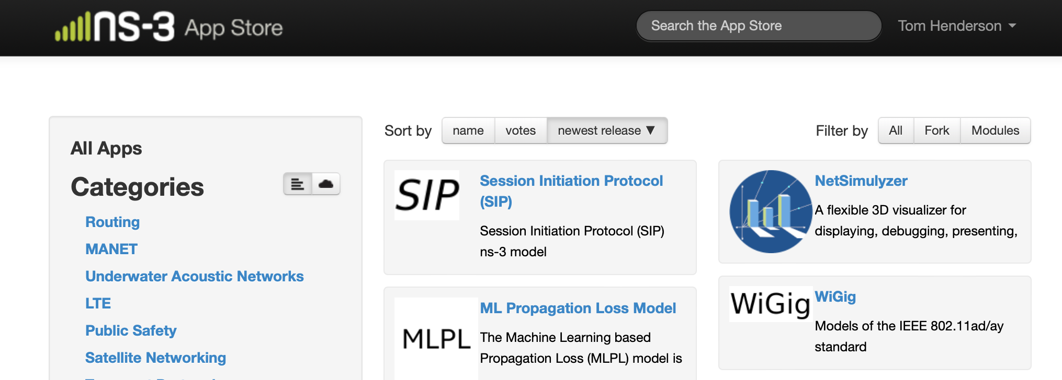
Recent Wi-Fi module releases (cont.)
ns-3.40 release, September 2023
Added support for multi-radio Multi-link operation (MLO)
  Support for 802.11be TID-to-Link Mapping
  Additional PHY support for multiple interfaces and switching
Added initial support for MU-MIMO (ideal PHY layer only)
Refactored 802.11ad model (WiGig) as an ns-3 extension module in the ns-3 App Store

Slide 14
Recent Wi-Fi module releases
ns-3.41 release, January 2024
Complete support for Enhanced Multi-link Single Radio (EMLSR) mode of MLO
  can support reduced functionality auxiliary radios for sensing, RTS/CTS transmissions
ns-3.42 release, May 2024
WifiPhyRxTraceHelper
More EMLSR fixes/improvements
Operations in the 6 GHz band
Rework attributes to more easily set EDCA parameters

Slide 15
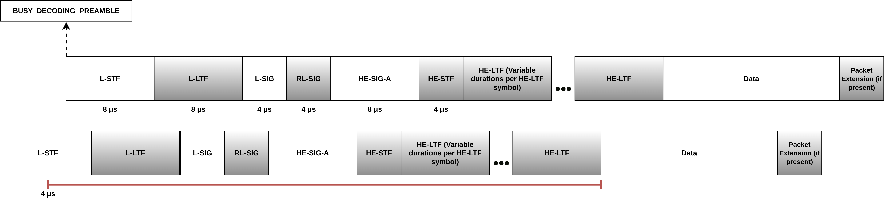
Wi-Fi Trace Helpers for Multi-BSS Scenarios
Understanding network behavior in dense wireless networks can be challenging
UW has developed a new PHY reception trace helper to track and tabulate all signal overlaps and reception outcomes
Second Frame that arrived
First Frame that arrived
Figure courtesy of Juan Leon
Fine-grained tracking of all PPDU and MPDU reception events and outcomes

Slide 16
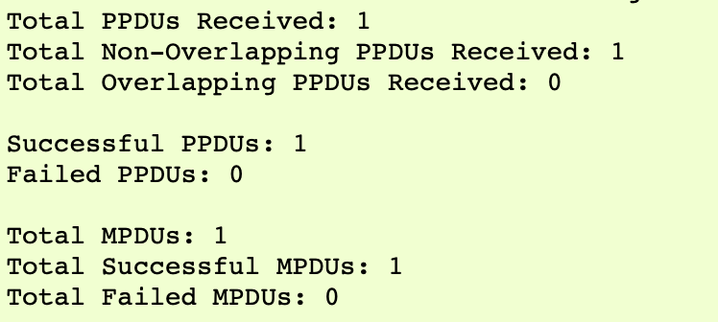
Wi-Fi Trace Helpers (cont.)
Based on a time window of interest, the API supports printing of statistics at the granularity of an MLO link, or aggregated from a node container, all nodes, all links
Sample, built-in output from a documented basic example
The API also supports exporting access to the full trace records, with similar link granularity, allowing for custom output or data processing

Slide 17
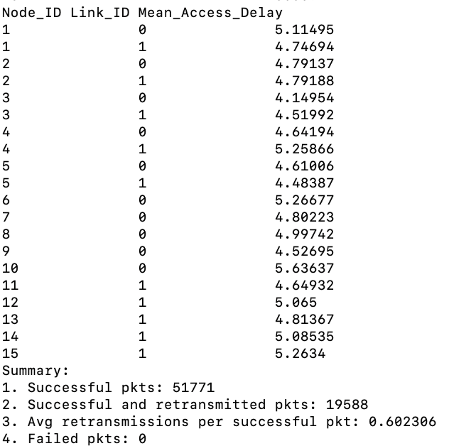
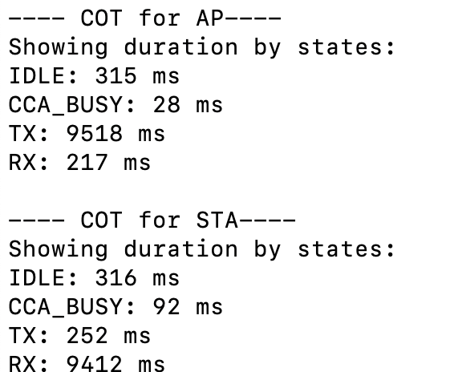
Wi-Fi Trace Helpers (cont.)
Additional trace helpers are planned for ns-3.43
  MAC Transmission Statistics Helper on reception outcomes and transmission delays (collaboration with Huazhong University of Science and Technology)
  Channel Occupancy Statistics Helper for channel occupancy and airtime fairness tracking (collaboration with IIIT-Delhi)
Sample of channel occupancy statistics helper
Sample of transmission statistics helper

Slide 18
What's next for ns-3 Wi-Fi module?
Features under development include:
802.11be EMLSR
80+80 MHz
Groupcast with retries: GCR-UR and GCR-BA
Power save modes
EHT RU and MRU (and finalize support for preamble puncturing)
320 MHz channel width
802.11bn (Wi-Fi 8)
TWT (Target Wake Time)

Slide 19
Summary
ns-3 is being used for Wi-Fi 6/7 algorithmic exploration and for Wi-Fi 8 feature exploration, in industrial and academic studies
The ns-3.42 (May 2024) release includes models for MLO (STR, EMLSR, and a simple RR scheduler) and detailed overlapping signal PHY tracing
University of Washington FUNLAB focuses on cross-layer research with emphasis on algorithmic and machine learning approaches
Industrial funding and participation is paramount for new feature development, validation exercises and for ns-3 sustainment (6G)

Slide 20
Broader Goals and Issues
ns-3 has always been intended to be a peer-produced, peer-reviewed tool for reproducible research
1) how do we attract more peer participation?
Many possibilities: feedback, bug reporting, code reviews, attend our annual workshop, help us to interpret standards, assist in mentoring students, ...
2) how do we sustain the core and the essential models?
ns-3 is not eligible for further NSF awards towards software development and sustainment of existing software
Please send any ideas or interest to one of us, or participate in one of our public
forums (ns-3-users or ns-developers Google Groups, Zulip chat room)

Slide 21
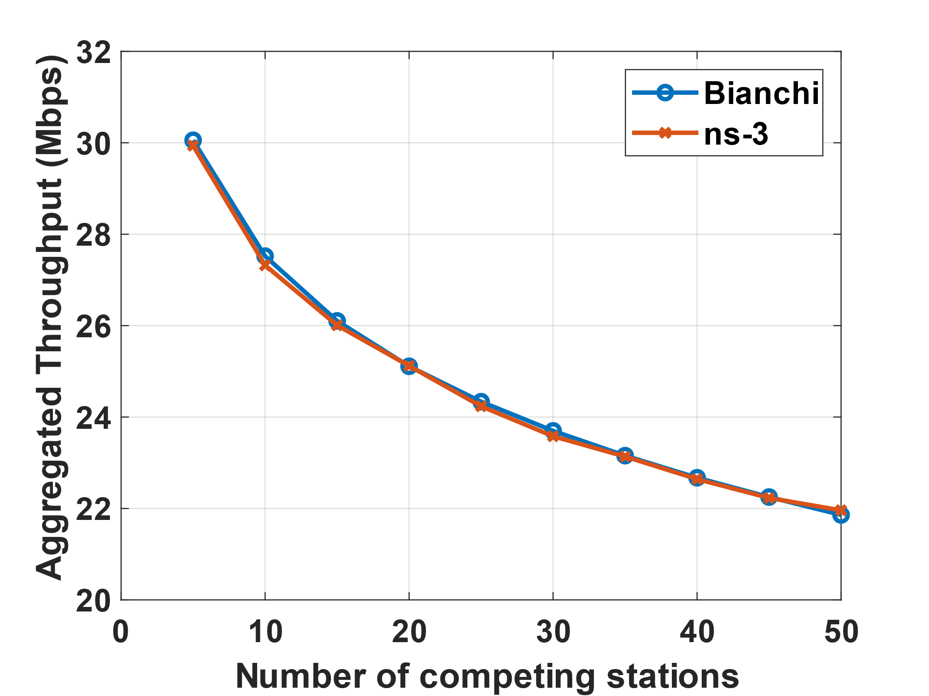
WiFi Latency Analysis
Previous use of ns-3 for Wi-Fi network simulations → main focus on throughput !!
Benchmark DCF performance: saturated traffic, single BSS baseline vs Bianchi [1]
ns-3 script (src/wifi/examples/wifi-bianchi.cc) used to validate simulator vs analysis
  5 to 50 nodes, infrastructure network, MCS4
  Traffic: Saturated traffic
Wi-Fi 7&8
Latency sensitive applications: VR, streaming, gaming… → delay analysis !!
Unsaturated conditions for delay analysis
- latency in saturated conditions (from Bianchi) only of limited interest !
Needs alternate analytical approach to Bianchi:
- Latency modeling for unsaturated conditions [2][3]

Slide 22
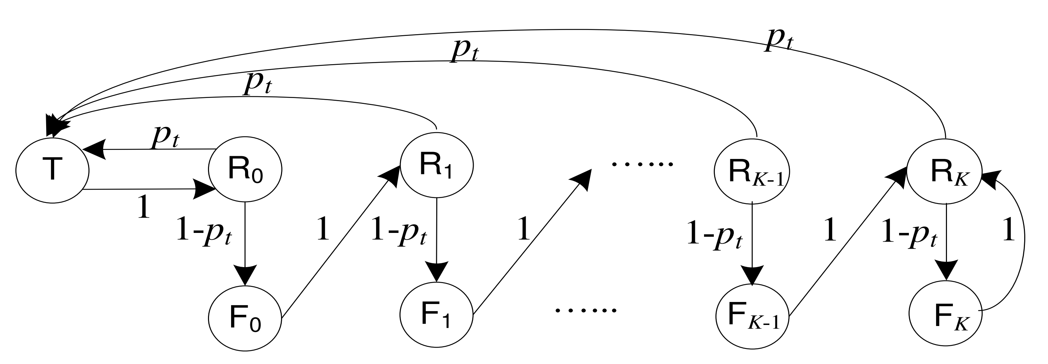
Delay Analysis: HOL Model
New Analytical model based on the HOL [2]:
Delay modeling based on alternative Markov state
description (HOL packet status)
Support both saturated and unsaturated conditions
Limitations of the Bianchi Model (Conditional Collision Probability)
Relies on conditional collision probability – identical for each node & indep. of node state - to characterize the network operating point.
No consensus on fixed-point in unsaturated scenarios, leading to inaccuracies.
Advantage of HOL model:
Models behavior of each HOL packet - including backoff, collision, and successful transmission, as a discrete-time Markov renewal process.
Key Feature: The steady-state distribution is determined by the limiting probability of successful transmission of HOL packets when the channel is idle (p).
Network Conditions: Derives distinct fixed-point equations which supports both unsaturated and saturated scenarios.

Slide 23


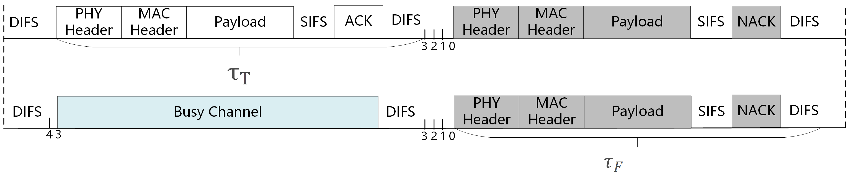

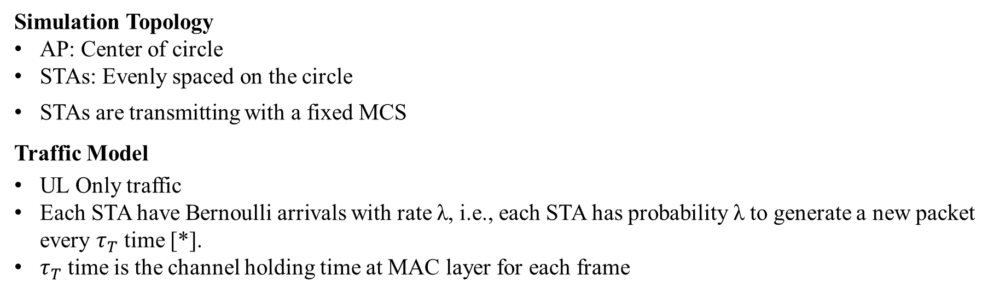

Delay - Single Link (SLO)
Simulation Topology
AP: Center of circle
STAs: Evenly spaced on the circle
STAs are transmitting with a fixed MCS
Traffic Model
UL Only traffic
﻿Each STA have Bernoulli arrivals with rate λ, i.e., each STA has probability λ to generate a﻿ new packet every $τ_{T}$time [*].
$τ_{T}$time is the channel holding time at MAC layer for each frame
$Bernoulli\left(\frac{λ}{τ_{T}}\right):$
x
x
x
x
Every $τ_{T}$time
$\hat{λ}=n λ,$the aggregate input data rate for n nodes
[*] L. Dai and X. Sun, "A Unified Analysis of IEEE 802.11 DCF Networks: Stability, Throughput, and Delay," in IEEE Transactions on Mobile Computing, vol. 12, no. 8, pp. 1558-1572, Aug. 2013, doi: 10.1109/TMC.2012.128.

Slide 24
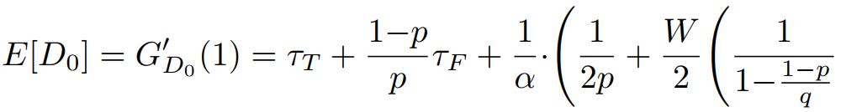
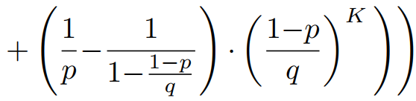
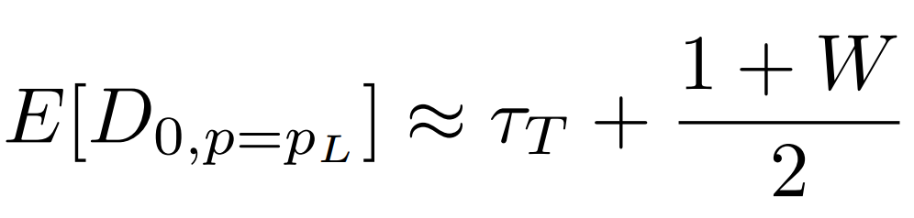
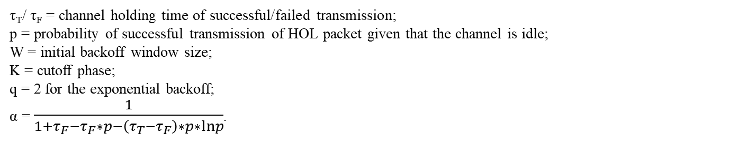
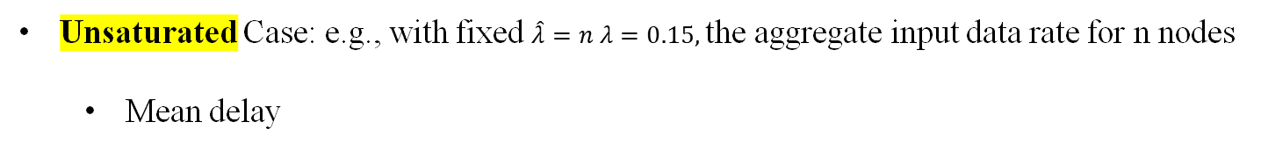
Delay Analysis (2)
Stable State from Markov chain for backoff window change due to collisions
Access Delay:
Saturated Case
  Mean delay
Success
Failure
Unsaturated Case: e.g., with fixed $\hat{λ}=n λ=0.15,$the aggregate input data rate for n nodes
  Mean delay
Delay mainly related to the initial backoff window size with low arrival rate and low collision probability.
τ_{T}/ τ_{F} = channel holding time of successful/failed transmission;
p = ﻿probability of successful transmission of HOL packet given that the channel is idle;
W = initial backoff window size;
K = cutoff phase;
q = 2 for the exponential backoff;
α = $\frac{1}{1+τ_{F}−τ_{F}∗p−\left(τ_{T}−τ_{F}\right)∗p∗lnp}$.

Slide 25
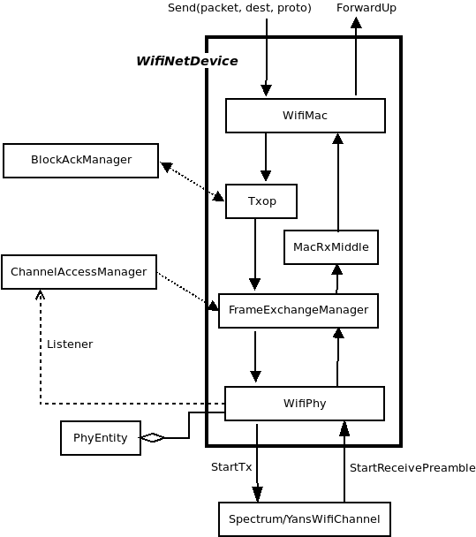
ns-3 based Delay Simulation
Extended TraceHelpers in ns-3
Packet-level traces for delay measurements
Calculate different delay components: Queuing, Media access delay, transmission delay
Adding the different timestamps in the Wi-Fi MAC layer to get the delay per packet:
Queueing Delay: difference between time instant when packet enters queue till it becomes Head of Line (HOL): T2 – T1
Media access Delay: difference between time instant when it becomes HOL to 1st transmission : T3 – T2
Transmission Delay: difference between 1sttransmission instant till when packet is de-queued from RX Buffer: T4 – T3
T1: Pkt Enqueue from MAC layer
T2: Pkt become the head of line pkt
T4: Pkt was successfully received
T3: Pkt was sent

Slide 26
Using ns-3 Wi-Fi models
Phase 1: Validate the ns-3 model implementations
  Start with existing examples
  Set up simple system level simulations
  Compare with well known theoretical model/other accepted simulation-based results
Phase 2: Build new scenarios and/or explore with different parameters
  Investigate the impact of different parameters: TxPwr, Rate, MIMO (# streams). Mobility …
  Evaluate performance of more complex scenarios : single cell → multi cells
Phase 3: Build/test new system-level algorithms
  Machine Learning for network management/optimization
    New features in evolving standards → new ns-3 module implementations
    New Wi-Fi network management architectures
802.11 be MLO example

Slide 27
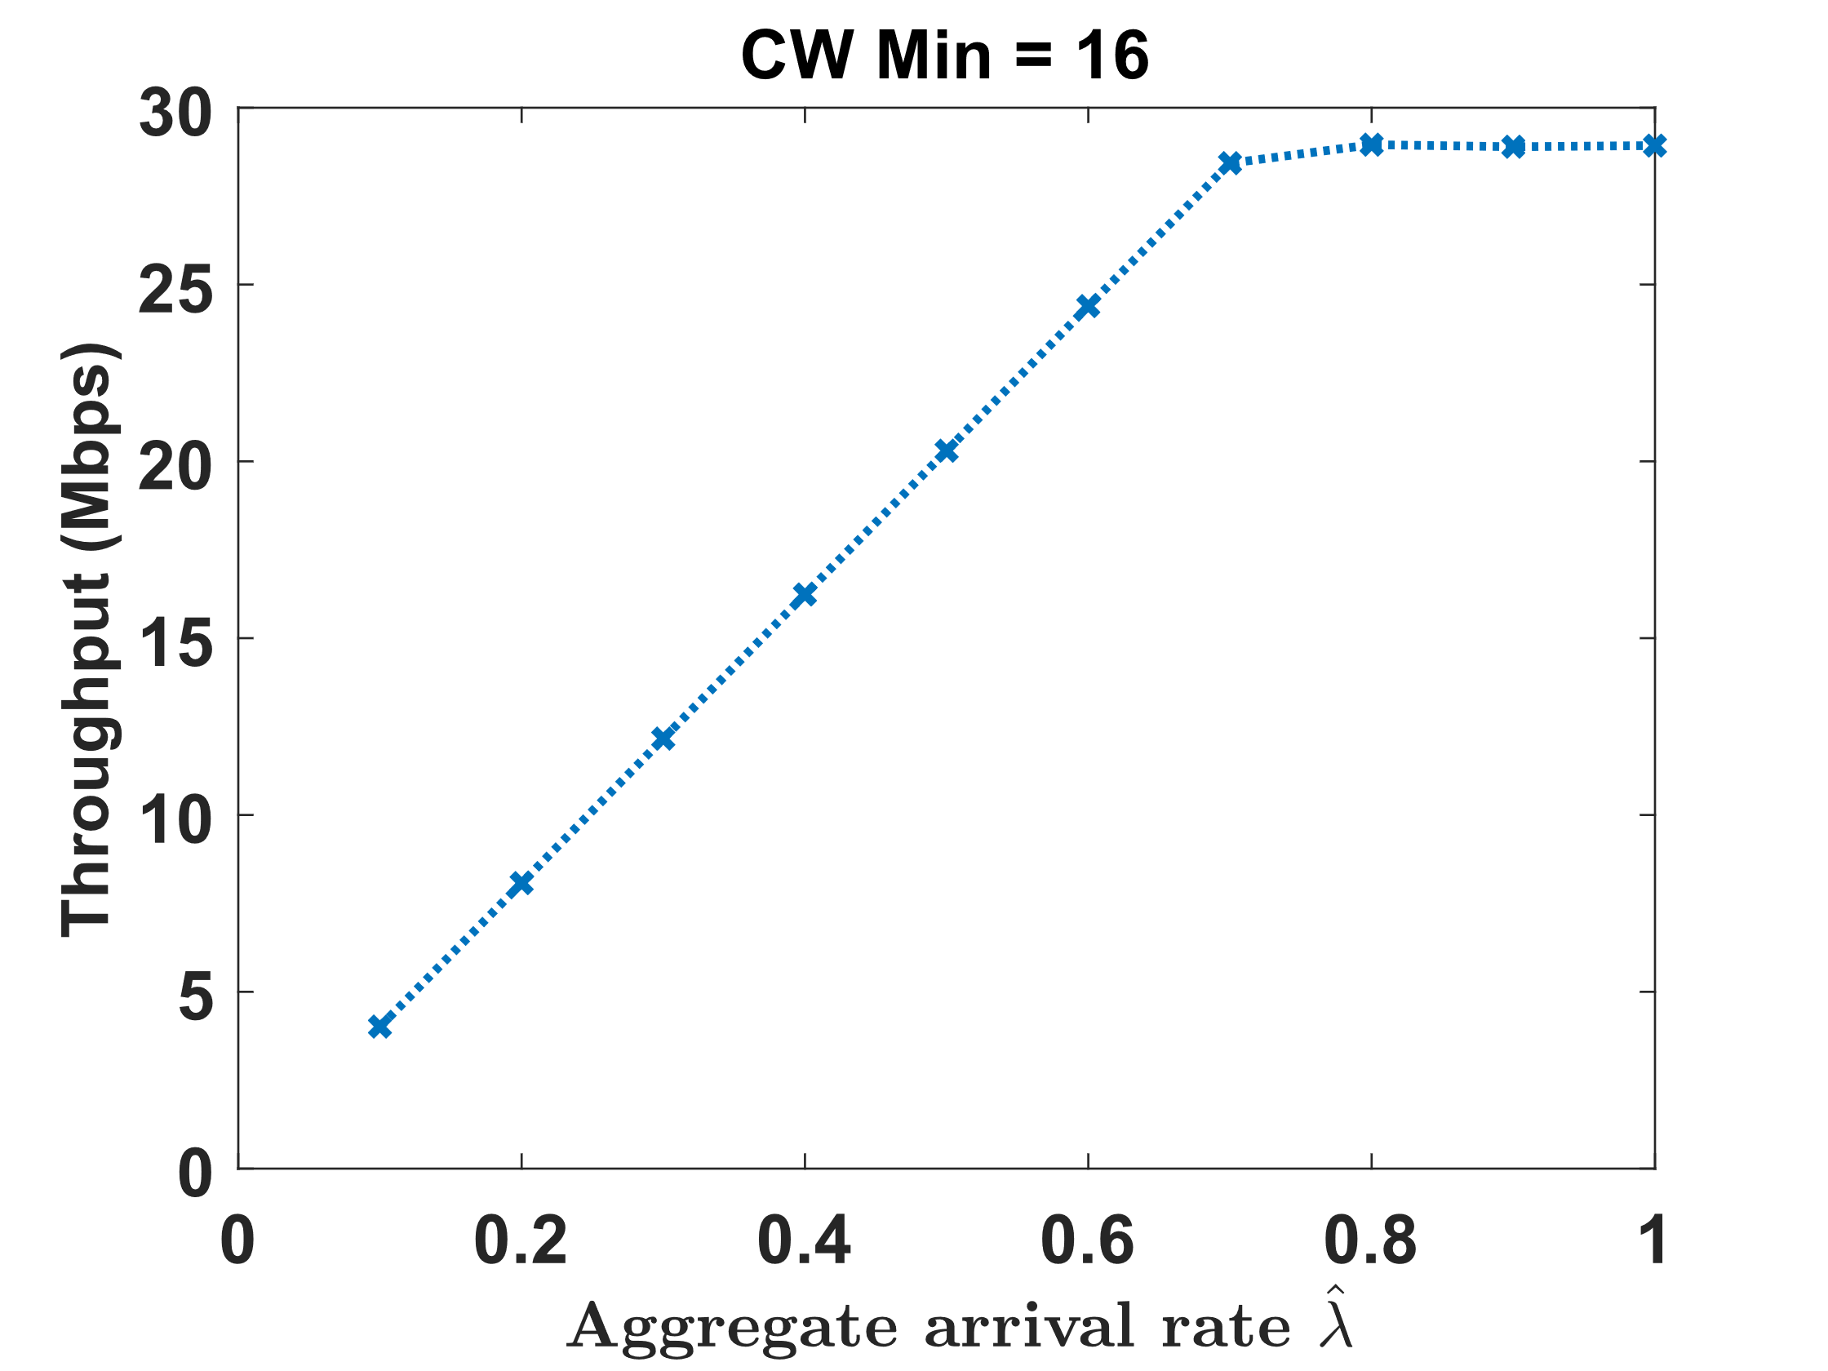
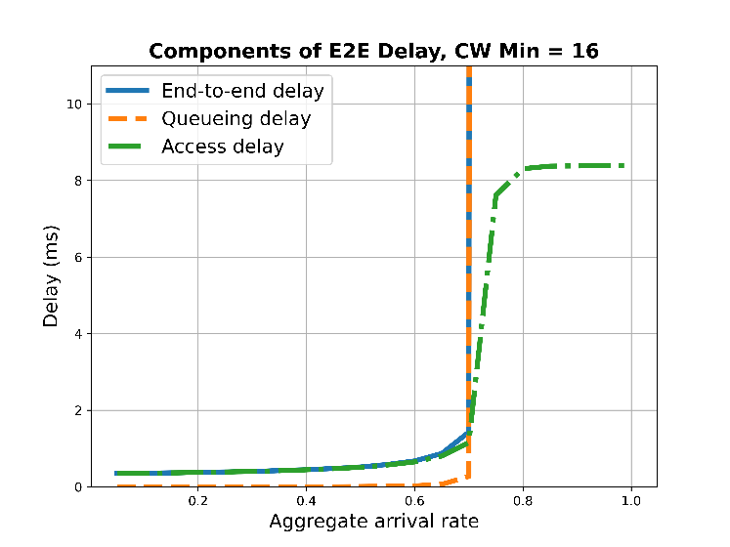
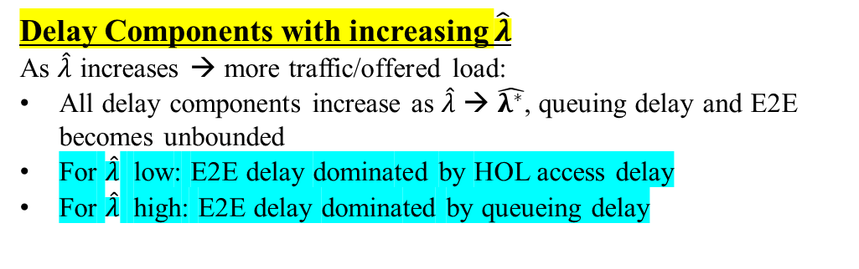
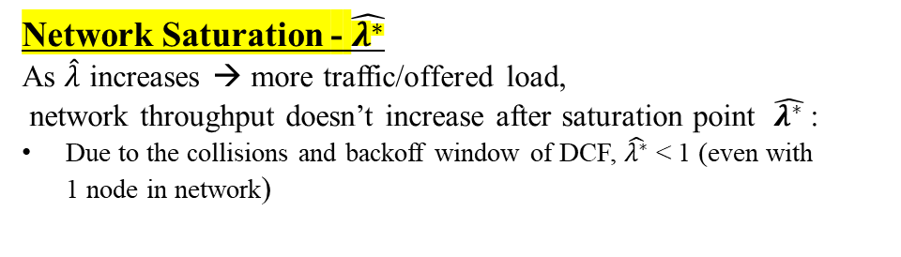

Delay Simulations
Delay Components
Queueing Delay: difference between time instant when packet enters queue till it becomes Head of Line (HOL)
Media Access Delay: difference between time instant when it becomes HOL to 1st transmission
Transmission Delay: difference between 1st transmission instant till when packet is de-queued from RX Buffer
HOL Delay: Combing delay components 2 and 3
End-to-End Delay: Combing all the delay components 1+2+3
Network Saturation - $\hat{λ^{∗}}$
As $\hat{λ}$ increases → more traffic/offered load,
network throughput doesn’t increase after saturation point $\hat{λ^{∗}}$:
Due to the collisions and backoff window of DCF, $\hat{λ^{∗}}$ < 1 (even with 1 node in network)
Delay Components with increasing $\hat{λ}$
As $\hat{λ}$ increases → more traffic/offered load:
All delay components increase as $\hat{λ}$ → $\hat{λ^{∗}}$, queuing delay and E2E becomes unbounded
For $\hat{λ}$ low: E2E delay dominated by HOL access delay
For $\hat{λ}$ high: E2E delay dominated by queueing delay
$$\hat{λ^{∗}}$$

Slide 28
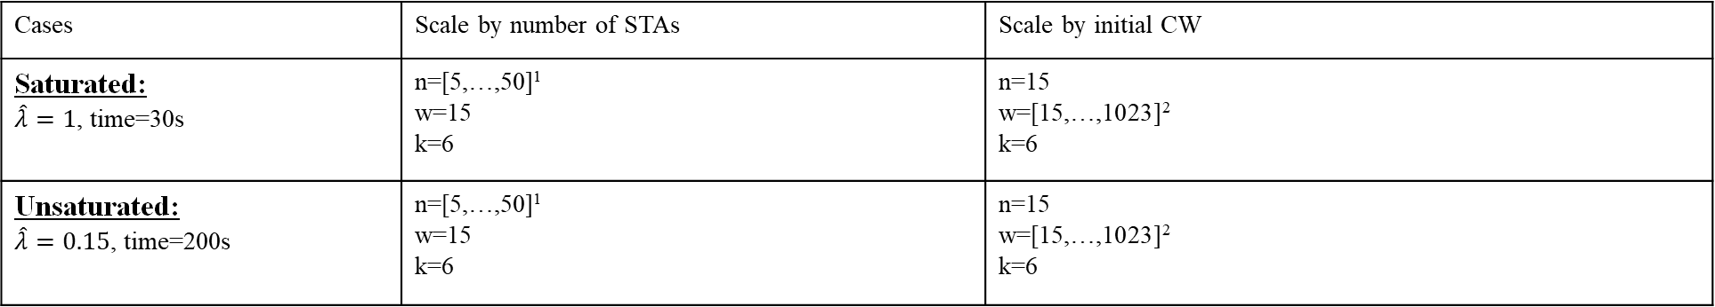
Delay Simulations vs Analysis Validation (1)
Delay Components
Queueing Delay: difference between time instant when packet enters queue till it becomes Head of Line (HOL)
Media Access Delay: difference between time instant when it becomes HOL to 1st transmission
Transmission Delay: difference between 1st transmission instant till when packet is de-queued from RX Buffer
HOL Delay: Combing delay components 2 and 3
End-to-End Delay: Combing all the delay components 1+2+3
* Validated the HOL delay (2+3) in ns-3 vs analytical model
Cases | Scale by number of STAs | Scale by initial CW
Saturated: $\hat{λ}=1$, time=30s | n=[5,…,50]¹ w=15 k=6 | n=15 w=[15,…,1023]² k=6
Unsaturated: $\hat{λ}=0.15$, time=200s | n=[5,…,50]¹ w=15 k=6 | n=15 w=[15,…,1023]² k=6
$\hat{λ}$ = aggregate input rate, proportional to Bernoulli arrival probability;
n = number of STAs; w = initial CW; k = backoff stages.
¹ Step size = 5
² Powers of 2 from 2⁴ to 2¹⁰

Slide 29
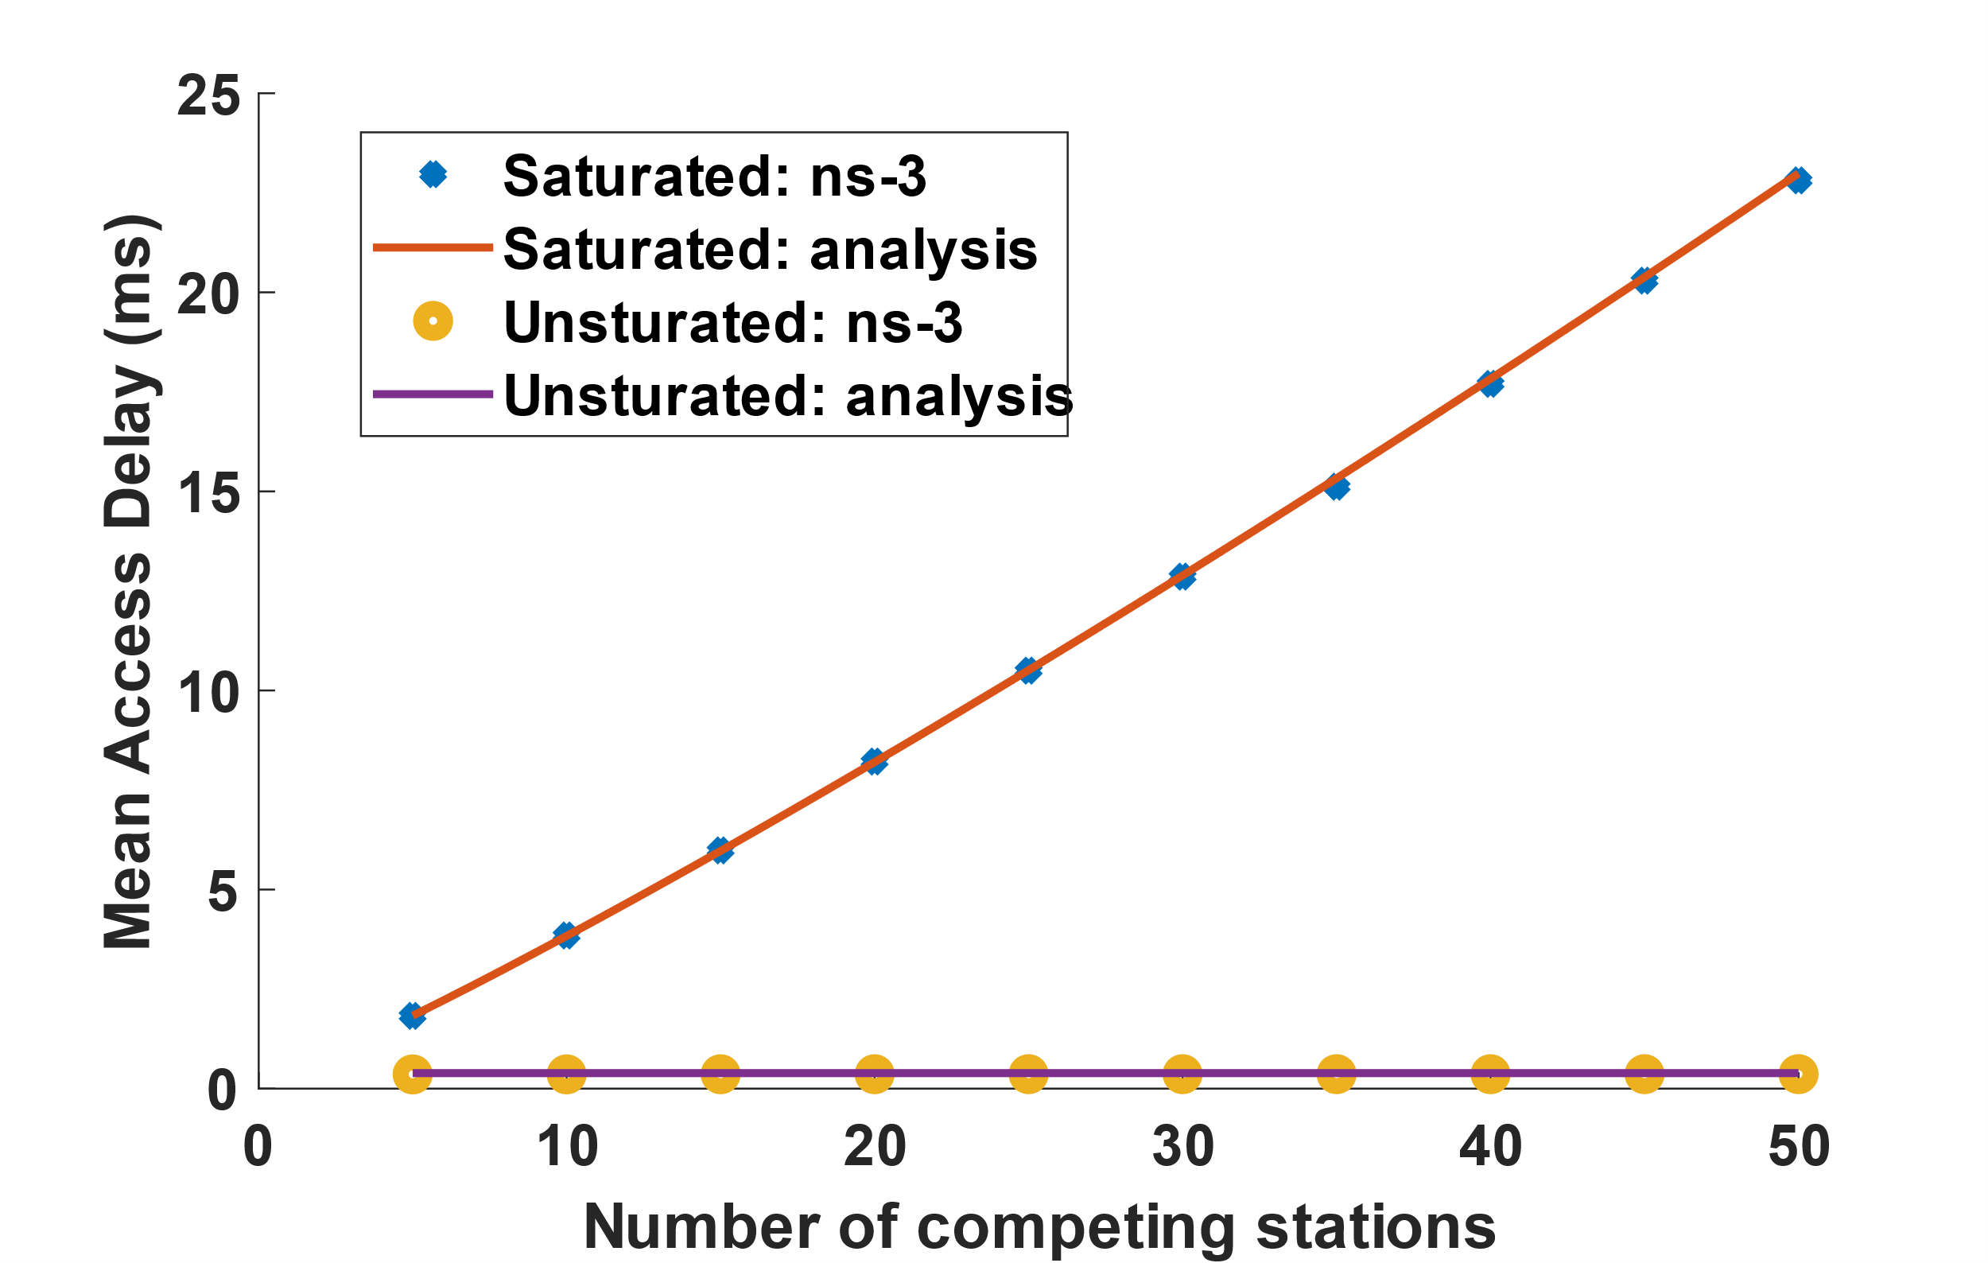
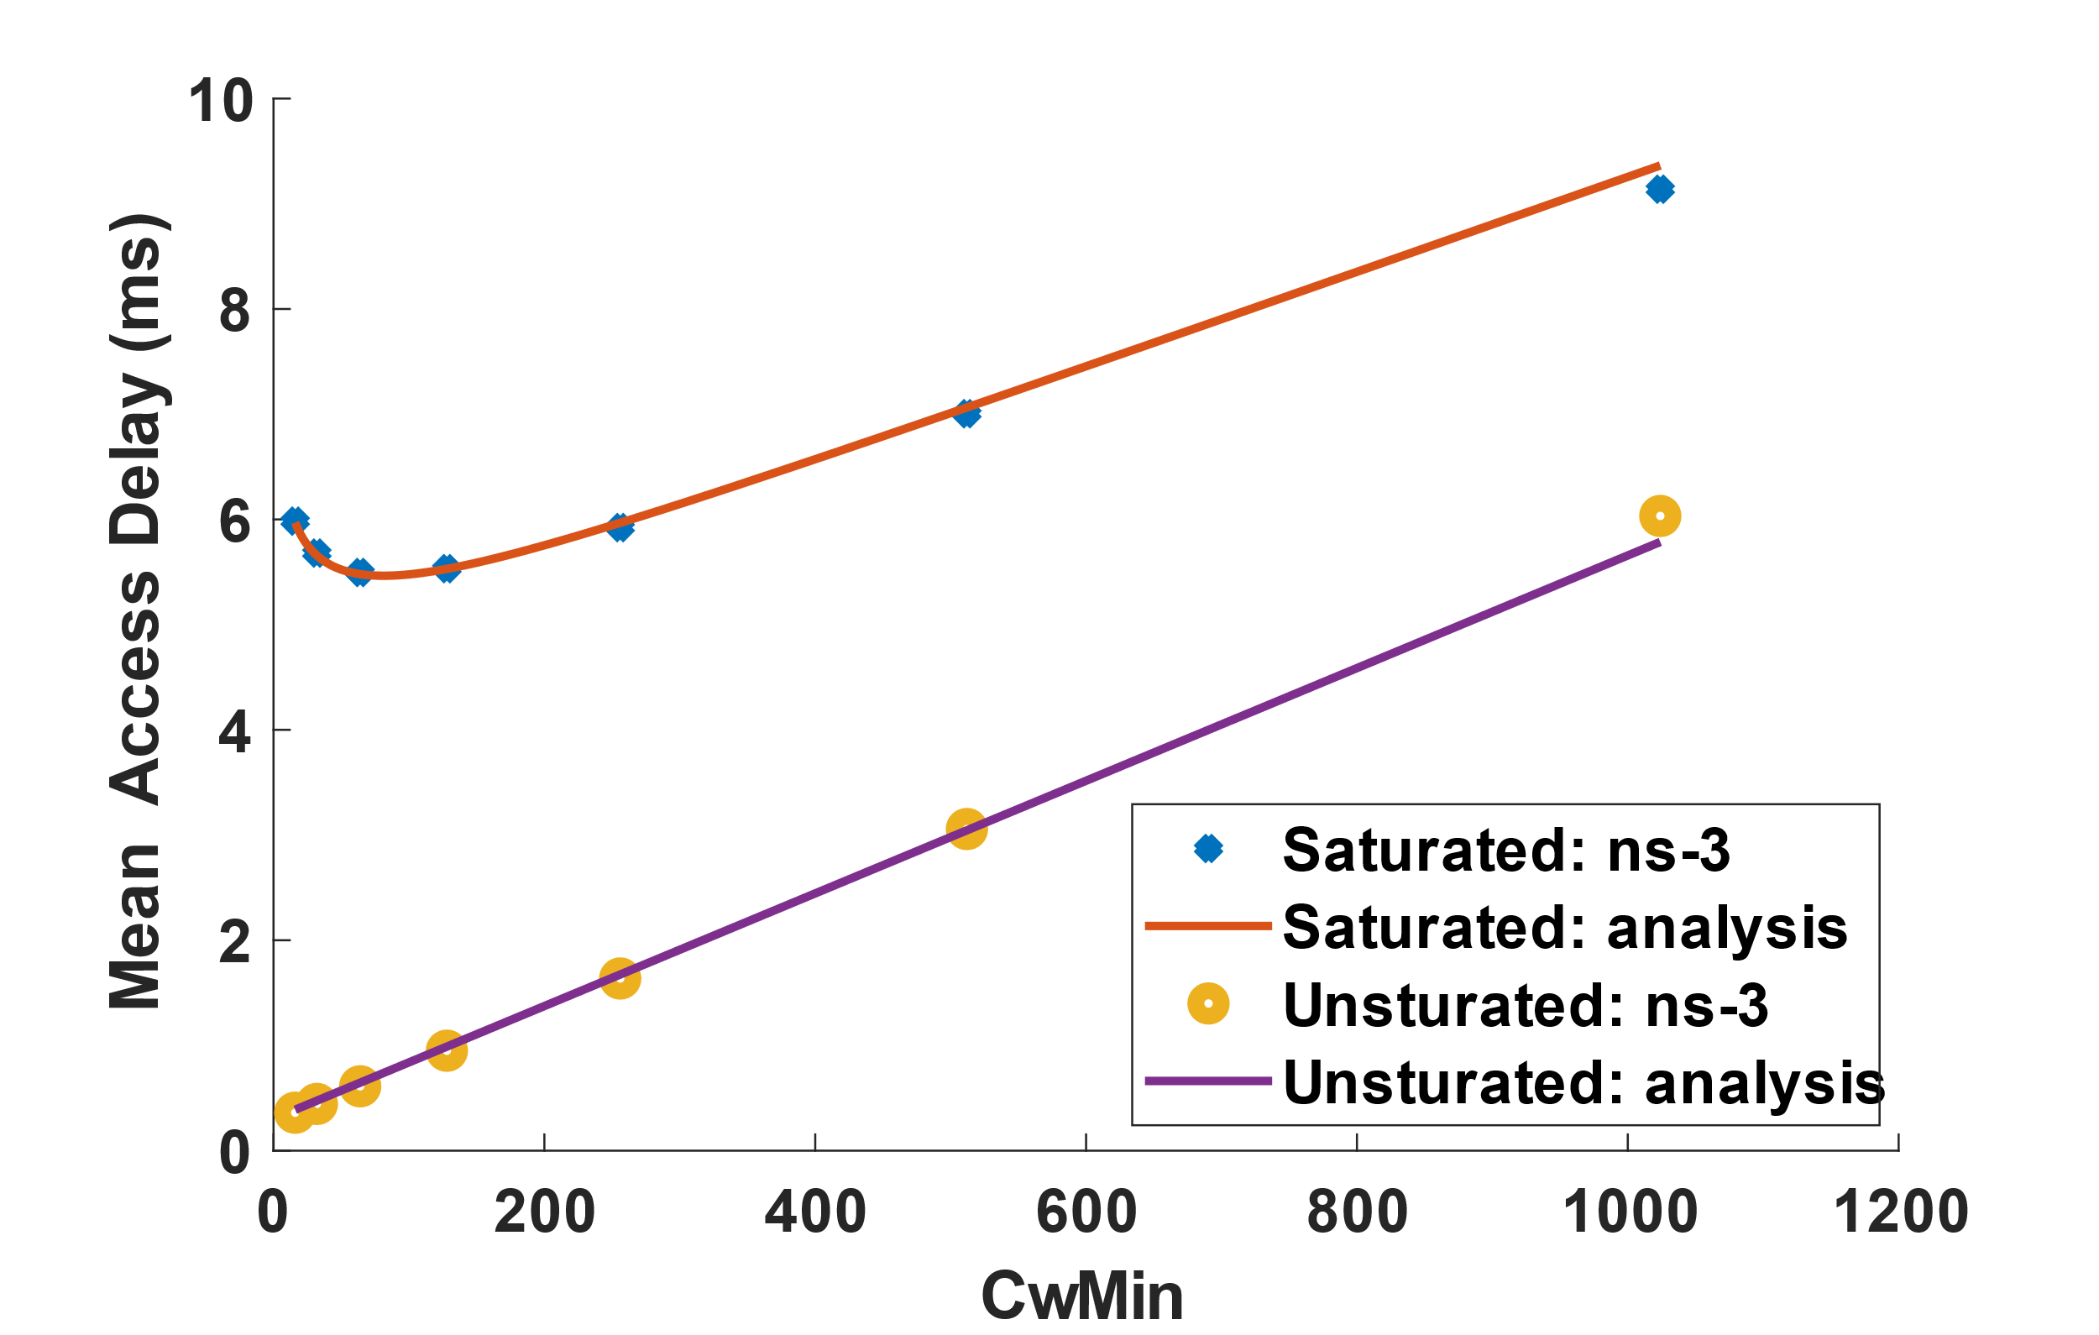
Delay Simulations: Validation (2)
802.11ax, CwMin=16, CwMax = $2^{6}$*CwMin, DCF Basic, Scale by number of STAs, MCS6
Mean HOL Delay (ms)
ns-3 simulation results aligned with analytical model
Saturated condition: delay scales with # nodes → more nodes, more collisions
Unsaturated condition: delay is constant → with fixed aggregate rate, low collisions
802.11ax, nSTA = 15, CwMax = $2^{6}$*CwMin , DCF Basic, Scale by initial CW (CwMin) , MCS6
Mean HOL Delay (ms)
ns-3 simulation results aligned with analytical model
Under Saturated condition: delay first drops then increase → the tradeoff between less collisions and long backoff period
Under Unsaturated condition, delay increases with CwMin → only related to the initial CW size

Slide 30
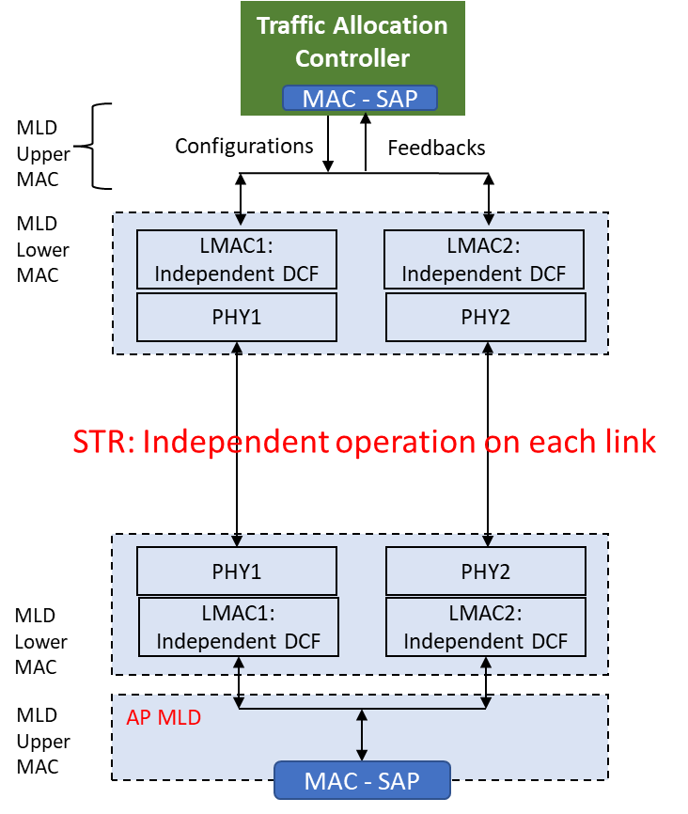
Multi-Link Operation (MLO)
Previous WiFi6: STA is limited to one band/one channel at any channel access
MLO = simultaneous use of Multiple Links using STR and TID-to-Link Mapping (WiFi 7)
  STR (Simultaneous Tx. and Rx.): independent channel access on each link
  - enables simultaneous asynchronous access to multiple channels on Tx or Rx
  TID-to-Link Mapping: packet-to-link allocation based on traffic ID (TID)
Explore impact of MLO on delay-sensitive traffic
  How does MLO STR improve delay? → Validation of ns-3 MLO model implementation
  How can we use ns-3 to analyze different scenarios? → Impact of MLD & SLD Coexistence
‘Link’ = a specific channel in a specific band

Slide 31
Current Status of MLO in ns-3
Timeline of MLO support in ns-3
ns-3.37:
Multi-link discovery & setup
ns-3.38:
MLO STR mode + example
ns-3.40:
TID-to-Link Mapping
(ns-3.39)
(ns-3.41)
(ns-3.42)
Nov 2022
Mar 2023
Jul 2023
Sep 2023
Feb 2024
May 2024
Wi-Fi MLO features: since ns-3.40
Existing examples/tests that use MLO STR:
  examples/wireless/wifi-eht-network.cc: 1/2/3 links can be used to test network throughput
  src/wifi/test/wifi-mlo-test.cc: tests all MLO procedures
Architecture of ns-3 MLO from channel access perspective
Upper MAC (ns3::Txop) requests channel access from Lower MAC (ns3::CAM)
ns3::CAM listens to per-link PHY events (medium busy end, ACK timeout time, etc) & manages per-Txop backoff counter, to decide when access is granted to the requesting Txop
With access granted, ns3::FEM sets transmission params for the transmitting MPDU, then forward it to PHY

Slide 32


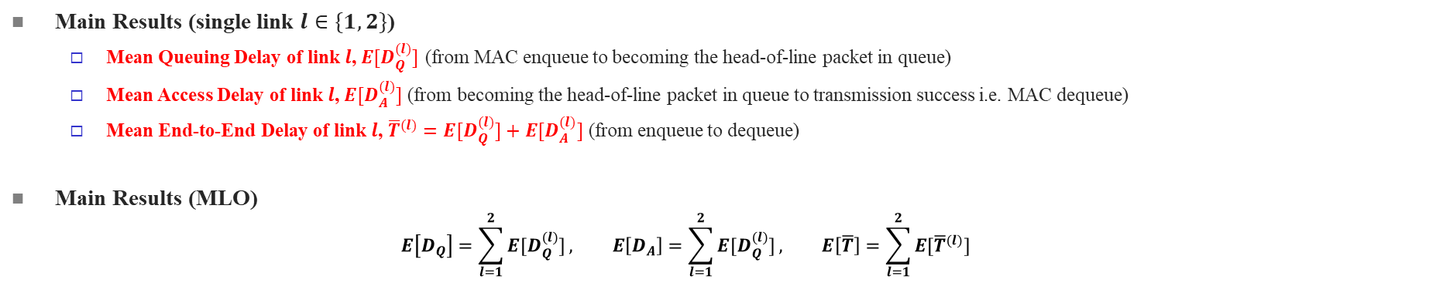
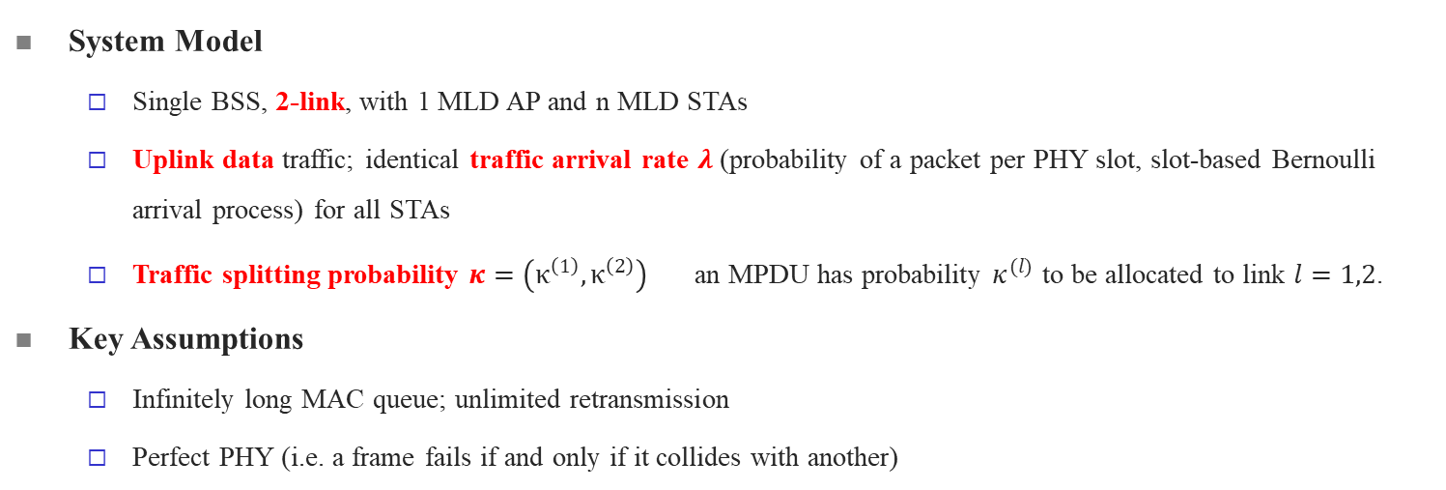
Delay Analysis – MLDs Only [3]
System Model
  Single BSS, 2-link, with 1 MLD AP and n MLD STAs
  Uplink data traffic; identical traffic arrival rate $λ$ (probability of a packet per PHY slot, slot-based Bernoulli arrival process) for all STAs
  Traffic splitting probability $κ=\left(κ^{\left(1\right)},κ^{\left(2\right)}\right)$ an MPDU has probability $κ^{(l)}$ to be allocated to link $l=1,2$.
Key Assumptions
  Infinitely long MAC queue; unlimited retransmission
  Perfect PHY (i.e. a frame fails if and only if it collides with another)
Main Results (single link $l∈\{1,2\}$)
  Mean Queuing Delay of link $l$, $E[D_{Q}^{(l)}]$ (from MAC enqueue to becoming the head-of-line packet in queue)
  Mean Access Delay of link $l$, $E[D_{A}^{(l)}]$ (from becoming the head-of-line packet in queue to transmission success i.e. MAC dequeue)
  Mean End-to-End Delay of link $l$, ${\overline{T}}^{(l)}=E[D_{Q}^{(l)}]+E[D_{A}^{(l)}]$ (from enqueue to dequeue)
Main Results (MLO)
  $$E\left[D_{Q}\right]=\sum_{l=1}^{2}{E[D_{Q}^{(l)}]}, E\left[D_{A}\right]=\sum_{l=1}^{2}{E[D_{Q}^{(l)}]}, E\left[\overline{T}\right]=\sum_{l=1}^{2}{E[{\overline{T}}^{(l)}]}$$

Slide 33
Delay Simulations: MLD Validation
Mean Queuing/Access/E2E Delay vs. Aggr. Arrival Rate (CW_{min}=15, Mcs 6)
Close to zero
Bounded value of access delay when saturated
≈ access delay
≈ queuing delay
Saturation of Single Link
Saturation of 2-link MLO
Mean Queuing/Access/E2E Delay vs. Aggr. Arrival Rate (CW_{min}=127, Mcs 6)
  Results match better than CW_{min}=15 case, due to more randomized transmission attempts in the simulation.

Slide 34
Coexistence of the SLDs and MLDs
Setups:
  20 MHz and MCS=6 on both links
    Application Data Rate: 77.4 Mbps CBR
    PHY Rate: 54 Mbps
  Traffic split for MLDs: 0.5/0.5
  Goals:
  By using the TxTraceHelper, what can we get from the simulations
  Validate the simulator with extended analytical model
  Explore the possible optimization for MLD & SLD coexistence cases
MLD & SLD coexistence scenario
n SLDs on link 1
n SLDs on link 2
m MLDs on link 1 and link 2

Slide 35
Detailed Simulation Result Example
Commands:
./ns3 run --single-bss-coex --simulationTime=20 --nMldSta=5 --mldPerNodeLambda=0.01 --mldProbLink1=0.5 --nSldLink1Sta=5 --sldLink1PerNodeLambda=0.005 --nSldLink2Sta=5 --sldLink2PerNodeLambda=0.005 --mcs=6 --mcs2=6 --channelWidth=20 --channelWidth2=20
Codes: https://gitlab.com/uw-ns3-research/ns-3-dev/-/tree/obss_delay_optimization?ref_type=heads
Example Outputs:
Results for MLDs
Results for SLDs
Parameters | Value
mldSuccPrLink1 | 0.622627
mldSuccPrLink2 | 0.624318
mldSuccPrTotal | 0.623472
mldThptLink1 | 15.8796
mldThptLink2 | 15.9246
mldThptTotal | 31.8042
mldMeanQueDelayLink1 | 7595.09
mldMeanQueDelayLink2 | 7435.49
mldMeanQueDelayTotal | 7515.18
mldMeanAccDelayLink1 | 3.77655
mldMeanAccDelayLink2 | 3.76658
mldMeanAccDelayTotal | 3.77156
mldMeanE2eDelayLink1 | 7598.87
mldMeanE2eDelayLink2 | 7439.25
mldMeanE2eDelayTotal | 7518.95
Parameters | Value
sldLink1SuccPr | 0.626401
sldLink2SuccPr | 0.625969
sldLink1Thpt | 16.1634
sldLink2Thpt | 16.1346
sldMeanQueDelayLink1 | 7300.5
sldMeanQueDelayLink2 | 7543.74
sldMeanAccDelayLink1 | 3.70293
sldMeanAccDelayLink2 | 3.70781
sldMeanE2eDelayLink1 | 7304.2
sldMeanE2eDelayLink2 | 7547.45
Very detailed results based on the TxTraceHelper:
Delays, successful transmission probability, throughput, etc.
Split to per-node and per-link stats

Slide 36
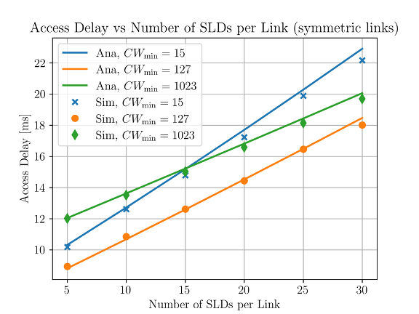
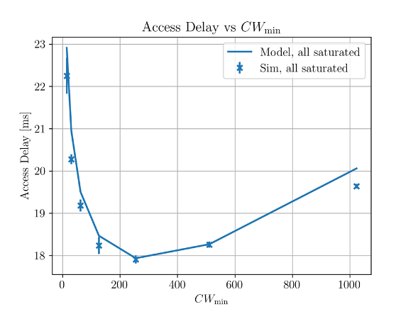
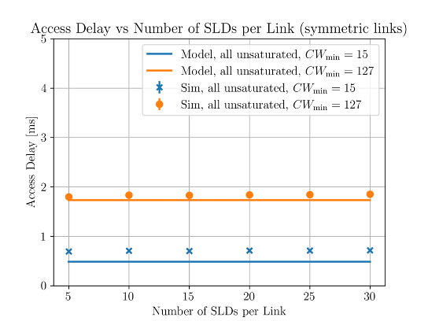
Simulation and Analysis Results
SLD = 30 per link,
Different CWmin
Saturated Case Mean Access Delay for MLDs (m = 20)
As the number of SLDs in each link increases, the access delay increases
The initial backoff window size (CWmin) impacts the access delay
For different number of SLDs, the optimal CWmin is different
Unsaturated Case Mean Access Delay for MLDs (m = 20)
Under unsaturated case, the collision probability is low -> mean access delay not scale with number of nodes
The access delay mainly impacted by the CWmin

Slide 37
Future Work
MLD performance optimization
Take into account the link asymmetry: bandwidth, MCS and number of STAs
Traffic splitting methods to minimize the access and end-to-end delay
Dynamic policies for traffic splitting to minimize E2E delay
  Based on past experience of link condition (DRL + ns3-ai[4])
Other performance constraints for latency-sensitive applications
Worst-case (95 %-tile) delay
Jitter

Slide 38
References
[1] G. Bianchi, "Performance analysis of the IEEE 802.11 distributed coordination function," IEEE Journal on Selected Areas in Communications, vol. 18, no. 3, pp. 535-547, March 2000
[2] L. Dai and X. Sun, "A Unified Analysis of IEEE 802.11 DCF Networks: Stability, Throughput, and Delay," IEEE Transactions on Mobile Computing, vol. 12, no. 8, pp. 1558-1572, Aug. 2013, doi: 10.1109/TMC.2012.128.
[3] Shen, Muyuan, Jie Zhang, Hao Yin, Sumit Roy, and Yayu Gao. "Delay in Multi-Link Operation in ns-3: Validation and Impact of Traffic Splitting." In Proceedings of the 2024 Workshop on ns-3, pp. 19-26. 2024.
[4] Hao Yin, Pengyu Liu, Keshu Liu, Liu Cao, Lytianyang Zhang, Yayu Gao, and Xiaojun Hei. 2020. ns3-ai: Fostering Artificial Intelligence Algorithms for Networking Research. In Proceedings of the 2020 Workshop on ns-3. 57–64.

Slide 39
Other ns-3 Wi-Fi Pubs (UW FUNLaB)
Leon-Rosas et al, "Verification of ns-3 Wi-Fi Rate Adaptation Models on AWGN Channels," 2023 Workshop on ns-3.
Yin et al, "IEEE WLANs in 5 vs 6 GHz: A Comparative Study," 2022 Workshop on ns-3.
Jin et al., "Efficient PHY layer abstraction for fast simulations in complex system environments," IEEE Trans. Comm., August 2021.
Jin et al., "EESM-log-AR: An Efficient Error Model for OFDM MIMO Systems over Time-Varying Channels in ns-3," 2021 Workshop on ns-3.
Lanante et al, "Analysis and Optimization of Channel Bonding in Dense IEEE 802.11 WLANs," Ieee Trans. Wireless Comm., March 2021

Slide 40
BACKUP

Slide 41
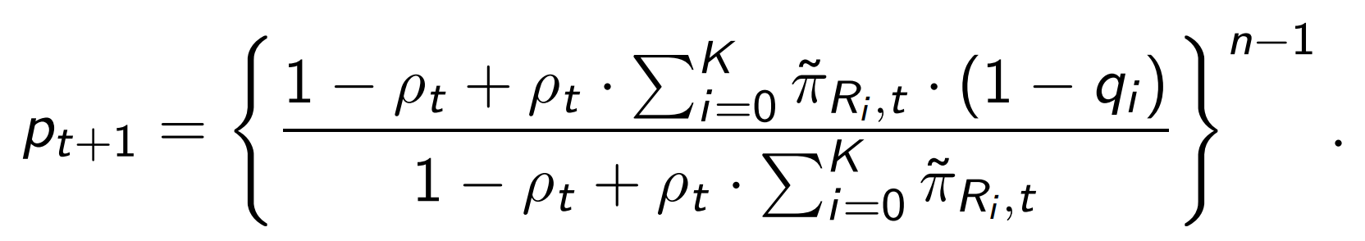
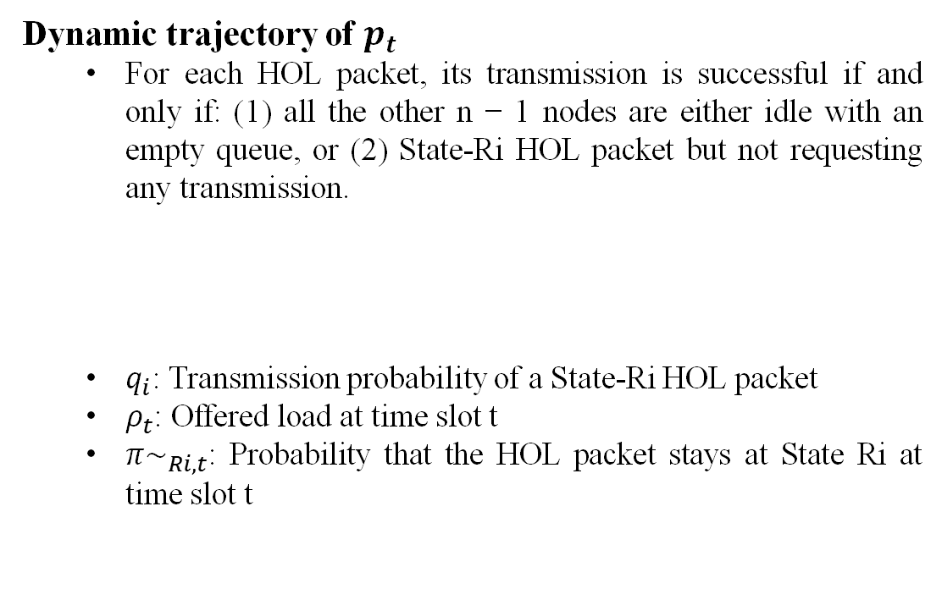
HOL Modeling
Embedded Markov chain of HOL packets definition
  State R_{i}: waiting to request, i = 0, . . . , K
  State F_{i}: collision, i = 0, . . . , K
  State T: successful transmission
Dynamic trajectory of $p_{t}$
  ﻿For each HOL packet, its transmission is successful if and only if: (1) ﻿all the other n − 1 nodes are either idle with an empty queue, or (2) ﻿State-Ri HOL packet but not requesting any transmission.
  ﻿$q_{i}$: Transmission probability of a State-Ri HOL packet
  $﻿ρ_{t}$: Offered load at time slot t
  ﻿${π\sim }_{Ri,t}$: Probability that the HOL packet stays at State Ri at time slot t

Slide 42
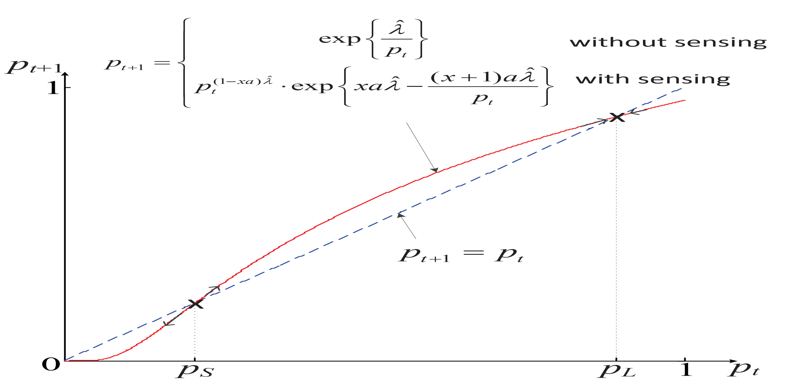
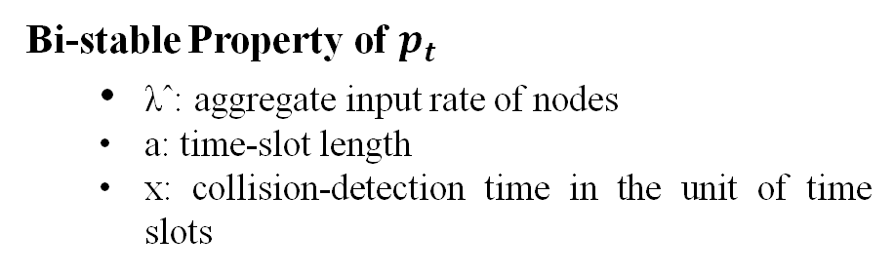

HOL Modeling
﻿Bi-stable Property of $p_{t}$
  ﻿λˆ: aggregate input rate of nodes
  ﻿a: time-slot length
  ﻿x: collision-detection time in the unit of time slots
﻿Desired Stable Point $p_{L}$ and Undesired Stable Point $p_{A}$
  ﻿If $p_{t}$ ≥ $p_{s}$ at any t
  and ﻿lim_{t→∞} $ρ_{t}$= ρ ≤ 1:
  ﻿lim_{t→∞} $p_{t}$ → $p_{L}$
  Otherwise:
    ﻿lim_{t→∞} $p_{t}$ → $p_{A}$

Slide 43
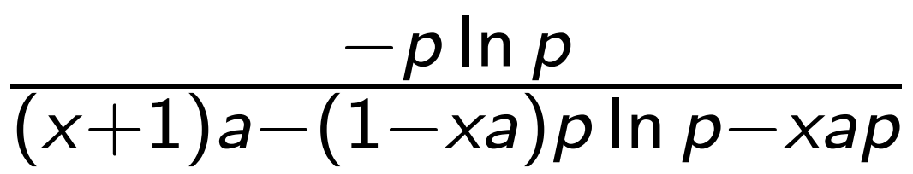
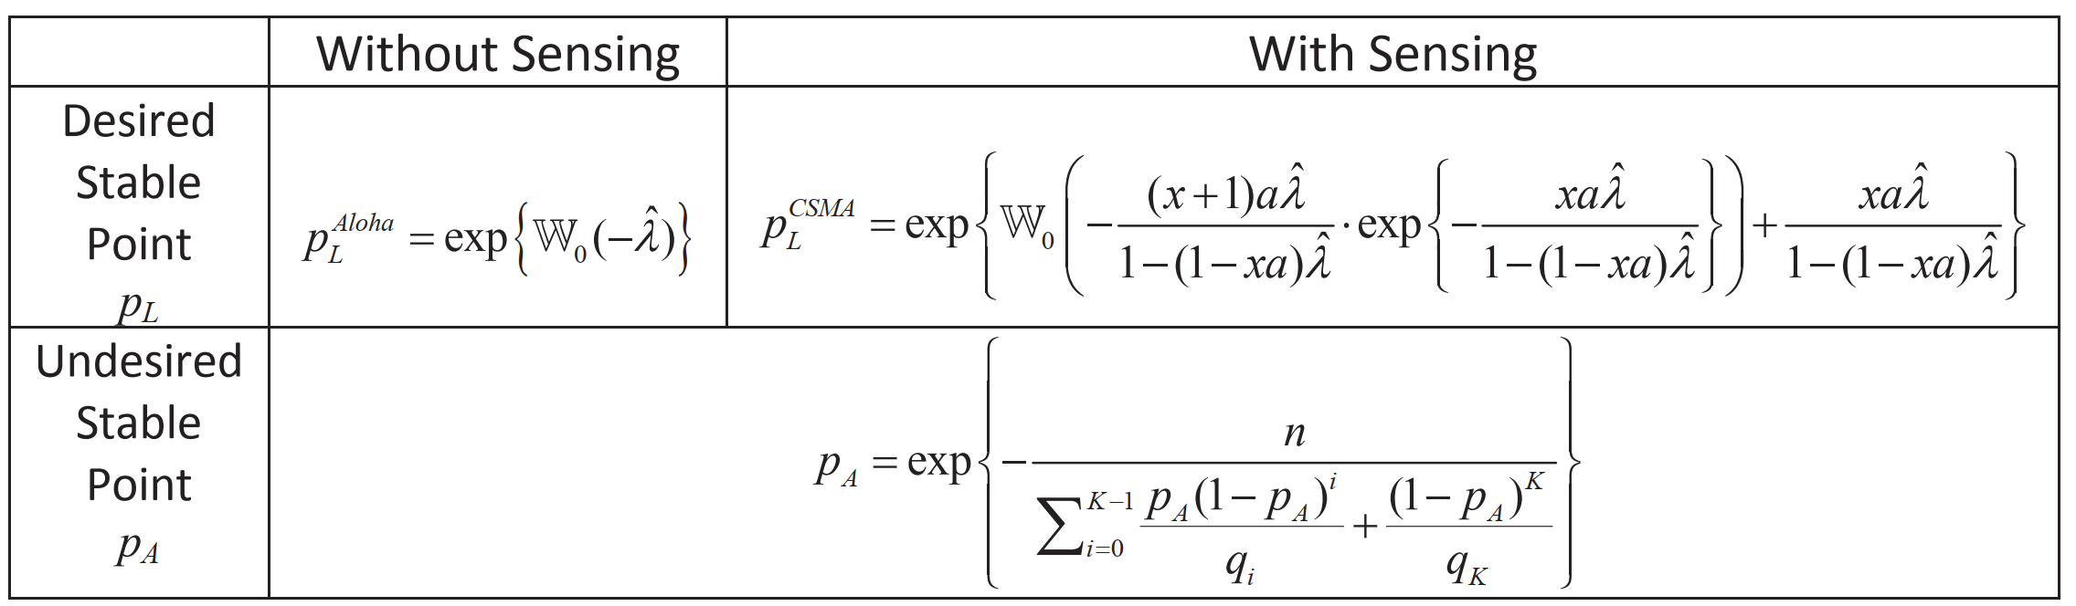

HOL Modeling
﻿Desired Stable Point $p_{L}$ and Undesired Stable Point $p_{A}$
  ﻿Desired Stable Point $p_{L}$ is determined by the aggregate input rate λˆ and independent of the backoff parameters {qi}
  ﻿Undesired Stable Point $p_{A}$ is determined by the backoff parameters {qi} and the number of nodes n
﻿Service Rate and Service Time Distribution
  Service rate
  ﻿Service time distribution
  ﻿GX(z) denotes the probability generating function of X.
  Di denotes the time spent from the beginning of State Ri until the service completion
  Yi denotes the holding time of a HOL packet in State Ri, i = 0, . . . , K

