Slide 1
Coexistence of Wi-Fi with Narrowband Technology
Date: 2024-07-16
Authors:

Slide 2
Abstract (1)
In 2020, CEPT/ECC opened the 5945 MHz to 6425 MHz band for license-exempt Wireless Access System/Radio Local Area Network (WAS/RLAN) operation in Europe [1]
This decision also permits for Narrowband Frequency Hopping (NB FH) operation
The Bluetooth SIG [2] and other entities announced their interest to operate NB FH equipment in the license-exempt 6 GHz band
In the future, NB FH devices are likely to share the wireless spectrum with devices operating according to the IEEE 802.11 standard [3]

Slide 3
Abstract (2)
To estimate how IEEE 802.11 and NB FH devices may be coexisting in the future, we are subjecting commercial (enterprise) IEEE 802.11 devices with NB FH signals and measuring the IEEE 802.11 devices’ capability to detect NB FH transmissions as well as to receive IEEE 802.11 transmissions interfered by concurrent NB FH signals
Because of easier commercial availability, all tests are conducted with devices operating in the license-exempt 5 GHz
Nonetheless, the gained insights are relevant for the discussion of the aspect of coexistence in the 6 GHz band, too

Slide 4
Abstract (3)
The IEEE 802.11-2020 standards define a global framework for Wi-Fi devices [3]
Section 17.3.10.6 defines requirements for clear channel assessment (CCA)
According to the standard, the CCA mechanism shall detect the medium as busy within 4 μs of any signal with a received energy that is 20 dB above the most robust modulation and coding (MCS) rate sensitivity
In the case of a 20 MHz channel, the standard defines this value as −82 dBm + 20 dB = −62 dBm, which will be referred to as the Energy Detection Threshold (EDT)

Slide 5
Testbed Setup

Slide 6
Test setup overview
⑬
④
⑫ RF Isolation Chamber
⑨
ATTN-1
AP2
①
⑥
AP1
⑦
Coaxial
③
Ethernet
⑩
Linux PC-2
USB
ATTN-2
⑧
②
Linux PC-1
−30 dB ATTN
−3 dB
−30 dB
⑤
−3 dB
USRP – B210
⑪
−1.3 dB
Signal Analyzer
−24 dB
−1.3 dB

Slide 7
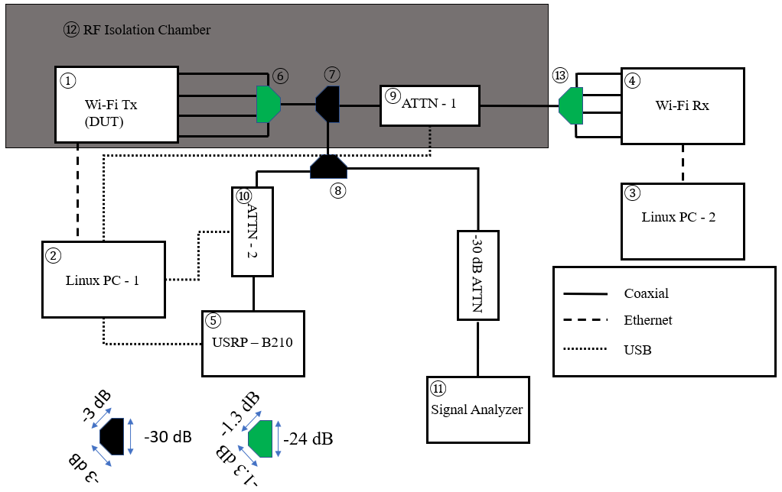
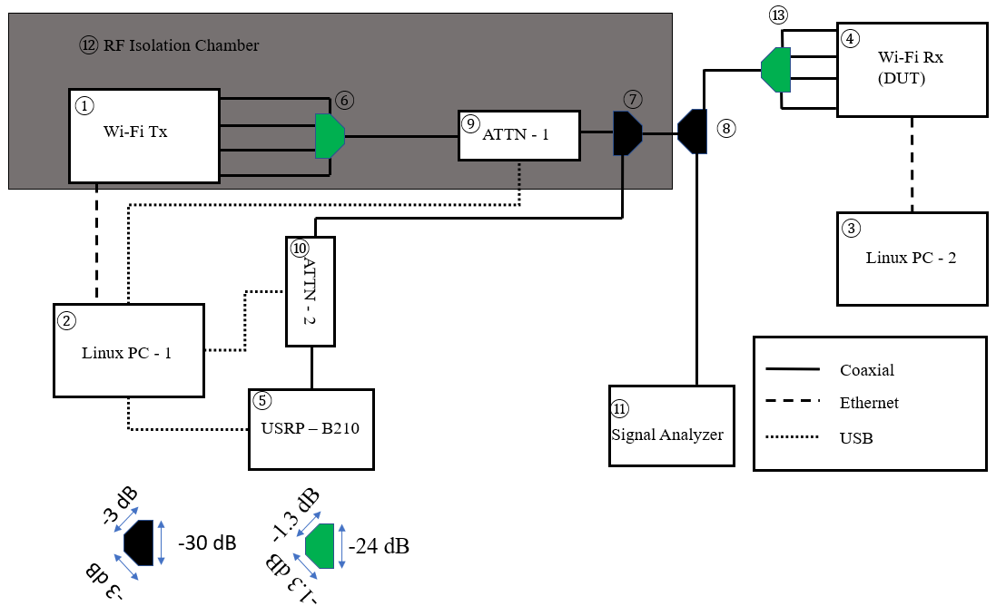
Impact on transmitting vs. receiving side
Test signal added to traffic source
Analyzing energy detection
Interference signal added to traffic sink
Analyzing robustness of receiver

Slide 8
Testbed settings (1)
All measurements rely on conducted setups
Provides for a high isolation against external factors
Additionally, equipment is operated within a Radio Frequency (RF) isolation chamber
Devices are operated on IEEE 802.11 5 GHz channel 36 (f_{c} = 5180 MHz)
The Ettus Research USRP B210 Software Defined Radio (SDR) is used to generate arbitrary test signals
We observe the performance of an IEEE 802.11 link between a transmitting and a receiving device
We use iperf3 to offer UDP traffic to the transmitting device
Therefore, the receiving device does not transmit data packets and limits itself to transmitting Control frames (e. g. IEEE 802.11 ACK) and necessary Management frames
When using OpenWRT between devices with different chipset vendors, iperf3 is run on the receiving device directly without the cost of extraneous CPU usage

Slide 9
Testbed settings (2)
The traffic source offers slightly more traffic than the IEEE 802.11 link’s capacity
Therefore, in all measurements (graphs etc.) the maximum throughput is 90 % of the nominal throughput
Where a Device under Test (DUT) records additional metrics, we use this data to further analyze the measurement results
E. g., statistics related to transmitted and discarded packets, percentage that the wireless medium was observed occupied
To calibrate the testbed setup and to estimate absolute values, we use the Agilent (Keysight) MXA signal analyzer N9020A
Power is measured with an integrated bandwidth of 20 MHz
Gaussian noise-based test signal
A technology agnostic signal whose primary characteristics of interest are bandwidth and power

Slide 10
Test setup, details
Transmitting AP
Operated in bridge mode if possible
iperf3 traffic source
iperf3 traffic sink
Receiving STA/AP
Operated in bridge mode if possible
SDR generating test signals
Antenna combiner, type A
Antenna combiner, type B
Antenna combiner, type B
Variable attenuator
Variable attenuator
Signal analyzer
RF isolation chamber
Antenna combiner, type A
DUT: Device Under Test

Slide 11
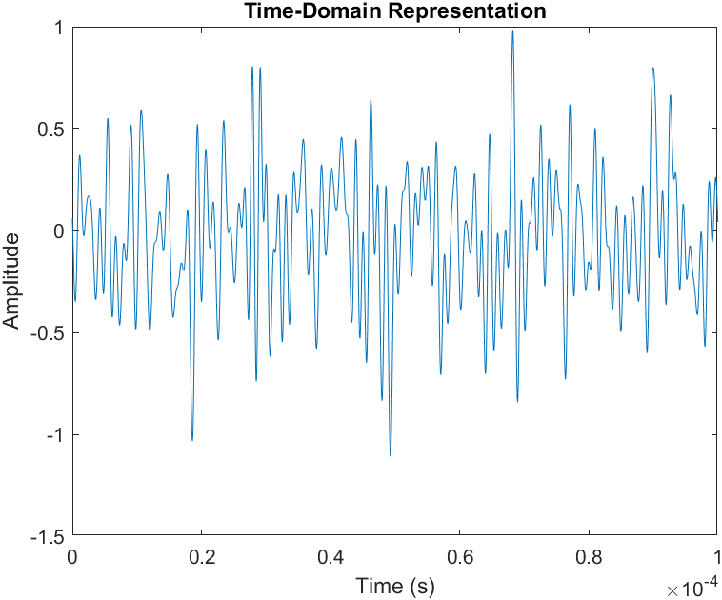
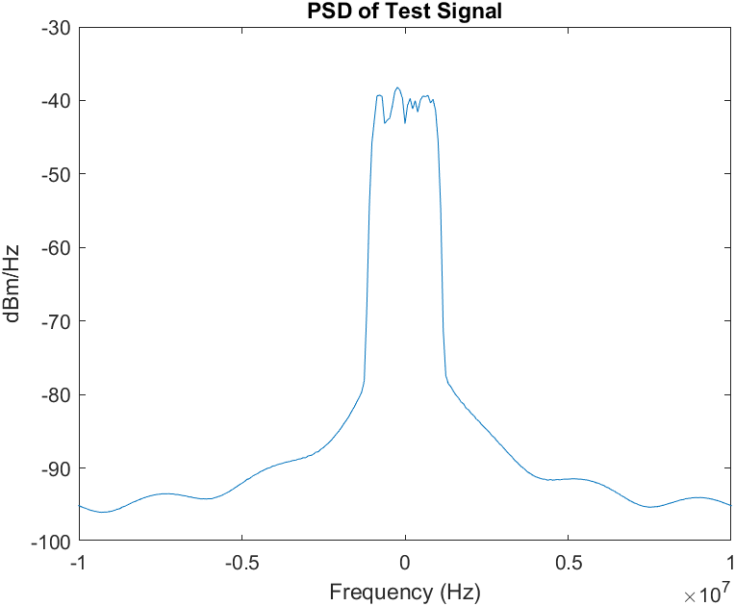
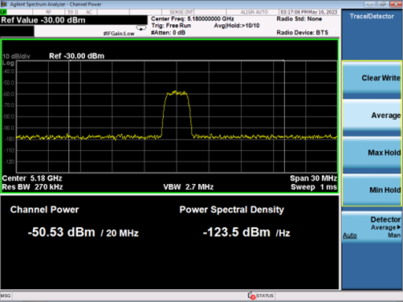
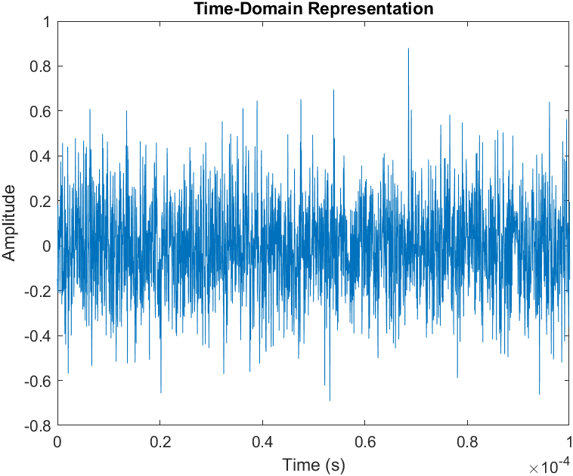
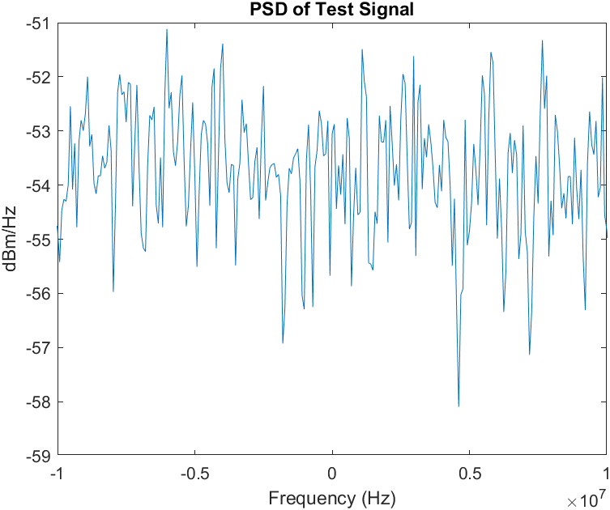
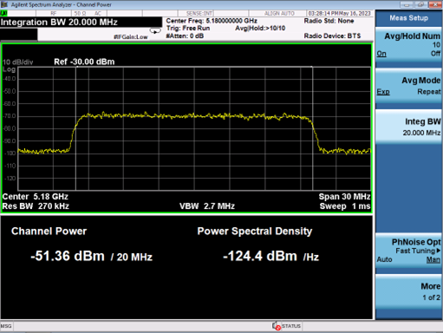
Static Gaussian Test Signals
Time-Domain Representation of Test Signals (MATLAB)
PSD Representation of Test Signals (MATLAB)
PSD Representation of Test Signals (Signal Analyzer)

Slide 12
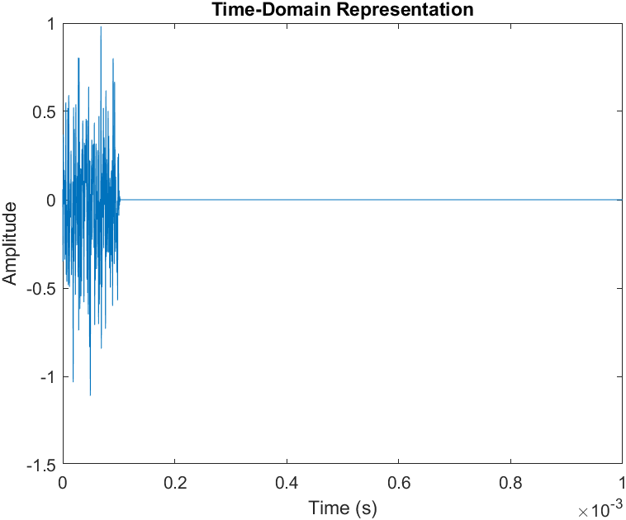
Dynamic (On-Off) 2 MHz Test Signals
Dwell Time defined as the active portion of signal block (on-time)
Duty Cycle defined as the percentage of the signal block that the signal is active
On-Off traffic is constructed by varying these time-domain parameters as shown to the right
2 MHz Test Signal with 100 µs Dwell Time and 10% Duty Cycle

Slide 13
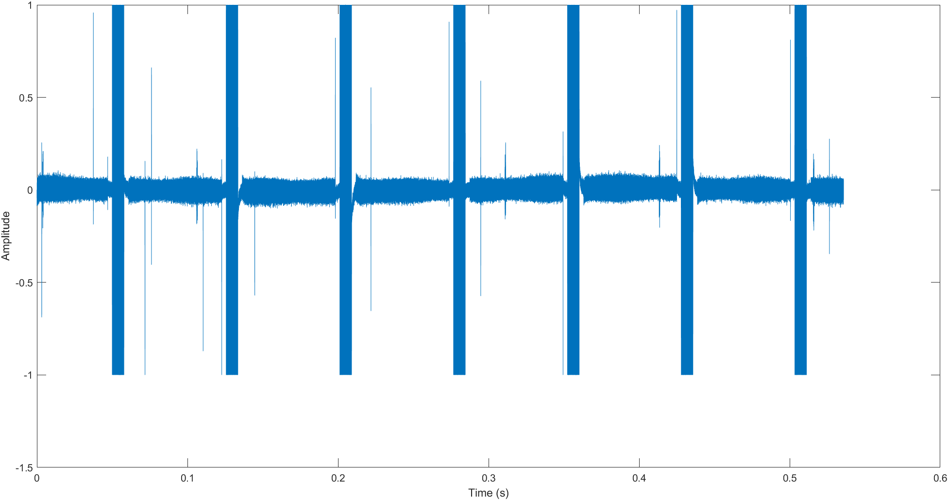
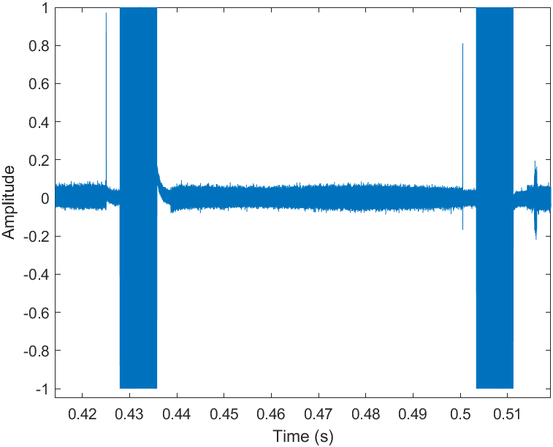
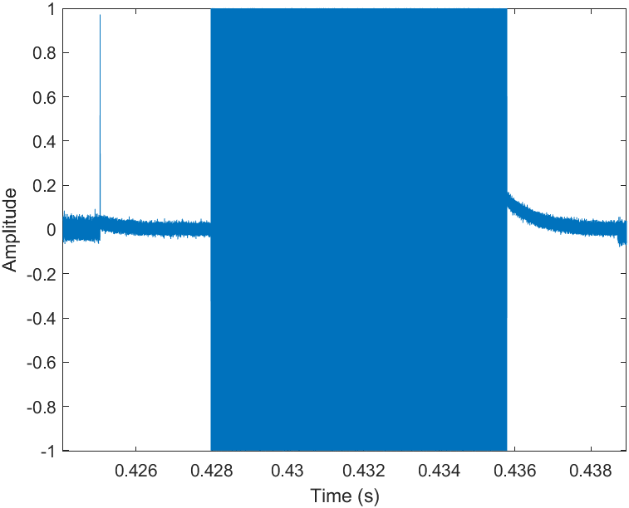
Frequency Hopping Emulation
7.5 ms
67.5 ms
Essentially a frequency hopping signal with a 7.5 ms Dwell Time and 10 % Duty Cycle

Slide 14
Energy Detection capabilities
Energy Detection performance with signals of less than 20 MHz bandwidth

Slide 16
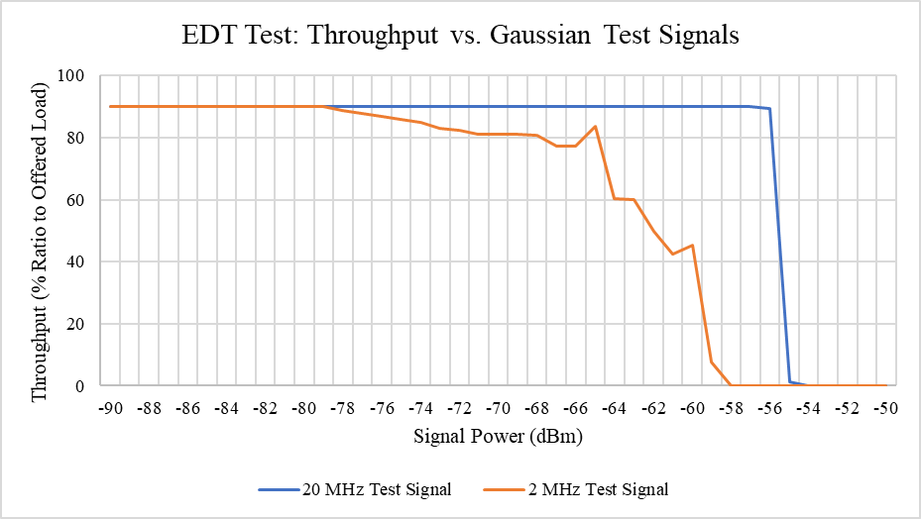
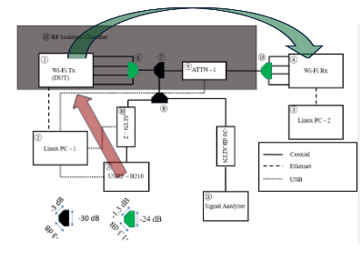
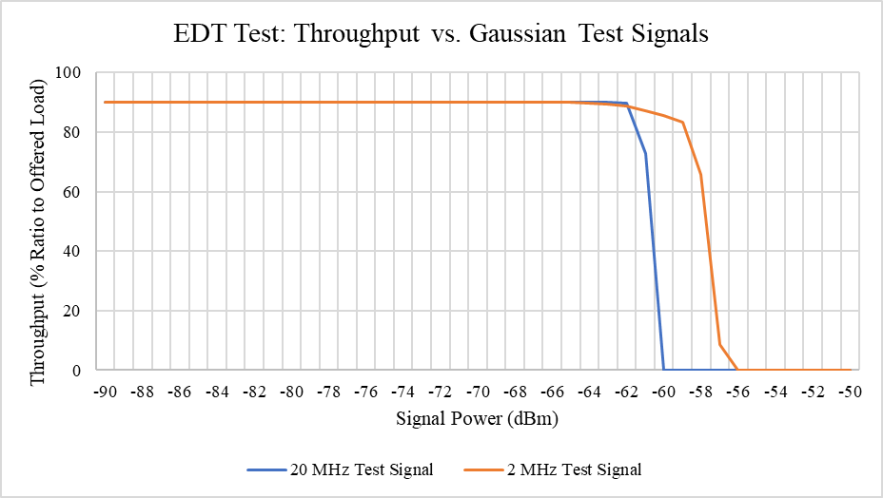
Test 1: Energy Detection of Broadband vs. Narrowband
Experiment:
Assess Energy Detection level of transmitting device using 20 MHz and 2 MHz test signals
Country Code set to Canada
EDT set to –62 dBm where applicable
Test signal transmitted at center frequency of channel 36
Observations
Narrowband test signal is measured differently than broadband test signal in both devices
Experimental EDT differs between devices and between the IEEE 802.11-2020 prescribed value
Device 1
Device 2

Slide 17
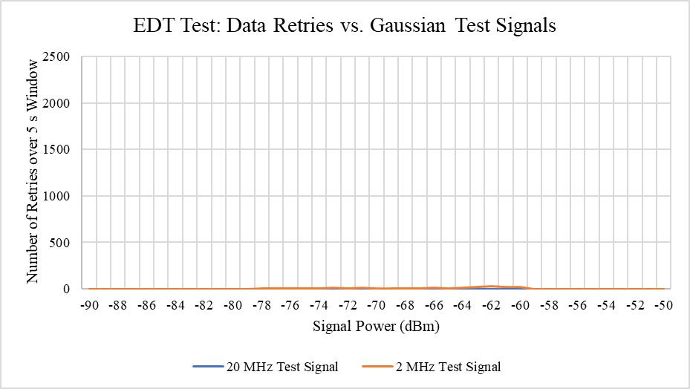
Test 1: Additional Supporting Metrics
Device 1 enables us to monitor live radio traffic statistics from the command line interface (CLI)
One useful metric is data retries over a 5 s window
Nominally, without a test signal present we expect ca. 2200 successful transmissions and 0 retries
We observe that although the throughput decreases, there is not a proportional increase in the number of retransmissions
Indicates an inaccurate energy measurement of the signal and throttling of transmissions, not packet corruption
Without loss of generality, this was observed for all transmitter-side tests
Device 1

Slide 18
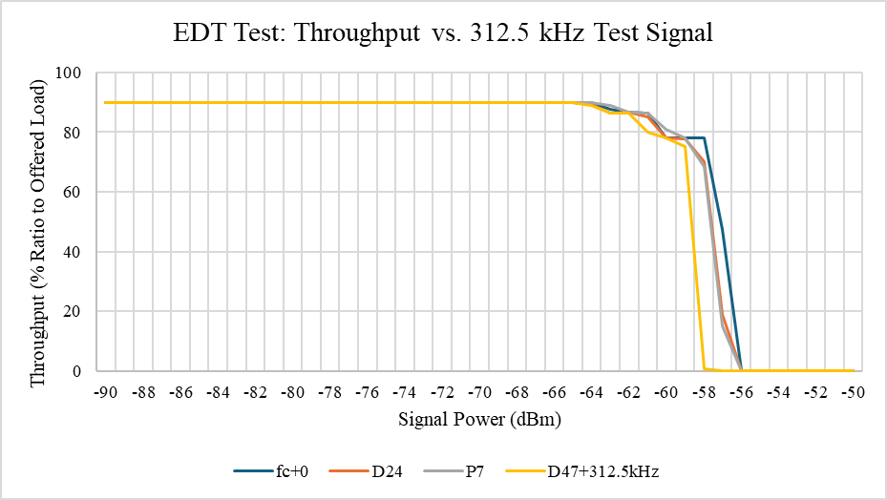
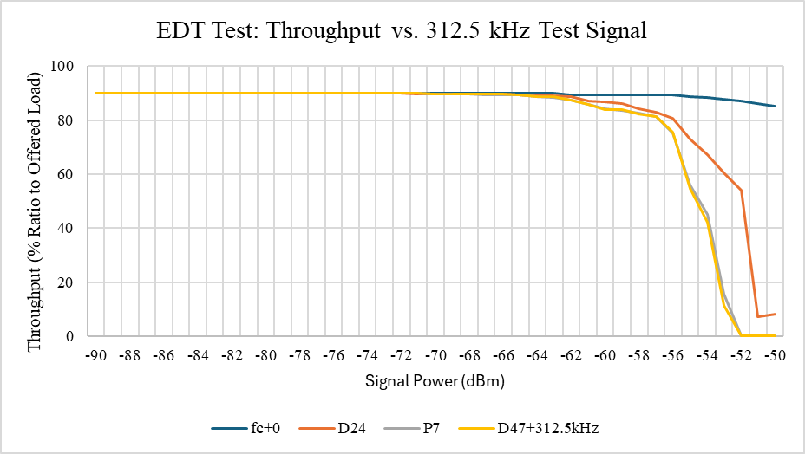
Test 2: Detection of 312.5 kHz wide test signals
Experiment:
Place a 312.5 kHz test signal at the center frequency, a random data tone (D24), a pilot tone (P7), and just right of the last sub-carrier (D47 + 312.5 kHz)
Observations:
Device 1 is able to perform CCA consistently at different carrier frequencies within the channel
Device 2 does not measure the test signal as accurately as the test 1 results, and is insensitive to the test signal at the center of the channel
Device 1
Device 2

Slide 19
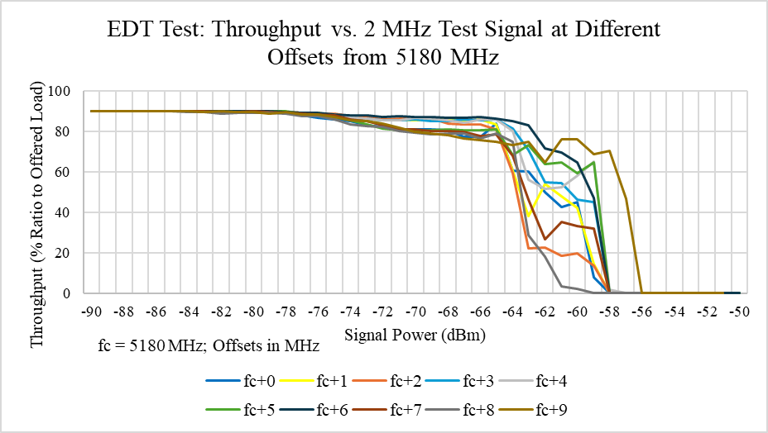
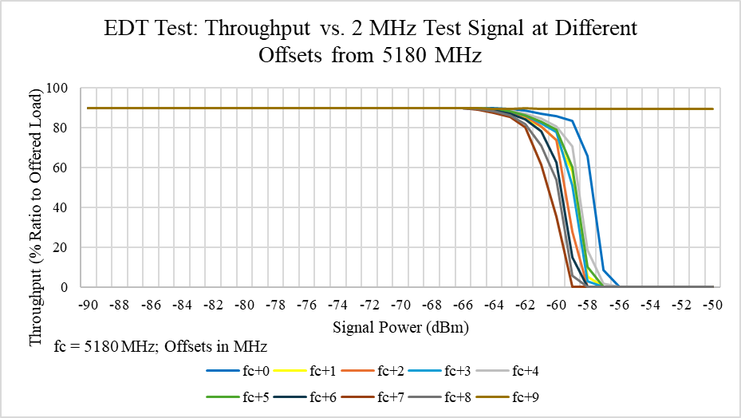
Test 3: Frequency Hopping—Part 1
Experiment
Evaluate energy detection performance in presence of a 2 MHz test signal placed at increasing 1 MHz offsets from center of IEEE 802.11 5 GHz channel 36
Observations
Both devices are less sensitive at the channel edge, in Device 2 CCA is not performed at all at 5189 MHz
Indicates device 2 has a better out-of-band rejection filter as this frequency is outside the occupied channel bandwidth
Device 1
Device 2

Slide 20
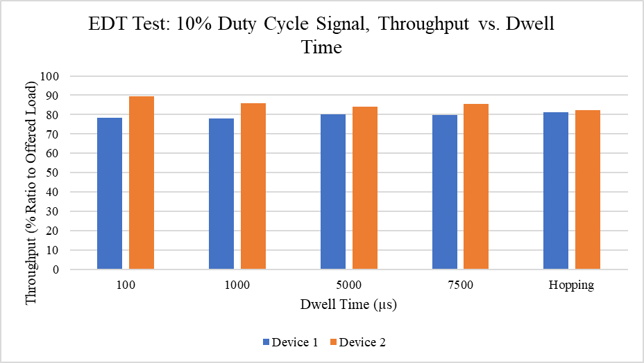
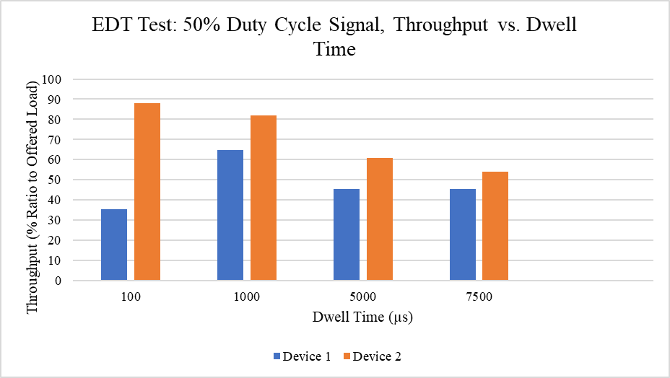
Test 4: Frequency Hopping—Part 2
Experiment
Energy detection evaluation in response to an on-off 2 MHz test signal above the measured EDT at 5180 MHz
Energy detection evaluation in the presence of a frequency hopping 2 MHz test signal above the measured EDT
Expected Throughput
Offered load selected to yield 90 % of the nominal throughput without test signal present
For a 10 % duty cycle, we would expect the device to perform CCA 10 % of the time, yielding an expected throughput of 0.9 × 90 % = 81 %
For a 50 % duty cycle, we would expect the device to perform CCA 50 % of the time, yielding an expected throughput of 0.5 × 90 % = 45 %
Observations:
Device 1 experiences expected throughput for longer dwell times
Device 2 experiences better than expected throughput for short dwell times, and expected throughput for longer dwell times

Slide 21
Receiver-side Tests
Packet reception performance in the presence of simultaneously inserted interference signals

Slide 23
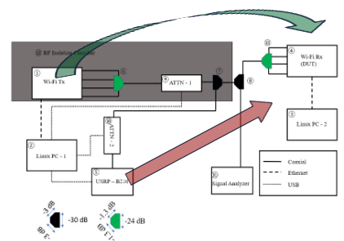
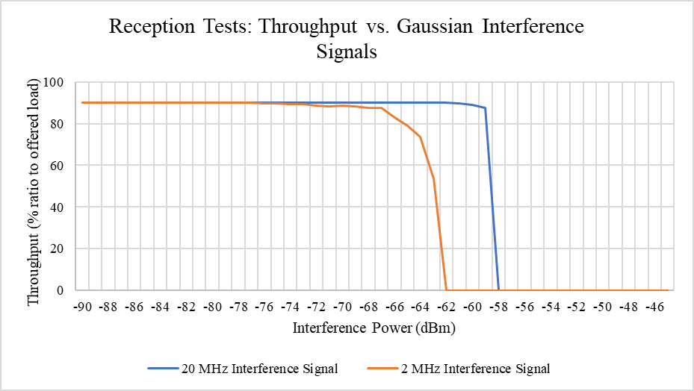
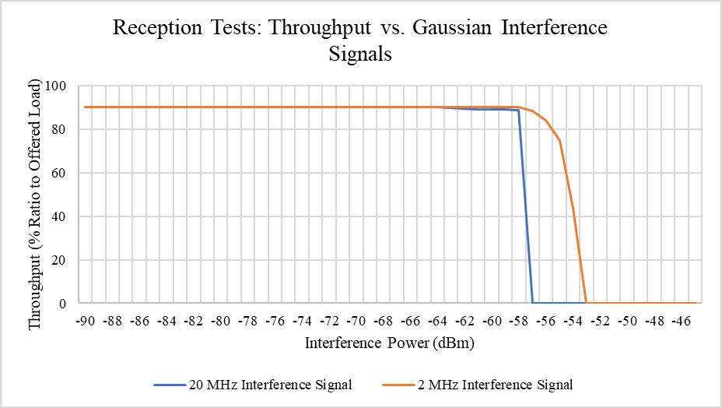
Test 1: Broadband vs. Narrowband
Experiment:
MCS: IEEE 802.11a BPSK ½
P_{RX}: −50 dBm
20 MHz vs. 2 MHz Gaussian interference signals centered @ f_{c} = 5180 MHz
The Wi-Fi station acting as an AP on the transmitter side dissociates on low acknowledgement
Observation:
Both devices disconnect at the same power level for a 20 MHz signal at around –57 dBm and −58 dBm respectively
Device 1 is more impacted by the 2 MHz signal, whereas device 2 is more impacted by the 20 MHz signal
Device 1
Device 2

Slide 24
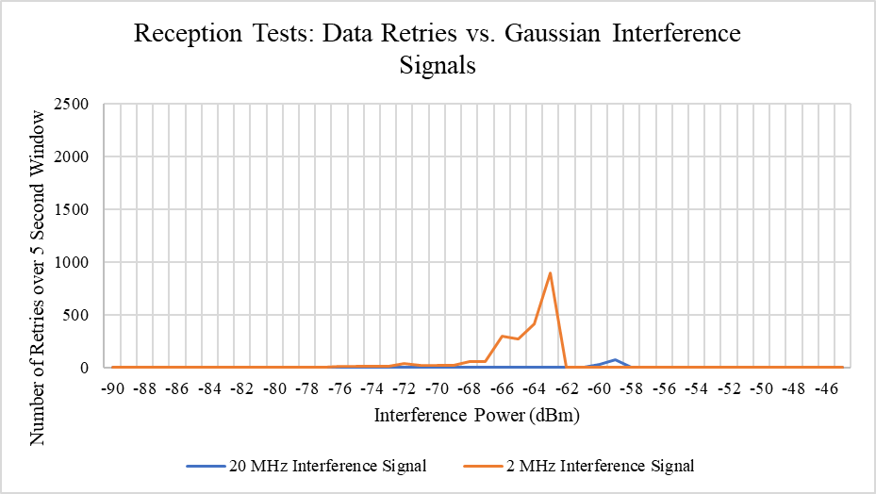
Test 1: Additional Supporting Metrics
On the receiver side, we observe the data retries concurrently with the throughput for device 1
We see that the number of retransmissions increases proportionally to the throughput drop, indicating that loss in throughput at the receiver side is due to packet loss
Without loss of generality, this trend holds true for all receiver side coexistence tests
Device 1

Slide 25
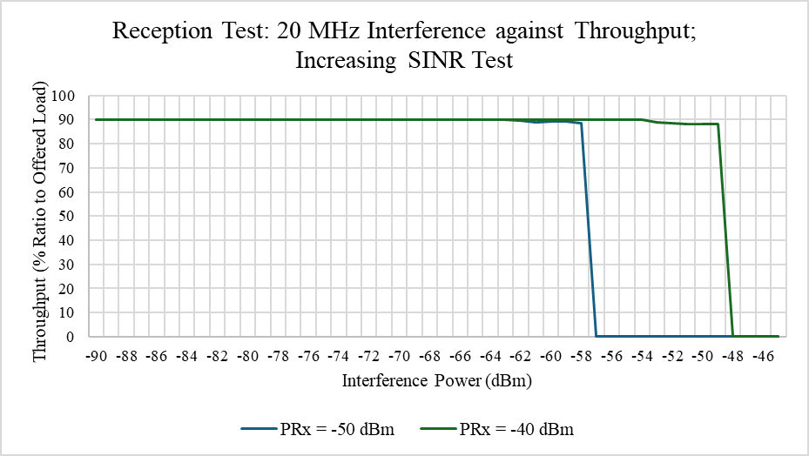
Test 1: Additional Supporting Metrics—Device 2
Although we are unable to view the radio statistics on device 2, it needs to be verified that a loss of throughput is not a result of CCA
To rule out CCA as the reason for a throughput loss, varying P_{RX} should vary the point where the connection is lost accordingly
As shown to the right, increasing P_{RX} increases the point at which the connection is dropped

Slide 26
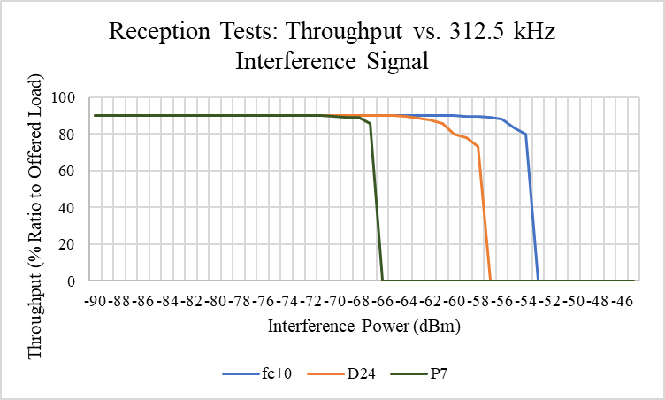
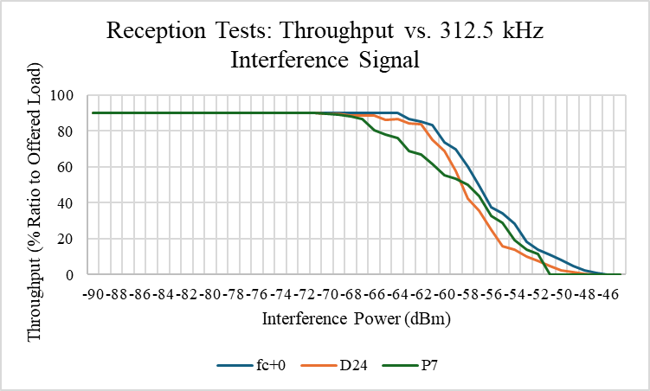
Test 2: 312.5 kHz Interference to Assess Sub-Carrier Susceptibility
Experiment
MCS: IEEE 802.11a BPSK ½
P_{RX}: −50 dBm
312.5 kHz interference signal placed at the center frequency, a random data tone (D24) and a random pilot tone (P7)
The Wi-Fi station acting as an AP on the transmitter side dissociates on low acknowledgement
Observation
In device 1, it is clear that interfering with a pilot sub-carrier is more harmful to the Wi-Fi traffic than a data sub-carrier, and interfering at the null tone has minimal impact as expected
In device 2, these discrepancies are less noticeable, although the dissociation point for the three cases follow the same order as device 1
Device 1
Device 2

Slide 27
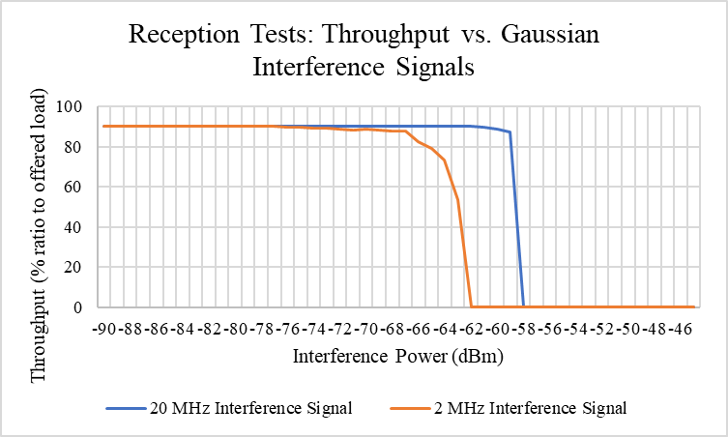
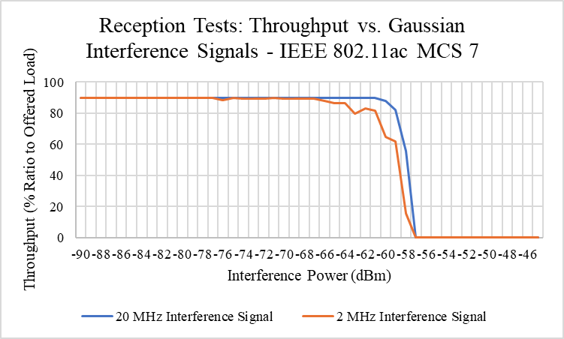
Test 3: Higher-Order MCS
Experiment
MCS: IEEE 802.11ac MCS 7
P_{RX} increased to −35 dBm
To account for higher order MCS
Assess 20 MHz and 2 MHz interference signals @ f_{c} = 5180 MHz (100 % Duty Cycle)
Evaluate if error detection and correction mechanisms offer better performance
Can only perform test on Device 1 due to limited MCS control on OpenWRT
Observations
We still see a greater throughput loss in the presence of narrowband interference
We see less drastic of a difference between broadband and narrowband interference signals
IEEE 802.11a BPSK 1/2 Results
IEEE 802.11ac MCS 7 Results

Slide 28
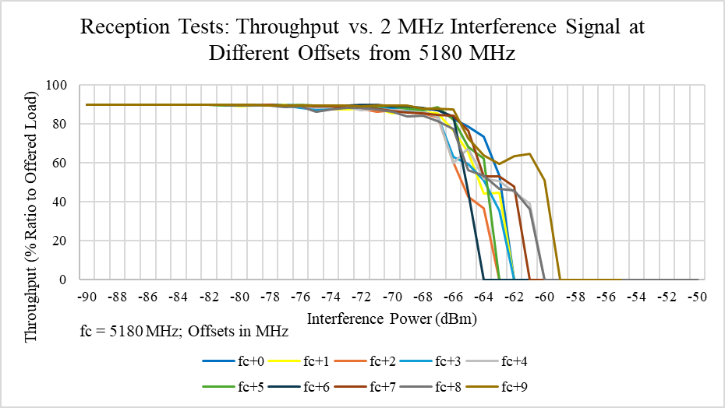
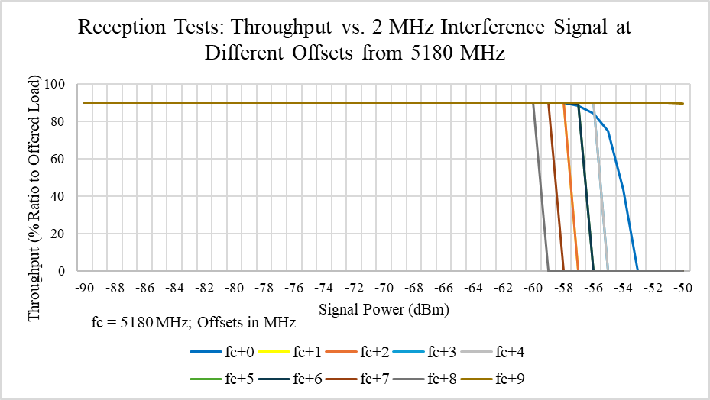
Test 3: Frequency Hopping Part 1
Experiment
MCS: IEEE 802.11a BPSK ½
P_{RX} = −50 dBm
Assess 2 MHz interference placed at f_{c} = 5180 MHz + {0, 1, 2, 3, 4, 5, 6, 7, 8, 9} MHz
Observations
Both devices are least sensitive to the test signal placed at the edge of the channel, with device 2 not dissociating up to an interference power of –50 dBm at this frequency placement
Device 1
Device 2

Slide 29
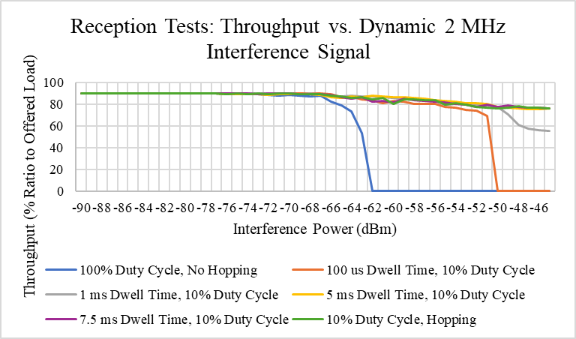
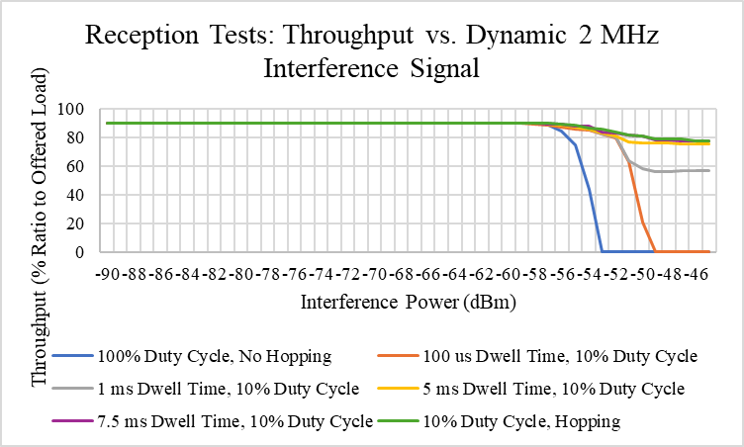
Test 3: Frequency Hopping Part 2
Experiment:
MCS: IEEE 802.11a BPSK ½
P_{RX} = −50 dBm
Run a 2 MHz interference signal with different dwell times and duty cycles at 5180 MHz
Run the interference using the described hopping algorithm
Observations
Short dwell-times cause connection to dissociate due to every packet experiencing interference for a fraction of the packet duration
Hopping with a 7.5 ms dwell-time and a 10 % duty cycle is equivalent to using an on-off signal with the same parameters at 5180 MHz, both of these result in the least throughput loss
Device 1
Device 2

Slide 30
Side-By-Side Analysis of Transmitter and Receiver Results

Slide 31
Compared to device 2, device 1 struggles to accurately detect narrowband traffic
Device 2 is more robust against narrowband traffic than device 1
Device 1
Device 1
Device 2
Device 2

Slide 32
Device 1 performs CCA better at the center frequency where there is a notch than device 2
Device 2 has a sharper filter in that a signal at the channel edge, which is outside the occupied bandwidth, is not detected
Device 1 is more sensitive to narrowband traffic at the receiver side than device 2
Device 1
Device 1
Device 2
Device 2

Slide 33
Adaptive Energy Detection Threshold

Slide 35
Background
While assessing the CCA mechanism of two additional commercial devices with the same chipset manufacturer, an adaptive energy threshold was observed
Noise Floor visibly increases in the presence of Gaussian Test signal, proportional to the test signal power
The EDT is calculated internally within the device as the: EDT Value = adapted noise floor + fixed offset
In some cases, this causes the device to become “deaf” to the test signal after some time and not defer its transmissions
Primarily in response to 20 MHz Gaussian Test Signal

Slide 36
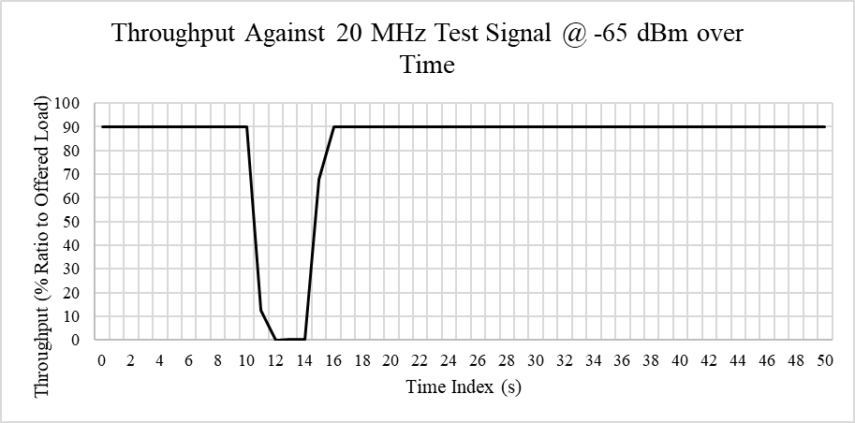
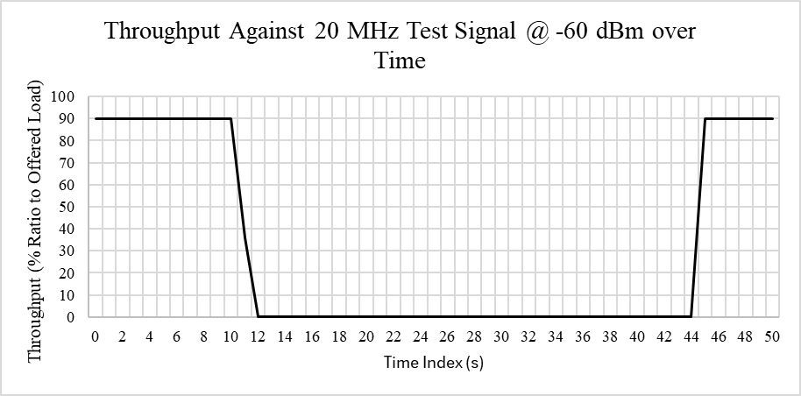
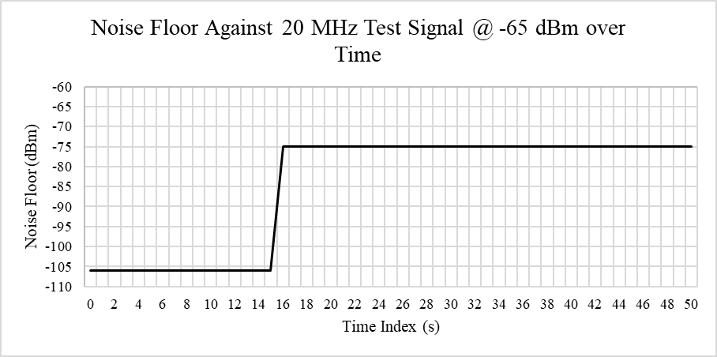
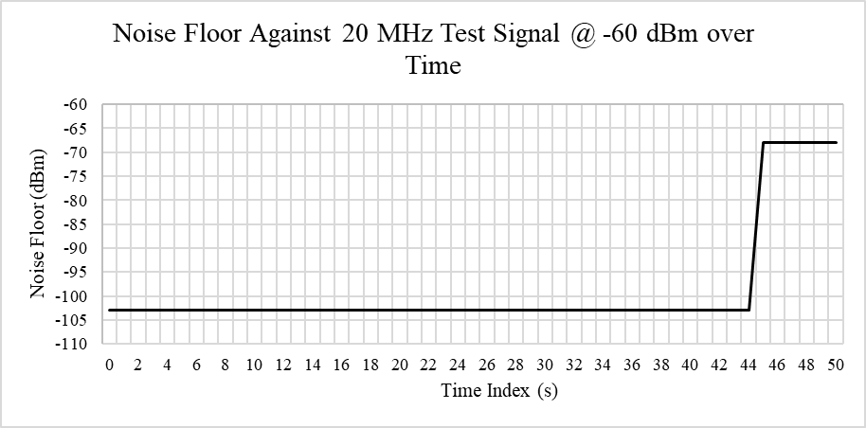
Time-Domain Visualization of Noise Floor Calibration
Device 3
Device 4

Slide 37
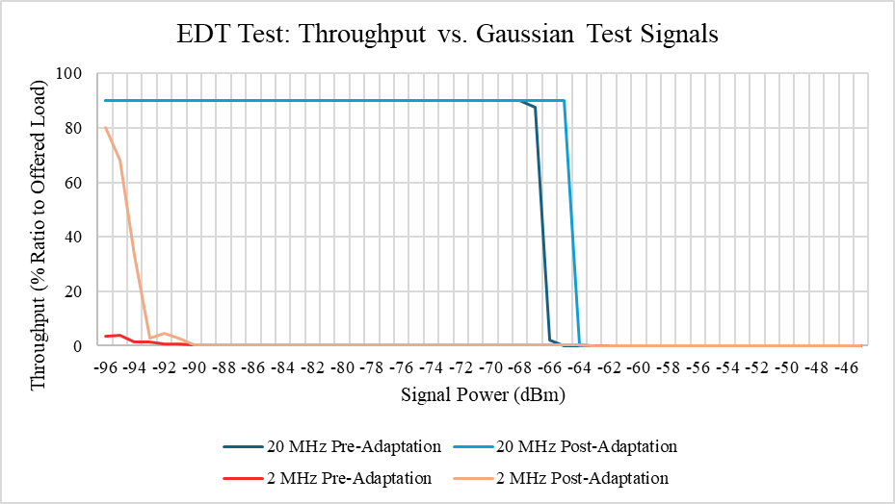
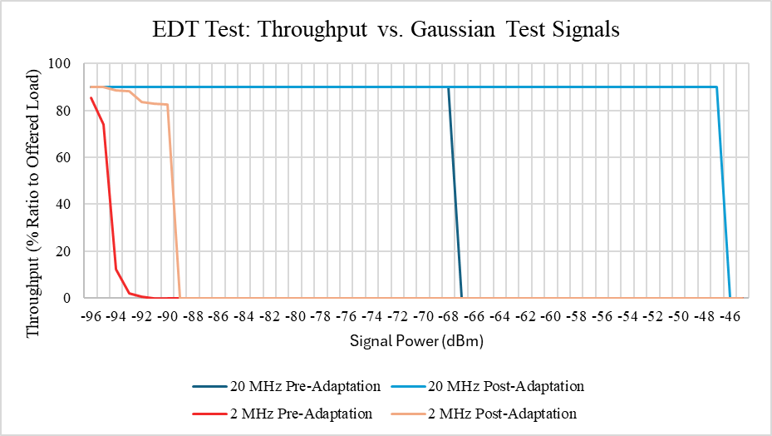
Impact on Throughput
Experiment:
Assess Energy Detection level of transmitting device using 20 MHz and 2 MHz test signals both before and after internal noise floor calibrations
Country Code set to Canada
Test signal transmitted at f_{c} = 5180 MHz
Device 4 uses IEEE 802.11n BPSK ½ due to configuration limitations
Observations
In both cases, the noise floor calibration allows for higher transmission over the 20 MHz test signal
Both devices measure narrowband signals very inaccurately and backoff even at low signal powers
Device 3
Device 4

Slide 38
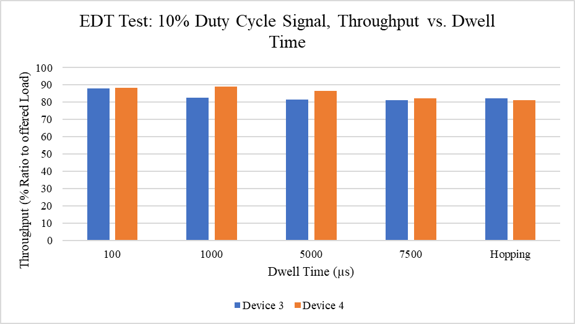
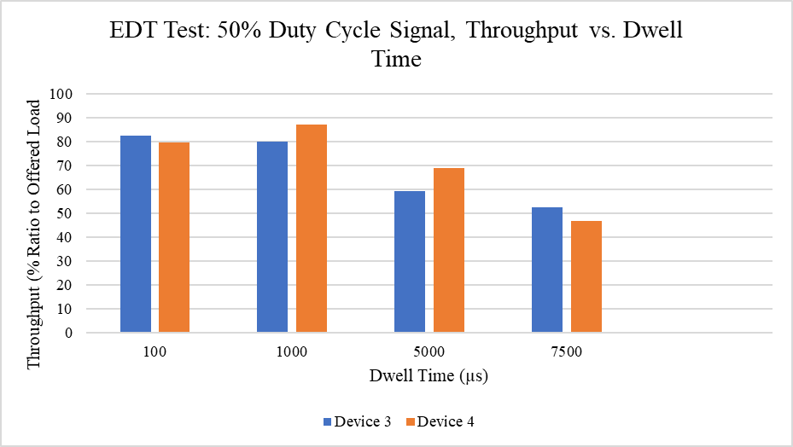
NB FH Impact
Experiment:
Assess the impact of dynamic 2 MHz test signals on these devices at a power level above the experimental EDT
Observations
In all cases better than expected throughput is achieved indicating that NB FH traffic does not have a disproportional impact on these devices' ability to perform CCA

Slide 39
Conclusions
From our test results, narrowband traffic is not detected nor accounted for in the device design compared with broadband traffic by these commercial and enterprise-grade Wi-Fi devices
From our test results, rapid NB FH traffic does not disproportionately impact Wi-Fi's performance, and as demonstrated is less detrimental to an ongoing Wi-Fi connection
From our test results, there appear to be several inconsistencies amongst device implementations between different manufacturers and between the IEEE 802.11-2020 standards

Slide 40
References
[1] European Conference of Postal and Telecommunications Administrations, “ECC Decision (20)01 on the Harmonised Use of the Frequency Band 5945-6425 MHz for Wireless Access Systems Including Radio Local Area Networks (WAS/RLAN),” approved Nov. 20th, 2020.
[2] J.-L. Aufran, “Bluetooth LE To Support 6 GHz Frequency Band,” CNXSOFT, Nov. 21st, 2022. [Online]. Available: https://www.cnx-software.com/2022/11/21/bluetooth-le-6-ghz-frequency-band
[3] IEEE 802.11 Working Group, “IEEE Standard for Information technology—Telecommunications and information exchange between systems—Local and metropolitan area networks—Specific requirements—Part 11: Wireless LAN Medium Access Control (MAC) and Physical Layer (PHY) Specifications,” IEEE Std. IEEE Std 802.11-2020, 2020.

Slide 41
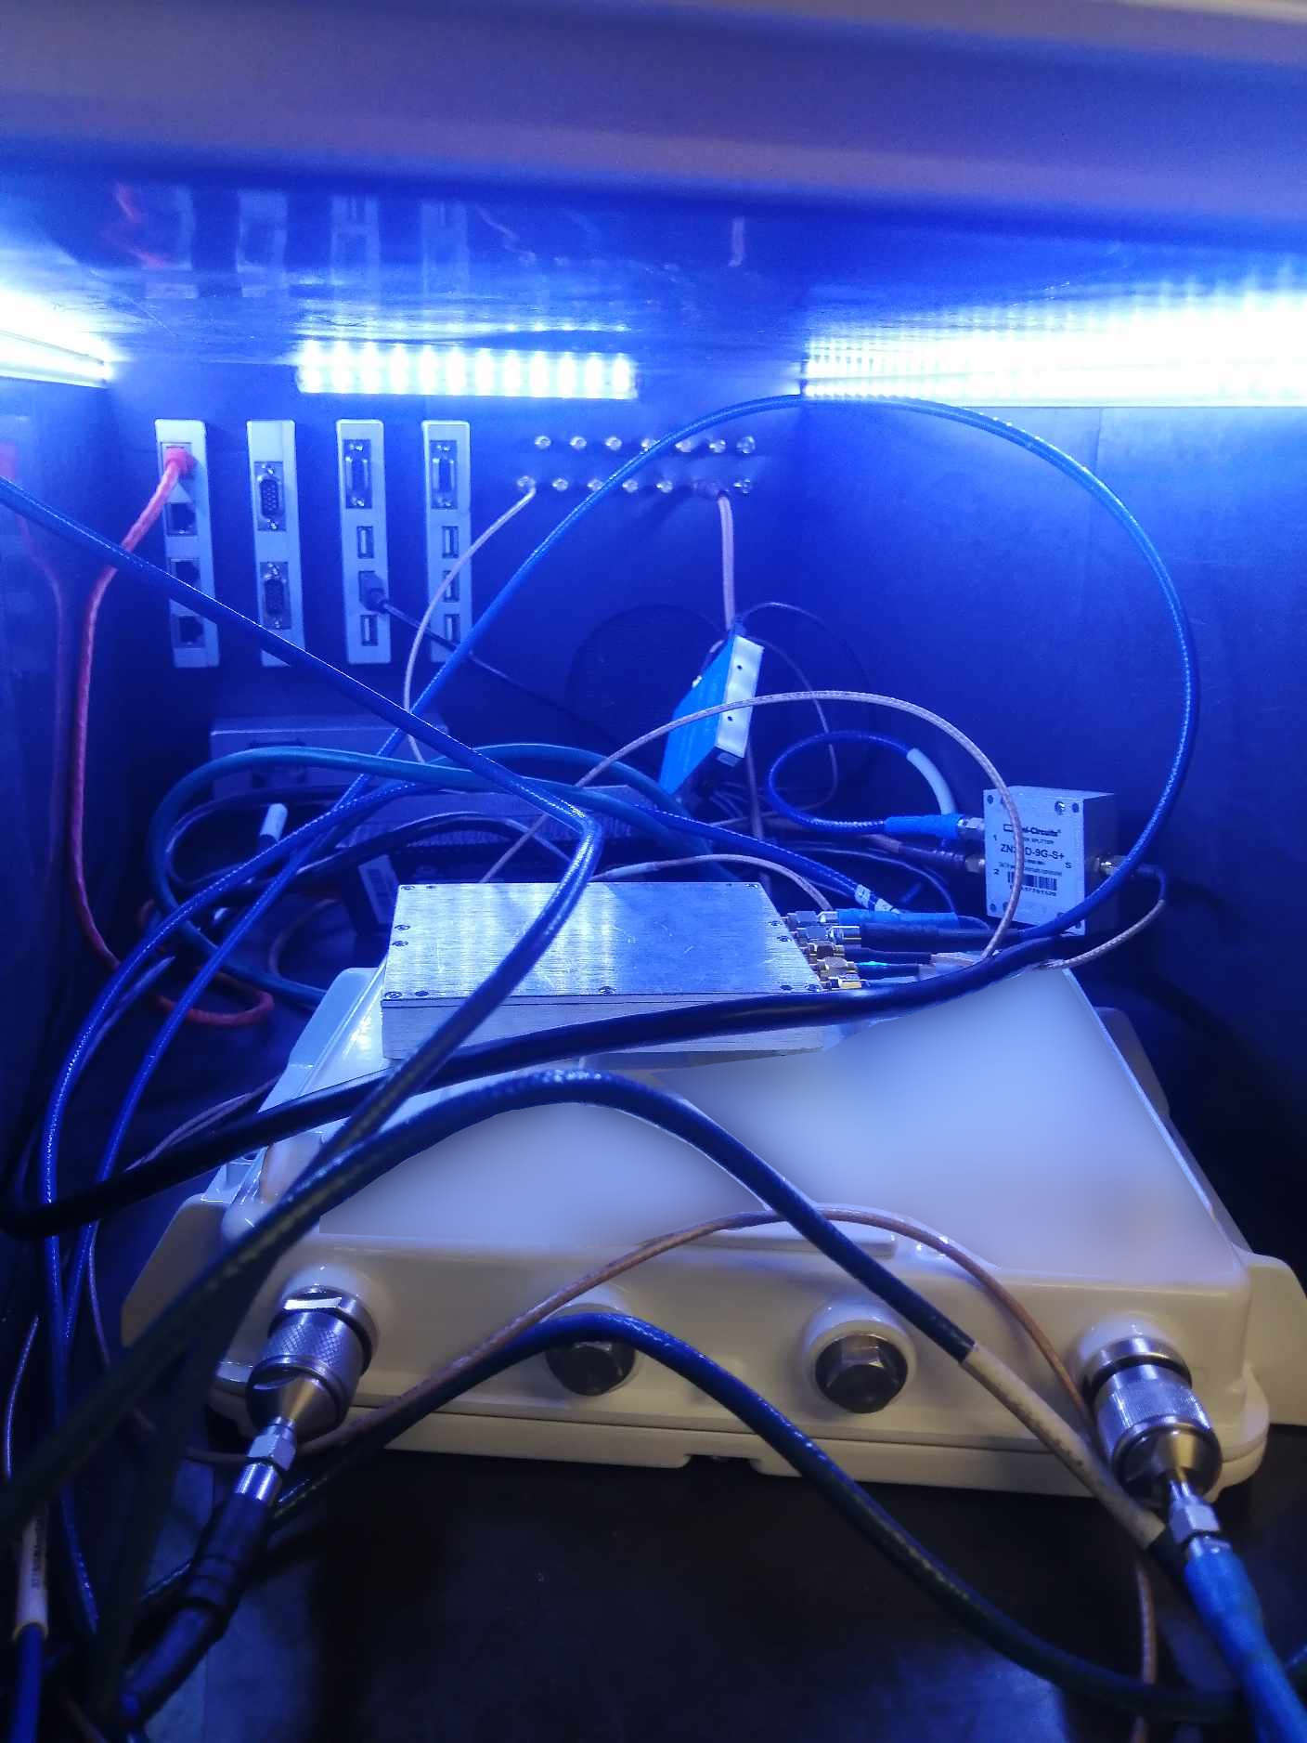
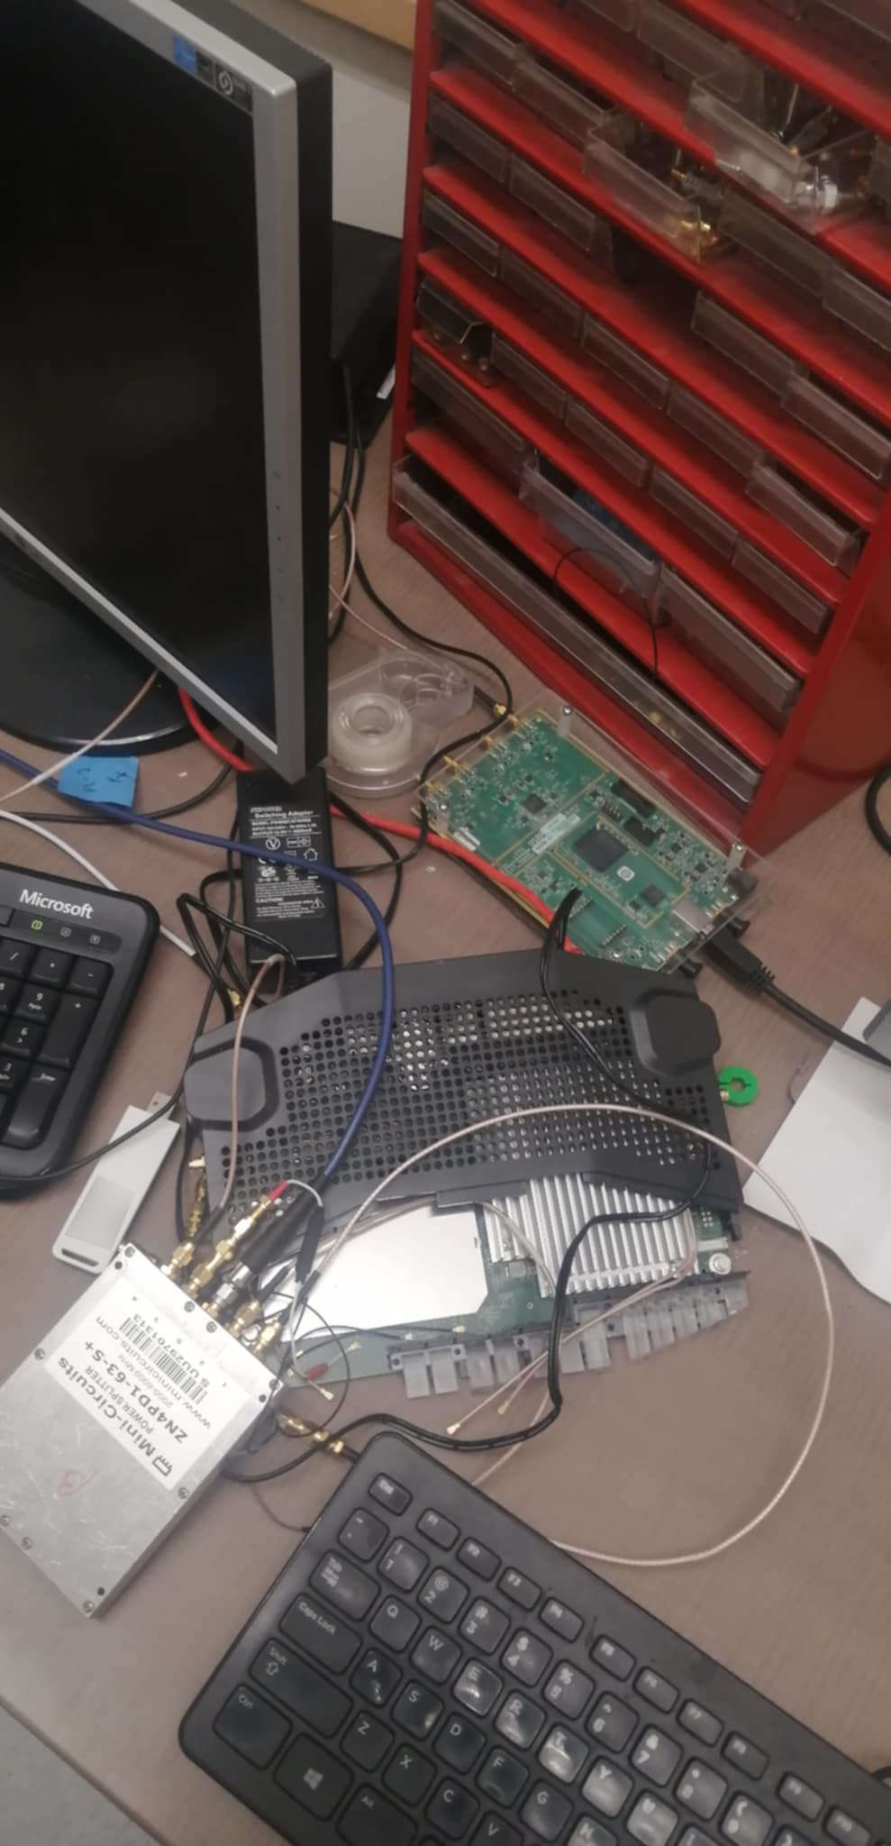
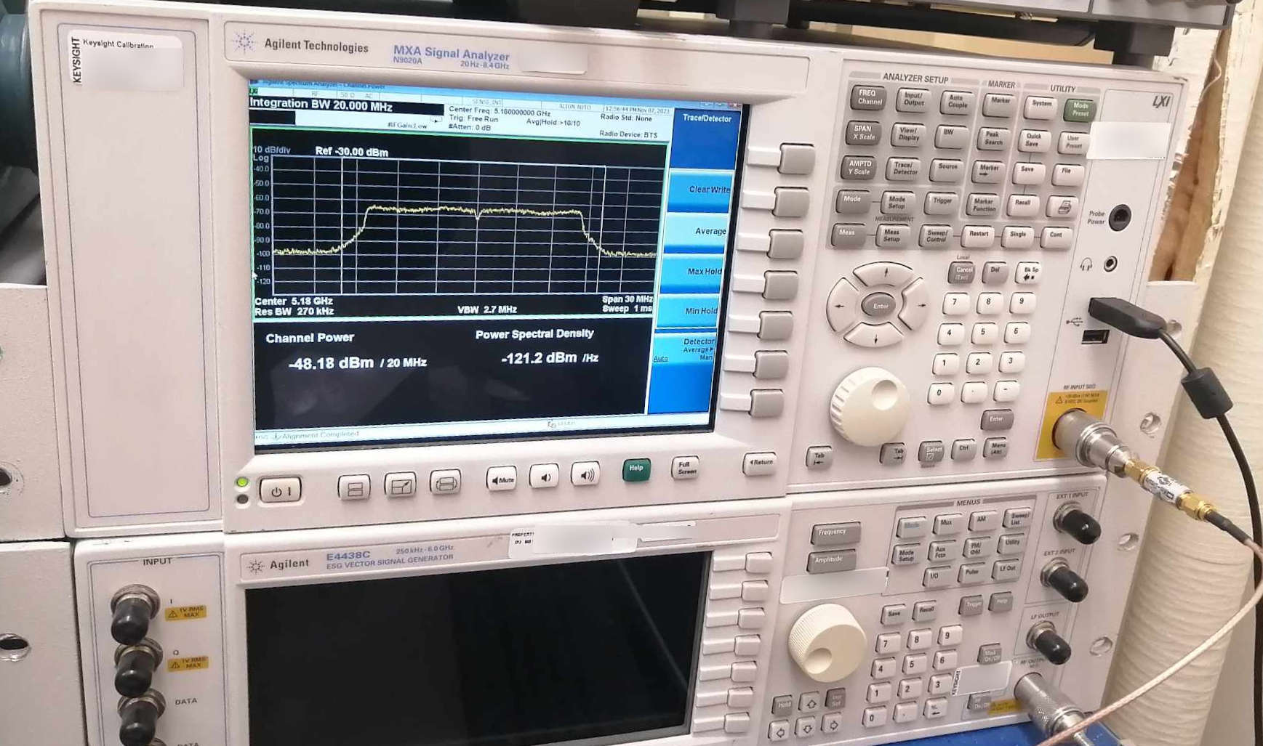
Appendix: Testbed Pictures

