Slide 1
Backhaul Design and Channel Setting for Multi-AP
Date: 2024-05-12
Authors:

Slide 2
Introduction
There are lot of contributions/discussion about Multi-AP in TGbn, such as Seamless Roaming [1], Coordinated R-TWT [2], Coordinated TDMA [3], Coordinated Spatial Reuse [4], Coordinated BF [5], and so on.
These features assume an environment with multiple non-collocated AP MLDs, but there are differences among proposals as to what configurations are assumed. For example,..
Backhaul Design: How to design backhaul between multiple AP MLDs.
Primary Channel Setting: How to set the channel for multiple AP MLDs.
In this contribution, we propose a direction (idea) of backhaul design and channel setting for Multi-AP.

Slide 3
Discussion Point 1: Backhaul Design (1/3)
Currently, there are two existing configurations for interfaces between AP MLDs in 11spec.
Over-the-Air
Communicate with other AP MLDs over the air by Wi-Fi signal.
Over-the-DS
Communicate with other AP MLDs over Distributed System (DS) via wired cable.
In the future, it may be necessary to consider the new interface currently under discussion related to Seamless Roaming (This is out of scope in this document).
Existing Interface
Over-the-DS
New Interface
Over-the-Air
AP
MLD2
Distribution System (DS)
Distribution System (DS)
Virtual MLD
AP
MLD1
AP
MLD3
AP
MLD1
AP
MLD2
AP
MLD3
AP
MLD1
AP
MLD2
AP
MLD3

Slide 4
Discussion Point 1: Backhaul Design (2/3)
If multiple AP MLDs can communicate via DS, it is desirable from an overhead perspective that some information be exchanged over the DS. For example..
Context(SN/PN, etc) for Seamless Roaming
R-TWT Scheduling Information for SP-based coordination
Resource Information for TXOP-based coordination
However, it may be preferable (or even necessary) to transmit signals over the air instead of DS in the following cases
Need to set NAV for surrounding STA MLDs by some signal (such as Trigger frame).
Need to synchronize at RF/PHY level for simultaneous transmission (such as Coordinated SR/BF)
Use case where AP MLDs are configured like a mesh network.
We propose 11bn should support the information exchange between AP MLDs in both “over-the-DS” and “over-the air” cases.

Slide 5
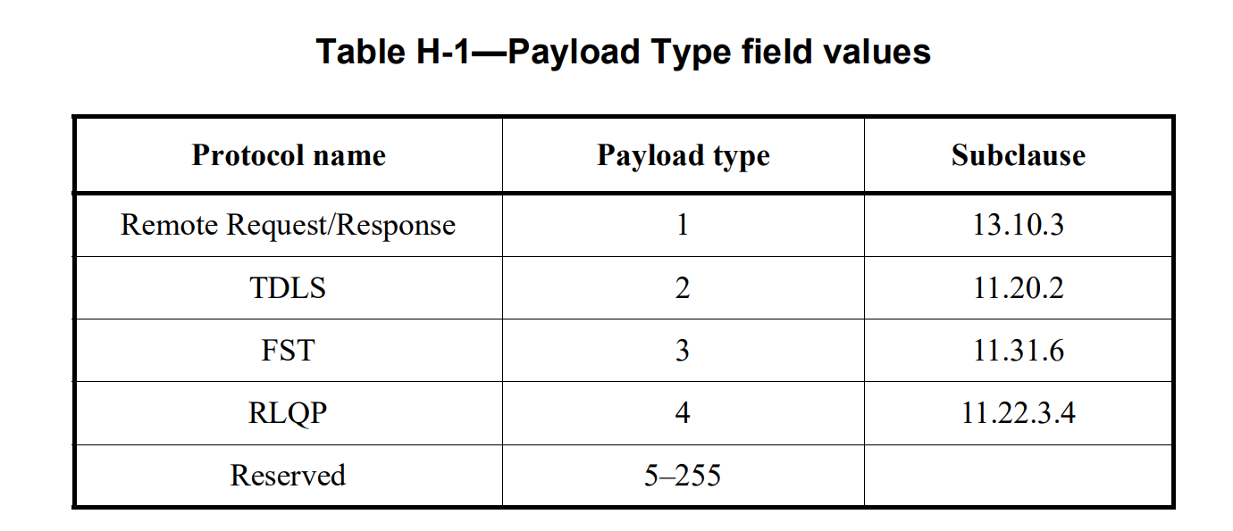
Discussion Point 1: Backhaul Design (3/3)
Regarding the "over-the-DS", some existing functions (TDLS and FST) can transmit frames defined in 802.11 as Ether frame.
An Ethertype 89-0d has been assigned for IEE802.11 specification.
With such an assignment, 802.11spec can define that control information/data are to be transferred over the DS.
We propose to define a new payload type in Ethertype 89-0d with 11bn so that information exchanged between APs required for AP coordination can be transmitted as Ether frame.
Annex.H in IEEE802.11-2020 [7]

Slide 6
Discussion Point 2: Primary Channel Setting (1/2)
AP coordination is used when multiple APs share the same channel resource.
Basically, multiple AP MLDs should be able to set up different primary channels [6]
An AP MLD can set a different primary channel than other AP MLD when the other AP MLDs’ primary channel is within its own operating BSS channel.
This configuration method is superior in performance to configuring the same primary channel because there is no mutual contention for TXOP on the primary channel.
If AP MLD has low latency (LL) traffic and doesn’t require transmission over wide-band (e.g., 80/160MHz), the AP MLD can transmit over a narrow bandwidth(e.g., 20MHz) without coordination with other AP MLDs.
If AP MLD has heavy traffic and requires transmission over wide-band (e.g., 80/160MHz), the AP MLD will attempt the cooperation with the other AP MLDs whose primary overlap with the transmitted signal.

Slide 7
Discussion Point 2: Primary Channel Setting (2/2)
On the other hand, depending on the distance between AP MLDs and the frequency of handover, it may be better to set up the same primary channel
Over-the-air information exchange between AP MLDs should be covered in multiple primary channels. It may shorten the transmission distance because signals must be transmitted over a wide bandwidth.
As for Seamless Roaming, difficult to set “Dual Link” because STA MLD cannot scan multiple primary channel at the same time.
We propose the following condition for AP coordination channel settings in 11bn:
AP MLD should at least set up the primary channel within the BSS Operating Channel of other AP MLD(s) with which it may cooperate.
Whether or not to align the primary channel can be determined by some situations, such as distance between APs.

Slide 8
Summary
We proposed the direction (idea) of backhaul design and channel setting for Multi-AP.
Backhaul Design
Information exchange between AP MLDs should support both “over-the-air” and “over-the-DS”.
New Payload Type should be defined so that frames defined in the 802.11 spec for AP coordination can be transmitted over Ether LAN.
Primary Channel Setting
AP should at least set up the primary channel within the BSS Operating Channel of other AP(s) with which it may cooperate.
APs are using the same primary channel and APs are using different primary channel.
If the distance between APs is large or frequent hand-over occurs, the same primary channel is desirable.
If the distance between APs is narrow and handover does not occur frequently, different primary channel is preferred

Slide 9
Update from r0 to r1
SP1: Minor change
SP2: Minor change
SP3: channel setting rule added limitation to at least Coordinated SR/BF (other multi-ap coordination modes are TBD)
After some offline discussion, many members said that in the case of Roaming, APs should also operate on a completely separate primary channel (i.e., outside the BSS operating channel).
Since other coordination schemes (especially Coordinated SR/BF with Motion Pass) are based on the assumption that the same frequency resources are used, the condition is to transmit on the same channel during wideband transmission, even if the primary channel is different.

Slide 10
References
[1] 2023/1884r2, “Seamless Roaming,” Duncan Ho (Qualcomm Technologies, Inc.)
[2] 2023/2022r1, “r-TWT for multi-AP follow up,” Laurent Cariou (Intel)
[3] 2023/1895r2, ”C-TDMA frame sequence, ” Abhishek Patil (Qualcomm)
[4] 2023/1868r2, “Coordinated-Spatial-Reuse-Design,” Jason Yuchen Guo (Huawei)
[5] 2024/0011r0, “Coordinated Spatial Nulling (C-SN) Concept,” MaxLinear
[6] 2020/0560r0, “Multi-AP Configuration and Resource Allocation,” Po-Kai Huang (Intel)

Slide 11
SP #1
Do you agree that 11bn supports the information exchange between AP MLDs in both wireless backhaul and wired backhaul?

Slide 12
SP #2
Do you agree that 11bn defines a new Payload Type for Ethertype 89-0d frame body so that Ether LAN can carry the newly defined frames in 802.11bn for exchanging information between multiple AP MLDs?

Slide 13
SP #3
Do you agree the following conditions for Multi-AP channel settings in 11bn:
AP can set a different primary channel than other AP(s) in Multi-AP coordination.
AP should at least set the primary channel within the BSS operating channel of other AP(s) in Multi-AP coordination.
Multi-AP coordination means at least Coordinate SR and Coordinated BF. Other modes are TBD.

