Slide 1
Unequal Modulation Patterns and new MCS
Date: 2024-03-08
Authors:

Slide 2
Introduction
Unequal modulation has been proposed as a promising technology for UHR to enhance MIMO RvR [1~3].
In this contribution, we will further
evaluate the useful unequal modulation combinations, and
investigate the benefits of adding several new MCSs.

Slide 3
UEQM QAM levels
UQAM examples:
E.g. 2ss, [256-QAM, 64-QAM]
E.g. 4ss, [1K-QAM, 1K-QAM, 256-QAM, 64-QAM]
Existing MCS has 7 QAM level
Limit the maximum Nss for UEQM to 4ss
Potentially has 100+ options for 4ss
Need to reduce the combinations to balance gain and complexity

Slide 4
2x2: UEQM QAM Level
1 QAM level diff: achieves most gains, but show losses across entire SNR range
2 QAM level diff: achieves all gains with minor difference

Slide 5
4x4: UEQM QAM Level
Both 3ss and 4ss EQM/UEQM are considered at each SNR points
Limit to 2 QAM level difference achieves most of the gains, with limited impact in middle SNR region

Slide 6
UEQM QAM Selection
Balancing between gain and complexity, 2-level QAM difference is sweet spot.
For up to 4ss, still up to 9 combinations for each MCS.
Further mode reduction to choose the most useful QAM combinations:
Per-channel PER simulation and per-channel per-SNR point optimal rate selection, i.e. manual rate adaptation
Rate selection criteria
UEQM is selected if >=4% higher goodput than existing MCS
Smallest rate difference between adjacent MCSs is 8% (MCS11 to MCS12)
Avoid the biased count at high-SNR points
Rank each UEQM QAM pattern by the occurrence count
across all configurations, channels, SNR points

Slide 7
4x4 UEQM Rank
3ss
4ss
M1 | M2 | M2 | %
0 | 0 | -2 | 25.93
0 | -1 | -2 | 22.22
0 | 0 | -1 | 18.52
0 | -1 | -1 | 11.11
0 | -2 | -2 | 11.11
0 | 0 | 0 | 11.11
M1 | M2 | M2 | M4 | %
0 | 0 | -1 | -2 | 21.05
0 | 0 | 0 | -2 | 15.79
0 | -1 | -2 | -2 | 15.79
0 | 0 | -1 | -1 | 10.53
0 | 0 | -2 | -2 | 10.53
0 | 0 | 0 | -1 | 10.53
0 | 0 | 0 | 0 | 10.53
0 | -1 | -1 | -2 | 5.26
Blos
M1 | M2 | M2 | %
0 | -1 | -2 | 25.93
0 | -1 | -1 | 25.93
0 | 0 | -1 | 18.52
0 | 0 | -2 | 14.81
0 | -2 | -2 | 14.81
M1 | M2 | M2 | M4 | %
0 | 0 | -1 | -2 | 20
0 | 0 | 0 | -2 | 14.29
0 | 0 | -1 | -1 | 14.29
0 | -1 | -2 | -2 | 14.29
0 | 0 | -2 | -2 | 11.43
0 | 0 | 0 | -1 | 11.43
0 | -1 | -1 | -2 | 11.43
0 | -1 | -1 | -1 | 2.86
DNLos

Slide 8
4x4 UEQM Choices
3ss:
4ss
M1 | M2 | M3
0 | 0 | -1
0 | 0 | -2
0 | -1 | -2
 | M1 | M2 | M3 | M4
 | 0 | 0 | -1 | -2
 | 0 | 0 | 0 | -2
Option 1 | 0 | -1 | -1 | -2
Option 2 | 0 | -1 | -2 | -2
Option 3 | 0 | 0 | -1 | -1
Option 4 | 0 | 0 | 0 | -1

Slide 9
DNLos 4x4 Goodput Gain
[0 0 0 -1] shows good benefits for the region that SNR saturates for certain QAM
Considering Tx power difference between MCSs, the pattern can help in more practical use cases.

Slide 10
BLos 4x4 Goodput Gain
[0 0 0 -1] shows good benefits for the region that SNR saturates for certain QAM
Considering Tx power difference between MCSs, the pattern can help in more practical use cases.

Slide 11
UEQM QAM Combinations
Propose UHR UEQM to define the following patterns
Note:
M is the modulation order index
M-1 refers to the modulation that is one order lower than M
M-2 refers to the modulation that is two orders lower than M
Total Nss | 1st ss | 2nd ss | 3rd ss | 4th ss
2ss | M | M-1
 | M | M-2
3ss | M | M | M-1
 | M | M | M-2
 | M | M-1 | M-2
4ss | M | M | M | M-1
 | M | M | M | M-2
 | M | M | M-1 | M-2

Slide 12
Thoughts on New MCS
Finer MCSs was discussed during 11be generation [4]
Revisit for UHR for RvR enhancement, especially for Nss=1 transmissions
New MCS definition can also help UEQM support
E.g. there is only one QAM (64 QAM) with rate 2/3

Slide 13
New MCS Selection
Per-channel PER simulation and per-channel per-SNR point optimal rate selection, i.e. manual rate adaptation
New rate selection criteria
New rate is selected if >=4% higher goodput than existing MCS
Smallest rate difference between adjacent MCSs is 8% (MCS11 to MCS12)
Avoid the biased count at high-SNR points
Rank each new rate by the occurrence count
across all configurations, channels, SNR points

Slide 14
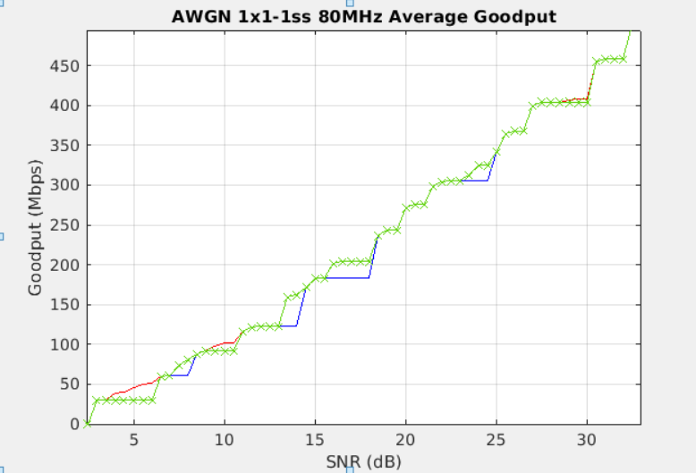
1x1-1ss AWGN
M | CR | Percentage %
16 QAM | 5/6 | 29.46
256 QAM | 2/3 | 14.5
16 QAM | 2/3 | 11.79
BPSK | 5/6 | 11.79
QPSK | 2/3 | 11.67
QPSK | 5/6 | 9.07
4K QAM | ½ | 5.89
BPSK | 2/3 | 5.83

Slide 15
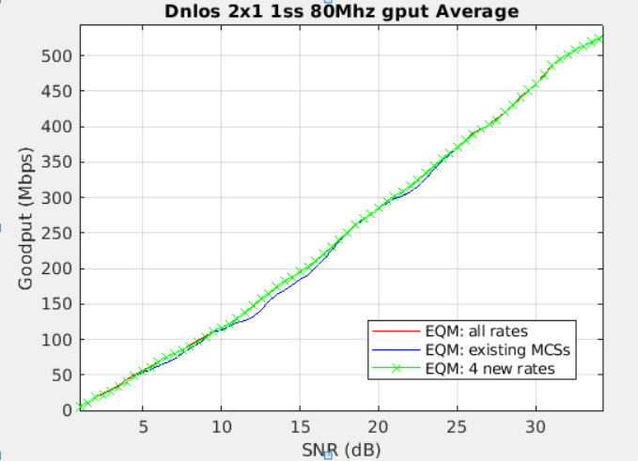
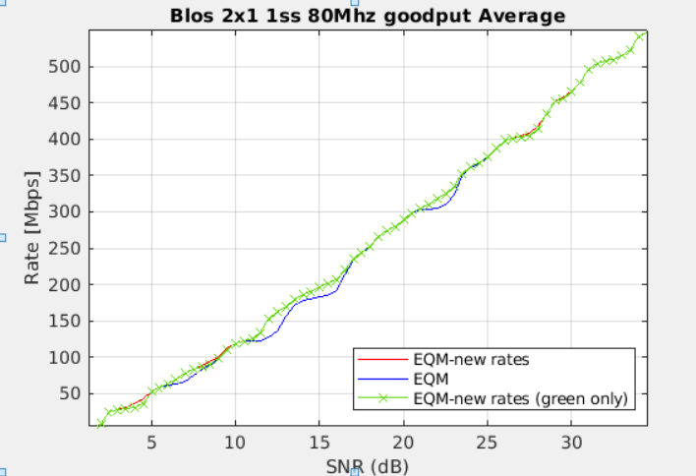
2x1-1ss
M | CR | Percentage %
16 QAM | 5/6 | 26.3
256 QAM | 2/3 | 22.18
16 QAM | 2/3 | 18.22
QPSK | 2/3 | 17.3
BPSK | 2/3 | 9.45
QPSK | 5/6 | 6.55
M | CR | Percentage %
16 QAM | 5/6 | 27.36
256 QAM | 2/3 | 20.9
16 QAM | 2/3 | 19.07
QPSK | 2/3 | 15.65
BPSK | 2/3 | 9.88
QPSK | 5/6 | 5.32
4K QAM | 1/2 | 1.82

Slide 16
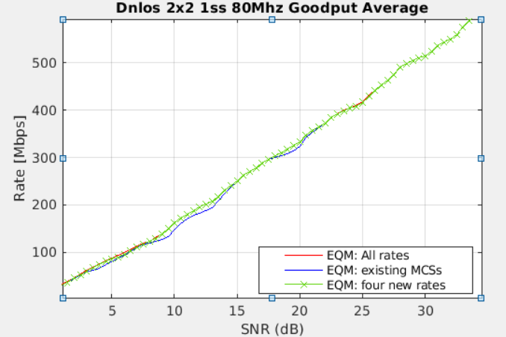
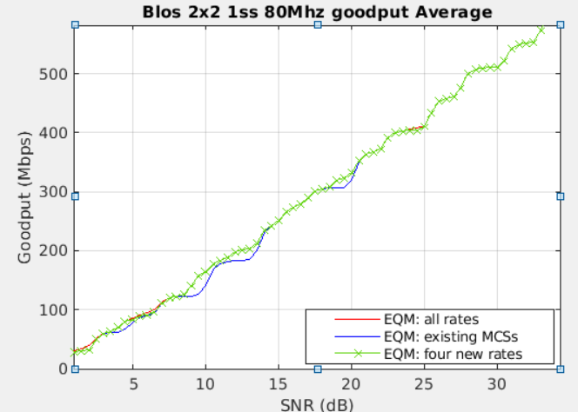
2x2-1ss
M | CR | Percentage %
16 QAM | 5/6 | 28.38
256 QAM | 2/3 | 20.98
16 QAM | 2/3 | 16.17
QPSK | 2/3 | 15.1
QPSK | 5/6 | 11.52
BPSK | 2/3 | 7.63
4K QAM | 1/2 | 0.23
M | CR | Percentage %
16 QAM | 5/6 | 28.64
256 QAM | 2/3 | 20.08
16 QAM | 2/3 | 18.18
QPSK | 2/3 | 14.17
BPSK | 2/3 | 9.09
QPSK | 5/6 | 8.79
4K QAM | 1/2 | 1..06

Slide 17
New Rate Selection
Modulation | CR | %
16 QAM | 5/6 | 29.57
256 QAM | 2/3 | 21.76
16 QAM | 2/3 | 17.41
QPSK | 2/3 | 15.49
BPSK | 2/3 | 5.15
QPSK | 5/6 | 5.37
BPSK | 5/6 | 3.05
4K QAM | ½ | 2.15
64 QAM | 1/2 | 0.03
Top four new MCSs benefits Nss=1 RvR the most.
Suggest to add.

Slide 18
Summary
Suggest to limit UEQM QAM combination
Suggest to add four new MCS
QPSK-2/3, 16QAM-2/3, 16QAM-5/6, 256QAM-2/3
Total Nss | 1st ss | 2nd ss | 3rd ss | 4th ss
2ss | M | M-1
 | M | M-2
3ss | M | M | M-1
 | M | M | M-2
 | M | M-1 | M-2
4ss | M | M | M | M-1
 | M | M | M | M-2
 | M | M | M-1 | M-2

Slide 19
Reference
[1] 11-24/16, uhr-mimo-rvr-enhancement-with-unequal-modulation
[2] 11-24/0113, unequal-modulation-in-mimo-txbf-in-11bn
[3] 11-24/0117, improved-tx-beamforming-with-ueqm
[4] 11-20/0083, impacts-of-mcs-set-expansion-on-11be-link-adaptation

Slide 20
SP
Do you support to include in the 11bn SFD:
Define unequal modulation over different spatial streams?

Slide 21
SP
Do you agree to add the following text into 11bn SFD?
11bn defines unequal modulation with the same coding rate for beamformed multi-stream transmission to single STA in full bandwidth or on a RU/MRU in OFDMA.

Slide 22
SP
Do you agree that the maximum QAM level difference for UEQM is 2?

Slide 23
SP
Do you agree to UEQM QAM combination for Nss=2 is limited to two as below?
[M M-1]
[M, M-2]
Note:
M is the modulation order index
M-1 refers to the modulation that is one order lower than M
M-2 refers to the modulation that is two orders lower than M

Slide 24
SP
Do you agree to UEQM QAM combination for Nss=3 is limited to three as below?
[M, M, M-1]
[M, M, M-2]
[M, M-1, M-2]
Note:
M is the modulation order index
M-1 refers to the modulation that is one order lower than M
M-2 refers to the modulation that is two orders lower than M

Slide 25
SP
Do you agree to UEQM QAM combination for Nss=4 is limited to three as below?
[M, M, M, M-1],
[M, M, M, M-2],
[M, M, M-1, M-2]
Note:
M is the modulation order index
M-1 refers to the modulation that is one order lower than M
M-2 refers to the modulation that is two orders lower than M

Slide 26
SP
Do you agree to define UEQM QAM combination as below?
Total Nss | 1st ss | 2nd ss | 3rd ss | 4th ss
2ss | M | M-1
 | M | M-2
3ss | M | M | M-1
 | M | M | M-2
 | M | M-1 | M-2
4ss | M | M | M | M-1
 | M | M | M | M-2
 | M | M | M-1 | M-2

Slide 27
SP
Do you agree to add the following text to 11bn SFD?
UEQM QAM combination for Nss=2 is limited to two as:
[M, M-1]
[M, M-2]
Note:
M is the modulation order index
M-1 refers to the modulation that is one order lower than M
M-2 refers to the modulation that is two orders lower than M

Slide 28
SP
Do you agree to add the following text to 11bn SFD?
UHR defines unequal modulation only for LDPC.

Slide 29
Appendix

Slide 30
Simulations
80MHz, DNLos/BLos channels
4x EHT-LTF, LDPC code
Tx: SVD Tx BF
Rx: Linear receiver
Modulations: BPSK to 4K-QAM
Unequal modulation: Up to 3 QAM gap between two streams
Coding [1/2, 2/3, 3/4, 5/6]
Equal modulation with new rates: all QAM + all CR (28 rates)
Comparison:
Equal modulation (EQM)
Equal modulation with new rates (EQM-new)
Unequal modulation (UEQM)

Slide 31
4x2 UEQM QAM level
1-level QAM: achieves most gains, but show losses in several SNR segments
2-level QAM: achieves all gains with minor difference

Slide 32
BLos 4x4 QAM Option RvR

Slide 33
DNLos 4x4 QAM Option RvR

Slide 34
Consideration on Tx Power Difference
4K QAM
1K QAM
Tx power backoff is needed for high QAMs to meet EVM
Some regions experience SNR saturation for lower QAM
More use cases to choose [M M M M-1] pattern

Slide 35
DNLos 4x4 without 4K-QAM

Slide 36
BLos 4x4 without 4K-QAM

