Slide 1
DRU Tone Plan for 11bn
Date: 2024-03-08
Authors:
Name | Affiliations | Address | Phone | Email
Shengquan Hu | Mediatek | 2840 Junction Ave. San Jose, CA, 95134 |  | shengquan.hu@mediatek.com
Jianhan Liu |  |  |  | jianhan.liu@mediatek.com
Thomas Pare

Slide 2
Introduction
Motion has been passed in January IEEE meeting to support Distributed tone RU (DRU) for a UHR TB PPDU transmission
We have shared our thoughts on DRU tone plan design criteria, methodology and principle in [1]. Our studies show that 26-tone RU based DRU tone plan design can:
  Meet all the design target and achieve optimal power boost gain
  Preserve hierarchical structure as RRU
  Have better tone distribution pattern with either uniformly or near-uniformly distributed
  Make easier for channel smoothing and simpler for scheduling/signaling
In this contribution, we will share the detailed DRU tone plan design:
  DRU subcarrier indices table for BW20/40/80
  DRU power boost gains
  DRU tone distribution range
  DRU tone distribution pattern
  PAPR performance

Slide 3
Recap: Design principles & methodologies of DRU Tone Plan [1]
Minimize the number of tones per 1MHz to achieve the optimal power boost gain.
Preserve DRU hierarchical structure as regular RU (RRU) to allow simple signaling of DRUs
  The key for simplified signaling of DRU is to have a one-to-one mapping between the RRU and the DRU
  Can reuse the existing RU Allocation table
Allow scheduling and distributing different size DRUs without overlapped tones.
Do not introduce new RU sizes to avoid extra different data rates and extra parsing, interleaving and encoding.
Achieve uniform or near-uniform tone distribution pattern for simpler smoothing algorithms, easier phase tracking, ICI cancellation and improved diversity
Reserve enough edge tones (e.g. left-12 & right-11 tone for DRU on BW40/80, left-6 & right-5 for BW20)
Reserve enough DC tones (e.g. >= 5 DC tone for DRU on BW40/80, >=3 for BW20)
Tones distributed over non-OFDMA tone plan range
DRU subcarrier indices generation with PAPR reduction
Slide 3
Shengquan Hu, Mediatek Inc.

Slide 4
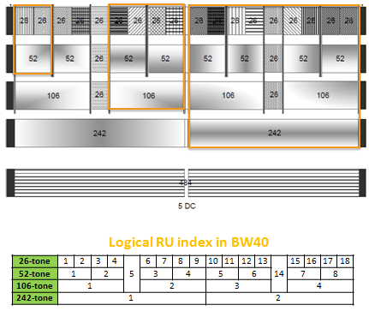
Recap: 26-tone RU Based DRU Design Method [1]
RRU has the hierarchical structure, i.e. each larger size RU consists of corresponding smaller size RU tones
For an example, one RRU52 consists of tones from two RRU26s, one RRU106 consists of tones from two RRU52 or four RRU26 with two extra tones
This hierarchical structure makes RU assignment & scheduling much simpler
It would be desired for DRU to maintain the similar hierarchical structure to make DRU implementation more friendly, scheduling easier and signaling simpler
RRU Index in BW40
DRU will maintain the similar hierarchical structure as RRU
Slide 4
Shengquan Hu, Mediatek Inc.

Slide 5
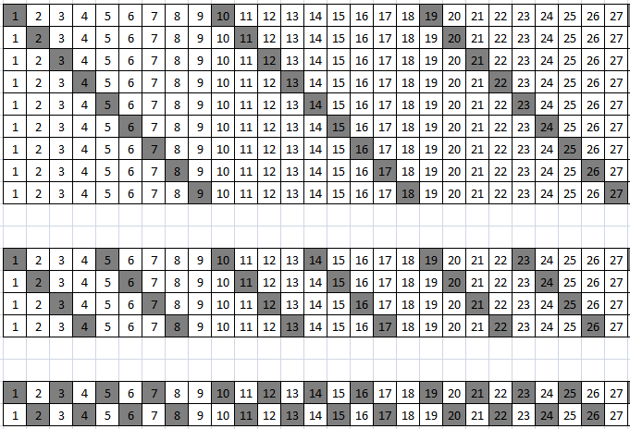
DRU Tone Pattern and Power Boost Gains for BW20
The key for design 26-tone RU based DRU design method is to generate 26-tone DRU
To achieve the optimal gains and better distribution patterns, the tone separation distance/or repetition period Np=9 is used for DRU26 on distribution BW =20MHz
Using DRU26 as a basic building block, all other sized DRUs are built on DRU26 tone plan
  DRU52 is built from two DRU26
  DRU106 is built from four DRU26 or two DRU52 with 2 extra padding tones
  The extra padding tones are chosen to make tone distribution pattern in repeatable fashion and without causing tone-overlap issue
Np=9
Np=9
DRU26
(1 tone in one repetition period)
 | BW20
 | #Tone/MHz | Power Boost (dB)
DRU26 | 2 | 8.13
DRU52 | 3 | 6.37
DRU106 | 6 | 3.56
Np=9
Np=9
DRU52
(2 tones in one repetition period)
Np=9
Np=9
DRU106
(4 tones in one repetition period)
Slide 5
Shengquan Hu, Mediatek Inc.

Slide 6
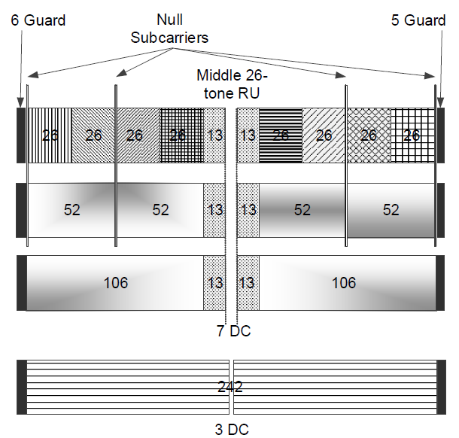
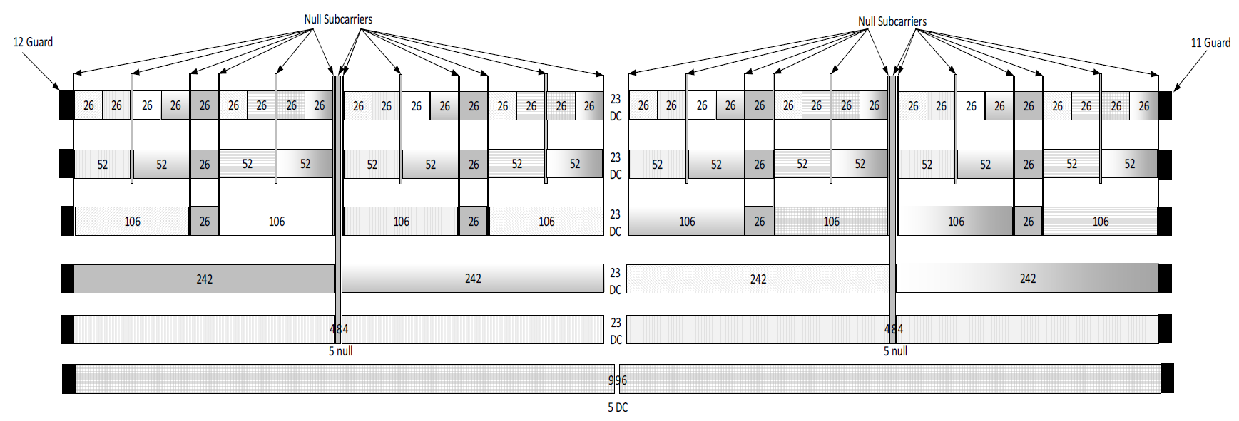
DRU Distribution Range on 20MHz
RRUs Span over 245 tones in range of [-122:-3,3:122] on BW20
DRU within 242-tone region for each 20MHz subblock on BW80/160/320
This allows DRU distribution on 20MHz subblock for puncture mode or 20MHz only operating devices
-120
120
DRUs Span over 241 tones in range of [-120:-2,2:120]
all DRUs keep >= 3 DC tones
Slide 6
Shengquan Hu, Mediatek Inc.

Slide 7
DRU Tone Plan for Distribution Bandwidth 20MHz
Keep the same number of DRUs as RRUs on BW20:
  9 DRU26; 4 DRU52D; 2 DRU106
Same format of indexing/ordering and tone plan table as RRU
Reuse existing RU Allocation table for trigger frame signaling
Data and pilot subcarrier indices for Distributed Tone RUs (DRUs) in a 20 MHz UHR PPDU
DRU type | DRU index and subcarrier range
26-tone DRU i=1:9 | DRU1 [-120:9:-12, 6:9:114] | DRU2 [-116:9:-8, 10:9:118] | DRU3 [-118:9:-10, 8:9:116] | DRU4 [-114:9:-6, 12:9:120] | DRU5 [-112:9:-4, 5:9:113]
 | DRU6 [-119:9:-11, 7:9:115] | DRU7 [-115:9:-7, 11:9:119] | DRU8 [-117:9:-9, 9:9:117] | DRU9 [-113:9:-5, 4:9:112]
52-tone DRU i=1:4 | DRU1 26-tone [DRU1, DRU2] |  | DRU2 26-tone [DRU3, DRU4]
 | DRU3 26-tone [DRU6, DRU7] |  | DRU4 26-tone [DRU8, DRU9]
106-tone DRU i=1:2 | DRU1 26-tone [DRU1~4], [-3, 3] |  | DRU2 26-tone [DRU6~9], [-2, 2]
Slide 7
Shengquan Hu, Mediatek Inc.

Slide 8
Example Illustration of DRU Distribution Pattern: DRU on BW20
26-tone DRUs are uniformly distributed over 20MHz
52-tone DRUs are near-uniformly distributed over 20MHz
Slide 8
Shengquan Hu, Mediatek Inc.

Slide 9
Example Illustration of DRU Distribution Pattern: DRU on BW20
106-tone DRUs are near-uniformly distributed over 20MHz
Slide 9
Shengquan Hu, Mediatek Inc.

Slide 10
Example Illustration of DRU on BW20
Different sized DRUs can be scheduled without tone-overlapping
The following illustrates 1st DRU26 (blue) and 2nd DRU52 (red) are assigned to two users
Slide 10
Shengquan Hu, Mediatek Inc.

Slide 11
PAPR Performance of DRU on BW20
Data and pilot subcarrier indices for Distributed Tone RUs (DRUs) in a 20 MHz UHR PPDU
DRU type | DRU index and subcarrier range
26-tone DRU i=1:9 | DRU1 [-120:9:-12, 6:9:114] | DRU2 [-116:9:-8, 10:9:118] | DRU3 [-118:9:-10, 8:9:116] | DRU4 [-114:9:-6, 12:9:120] | DRU5 [-112:9:-4, 5:9:113]
 | DRU6 [-119:9:-11, 7:9:115] | DRU7 [-115:9:-7, 11:9:119] | DRU8 [-117:9:-9, 9:9:117] | DRU9 [-113:9:-5, 4:9:112]
For PAPR reduction, tone spacing of all DRU26 are with an integer multiple of Np = 9
DRU26 achieves similar PAPR as RRU26 on BW20
Slide 11
Shengquan Hu, Mediatek Inc.

Slide 12
PAPR Performance of DRU on BW20
For DRU52/106 on BW20, PAPR is about 0.5~0.7dB higher than RRU @90%- percentile
Slide 12
Shengquan Hu, Mediatek Inc.

Slide 13
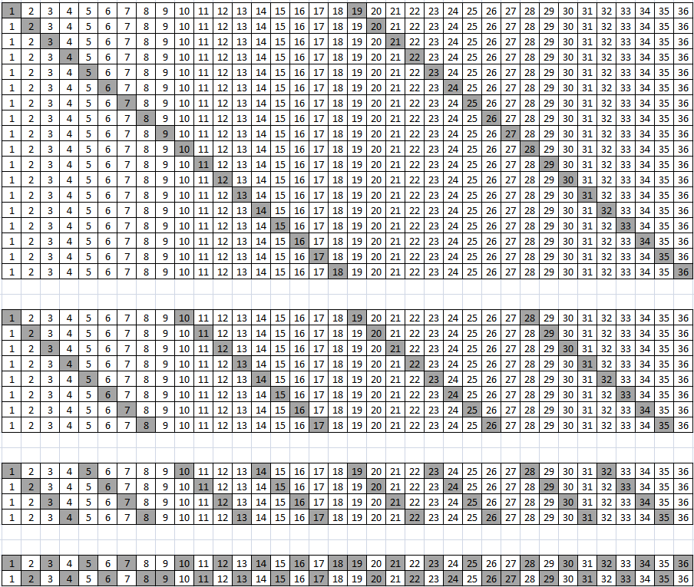
DRU Tone Pattern and Power Boost Gains for BW40
Tone separation distance/or repetition period Np=18 is used for DRU26 on distribution BW =40MHz
Using DRU26 as a basic building block, all other sized DRUs are built on DRU26 tone plan
  DRU52 is built from two DRU26
  DRU106 is built from four DRU26 or two DRU52 with 2 extra padding tones
  DRU242 is built from two DRU106 and one DRU26 with 4 extra padding tones
  The extra padding tones are chosen to make tone distribution pattern in repeatable fashion and without causing tone-overlap issue
Np=18
DRU26
 | BW40
 | #Tone/MHz | Power Boost (dB)
DRU26 | 1 | 11.14
DRU52 | 2 | 8.13
DRU106 | 3 | 6.37
DRU242 | 7 | 2.69
(1 tone in one repetition period)
Np=18
DRU52
(2 tones in one repetition period)
DRU106
Np=18
(4 tones in one repetition period)
DRU242
Np=18
(9 tones in one repetition period)
Slide 13
Shengquan Hu, Mediatek Inc.

Slide 14
DRU Tone Plan for Distribution Bandwidth 40MHz
Data and pilot subcarrier indices for Distributed Tone RUs (DRUs) in a 40 MHz UHR TB PPDU
DRU type | DRU index and subcarrier range
26-tone DRU i=1:18 | DRU1 [-242:18:-26, 10:18:226] | DRU2 [-233:18:-17, 19:18:235] | DRU3 [-238:18:-22, 14:18:230] | DRU4 [-229:18:-13, 23:18:239] | DRU5 [-225:18:-9, 27:18:243] | DRU6 [-240:18:-24, 12:18:228]
 | DRU7 [-231:18:-15, 21:18:237] | DRU8 [-236:18:-20, 16:18:232] | DRU9 [-227:18:-11, 25:18:241] | DRU10 [-241:18:-25, 11:18:227] | DRU11 [-232:18:-16, 20:18:236] | DRU12 [-237:18:-21, 15:18:231]
 | DRU13 [-228:18:-12, 24:18:240] | DRU14 [-234:18:-18, 18:18:234] | DRU15 [-239:18:-23, 13:18:229] | DRU16 [-230:18:-14, 22:18:238] | DRU17 [-235:18:-19, 17:18:233] | DRU18 [-226:18:-10, 26:18:242]
52-tone DRU i=1:8 | DRU1 [-242:9:-17, 10:9:235] |  | DRU2 [-238:9:-13, 14:9:239] |  | DRU3 [-240:9:-15, 12:9:237]
 | DRU4 [-236:9:-11, 16:9:241] |  | DRU5 [-241:9:-16, 11:9:236] |  | DRU6 [-237:9:-12, 15:9:240]
 | DRU7 [-239:9:-14, 13:9:238] |  | DRU8 [-235:9:-10, 17:9:242]
106-tone DRU i=1:4 | DRU1 26-tone [DRU1~4], [-8,5] |  | DRU2 26-tone [DRU6~9], [-6,7] |  | DRU3 26-tone [DRU10~13], [-7,6]
 | DRU4 26-tone [DRU15~18], [-5,8]
242-tone DRU i=1:2 | DRU1 106-tone [DRU1~2],26-tone DRU5, [-244,-4,3,9] |  | DRU2 106-tone [DRU3~4],26-tone DRU14, [-243,-3,4,244]
Slide 14
Shengquan Hu, Mediatek Inc.

Slide 15
Example Illustration of DRU Distribution Pattern: DRU on BW40
26-tone DRUs are perfect uniformly distributed over 40MHz
52-tone DRUs are perfect uniformly distributed over 40MHz
Slide 15
Shengquan Hu, Mediatek Inc.

Slide 16
Example Illustration of DRU Distribution Pattern: DRU on BW40
106-tone DRUs are near-uniformly distributed on 40MHz
Slide 16
Shengquan Hu, Mediatek Inc.

Slide 17
PAPR Performance of DRU on BW40
Apply same design methodology as DRU on BW20, for PAPR reduction, tone spacing of all DRU26 are with an integer multiple of Np = 18; tone spacing of all DRU52 are with an integer multiple of Np = 9;
DRU26 achieves similar PAPR as RRU26 on BW40; DRU52 achieves similar PAPR as RRU52 on BW40;
Slide 17
Shengquan Hu, Mediatek Inc.

Slide 18
PAPR Performance of DRU on BW40
For DRU106/242 on BW20, PAPR is about 0.5~0.7dB higher than RRU @90% percentile
Slide 18
Shengquan Hu, Mediatek Inc.

Slide 19
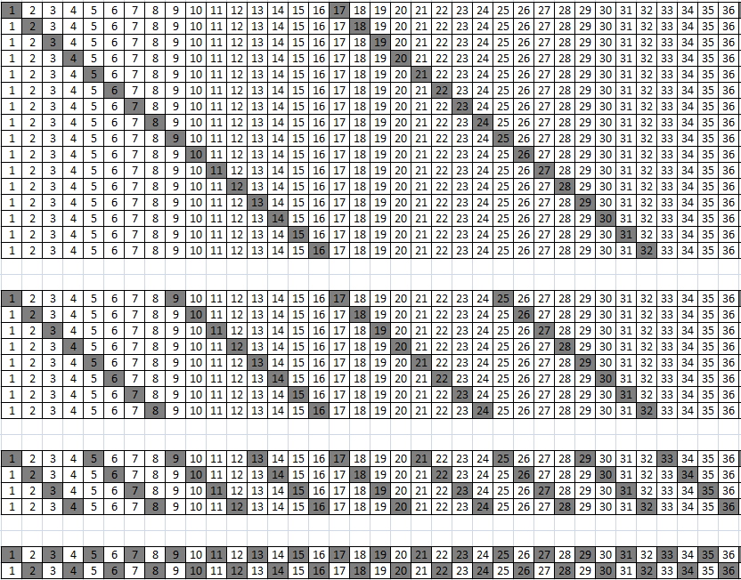
DRU Tone Pattern and Power Boost Gains for BW80
Tone separation distance/or repetition period Np=36 is used for DRU26 on distribution BW =80MHz
Using DRU26 as a basic building block, all other sized DRUs are built on DRU26 tone plan
  DRU52 is built from two DRU26
  DRU106 is built from four DRU26 or two DRU52 with 2 extra padding tones
  DRU242 is built from two DRU106 and one DRU26 with 4 extra padding tones
  DRU484 is built from two DRU242
  The extra padding tones are chosen to make tone distribution pattern in repeatable fashion and without causing tone-overlap issue
Make larger DRU242/484 perfect uniformly distributed instead of small DRU52/106, larger DRU will be benefit more better smoothing & lower PAPR from uniformly tone distribution
Np=36
DRU52
(2 tones in one repetition period)
 | BW80
 | #Tone/MHz | Power Boost (dB)
DRU52 | 1 | 11.14
DRU106 | 2 | 8.13
DRU242 | 4 | 5.12
DRU484 | 7 | 2.69
Np=36
DRU106
(4 tones in one repetition period)
DRU242
Np=36
(9 tones in one repetition period)
DRU484
Np=36
(18 tones in one repetition period)
Slide 19
Shengquan Hu, Mediatek Inc.

Slide 20
DRU Tone Plan for Distribution Bandwidth 80MHz
Data and pilot subcarrier indices for Distributed Tone RUs (DRUs) in a 80 MHz UHR TB PPDU
DRU type | DRU index and subcarrier range
52-tone DRU i=1:16 | DRU1 [-483:36:-51, 17:36:449],[-467:36:-35, 33:36:465] | DRU2 [-475:36:-43, 25:36:457],[-459:36:-27, 41:36:473] | DRU3 [-479:36:-47, 21:36:453],[-463:36:-31, 37:36:469] | DRU4 [-471:36:-39, 29:36:461],[-455:36:-23, 45:36:477]
 | DRU5 [-477:36:-45, 23:36:455],[-461:36:-29, 39:36:471] | DRU6 [-469:36:-37, 31:36:463],[-453:36:-21, 47:36:479] | DRU7 [-481:36:-49, 19:36:451],[-465:36:-33, 35:36:467] | DRU8 [-473:36:-41, 27:36:459],[-457:36:-25, 43:36:475]
 | DRU9 [-482:36:-50, 18:36:450],[-466:36:-34, 34:36:466] | DRU10 [-474:36:-42, 26:36:458],[-458:36:-26, 42:36:474] | DRU11 [-478:36:-46, 22:36:454],[-462:36:-30, 38:36:470] | DRU12 [-470:36:-38, 30:36:462],[-454:36:-22, 46:36:478]
 | DRU13 [-476:36:-44, 24:36:456],[-460:36:-28, 40:36:472] | DRU14 [-468:36:-36, 32:36:464],[-452:36:-20,48:36:480] | DRU15 [-480:36:-48, 20:36:452],[-464:36:-32, 36:36:468] | DRU16 [-472:36:-40, 28:36:460],[-456:36:-24, 44:36:476]
106-tone DRU i=1:8 | DRU1 52-tone [DRU1~2], [-495, 485] | DRU2 52-tone [DRU3~4],[-491, 489] | DRU3 52-tone [DRU5~6],[-489, 491] | DRU4 52-tone [DRU7~8],[-493, 487]
 | DRU5 52-tone [DRU9~10],[-494, 486] | DRU6 52-tone [DRU11~12],[-490,490] | DRU7 52-tone [DRU13~14],[-488,492] | DRU8 52-tone [DRU15~16],[-492,488]
242-tone DRU i=1:4 | DRU1 [-499:4:-19, 17:4:497] |  | DRU2 [-497:4:-17, 19:4:499]
 | DRU3 [-498:4:-18, 18:4:498] |  | DRU4 [-496:4:-16, 20:4:500]
484-tone DRU i=1:2 | DRU1 [-499:2:-17, 17:2:499] |  | DRU2 [-498:2:-16, 18:2:500]
Slide 20
Shengquan Hu, Mediatek Inc.

Slide 21
Example Illustration of DRU Distribution Pattern: DRU on BW80
52/106-tone DRUs are near-uniformly distributed on 80MHz
Slide 21
Shengquan Hu, Mediatek Inc.

Slide 22
PAPR Performance of DRU on BW80
242-tone DRUs are perfect uniformly distributed on 80MHz
Slide 22
Shengquan Hu, Mediatek Inc.

Slide 23
PAPR Performance of DRU on BW80
Apply same design methodology as DRU on BW20/40, for PAPR reduction, tone spacing of larger DRU242 are with an integer multiple of 4; tone spacing of all DRU484 are with an integer multiple of 2;
DRU242 achieves similar PAPR as RRU242 on BW80; DRU484 achieves similar PAPR as RRU484 on BW80;
Slide 23
Shengquan Hu, Mediatek Inc.

Slide 24
PAPR Performance of DRU on BW80
For DRU52/106 on BW80, PAPR is about 0.5~0.7dB higher than RRU @90% percentile
Slide 24
Shengquan Hu, Mediatek Inc.

Slide 25
Summary
In this contribution, we have shared our detailed DRU tone plan design for distribution BW20/40/80 by using 26-tone RU based method, and conclude that our final detailed DRU tone plan:
  Meets all the design target and achieve optimal power boost gain
  Preserve hierarchical structure for simpler scheduling & signaling
  Better tone distribution pattern in repetitive fashion with either uniformly or near-uniformly distributed which makes channel smoothing easier and achieve better smoothing gains
  Tone indices generation with PAPR reduction

Slide 26
Reference
  [1]. 11-23-2021-01-00bn-principle-and-methodology-for-dru-tone-plan-design
Slide 26
Shengquan Hu, Mediatek Inc.

Slide 27
Straw Poll #1
Do you agree to include the following text to the 11bn SFD?
  DRUs tone plan design for 11bn is 26-tone RU based DRU method (using 26-tone DRUs as basic building blocks)
Slide 27
Shengquan Hu, Mediatek Inc.

Slide 28
Straw Poll #2
Do you agree to include the following text to the 11bn SFD?
  Data and pilot subcarrier indices for DRUs in a 20 MHz UHR PPDU are defined in following table:
Data and pilot subcarrier indices for Distributed Tone RUs (DRUs) in a 20 MHz UHR PPDU
DRU type | DRU index and subcarrier range
26-tone DRU i=1:9 | DRU1 [-120:9:-12, 6:9:114] | DRU2 [-116:9:-8, 10:9:118] | DRU3 [-118:9:-10, 8:9:116] | DRU4 [-114:9:-6, 12:9:120] | DRU5 [-112:9:-4, 5:9:113]
 | DRU6 [-119:9:-11, 7:9:115] | DRU7 [-115:9:-7, 11:9:119] | DRU8 [-117:9:-9, 9:9:117] | DRU9 [-113:9:-5, 4:9:112]
52-tone DRU i=1:4 | DRU1 26-tone [DRU1, DRU2] |  | DRU2 26-tone [DRU3, DRU4]
 | DRU3 26-tone [DRU6, DRU7] |  | DRU4 26-tone [DRU8, DRU9]
106-tone DRU i=1:2 | DRU1 26-tone [DRU1~4], [-3, 3] |  | DRU2 26-tone [DRU6~9], [-2, 2]
Slide 28
Shengquan Hu, Mediatek Inc.

Slide 29
Straw Poll #3
Do you agree to include the following text to the 11bn SFD?
  Data and pilot subcarrier indices for DRUs in a 40 MHz UHR PPDU are defined in following table:
Data and pilot subcarrier indices for Distributed Tone RUs (DRUs) in a 40 MHz UHR TB PPDU
DRU type | DRU index and subcarrier range
26-tone DRU i=1:18 | DRU1 [-242:18:-26, 10:18:226] | DRU2 [-233:18:-17, 19:18:235] | DRU3 [-238:18:-22, 14:18:230] | DRU4 [-229:18:-13, 23:18:239] | DRU5 [-225:18:-9, 27:18:243] | DRU6 [-240:18:-24, 12:18:228]
 | DRU7 [-231:18:-15, 21:18:237] | DRU8 [-236:18:-20, 16:18:232] | DRU9 [-227:18:-11, 25:18:241] | DRU10 [-241:18:-25, 11:18:227] | DRU11 [-232:18:-16, 20:18:236] | DRU12 [-237:18:-21, 15:18:231]
 | DRU13 [-228:18:-12, 24:18:240] | DRU14 [-234:18:-18, 18:18:234] | DRU15 [-239:18:-23, 13:18:229] | DRU16 [-230:18:-14, 22:18:238] | DRU17 [-235:18:-19, 17:18:233] | DRU18 [-226:18:-10, 26:18:242]
52-tone DRU i=1:8 | DRU1 [-242:9:-17, 10:9:235] |  | DRU2 [-238:9:-13, 14:9:239] |  | DRU3 [-240:9:-15, 12:9:237]
 | DRU4 [-236:9:-11, 16:9:241] |  | DRU5 [-241:9:-16, 11:9:236] |  | DRU6 [-237:9:-12, 15:9:240]
 | DRU7 [-239:9:-14, 13:9:238] |  | DRU8 [-235:9:-10, 17:9:242]
106-tone DRU i=1:4 | DRU1 26-tone [DRU1~4], [-8,5] |  | DRU2 26-tone [DRU6~9], [-6,7] |  | DRU3 26-tone [DRU10~13], [-7,6]
 | DRU4 26-tone [DRU15~18], [-5,8]
242-tone DRU i=1:2 | DRU1 106-tone [DRU1~2],26-tone DRU5, [-244,-4,3,9] |  | DRU2 106-tone [DRU3~4],26-tone DRU14, [-243,-3,4,244]
Slide 29
Shengquan Hu, Mediatek Inc.

Slide 30
Straw Poll #4
Do you agree to include the following text to the 11bn SFD?
  Data and pilot subcarrier indices for DRUs in an 80 MHz UHR PPDU are defined in following table:
Data and pilot subcarrier indices for Distributed Tone RUs (DRUs) in a 80 MHz UHR TB PPDU
DRU type | DRU index and subcarrier range
52-tone DRU i=1:16 | DRU1 [-483:36:-51, 17:36:449],[-467:36:-35, 33:36:465] | DRU2 [-475:36:-43, 25:36:457],[-459:36:-27, 41:36:473] | DRU3 [-479:36:-47, 21:36:453],[-463:36:-31, 37:36:469] | DRU4 [-471:36:-39, 29:36:461],[-455:36:-23, 45:36:477]
 | DRU5 [-477:36:-45, 23:36:455],[-461:36:-29, 39:36:471] | DRU6 [-469:36:-37, 31:36:463],[-453:36:-21, 47:36:479] | DRU7 [-481:36:-49, 19:36:451],[-465:36:-33, 35:36:467] | DRU8 [-473:36:-41, 27:36:459],[-457:36:-25, 43:36:475]
 | DRU9 [-482:36:-50, 18:36:450],[-466:36:-34, 34:36:466] | DRU10 [-474:36:-42, 26:36:458],[-458:36:-26, 42:36:474] | DRU11 [-478:36:-46, 22:36:454],[-462:36:-30, 38:36:470] | DRU12 [-470:36:-38, 30:36:462],[-454:36:-22, 46:36:478]
 | DRU13 [-476:36:-44, 24:36:456],[-460:36:-28, 40:36:472] | DRU14 [-468:36:-36, 32:36:464],[-452:36:-20,48:36:480] | DRU15 [-480:36:-48, 20:36:452],[-464:36:-32, 36:36:468] | DRU16 [-472:36:-40, 28:36:460],[-456:36:-24, 44:36:476]
106-tone DRU i=1:8 | DRU1 52-tone [DRU1~2], [-495, 485] | DRU2 52-tone [DRU3~4],[-491, 489] | DRU3 52-tone [DRU5~6],[-489, 491] | DRU4 52-tone [DRU7~8],[-493, 487]
 | DRU5 52-tone [DRU9~10],[-494, 486] | DRU6 52-tone [DRU11~12],[-490,490] | DRU7 52-tone [DRU13~14],[-488,492] | DRU8 52-tone [DRU15~16],[-492,488]
242-tone DRU i=1:4 | DRU1 [-499:4:-19, 17:4:497] |  | DRU2 [-497:4:-17, 19:4:499]
 | DRU3 [-498:4:-18, 18:4:498] |  | DRU4 [-496:4:-16, 20:4:500]
484-tone DRU i=1:2 | DRU1 [-499:2:-17, 17:2:499] |  | DRU2 [-498:2:-16, 18:2:500]
Slide 30
Shengquan Hu, Mediatek Inc.

